Slide 1

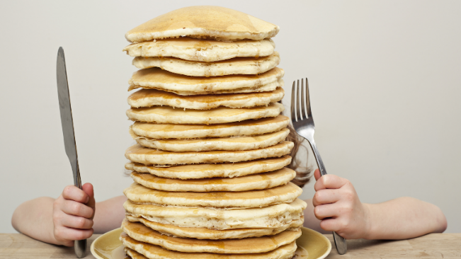



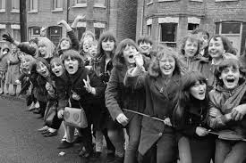
Stacks and Queues

Slide 2
Stack and Queue ADTs
ADT is specification of a collection of data and the operations that can be performed on it.
  Describes what a collection does, not how it does it
Consumers of stack or queue ADT do not need to know how they are implemented.
  Just need to understand idea of the collection and what operations it can perform.
  Stacks usually implemented with arrays.
  Queues often implemented with a linked list.
CS 221 - Computer Science II

Slide 3

Stacks
ADT based on the principle of adding elements and retrieving them in the opposite order.
  Last-In, First-Out ("LIFO")
  Elements are stored in order of insertion.
    Do not think of them as having indexes.
  Client can only add/remove/examine
  the last element added (the "top").
Basic stack operations:
  push - Add an element to the top.
  pop - Remove the top element.
  peek - Examine the top element.
push
pop, peek
top | 3
 | 2
bottom | 1
CS 221 - Computer Science II
stack
Notes:
analogy: trays of food at the sizzler

Slide 4
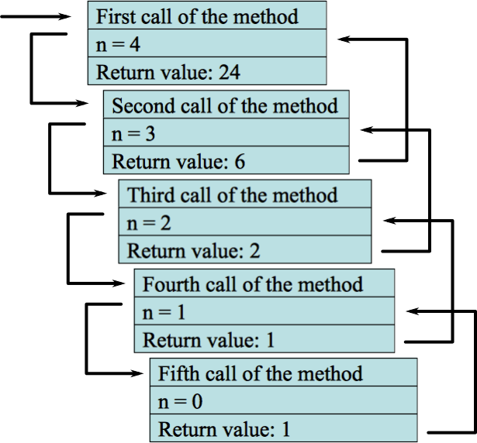
Stacks in Computer Science
Programming languages and compilers:
  Method calls are placed onto a stack.
    call=push
    return=pop
  Compilers use stacks to evaluate expressions.
Matching up related pairs of things:
  Find out whether a string is a palindrome.
  Examine a file to see if its braces { } match.
  Convert "infix" expressions to pre- / postfix.
Sophisticated algorithms:
  Searching through a maze with "backtracking."
  Many programs use an "undo stack" of previous operations.
CS 221 - Computer Science II

Slide 5
Stack Limitations
You cannot loop over a stack in the usual way. Assume we created our own Stack class.
  Stack<Integer> s = new Stack<Integer>();
  ...
  for (int i = 0; i < s.size(); i++)
  {
  do something with s.get(i);
  }
CS 221 - Computer Science II

Slide 6
Stack Limitations
You cannot loop over a stack in the usual way. Assume we created our own Stack class.
  Stack<Integer> s = new Stack<Integer>();
  ...
  for (int i = 0; i < s.size(); i++)
  {
  do something with s.get(i);
  }
CS 221 - Computer Science II

Slide 7
Stack Limitations
Instead, pop each element until the stack is empty.
  // process (and destroy) an entire stack
  while (!s.isEmpty())
  {
  do something with s.pop();
  }
CS 221 - Computer Science II

Slide 8
What Happened to My Stack?
Suppose we're asked to write a method max that accepts a Stack of Integers and returns the largest Integer in the stack:
  public static void max(Stack<Integer> s) {
  int maxValue = s.pop();
  while (!s.isEmpty()) {
  int next = s.pop();
  maxValue = Math.max(maxValue, next);
  }
  return maxValue;
  }
  Algorithm is correct, but what is wrong with the code?
CS 221 - Computer Science II

Slide 9
What Happened to My Stack?
The code destroys the stack in figuring out its answer.
  To fix this, you must save and restore the stack's contents:
  public static void max(Stack<Integer> s) {
  Stack<Integer> backup = new Stack<Integer>();
  int maxValue = s.pop();
  backup.push(maxValue);
  while (!s.isEmpty()) {
  int next = s.pop();
  backup.push(next);
  maxValue = Math.max(maxValue, next);
  }
  while (!backup.isEmpty()) { // restore
  s.push(backup.pop());
  }
  return maxValue;
  }
CS 221 - Computer Science II

Slide 10

Queues
ADT that retrieves elements in the order they were added.
  First-In, First-Out ("FIFO")
  Elements are stored in order of
  insertion but don't have indexes.
  Client can only add to the end of the
  queue, and can only examine/remove
  the front of the queue.
Basic queue operations:
  enqueue - Add an element to the back.
  dequeue - Remove the first element.
  first - Examine the first element.
front |  | back
1 | 2 | 3
dequeue, first
enqueue
queue
CS 221 - Computer Science II
Notes:
analogy: trays of food at the sizzler

Slide 11
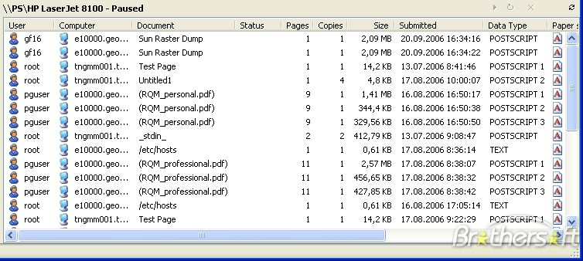
Queues in Computer Science
Operating systems:
  Queue of print jobs to send to the printer.
  Queue of programs / processes to be run.
  Queue of network data packets to send.
Programming:
  Modeling a line of customers or clients.
  Storing a queue of computations to be performed in order.
Real world examples:
  People on an escalator or waiting in a line.
  Cars at a gas station (or on an assembly line).
CS 221 - Computer Science II

Slide 12
Using Queues
As with stacks, must pull contents out of queue to view them. Assume we created our own Queue class.
  // process (and destroy) an entire queue
  while (!q.isEmpty()) {
  do something with q.dequeue();
  }
  To examine each element exactly once.
  int size = q.size();
  for (int i = 0; i < size; i++) {
  do something with q.dequeue();
  (including possibly re-adding it to the queue)
  }
    Why do we need the size variable?
CS 221 - Computer Science II

Slide 13
Mixing Stacks and Queues
We often mix stacks and queues to achieve certain effects.
  Example: Reverse the order of the elements of a queue.
  Queue<Integer> q = new Queue<Integer>();
  q.enqueue(1);
  q.enqueue(2);
  q.enqueue(3); // [1, 2, 3]
  Stack<Integer> s = new Stack<Integer>();
  while (!q.isEmpty()) { // Q -> S
  s.push(q.dequeue());
  }
  while (!s.isEmpty()) { // S -> Q
  q.enqueue (s.pop());
  }
  System.out.println(q); // [3, 2, 1]

Slide 14
Exercises
Write a method stutter that accepts a queue of Integers as a parameter and replaces every element of the queue with two copies of that element.
  [1, 2, 3] becomes [1, 1, 2, 2, 3, 3]
Write a method mirror that accepts a queue of Strings as a parameter and appends the queue's contents to itself in reverse order.
  [a, b, c] becomes [a, b, c, c, b, a]
CS 221 - Computer Science II

Slide 15
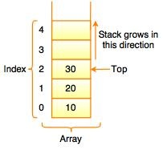
Implementing a Stack with an Array
If use end of the array as the “top” of the stack, push, pop, and peek operations take constant time.
How handle “overflow?”

Slide 16
Implementing a Stack with Links
Can also use linked list to implement Stack class.
If use head of linked list as “top,” push, pop, and peek operations take constant time.
However, because more complicated to implement than arrays, not usually used.
Why shouldn’t you use the tail of the linked list as “top?”
CS 221 - Computer Science II

Slide 17
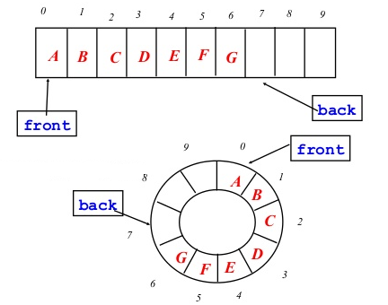
Implementing a Queue with an Array?
Queue class not normally implemented using a basic array. Why?
Can use a circular array instead:
  Keep track of indexes for “front” and “back” of queue.
  When dequeue an element, don’t shift elements, just advance “front.”
  Advance “back” when enqueue element.
  When “back” reaches end of array, may increase capacity or wrap index around.

Slide 18
Implementing a Queue with Links
Can also use linked list to implement Queue class.
If use head of linked list as “front” and tail as “rear,” enqueue, dequeue, and front operations take constant time.
Why shouldn’t you use the tail of the linked list as “front” and head as “back?”
CS 221 - Computer Science II

Slide 19

CS 221 - Computer Science II

Slide 20
Java Stack Class
  Stack<String> s = new Stack<String>();
  s.push("a");
  s.push("b");
  s.push("c"); // bottom ["a", "b", "c"] top
  System.out.println(s.pop()); // "c"
  Stack has other methods that are off-limits (not efficient)
Stack<T>() | constructs a new stack with elements of type T
push(value) | places given value on top of stack
pop() | removes top value from stack and returns it; throws EmptyStackException if stack is empty
peek() | returns top value from stack without removing it; throws EmptyStackException if stack is empty
size() | returns number of elements in stack
isEmpty() | returns true if stack has no elements
CS 221 - Computer Science II

Slide 21
Java Queue Interface
  Queue<Integer> q = new LinkedList<Integer>();
  q.add(42);
  q.add(-3);
  q.add(17); // front [42, -3, 17] back
  System.out.println(q.remove()); // 42
  IMPORTANT: When constructing a queue, you must use a new LinkedList object instead of a new Queue object.
    Because Queue is an interface.
add(value) | places given value at back of queue
remove() | removes value from front of queue and returns it; throws a NoSuchElementException if queue is empty
peek() | returns front value from queue without removing it; returns null if queue is empty
size() | returns number of elements in queue
isEmpty() | returns true if queue has no elements
CS 221 - Computer Science II

