Slide 1
JPA with Hibernate

Slide 2

Raoul Van den Berge
IT Consultant
raoul.vandenberge@infosupport.com
Graduated from KdG in 2020

Slide 3
Content
Spring Data JPA and Hibernate
What am I actually using? Who has which responsibility?
Transaction management
How does Spring manage transactions and how does it map to JPA/Hibernate?
Loading associations: best practices
What is the best way to fetch associations?
Schema generation and validation
How can I evolve my database?
JPQL
How can I use JPQL to fix the N+1 problem? What can I do against the cartesian product problem?
Performance tips and common mistakes
Further resources

Slide 4
Spring Data JPA and Hibernate
What am I actually using? Who has which responsibility?

Slide 5
What is what?
JPA
Java Persistence API
Now named: Jakarta Persistence API
Specification and interfaces.
Hibernate
Implementation of the JPA API.
Spring Data JPA
Layer on top of JPA which makes interacting with JPA less cumbersome.
Uses Hibernate behind the scenes.

Slide 6
Transaction management
How does Spring manage transactions and how does it map to JPA/Hibernate?

Slide 7
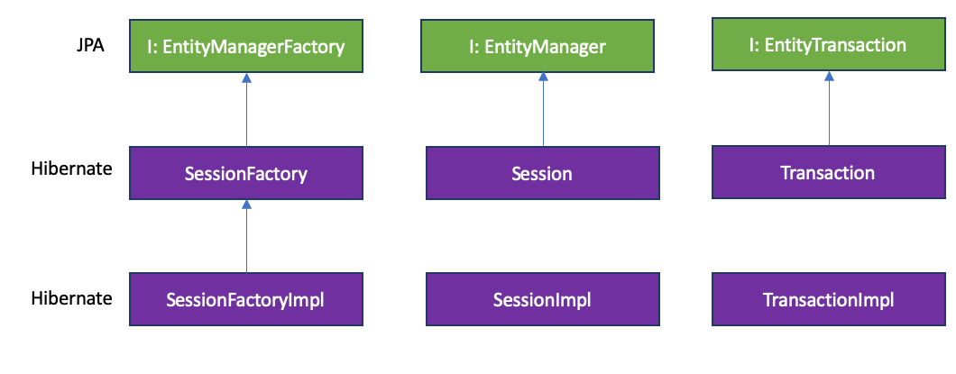
EntityManager vs Session

Slide 8
Persistence context
The persistence context tracks the entities in memory (the first level cache)
In JPA: EntityManager
In Hibernate: Session
A database connection is bound to a Session.
A Session can span multiple transactions.
Open Session In View (a Session per request)
A Session can span a single business use case/transaction.
“Transaction Scoped Persistence Context”
A new Session/EntityManager per transaction.
@Transactional

Slide 9
Who does what?
What? | Project
EntityManager | JPA
Session | Hibernate
CrudRepository | Spring Data JPA
@Transactional | Spring Transaction
JPQL | JPA
JPQL/HQL (implementation) | Hibernate

Slide 10
Accessing the persistence context
@PersistenceContext
private EntityManager em;
If you are using Spring Data JPA, you don’t need to use EntityManager directly (use a repository).

Slide 11
Transaction management in Spring
JPA/Hibernate doesn’t provide any type of declarative transaction management.
Spring offers an API-neutral transaction platform.
Support for plain JDBC, JPA, etc.
@Transactional, TransactionTemplate, TransactionManager
TransactionManager manages transactions (and database connections) and binds them to the current thread.

Slide 12
Loading associations: best practices
What is the best way to fetch associations?

Slide 13
Demo setup
Maven, Spring 3, Hibernate 6
Primarily using tests
Sometimes a little web…

Slide 14

Problem
Given:
A Post that can have multiple Comments.
We want to:
Generate a summary of that Post with all its Comments.
Problem:
How do we efficiently retrieve all Comments on a Post?

Slide 15
Solution 1: Use lazy loading with FetchType.LAZY
Loads the association lazily when the getter on the entity is used.

Slide 17
Open Session in View?!
findById only keeps the database session open when retrieving the initial entity (the post).
Open Session in View ensures that a database session is active throughout the entire web request – so that we can retrieve the lazy loaded collections in the same database session (the post comments).
By default “on” in Spring Boot (spring.jpa.open-in-view=true)

Slide 18
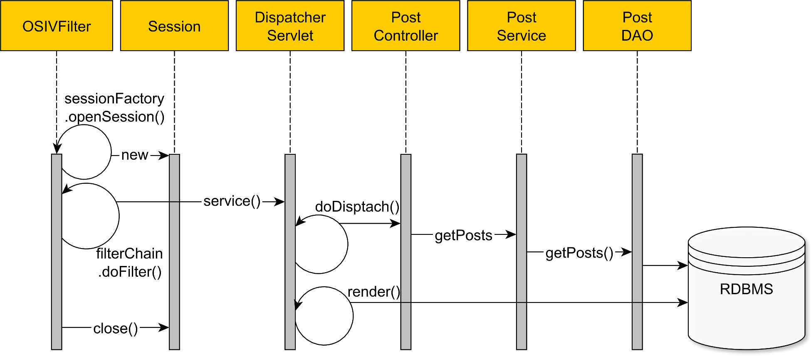
Open Session in View (OSIV)
Filters are a concept of Spring Web

Slide 19
Advice
Avoid Open Session in View, especially if you’re not familiar with JPA.
There is no separation of concerns since SQL statements can be generated at any point in the application (like the UI rendering process).
Hard to get rid of in badly tested projects.
It’s easy to navigate associations at any point, which might cause performance issues later on.
Database connection is held throughout the entire request, which increases connection lease times.
Notes:
The service layer opens and closes a database transaction, but afterward, there is no explicit transaction going on. For this reason, every additional statement issued from the UI rendering phase is executed in auto-commit mode. Auto-commit puts pressure on the database server because each statement must flush the transaction log to disk, therefore causing a lot of I/O traffic on the database side.
There is no separation of concerns anymore because SQL statements are generated both by the service layer and by the UI rendering process.
Hard to get rid of in badly tested projects.
The UI layer is limited to navigating associations which can, in turn, trigger N+1 query problems.
The database connection is held throughout the UI rendering phase, which increases connection lease time and limits the overall transaction throughput due to congestion on the database connection pool.

Slide 20
Problem: LazyInitializationException
A lazy association needs the Session to be opened in order to initialize the collection.
Open Session in View kept a session open for us the entire request…
The persistence context (Session) is closed after executing a method on a JpaRepository.
If the persistence context is closed, when trying to access a non-initialized lazy association, the infamous LazyInitializationException is thrown.

Slide 21
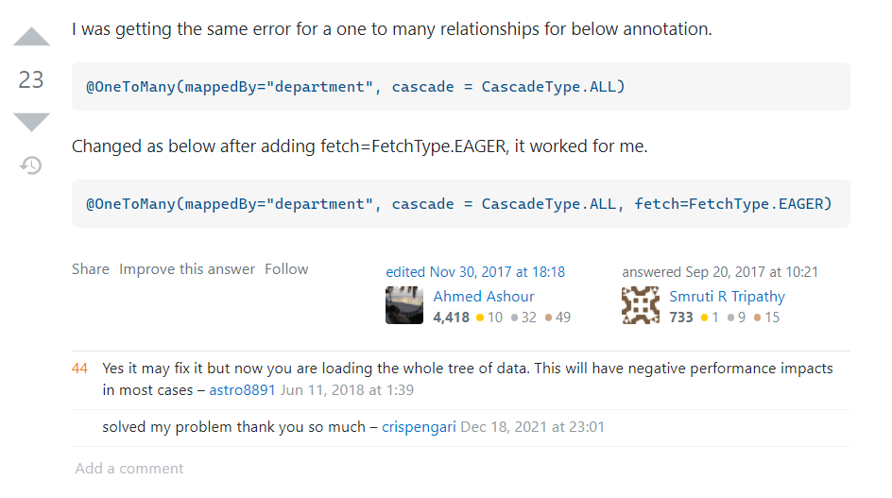
Solution 2: Use eager loading with FetchType.EAGER

Slide 22
Lazy loading vs eager loading
FetchType.EAGER is a code smell.
Most often it’s used for simplicity sake without considering the long-term performance penalties.
The fetching strategy should never be the entity mapping responsibility.
Once a relationship is set to be eagerly fetched, it cannot be changed to being fetched lazily on a per-query basis.
Each business use case has different entity load requirements and therefore the fetching strategy should be delegated to each individual query.

Slide 23
Advice
Use lazy associations.
Using lazy associations gives you the flexibility of changing the fetching strategy at query time with the FETCH HQL directive.

Slide 24
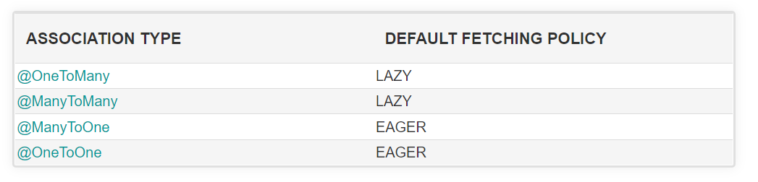
Advice
Good practice: always set the fetching policy explicitly in your entity mapping.

Slide 25
Solution 3: use @Transactional
Ensures that a transaction is active within a scope using aspect-oriented-programming (AOP).
At the location where you initialize a collection, ensure that it is wrapped in @Transactional.

Slide 26
Where to use @Transactional
The service layer determines the transaction boundaries.
Avoid it in the web layer: it increases database connection lease times (see OSIV)
Repositories require a transaction, but this should propagate from the service layer.

Slide 27
When to use @Transactional
When using repositories, @Transactional is applied to repository scope automatically.
You’d lose the connection after getting a result back from the repository.
You’d get a LazyInitializationException when using Lazy Loading out of repository scope because the session is lost.
You’ll have to use it when using Lazy Loading.
Good practice: always use it to clearly define transaction boundaries!

Slide 28
Solution 4: custom query with JPQL JOIN FETCH
Retrieves an entity with the flexibility of choosing the fetching strategy for an association.

Slide 29
JOIN FETCH with projections
Often used in combination with DTO projections for read-only datasets.
DTO = Data Transfer Object
You should fetch just as much data you need to fulfill the requirements of a given business logic use case.
Fetching too many columns than necessary has an impact, and that’s why entities are not good candidates for read-only views.
Good practice: make a separate model for reading and writing (CQRS).

Slide 30
Schema generation and validation
How can I evolve my database?

Slide 31
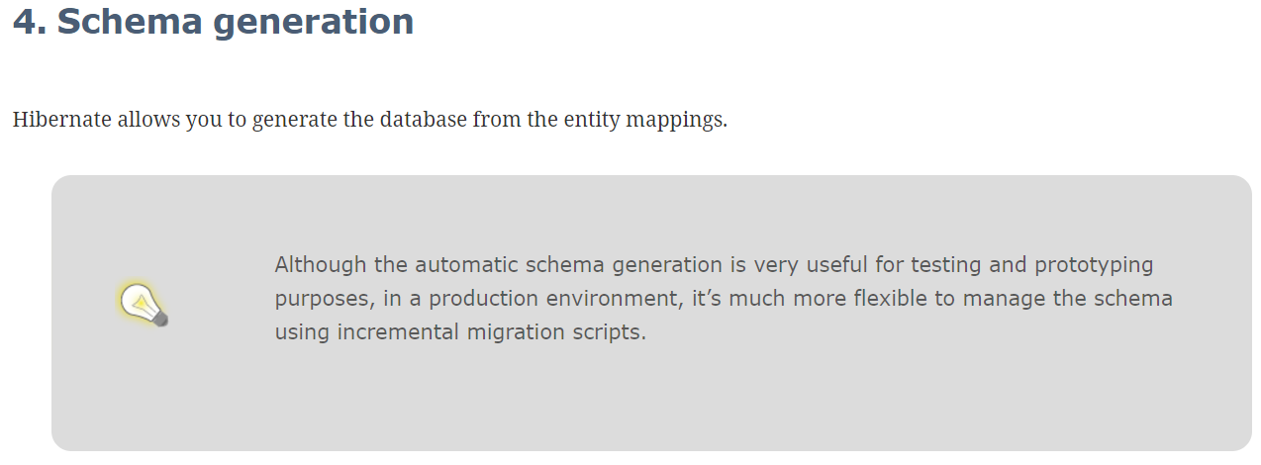
Schema generation
Let Hibernate update the schema?
Don’t do this in production!
Better write your own patches and migrations.

Slide 32
Schema generation
The scripts will reside in version control along with your codebase. When you check out a branch, you can recreate the whole schema from scratch (and so can your tests).
The incremental scripts can be included in your test setup.
Flexibility of writing your own migration logic.

Slide 33
Schema validation
Use ddl-auto validate mode.
Validates the real database model against your entities.
This doesn’t do any changes to the database!

Slide 34
Integration testing
My advice: avoid using embedded databases like H2 on more complex projects.
Use Testcontainers with your real production database.
Use the same Liquibase/Flyway migrations.

Slide 35
JPQL
How can I use JPQL to fix the N+1 problem? What can I do against the cartesian product problem?

Slide 36
Why use JPQL?
Very SQL like.
Supports many features.
Database independency.

Slide 37
JPQL vs auto-generated repository methods
Use JPQL when a query can’t easily be expressed in a repository method name.
Use JPQL when your repository method name becomes too long.
Use JPQL when you think it will improve readability.

Slide 38
The N+1 query problem
The N+1 query problem happens when the data access framework executed N additional SQL statements to fetch the same data that could have been retrieved when executing the primary SQL query.
Eager loading is prone to this issue.
Lazy loading is prone to this issue.

Slide 39
JOIN FETCH directive in JPQL
Solution for the N+1 problem.
Avoid lazily navigating associations, or eagerly retrieving associations that you don’t need.
Careful! If you forget to “JOIN FETCH” properly, the persistence context will run queries on your behalf while you navigate the lazy associations (the N+1 query problem).
When using JOIN FETCH we create a new problem: The cartesian product problem.

Slide 40
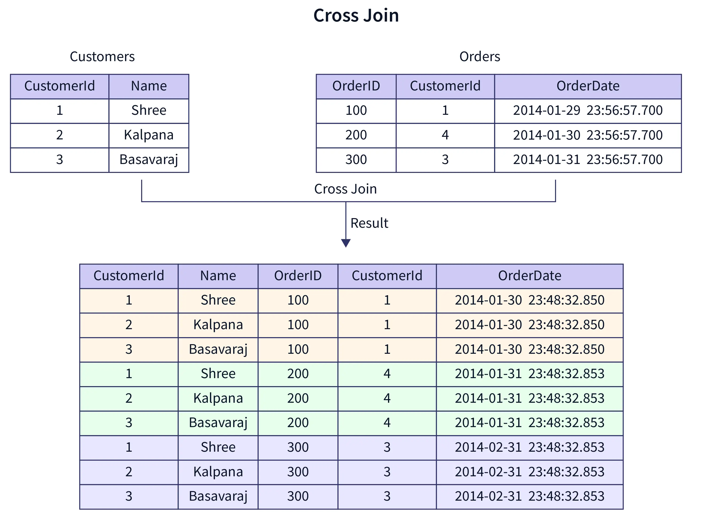
Cartesian product problem
JOINs lead to big datasets.
Reading and parsing a big dataset from the database takes some time.
Hibernate needs to de-duplicate in-memory: could cause performance issues.

Slide 41
What solution do I use to fix the cartesian product problem?
It depends.
Could avoid the JOIN and use lazy loading.
Fetching associations with lazy loading causes more database traffic and latency but could be faster than loading and deduplicating a massive result set.

Slide 42
MultipleBagFetchException
Hibernate can no longer differentiate between information that is supposed to be duplicated and information that was duplicated by the cartesian product.
Solution 1: Use Set instead of List (small datasets only)
Solution 2: Use lazy loading.

Slide 43
Difference between JOIN FETCH and eager loading
JOIN FETCH affects the query (will use a JOIN operation)
Eager loading affects the point in time when a collection is loaded (just like lazy loading, will perform an additional query, but when loading the “parent” entity, not lazily)

Slide 44
Performance tips and common mistakes

Slide 45
Tip 1: Avoid entity overhead
Entities come with a lot of overhead (dirty checking, persistence context)

Slide 46
Tip 1: Avoid entity overhead
If your use-case doesn’t require propagating changes to the database, use read-only transactions.
@Transactional(readOnly=true)
It eliminates dirty-checking.
It eliminates loading the entity in the persistence context.

Slide 47
Tip 1: Avoid entity overhead
You can also eliminate entities by using DTO projections.
Same result as using @Transactional(readOnly=true) but allows you to only extract fields that are required.

Slide 48
Tip 2: Read SQL logs
Don’t use hibernate.show_sql
Statements are always logged to console.
Use the logging framework instead:
logging:
level:
org.hibernate.SQL: debug
org.hibernate.type.descriptor.sql: trace

Slide 49
Tip 3: Don’t use @Transactional in tests
Why would you use @Transactional in a test?
To clean up data and ensure a deterministic test suite.
Behavior of @Transactional in tests = rollback
In the Spring TestContext framework, transactions are managed by the TransactionalTestExecutionListener.
What is the biggest problem when doing this?
Using @Transactional in tests is dangerous as it can hide production issues.
Solution:
Clean up manually (@AfterEach).

Slide 50
Tip 4: Use bulk operations
Anti-pattern: retrieving entities and updating/deleting them one by one.
Try to create an update/delete query for all relevant rows.
If not possible to write a general query: think about batch processing and Hibernate memory usage.
https://docs.jboss.org/hibernate/core/3.6/reference/en-US/html_single/#batch

Slide 51
Tip 5: Avoid association fetching anti-patterns
Open session in view
enable_lazy_load_no_trans
FetchType.EAGER
Not using JOIN FETCH directive if necessary to avoid the N+1 problem.

Slide 52
Tip 6: Use the same database system in your tests
No need for H2, use Testcontainers for integration tests.
Ensures that your tests are representative for production.
Allows you to use more database specific features.

Slide 53
Tip 7: Understand @Transactional semantics
Spot the problems:
Demo: retrieve all comments
Demo: give managers a raise

Slide 54
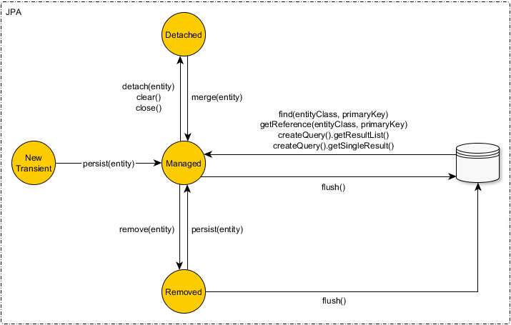
Tip 7: Understand @Transactional semantics

Slide 55
Tip 8: Use DTOs in the web layer, not entities
Always map entities to a data transfer object (DTO).
Avoid security leaks and have a separation between the database model and the web model.

Slide 56
Tip 9: Use getReferenceById instead of findById if you don’t need the entity contents
getReferenceById returns a proxied reference to an entity, it doesn’t go to the database.
You can use getters on the proxied reference, but this triggers lazy loading.
Perfect when you only need the entity for establishing a relationship.
Example: Inserting a PostComment for a Post.

Slide 57

Tip 10: Don’t trust Stack Overflow blindly

Slide 58
In conclusion…
All my advice is a nuanced story…
Important to realize that using JPA comes with a performance impact.
Don’t be afraid to utilize JPA!
Awareness is the most important: know what JPA does for you behind the scenes.

Slide 59
Further resources

Slide 60
Slides and demos
Slides and demos are available on GitHub.
https://github.com/raoulvdberge/jpa-with-hibernate

Slide 61
Further resources
Vlad Micalcea (Hibernate contributor and expert)
https://vladmihalcea.com/
https://vladmihalcea.com/the-open-session-in-view-anti-pattern/
https://vladmihalcea.com/eager-fetching-is-a-code-smell/
Hibernate User Guide
https://docs.jboss.org/hibernate/orm/current/userguide/html_single/Hibernate_User_Guide.html
JPA specification
https://jakarta.ee/specifications/persistence/3.0/jakarta-persistence-spec-3.0.html
How does Spring Transactional work?
https://dzone.com/articles/how-does-spring-transactional
JPA Join Types
https://www.baeldung.com/jpa-join-types

