Slide 1
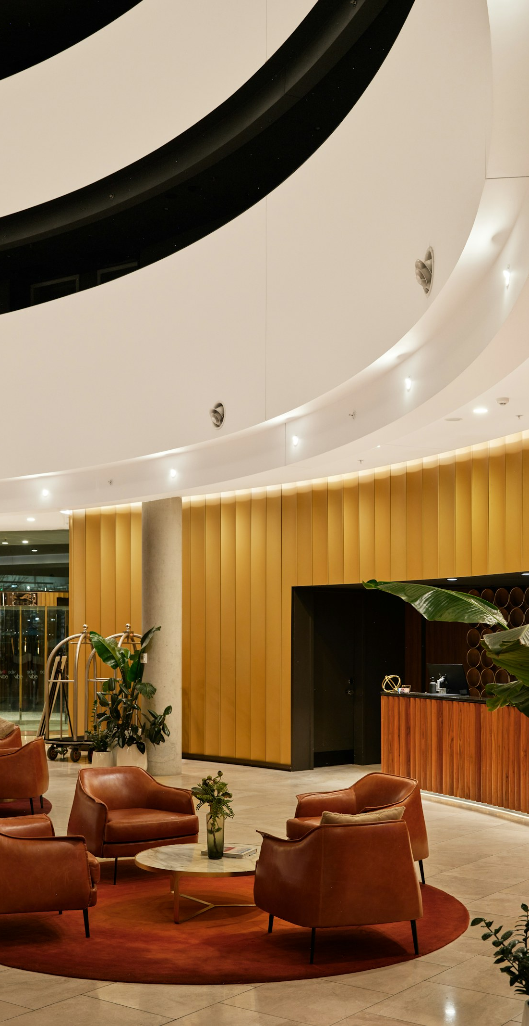
Aurora Stays Q&A
Retrieval-Augmented Generation (RAG) POC
14 October 2026
Photo: Unsplash free-use stock
01

Slide 2
Contents / Agenda
Executive Summary
Business Problem and Solution Approach
STORY ARC
Data Understanding
01 Discover
Problem + data
Retrieval-Augmented Generation System
02 Build
RAG + LLM
Evaluation
Deployment, Inference and Handoff
03 Prove
Evaluation
Appendix — evaluation, workflows and operating measures
04 Operate
Deploy + inference
from question to production
02

Slide 3
Executive Summary
Design stages translated into a production-ready hotel policy assistant
1
2
3
4
5
Source
policies
PDFs → Markdown
Structure
& chunk
120 / 16 + metadata
Retrieve
& rerank
FAISS + MMR + CrossEncoder
Generate
& evaluate
GPT-4o-mini + DeepEval
Deploy
& monitor
Flask + Streamlit + Codespaces
178
indexed chunks
k=5
selected baseline
7
pass rate / 10
.867
weighted composite
Guest
question
Relevant
evidence
Grounded
answer
Assisted
review
03

Slide 4

Business Problem Overview and Solution Approach
Problem
Staff handle about 1,200 guest queries per week; roughly 40% require multiple policy documents.
Manual lookup takes 8–12 minutes and creates a 15–20% risk of incomplete or incorrect answers.
Property-specific fees, room features, cancellation rules, and accessibility guidance are easy to mix up.
Solution approach
Extract policy PDFs with Docling; preserve headings and tables as Markdown.
Use token-aware chunking, domain embeddings, FAISS retrieval, MMR, and CrossEncoder reranking.
Generate concise answers with GPT-4o-mini using a strict retrieved-context-only prompt.
Photo: Unsplash
04

Slide 5
Data Understanding
Source PDF | Pages | Structure / coverage observed
aurorastay_room_and_property_ information.pdf | 5 | Policy prose + six-property matrix; property-specific rows
aurorastay_booking_terms_and_ cancellation_policy.pdf | 5 | Rates, cancellation, check-in/out, reservation conditions
aurorastay_refunds_and_additional_ charges_guide.pdf | 4 | Refund rules, fees, exceptions, and conditional charges
aurorastay_guest_conduct_accessibility_ and_resolution_guidelines.pdf | 5 | Conduct, accessibility, eligibility, and resolution guidance
DATA PIPELINE
PDF
PDF
PDF
Markdown
+ headings
Verification: all four PDFs loaded successfully; selectable text made OCR unnecessary. Docling preserved headings, lists, tables, and property rows.
Chunks +
metadata
DESIGN IMPLICATION: preserve headings/tables, isolate property rows, and retain source/section/property/topic metadata. Supports domain embeddings and 120/16 token chunking.
4 source guides
05

Slide 6
Data Understanding - Markdown / Table Output
Converted Markdown | source: aurorastay_room_and_property_information.pdf
## Room and Property Information Guide
| Policy code | AS-02 |
|---|---|
| Effective date | January 1, 2026 |
## 5. Property-specific matrix
Extracted Markdown table | preserved rows and property-specific values
| Property | Check-in / out | Parking | Pets |
|---|---|---|---|
| ASH-ATL Midtown | 3:00 PM / 11:00 AM | Self parking, $28/night | $75/stay |
| ASH-CHI Loop | 3:00 PM / 12:00 PM | Self parking, $42/night | $50/night; $150 cap |
| ASH-MIA Brickell | 4:00 PM / 11:00 AM | Valet, $55/night | $100/stay |
Why it matters: headings retain semantic context; table rows preserve exact property values for focused retrieval.
06

Slide 7
RAG - Chunking - Embedding Model
Embedding model: HarishMaths/Hotel-Policy-Embedding.
Tokenizer maximum length: 128 tokens; token-safe chunk size: 120 tokens.
EMBEDDING FLOW
Embeddings run on CPU with normalized vectors and progress rendering disabled.
Policy
text
The same model is used when building and loading the FAISS index.
Token
chunks
MODEL SELECTION RATIONALE: the corpus is hotel-policy text with repeated property codes, fees, exceptions, and room-feature terms.
A domain-trained encoder should preserve these policy distinctions more directly than a generic embedding model.
FAISS
index
The document inspection therefore supports HarishMaths/Hotel-Policy-Embedding as the fit-for-purpose choice.
07

Slide 8
RAG - Chunking - Chunker
Chunker: RecursiveCharacterTextSplitter.from_huggingface_tokenizer.
Chunk size: 120 tokens; overlap: 16 tokens.
Split priority: paragraph, line, heading, sentence, word, then character boundaries.
Atomic property rows are added for property-matrix entries so a single property and fee can be retrieved precisely.
Metadata is added after splitting to preserve section, topic, and property identity.
CHUNKING RATIONALE: 120/16 stays within the 128-token tokenizer limit while retaining local policy context; overlap protects rules at boundaries.
08

Slide 9
RAG - Chunking - Chunk Documents
Total chunks created: 178, including atomic property rows.
Example focused chunk
## Property-specific matrix | Property: ASH-MIA
ASH-MIA Brickell | Parking: Valet, $55 per night | Pets: $100 per stay; 2 pets max
One-property rows reduce contamination from unrelated properties and broad policy sections.
Each chunk carries source, section, property_codes, and topics metadata.
09

Slide 10
RAG - Vector Database
Vector database: FAISS with 178 normalized document vectors.
Index is persisted for the backend under backend/faiss_index.
RAG FLOW
property/topic metadata
Final retrieval setting: k=5 chunks.
Question
Top-k trade-off: larger k improves retrieval recall but increases context noise; k=5 was selected as the best balance on held-out evaluation.
FAISS
retrieve
Candidate search uses MMR lambda=0.50 and fetch_k=20.
MMR +
rerank
CrossEncoder ms-marco-MiniLM-L-6-v2 reranks candidates; topic and property metadata provide additional boosts.
Grounded
answer
10

Slide 11
RAG - Vector Database - Retrieval Function
Query: What are the parking fees at the Atlanta and Miami hotels?
Property routing identifies ASH-ATL and ASH-MIA; topic routing identifies parking.
Property/topic routing filters candidates before reranking when focused matches exist, with global fallback for ambiguous questions.
Metadata is retained for source traceability and evidence display.
Candidate chunks are retrieved with MMR, then reranked for direct relevance.
Relevant evidence
ASH-ATL Midtown: self parking, $28 per night.
ASH-MIA Brickell: valet, $55 per night.
The final context contains the two requested property rows instead of unrelated policy sections.
11

Slide 12
RAG - Generation System - Load the LLM
Generator: OpenAI-compatible ChatOpenAI wrapper.
Model: gpt-4o-mini.
temperature=0.0 | top_p=1.0 | max_tokens=512.
GENERATION / LLM
context-only prompt
API key and base URL are loaded from environment/configuration rather than hard-coded.
Question +
retrieved context
Deterministic settings favor repeatable, concise policy answers for evaluation and operations.
GPT-4o
-mini
Grounded
answer
12

Slide 13
RAG - Generation System - Generation Prompt
Prompt inputs: user query + retrieved policy information.
Prompt excerpt: "You are the Aurora Stays policy assistant. Use only the retrieved policy context to answer."
GENERATION / LLM
context-only prompt
Use only information explicitly supported by retrieved policy text.
Question +
retrieved context
Include relevant conditions, exclusions, limits, exceptions, and coverage details.
GPT-4o
-mini
Focus on the question; omit unrelated content and do not invent facts.
If evidence is insufficient, return: The available policy documents do not contain enough information to answer this question.
Grounded
answer
Additional guards focus Advance Purchase, Accessible King, and late-checkout questions on their relevant evidence.
13

Slide 14
RAG - Generation System - RAG Function
Pipeline: query -> retrieve top-k chunks -> generate grounded answer -> return answer and evidence.
Example query: What is the cancellation policy for a flexible reservation?
Example answer: Flexible rates can normally be canceled by 6:00 PM local property time one day before arrival without a room charge. Later cancellation or no-show may be charged one night plus tax; the confirmation controls if it differs.
The response endpoint can return the answer alone or the answer plus relevant chunks for verification.
14

Slide 15
Evaluation - Load the Evaluation Data
Development evaluation file: data/evaluation.csv.
10 records with question, expected answer, and ground-truth relevant context.
Sample question: What time can I check in at ASH-CHI Loop, and when do I need to be out?
Expected answer: Standard check-in is 3:00 PM and standard check-out is 12:00 PM local property time; early arrival and late departure depend on availability and approval.
Multi-context records use <> separators so relevant policy sections can be evaluated together.
15

Slide 16
Evaluation - Define the Evaluation Model
Judge model: gpt-4o through the DeepEval OpenAIModel wrapper.
The generator remains gpt-4o-mini with temperature=0.0, top_p=1.0, and max_tokens=512.
A separate, stronger judge model reduces self-evaluation bias and provides a more independent assessment of generated answers.
The judge scores factual support, retrieval coverage, retrieval focus, and answer relevance.
Evaluations run synchronously so each test case has a stable, auditable metric result.
16

Slide 17
Evaluation - Define the Evaluation Metrics
Faithfulness >= 0.85: actual answer + retrieved context; every important claim must be supported.
Contextual Recall >= 0.80: expected answer + retrieved context; required evidence must be present.
EVALUATION
Contextual Precision >= 0.75: question + retrieved context; relevant evidence must be prioritized over noise.
F
0.99
R
0.96
Answer Relevancy >= 0.75: question + generated answer; the answer must directly address the question.
P
0.78
Composite = 0.35F + 0.25Recall + 0.20Precision + 0.20Relevancy.
AR
0.93
A case passes only when all four metric thresholds are met.
Held-out averages | 4 gates → pass / review
17

Slide 18
Evaluation - Build and Run the Evaluation
Evidence | Evaluation progression and final 120/16 run
Initial baseline | 7/10 passed | 120/16 token-safe chunking run
Improvement path | 120/16 chunks | MMR 0.50 | CrossEncoder | property/topic routing
Notebook | Aurora_Stays_RAG_POC_Local_120_16_token_safe_executed.ipynb
Cases loaded | 10 held-out cases
Pass rate | 7/10 (70%)
Weighted composite | 0.867
Configuration | k=5 | chunk 120/16 | MMR 0.50 | fetch_k=20
Evaluation loop | Each case runs retrieve → generate; all four metrics are computed per case, then aggregated.
Recorded artifact | reports/notebook_120_16_token_safe_test_cases.csv
The executed 120/16 token-safe run is the final held-out result shown in the case-level table: 7/10 passed.
18

Slide 19
Evaluation - Load the Test Data
Held-out file: data/test.xlsx.
10 unseen questions covering cancellation, discounts, room occupancy, accessibility, parking, breakfast, rate changes, checkout, pets, and incidental holds.
Sample question: How many people can stay in a Double Queen room?
Expected answer: Up to 4 guests, subject to fire-code and property occupancy limits; recheck the room and rate if the group size changes.
The held-out set is used only for final comparison and selection of the baseline.
19

Slide 20
Evaluation - Build and Run the Evaluation
Case | Test case | F | R | P | AR | Composite | Result
1 | OTA cancellation/refund | 0.977 | 0.901 | 0.771 | 0.978 | 0.917 | PASS
2 | Member discount/cancellation | 0.997 | 0.967 | 0.797 | 0.995 | 0.949 | PASS
3 | Double Queen occupancy | 1.000 | 0.986 | 0.950 | 0.998 | 0.986 | PASS
4 | Accessible King inclusions | 0.985 | 0.887 | 0.384 | 0.601 | 0.764 | FAIL
5 | Atlanta/Miami parking | 1.000 | 0.961 | 0.673 | 0.871 | 0.899 | FAIL
6 | Miami breakfast | 0.991 | 0.003 | 0.000 | 0.259 | 0.399 | FAIL
7 | Advance Purchase change | 0.980 | 0.991 | 0.887 | 0.984 | 0.965 | PASS
8 | Denver late checkout | 1.000 | 1.000 | 0.820 | 0.885 | 0.941 | PASS
9 | ASH-CHI pet fee | 0.995 | 0.861 | 0.766 | 1.000 | 0.917 | PASS
10 | Card-hold difference | 0.992 | 0.946 | 0.814 | 0.930 | 0.933 | PASS
Transparent 120/16 result: 7/10 passed; weighted composite .867. Failed cases are Accessible King, Atlanta/Miami parking, and Miami breakfast.
F = Faithfulness | R = Contextual Recall | P = Contextual Precision | AR = Answer Relevancy
20

Slide 21
Deployment - Backend - Serialize the Vector Database
Backend artifact: backend/faiss_index/index.faiss.
Metadata and document store: backend/faiss_index/index.pkl.
IMPLEMENTATION
The persisted FAISS index contains 178 normalized vectors from the policy knowledge base.
FAISS
index
Flask
API
The backend loads the trusted local artifact at startup; the Docker image copies the index into /app/faiss_index.
The artifact must be rebuilt whenever source documents, chunking, or embeddings change.
Streamlit
UI
Docker +
Codespaces
21

Slide 22
Deployment - Backend - Define the Flask Application
Service entry point: backend/app.py; production command uses Gunicorn and app:rag_api.
POST /v1/relevant_chunks returns the top-k retrieved policy chunks; answer endpoints return generated output with optional evidence.
Request validation rejects missing/non-JSON bodies, blank queries, invalid k, and out-of-range generation parameters with JSON HTTP 400 responses.
Unexpected inference failures are logged server-side and returned as a generic JSON HTTP 500 response; 404/405 errors also use JSON responses.
GET / returns a readiness message; container binding is 0.0.0.0:7860 and local smoke tests use port 5000.
Defaults: k=5, gpt-4o-mini, temperature=0.0, top_p=1.0, max_tokens=512.
22

Slide 23
Deployment - Backend - Define the Dependencies
All runtime dependencies are version-pinned in backend/requirements.txt.
Flask 3.1.3, Werkzeug 3.1.8, requests 2.34.2, Gunicorn 26.2.0, and uvicorn 0.52.3.
LangChain HuggingFace 1.2.2, Community 0.4.2, OpenAI 1.6.1, sentence-transformers 6.1.0, faiss-cpu 1.15.0, truststore 0.10.4.
Docker pins torch 2.14.0 from the CPU-only PyTorch index before installing the requirements file.
The embedding model is cached during image build so runtime can use offline mode.
23

Slide 24
Deployment - Backend - Define the Dockerfile
Base image: python:3.13.15-slim; copies the backend application, FAISS artifact, and pinned requirements into /app.
Installs pinned CPU-only torch 2.14.0 and all pinned backend dependencies without pip cache.
Downloads the Hugging Face embedding model at build time and stores it under HF_HOME=/app/huggingface for reuse.
The Transformers runtime, used through sentence-transformers, loads the cached embedding model; offline flags prevent runtime downloads, and EXPOSE 7860 receives Codespaces traffic.
Container startup command: Gunicorn launches app:rag_api with one worker on 0.0.0.0:7860 and a 120-second timeout.
24

Slide 25

Deployment - Frontend - Define the Streamlit App
Frontend entry point: frontend/app.py; it provides the Aurora Stays question-and-answer interface.
Sidebar controls: k from 1 to 10, temperature from 0.0 to 1.0, and max_tokens from 64 to 2048.
Users can select Answer only or Answer + Relevant Chunks.
The backend address is supplied through BACKEND_URL; Docker uses port 7860 while local smoke tests may use port 5000.
The interface displays the answer, retrieved evidence, and a clear API connectivity error when the backend is unavailable.
Validated in Codespaces with Streamlit on port 8501 and the Dockerized Flask API on port 7860.
Photo: Unsplash
25

Slide 26
Deployment - Frontend - Define the Dockerfile
Base image: python:3.13.15-slim.
Copies the Streamlit application and installs requests 2.34.2 and streamlit 1.64.0.
Binds Streamlit to 0.0.0.0:8501 for Codespaces or container access; EXPOSE 8501 makes the service discoverable.
Docker command: streamlit run app.py --server.port=8501 --server.address=0.0.0.0.
Clarification: 0.0.0.0:8501 is the container bind address; users open the browser-facing Codespaces/public forwarded URL, not 0.0.0.0 directly.
XSRF protection is disabled in the supplied deployment command to simplify external access.
The image defaults BACKEND_URL to http://host.docker.internal:7860; override it with the backend Codespace URL when needed.
26

Slide 27
Deployment - Frontend - Push the Files to GitHub
Repository: github.com/raovutukoor1/aurora-stay-qna-120-token-option.
Current deployment commit: d7a7e3f — fixed the 120-token Docker runtime configuration.
DEPLOYMENT FLOW
Reproducible tree: backend/app.py, rag_utils.py, Dockerfile, backend/requirements.txt, and FAISS artifacts; frontend/app.py, Dockerfile, and its dependency manifest.
GitHub
repository
Evaluation artifacts: executed 120/16 notebook and reports/notebook_120_16_token_safe_test_cases.csv; presentation source and generated PPTX/PDF are retained.
Codespace
container
Runtime configuration: OPENAI_API_KEY and OPENAI_BASE_URL come from Codespaces Secrets or a private local config; credentials are not tracked.
Streamlit
UI
A fresh deployment can therefore rebuild the index-backed backend and Streamlit frontend without missing code, artifacts, or configuration guidance.
Forwarded
port 8501
27

Slide 28

Deployment - Inference - Define the Forwarded URL
In GitHub Codespaces, open the Ports panel and forward the Streamlit port 8501.
The public URL is generated per Codespace session; it is not hard-coded in the repository.
Set BACKEND_URL to the backend service URL or its forwarded port before starting Streamlit.
Validated public endpoints: frontend port 8501 and backend port 7860; both returned HTTP 200.
Production smoke tests used the parking-fee query and the ASH-CHI Loop pet-charge query.
API keys belong in Codespaces Secrets or a private local config file, never in the forwarded URL or source code.
Photo: Unsplash
28

Slide 29
Deployment - Inference - Relevant Chunks
Endpoint: POST {BACKEND_URL}/v1/relevant_chunks.
Payload: {"query": "What are the parking fees at the Atlanta and Miami hotels?", "k": 5}.
Response fields: query, k, and relevant_chunks.
Response excerpt: relevant_chunks include ASH-ATL Midtown self parking at $28 per night and ASH-MIA Brickell valet at $55 per night.
This endpoint is useful for checking retrieval quality before evaluating the generated answer.
29

Slide 30
Deployment - Inference - Answer with Relevant Chunks
Endpoint: POST {BACKEND_URL}/v1/answer_with_relevant_chunks; payload includes query, k=5, temperature=0.0, and max_tokens=512.
Response includes the answer, model name, parameters, and supporting evidence chunks.
Live Codespaces smoke tests: frontend HTTP 200, backend readiness HTTP 200, answer HTTP 200, and answer-with-evidence HTTP 200 with 3 evidence chunks.
Parking: Atlanta self-parking $28/night and Miami valet $55/night; evidence returned.
ASH-CHI pet charge: $50/night with a $150 stay cap; flexible cancellation: 6:00 PM local-property-time deadline.
Online/offline consistency check: these policy values and evidence selections matched the corresponding offline evaluation checks; no endpoint-specific answer drift was observed.
30

Slide 31
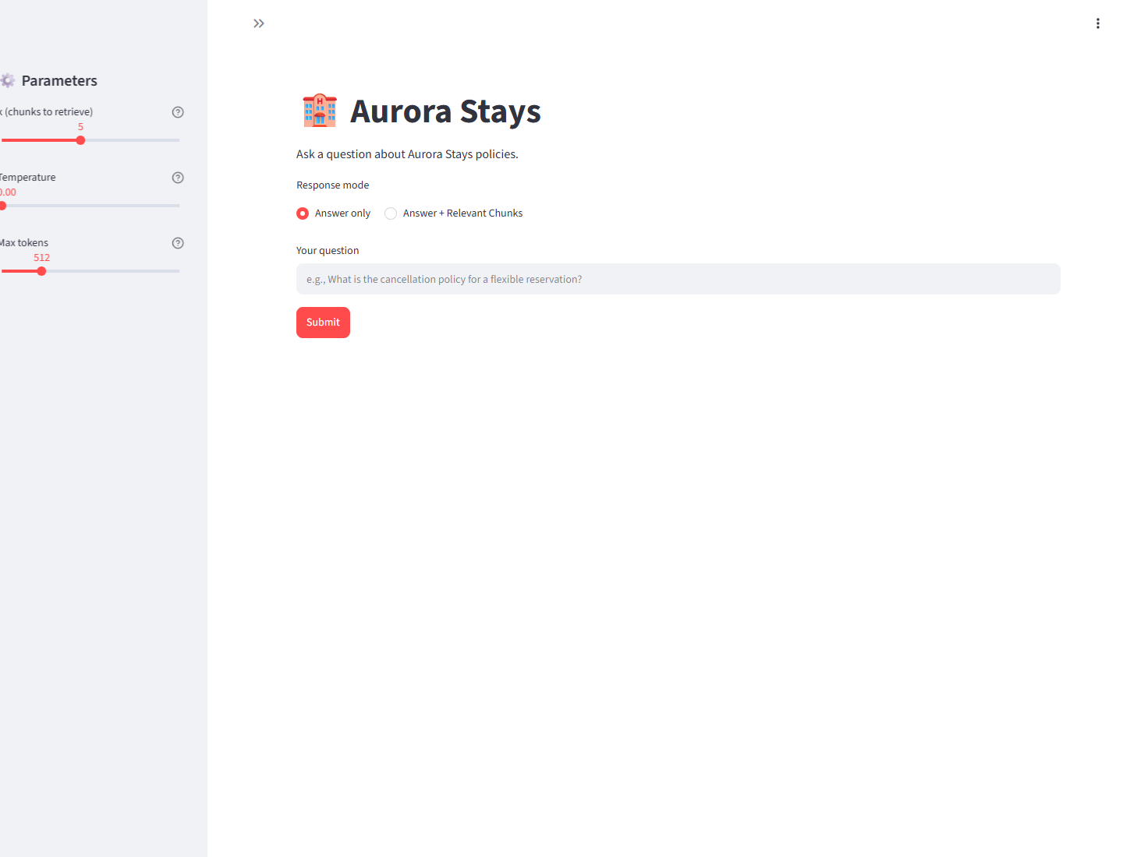
Deployment - Live Streamlit Webpage
Public frontend URL
https://turbo-zebra-4qqj6wr7pv573xpr-8501.app.github.dev
Backend API URL
https://turbo-zebra-4qqj6wr7pv573xpr-7860.app.github.dev
Status
Frontend loaded with HTTP 200.
Backend readiness returned HTTP 200.
Captured: 20 October 2026
31
Full-page capture from the public Codespaces frontend

Slide 32
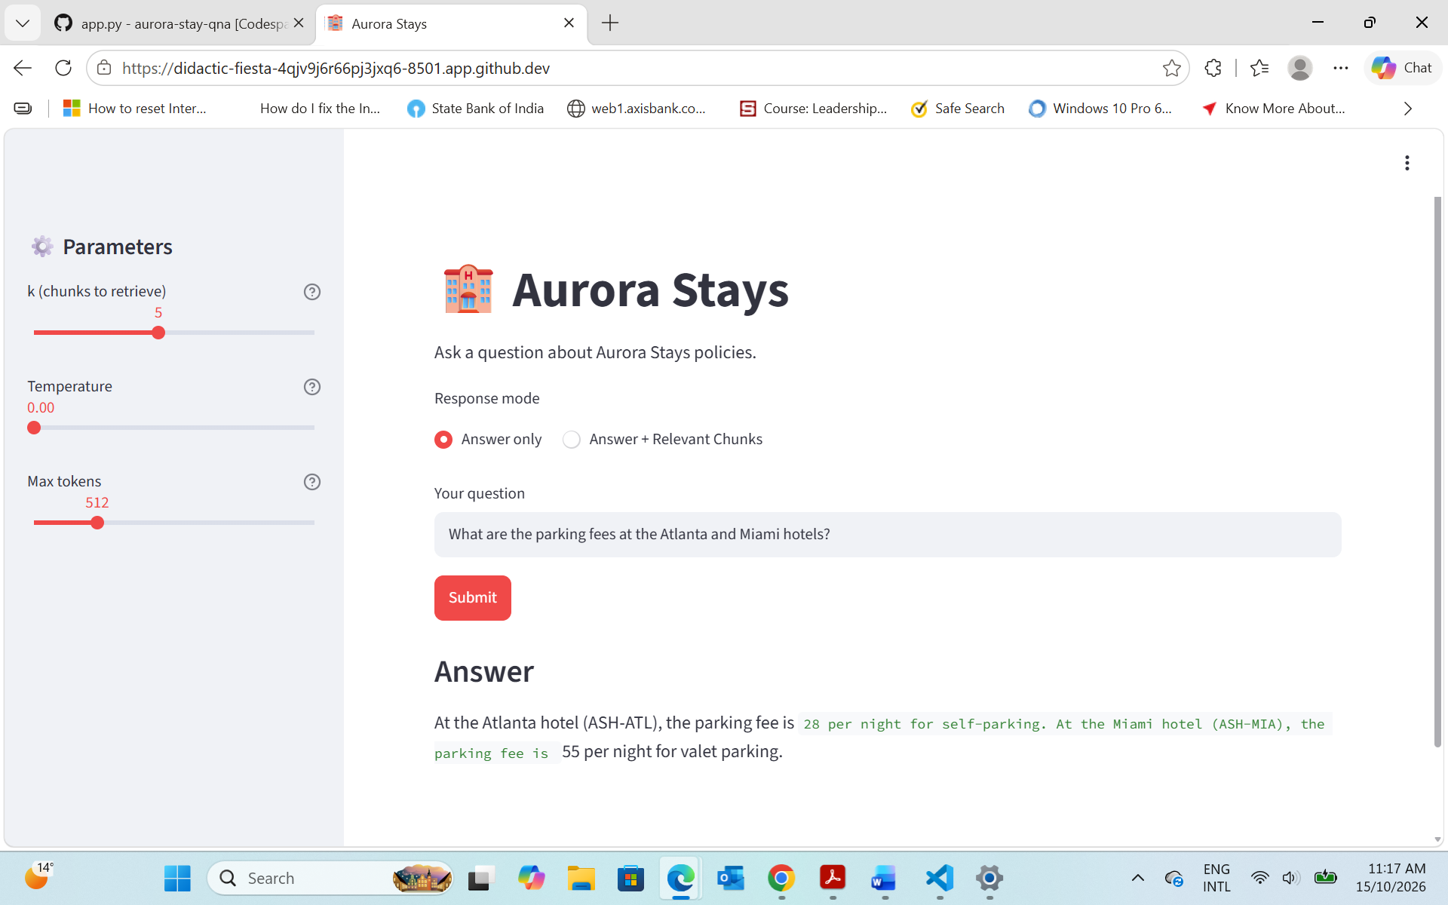
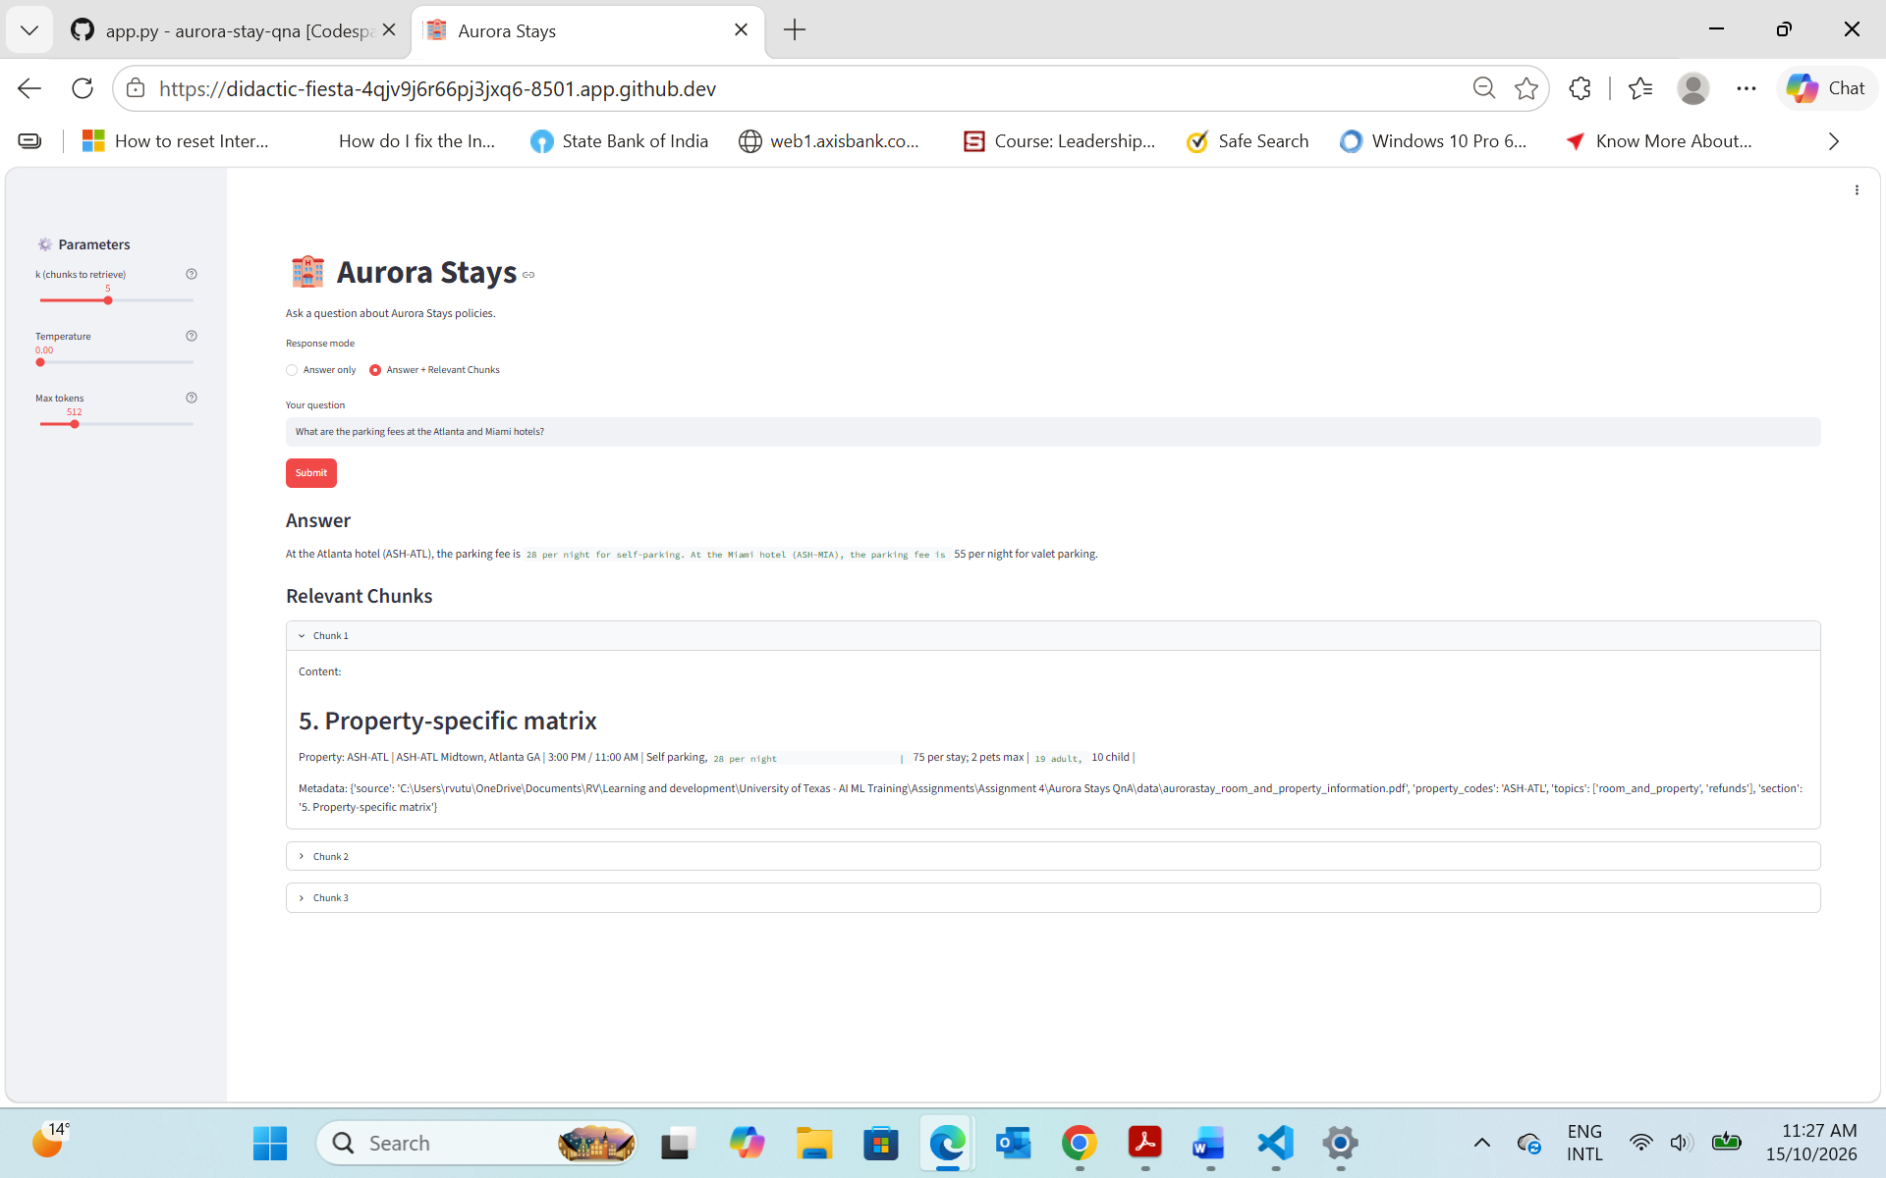
Deployment - Live Smoke-Test Results
Answer only — supplied smoke-test capture
Validated public Codespaces deployment — 20 October 2026.
Frontend + backend: HTTP 200; Streamlit UI and readiness response returned.
Answer only: HTTP 200; grounded parking answer; chunks omitted by design.
Answer + chunks: HTTP 200; same answer plus 3 evidence chunks.
Parking: Atlanta $28/night self-parking; Miami $55/night valet.
Answer + Relevant Chunks — supplied smoke-test capture
ASH-CHI pet: $50/night; $150/stay cap; 3 evidence chunks.
Flexible cancellation: 6:00 PM deadline; 5 evidence chunks.
32

Slide 33
Insights from Analysis
What the analysis means for the business
PERFORMANCE SIGNAL
7/10 held-out cases passed with a weighted composite of .867 using 120/16 token-safe chunking. This is a quality signal for fewer manual policy lookups; HTTP 200 smoke tests support service readiness.
RISK TO MANAGE
Three cases failed: Accessible King (precision=.384), Atlanta/Miami parking (precision=.673), and Miami breakfast (recall=.003; precision=0.000).
BUSINESS IMPLICATION
Pilot success should be measured through handling time, first-contact resolution, escalation rate, evidence clicks, latency, and availability. Evidence display plus assisted review protects quality while adoption grows.
33

Slide 34
Actionable Recommendations
Logical next steps for a controlled business pilot
1
PILOT THE BASELINE
2
MONITOR QUALITY
Use k=5 with evidence display enabled for support staff.
Track pass rate, precision, latency, escalation rate, and evidence clicks.
3
ESCALATE AMBIGUITY
4
REVIEW BEFORE SCALE
Route low-confidence or underspecified questions to assisted review.
Investigate the Accessible King failure during the pilot before wider release.
DECISION: proceed with a controlled pilot; review the known Accessible King failure before wider release.
34

Slide 35
APPENDIX
Evaluation transparency, development workflow,
deployment workflow, and operating measures
Reference section for implementation, auditability, and handoff
35

Slide 36
Evaluation Evidence
APPENDIX
Production checklist
Create config/config.json locally or set Codespaces Secrets for OPENAI_API_KEY and OPENAI_BASE_URL.
Start the backend first, confirm the readiness response, then start Streamlit on port 8501.
Run a property-specific query and an evidence-display query before wider use.
Known limitation
The Accessible King case has Contextual Precision=.384 because the benchmark question is underspecified for the auto-answer strategy.
The focused clarification experiment reached Precision=.961; the benchmark question and retrieval baseline remain unchanged.
See Appendix slide 40: Failed Case Analysis.
36

Slide 37
Development Workflow
APPENDIX
Reproducible path from source policy documents to evaluated RAG artifacts
01
02
03
04
05
06
07
08
09
10
1
Source ingestion — load four policy PDFs with Docling
6
Generate — GPT-4o-mini answers from retrieved evidence only
2
Structure — normalize Markdown; preserve headings and tables
7
Evaluate — DeepEval scores faithfulness, recall, precision, relevancy
3
Chunk + enrich — 120/16 token chunks, atomic rows, metadata
8
Tune + repair — diagnostics drive focused retrieval improvements
4
Embed + index — domain embeddings stored in FAISS
9
Package — persist index, notebook outputs, CSV reports, prompts
5
Retrieve — MMR, topic/property routing, CrossEncoder reranking
10
Version — commit code, artifacts, configuration guidance, and deck
Aurora Stays RAG | Appendix workflow | source → evidence → grounded answer → monitored service
37

Slide 38
Deployment Workflow
APPENDIX
Runtime path from container startup to monitored, evidence-backed responses
01
02
03
04
05
06
07
08
09
10
1
Backend load — Flask loads FAISS, metadata, and cached embedding model
6
Configuration — secrets provide API key, base URL, and BACKEND_URL
2
API surface — answer, answer-with-chunks, and relevant-chunks endpoints
7
Network — ports are forwarded; users open the public/browser URL
3
Backend container — Gunicorn on 0.0.0.0:7860; readiness endpoint
8
Smoke test — validate HTTP 200, answers, evidence, and policy values
4
Frontend app — Streamlit sends query, k, temperature, and token limits
9
Monitor — track pass rate, precision, latency, escalation, evidence clicks
5
Frontend container — Streamlit binds to 0.0.0.0:8501
10
Handoff — retain logs/artifacts and the operational runbook
Aurora Stays RAG | Appendix workflow | source → evidence → grounded answer → monitored service
38

Slide 39
APPENDIX
Rubric Evidence
Project Evaluation Rubric areas → implementation evidence → verified artifact or outcome
Rubric area | Slide(s) | Implementation evidence | Artifact / outcome
Data understanding | 5–6 | Four policy PDFs converted to structured Markdown; headings and tables preserved. | Markdown/table evidence slide; source files retained.
Retrieval Augmented Generation System | 7–14 | Token-safe 120/16 chunks, metadata, FAISS, MMR, routing, reranking, and grounded generation. | Backend retrieval module, indexed artifacts, and evidence-backed responses.
Evaluation | 15–20 | Four DeepEval gates with explicit thresholds; initial 7/10 baseline retained for comparison. | Final selected run: 7/10 passed; composite .867.
Deployment - Backend | 21–24 | Flask API, FAISS/model loading, pinned dependencies, Docker, and Gunicorn readiness service. | HTTP 200 readiness and answer/evidence endpoints.
Deployment - Frontend | 25–26 | Streamlit UI, parameter controls, answer/evidence display, and frontend container binding. | Browser-facing application on the forwarded Streamlit port.
Deployment - Inference | 28–32 | Forwarded URL configuration, relevant-chunks and answer-with-chunks requests, and smoke tests. | HTTP 200 inference checks with policy values and evidence returned.
Actionable Insights and Recommendations | 33–34 | Business implications, pilot controls, monitoring measures, and next-step recommendations. | Controlled-pilot recommendation with quality and operating measures.
39

Slide 40
Failed Case Analysis
120/16 token-safe held-out run | 7/10 passed | failures are retrieval-focused
Case 4 · Accessible King
Case 5 · Parking
Case 6 · Breakfast
P .384 | AR .601
P .673 | R .961
R .003 | P 0.000
CAUSE
Ambiguous property/feature leads to broad room and accessibility context.
CAUSE
Two-property request mixes parking rows with unrelated chunks.
CAUSE
“Miami Brickell” is not normalized to ASH-MIA; the row is split.
FIX
Clarify the property/feature and route to the exact room row.
FIX
Map both entities and retrieve only the Atlanta/Miami parking rows.
FIX
Add alias mapping and preserve complete property rows.
Generation tuning: keep temperature=0.0 and top_p=1.0; tuning cannot repair missing retrieval evidence.
40

