Slide 1


Investor Brief
Safer On-the-go Hydration | Anti-theft Bottle Bag (Integrated Lock)
版本：2025-10-22｜此材料为内部路演使用

Slide 2
1. Problem & Insight
Commuting/short trips/light hiking: bottles get scuffed, open accidentally, or roll around in bags.
Consumers pay for 'safety + design'; cross-border platforms reward differentiated features.

Slide 3
2. Solution Overview
Integrated lock & mouth structure: dual zipper pullers auto-lock; 3-digit code + lever/hook release.
Semi-wrap mounting + backplate/ribs: loads go to inner board, not fabric, improving durability.
Guiding ramps + anti-shim slit, silent buffer, visual confirmation; fits #5/#8 pullers.

Slide 4
3. Market & Competition
Dimension | Generic Sleeve | Bag w/ Buckles | KEYORA Anti-theft Bag
Protection | Basic wrap | Enhanced wrap | Wrap + anti-pry lock + confirmation
Safety | No lock/easy to open | Buckles releasable | 3-digit + linkage release
Experience | No guiding | Partial guiding | Guiding ramps + silent buffer
Differentiation | Low | Medium | High (structure + design moat)

Slide 5
4. Supply Chain & Milestones (Ningbo/Yiwu)
Materials/sewing: Yiwu; plastics/molds/TPE: Ningbo/Yuyao; zinc die-cast/metal: Yongkang/Wenzhou.
Path A: common 3-digit core + custom guides/housing (7–10d prototyping, 200–500 pilot).
Path B: semi/full custom linkage (10–25d fixtures + assembly SOP).
Milestones: 2025-08-13 UM; 2025-09-29 Design Patent; 2025-10~11 pilot validation.

Slide 6
5. Unit Economics (Illustrative)
Item | Share
Materials/Process | 25%
Lock & Housing | 22%
Assembly/Sewing | 8%
Logistics/Packaging | 10%
Platform Fee | 20%
Target GM | 25%

Slide 7
6. IP & Compliance
Trademarks: KEYORA (primary) / RAOZP (backup); ZIKON/GEONIC abandoned.
Patents: design + utility model submitted; dual-track lock patent optional post-pilot.
Compliance: RoHS/REACH/CA Prop65; salt-spray/thermal/drop tests in pilot stage.

Slide 8
7. Fundraising (Indicative)
Aspect | Details
Round/Instrument | Seed/Angel (equity or SAFE/convertible)
Use of Proceeds | Molds & prototyping, pilot stock, brand & channels, IP & legal, working capital
Milestones | V1 pilot validation, first reviews, platform rating/repurchase KPIs
Investor Value | Supply chain, channels, co-branding/promotion leverage

Slide 9
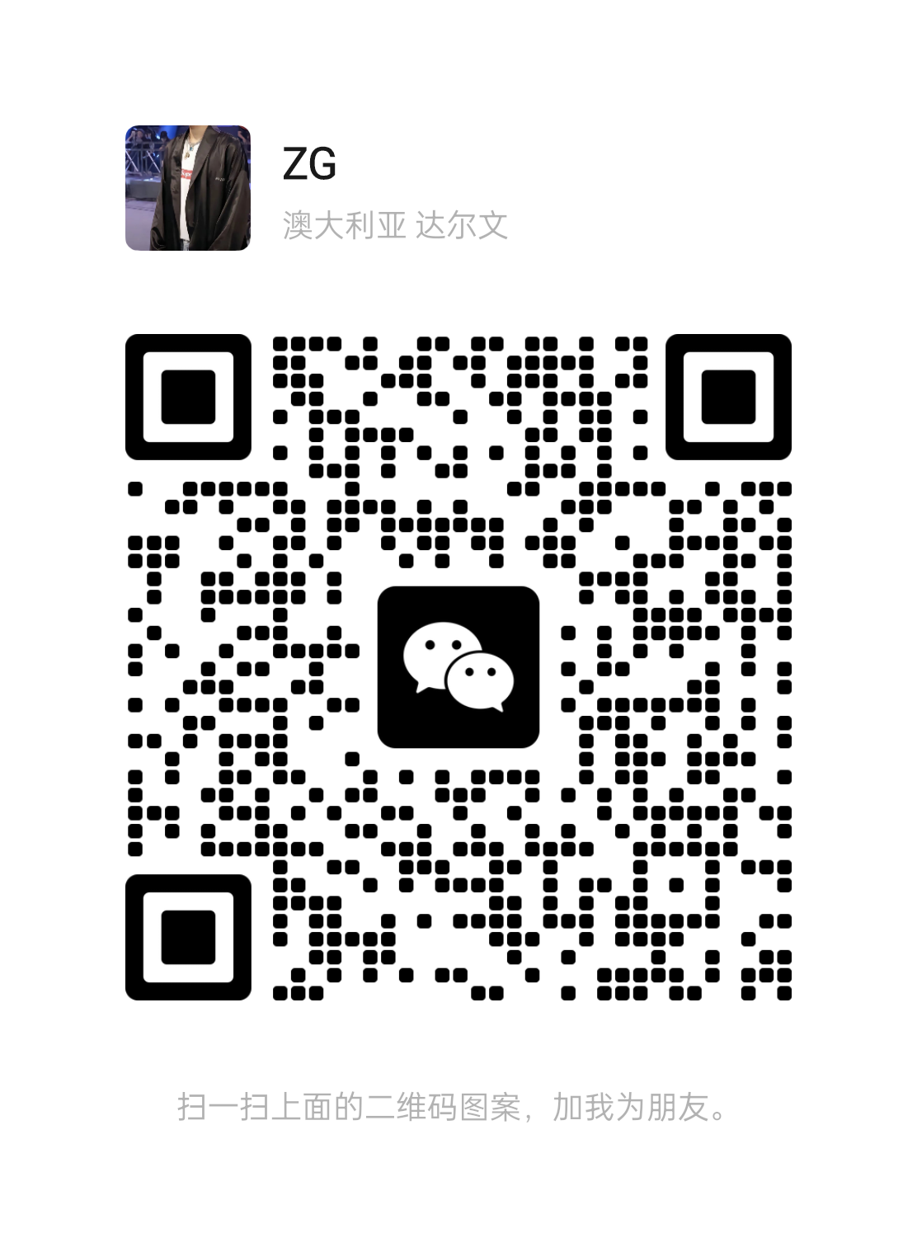
8. Team & Contact
Phone / WeChat: +86 150 6896 3932
微信扫码添加

