Slide 2
John Lovell – motif enrichment

Slide 3
Manually searched for [A/G]CCGAC in the 1kb promoters that John made
# L58: 22714
# A03: 22482
# PCGlu: 22620
# R500: 22744
# VT123: 22684
# WO83: 22482

Slide 4
Known CRTF based approach

Slide 5
Known CRTF based approach

Slide 6
GRN-based approach

Slide 7
We are looking for candidate binding motifs that known CR TFs have been shown to bind to
Ex: DREB/CRTs, Evening Element (EE), DOFs, ect
Only included motifs that had good evidence for binding; i.e. EMSA or ChIP
We are using our cold responsive GRNs to identify significant edges between each CR TFs and their predicted targets
We then focusing on targets that:
1. Are paralogs
2. Are part of an orthologous group that contains (at least) one CR paralog AND (at least) one non-CR paralog
3. Have a known binding motif (for that CR TF) at least once in one of the remaining paralogs
Since we were only able to run the motif analyses on the reference lines, the candidates will be taken from the six reference lines

Slide 8
Also checked that our filtering scheme (FIMO score) for the final list of motifs associated with Brapa genes isn’t affecting our ability to pull out genes with associated motifs
In general, there is little difference between the number of genes with a motif across the various motif datasets I have
One possible exception is TOC1

Slide 9
TOC1 Targets
TOC1 is known to bind to the Evening Element (EE) motif (AAAATATCT)
When we ignore genes that don’t have at least one predicted EE (per Og) we no longer have hits with the exciting targets like we did previously
- Perhaps we should ignore FIMO filtering?

Slide 10
CBF1 Target – KPI1
Top: VT123 Copy2 (CR) Middle: ACC50; same copy not CR Bottom: R500 Copy1 not CR
Seems like what I need is a way to see the whole promoter but color/outline the motifs of interest
ICE2 Target – AVA-P2
Top: VT123 Copy2 (CR) Middle: VT123 Copy 3not CR Bottom: ACC28 Copy3 not CR

Slide 11
ICE2 Targets
ICE2 is known to bind to DREB/CRT motifs ([A/G]CCGAC)
A good example of a CR copy vs nonCR – potential candidate!!
https://benchling.com/s/seq-RXOkYBQPQO3OY2glyMdm?m=slm-UsWSjSWEN5SE42AZ464g
MEE4 (maternal effect embryo arrest 4) (Primary Symbol)

Slide 12
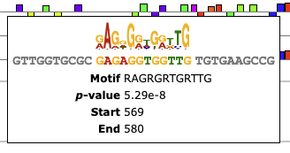
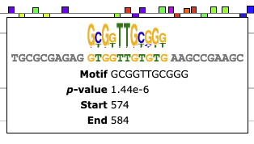
WHAT GENES ARE THESE FROM????
I THINK ICE1 TARGETS….
BBR/BPC Motif family?
Similar to DREB2 binding site (GGTGGT vs GGCGGT)
Hn53: COPY 2 (kME)
A03: COPY 3
ZCT: COPY 2
ERF Motif family?

