Slide 1

Introduction to Flutter

Slide 2
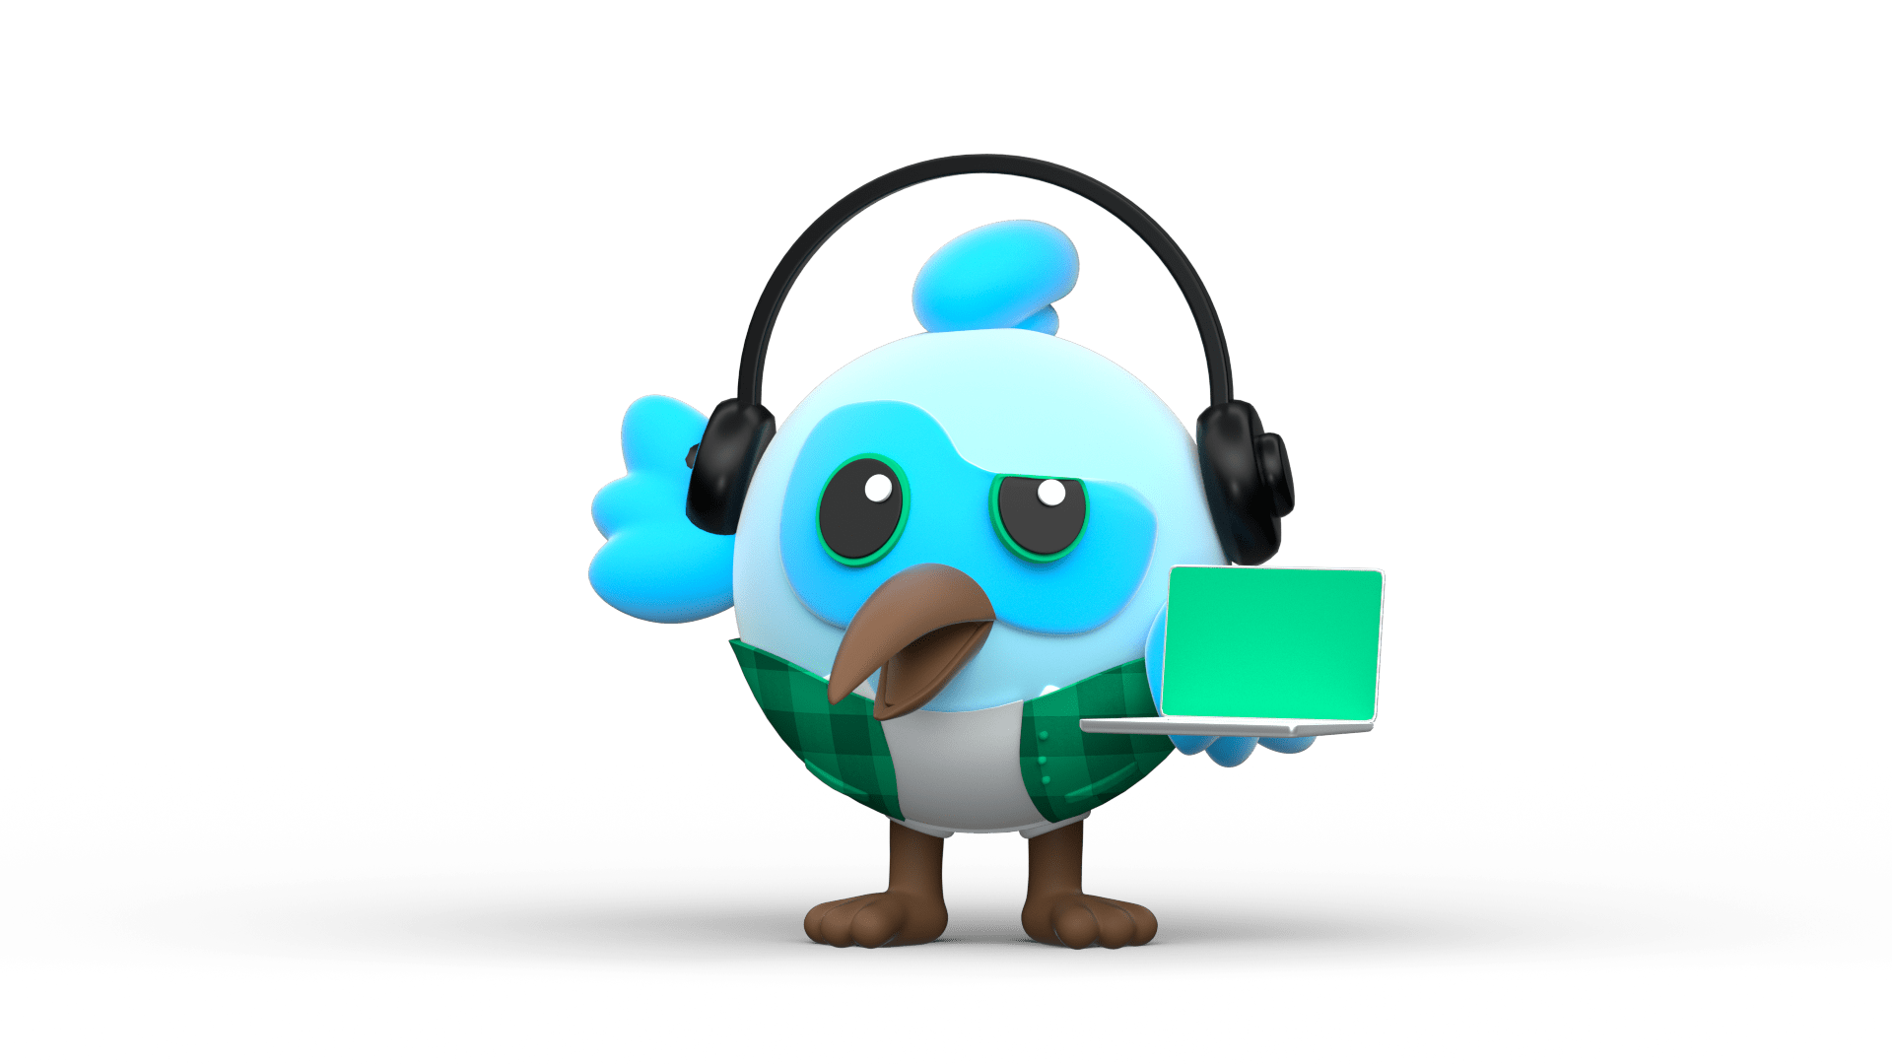

Flutter
Flutter is framework created by google.
A cross-platform framework used to develop application for
Android
iOS
Web
and Desktop
Dart Programming language

Slide 3


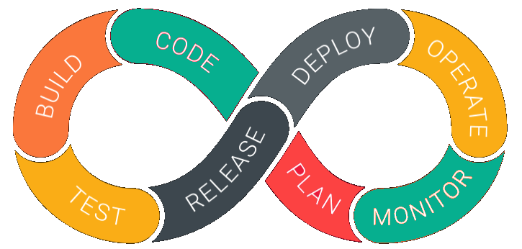
Why Flutter for App Development
1. Open Source | 2. Faster development Cycle | 3. Super Productive
Flutter is Open-Source framework
Therefore, anyone can use it for any given purpose.
Flutter is so fast that it takes less then 30 sec for first full compilation.
Comes with Hot-Reload & Hot-Restart.
Comes with Hot-Reload & Hot-Restart.
Due to Stateful widget hot-reload feature Flutter is very fast iterative coding style.

Slide 4

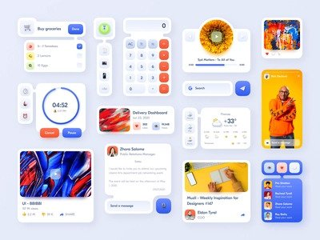

Why Flutter for App Development
4. Ease to learn & code sharing | 5. Widget Libraries | 6. Community Support
Any one who have basic knowledge of OOPS & UI Designing can easily learn Flutter.
Ready to use widget, Flutter have many widget that you can use to build flutter application.
Such as : http, get, share plus, toggle switch etc.
Flutter Community is bit small if we compare with other framework like React.
But Flutter is grow very fast then other framework.

Slide 5
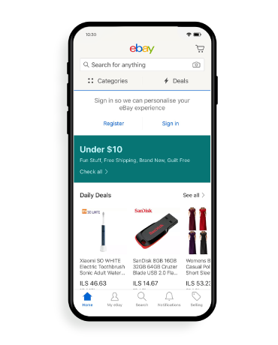
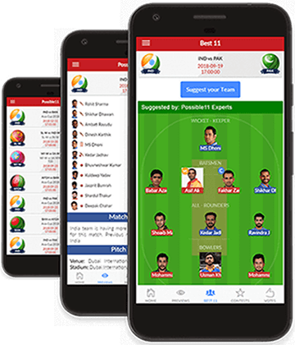
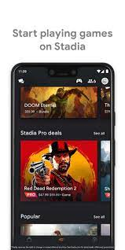
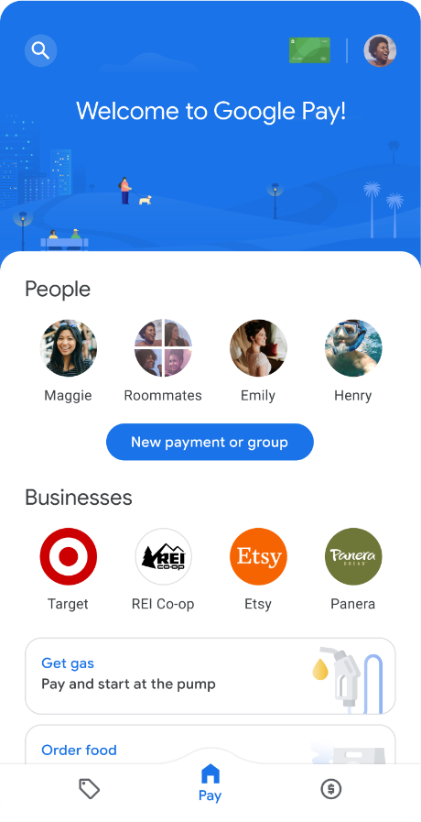
Apps that are build using Flutter
Stadia
gaming platform.
Dream 11
eBay
Google Pay

Slide 6

Feature of Flutter
Cross Platform App Development.
Easy access to Native Features.
Minimal Coding.
Fast Development
Hot Reload & Hot Restart

Slide 7
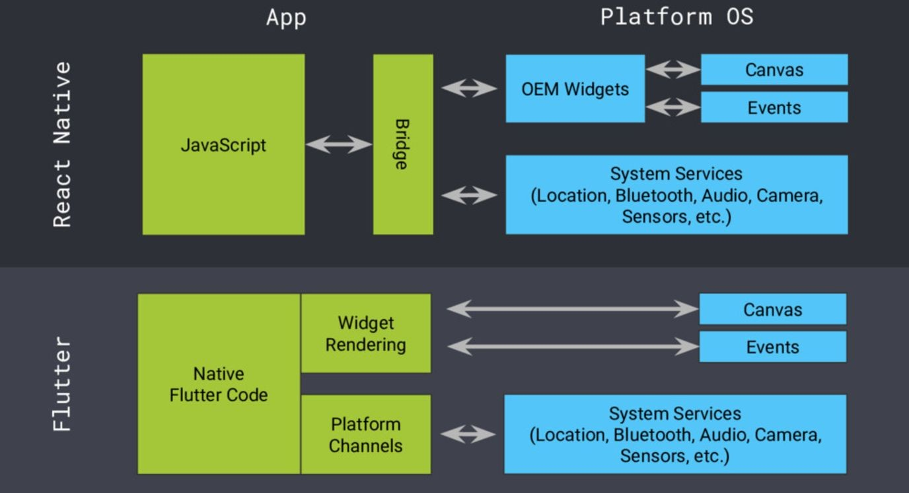
Our cross-platform code
Native land
Also fast performance here, however:
Everything in our control
Things we do here have fantastic performance and are cheap
We should stay here as much as possible
Expensive to travel to
We can’t afford to go here too often, just like we can’t afford beach vacations every week
Base image from: https://speakerdeck.com/passsy/flutter-60-fps-ui-of-the-future

Slide 8
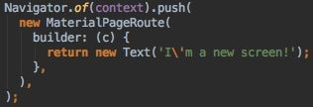
Widgets
To build UIs, we have Widgets -> the only UI building block in Flutter
The whole app is a Widget. A screen is a Widget that contains Widgets. Widgets are made by composing basic Widgets into more advanced Widgets.
  Yo dawg?
There’s a huge amount of different Widgets
Can represent a:
  UI element, such as Text, Button, BottomNavigationBar, TextField, etc.
  Layout element, such as Padding, Center, Stack, Column, etc.
  Completely new screen (Activity/ViewController equivalent), for example:

Slide 9
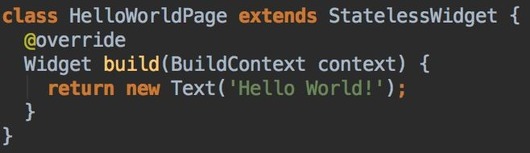
Stateless Widgets
Have no state (duh)
Immutable -> all instance fields are final
For displaying something that doesn’t change once it has been initialized

Slide 10
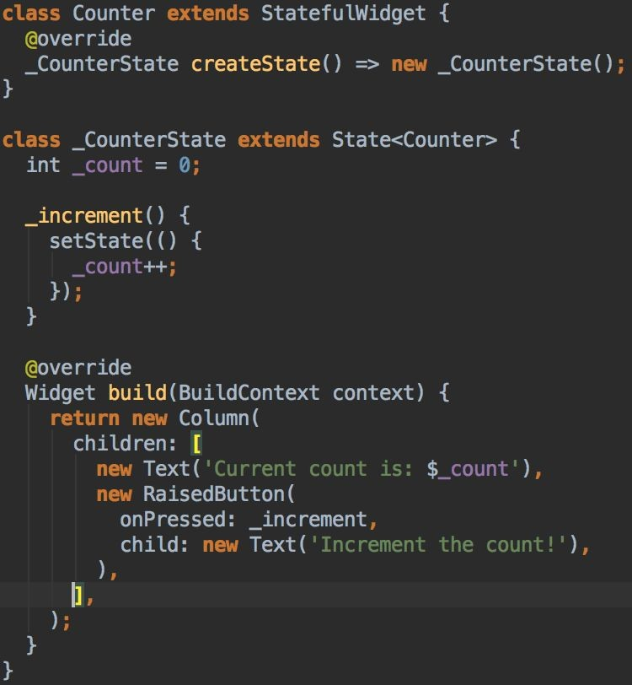
Stateful Widgets
Have a state (duh)
The state has mutable instance fields that can be read synchronously
Call setState() method for updating the state
Framework handles UI Widget updates intelligently and efficiently when necessary
So basically, really similar to React concepts
(count = count + 1;)

Slide 11
Conclusion
Flutter framework does a great job by providing an excellent framework to build mobile applications in a truly platform independent way. By providing simplicity in the development process, high performance in the resulting mobile application, rich and relevant user interface for both Android and iOS platform, Flutter framework will surely enable a lot of new developers to develop high performance and feature-full mobile application in the near future.

