Slide 1
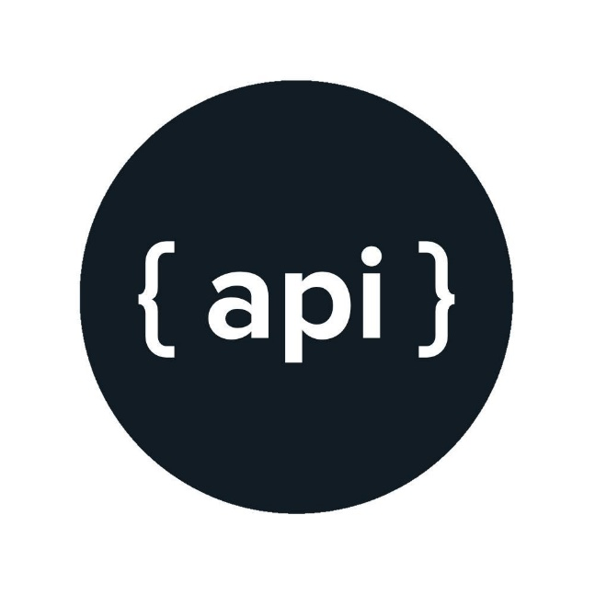


Application Programming Interface
May 9th 2018
Rapando Sam
@samy_raps
rapando

Slide 2
Application Programming
Interface
What is It?
Examples
Importance

Slide 3
Representational State
Transfer
GET
POST
PUT
PATCH
DELETE

Slide 4
Web APIs

Slide 5
When and Why?

Slide 6
Examples

Slide 7
Creating an API

Slide 8
Using an API

Slide 9
GraphQL

Slide 10
What Next?
graphQL
Authentication
Serverless APIs

Slide 11
t.me/samy_raps

