Slide 1
Automatic Fourier Modelling of Vision-based Gait Motion for Representing Person
19th September 2019
Rapee Wannasiri

Slide 2
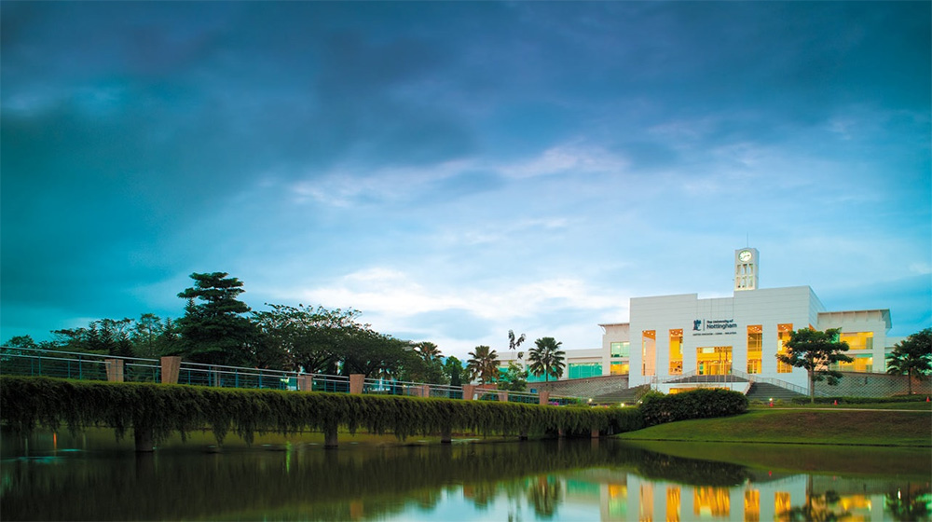
OUTLINE
Introduction
Methodology
Results
Conclusions

Slide 3
INTRODUCTION
Gap between two measurement systems
Vision-based
Images and videos
Image processing
Sensor-based
Signal
Gait analysis
Image sequence of gait (Rahman, Kalpoma and Hasan 2015)
Gap
Gait signal (Morgan and Noehren 2018)
Notes:
Gait Motion, Gait Patterns and Gait Cycle
Gait Analysis and Gait Recognition

Slide 4
METHODOLOGY
Solution Pipeline
Leg analysis
A video
Frame Extraction
An image sequence
Pose Estimation
Gait Data
Kinematic Calculation
Kinematic Parameters
Fourier Curve Fitting
Models
Input
Walking
Side view gait
Output
Deep Neural Network (DNN)

Slide 5
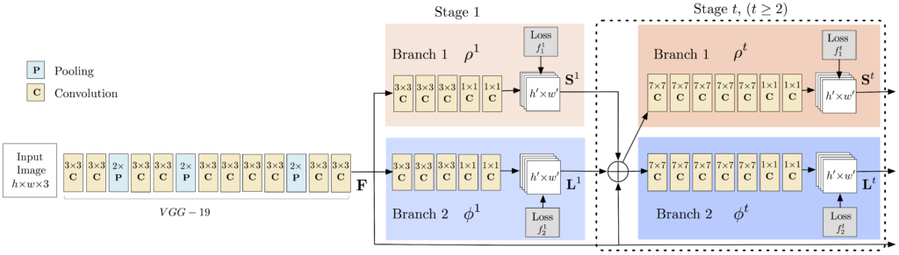
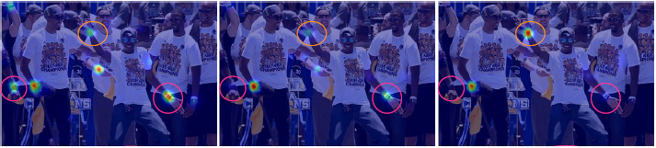
METHODOLOGY
Pose Estimation
Trained DNN
Multi-Person Pose Estimation model (MPI) (Cao et al. 2017, Gupta 2018)
Confidence maps
Maximum probability
Produce joint locations
DNN’s structure (Gupta 2018)
Confidence maps (Cao et al. 2017)

Slide 6
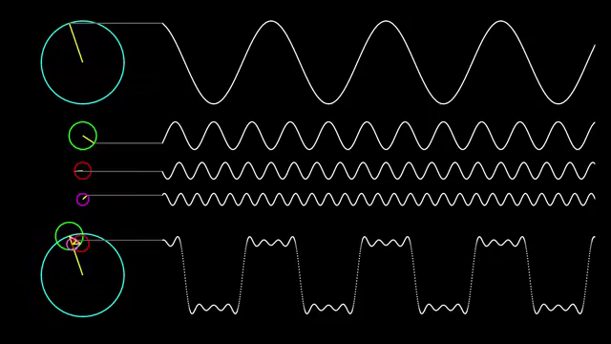
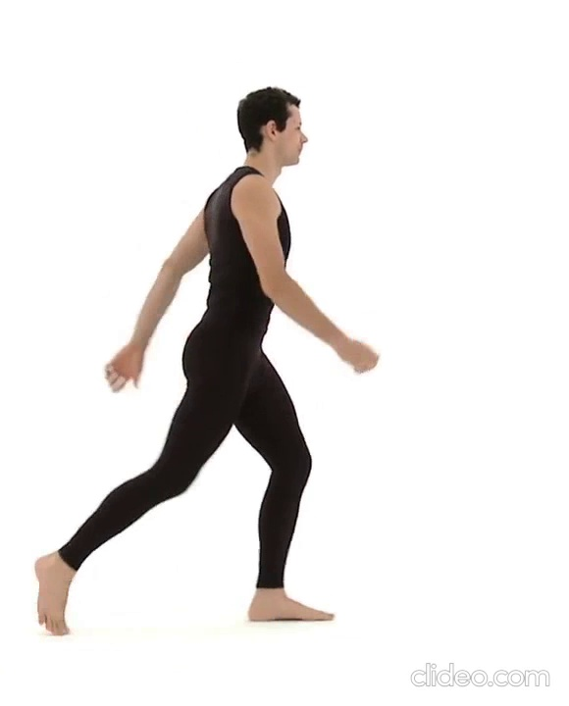












METHODOLOGY
Kinematic Calculation
Fourier Curve Fitting
9 kinematic parameters:
3 Translation
6 Rotation
(Ren et al. 2007)
Hip
Hip
Reference line
$$θ_{\vec{HK}}=\hat{HK}$$
$$\vec{HK}$$
$$θ_{H}=\hat{H}$$
$$\left\|\vec{HK}\right\|$$
$$θ_{\vec{HA}}=\hat{HA}$$
Knee
Knee
Reference line
$$\vec{HA}$$
$$\left\|\vec{HA}\right\|$$
$$θ_{K}$$
$$θ_{\vec{KA}}=\hat{KA}$$
$$\vec{KA}$$
$$\left\|\vec{KA}\right\|$$
Ankle
$$θ_{A}=\hat{A}$$
Reference line
Fourier series (GLV 2019)
Ankle
Kinematic parameters
Notes:
**Fourier is worth to explain
Maybe talk about result of Kinematic in this and remove the result slide.

Slide 7
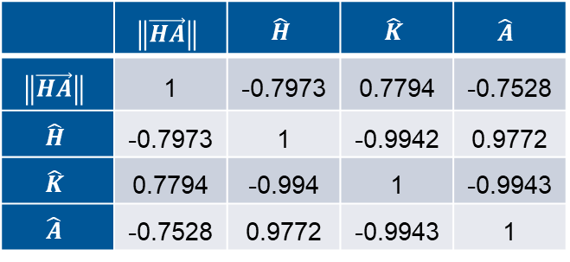

RESULTS
2 gait patterns in Kinematic parameters:
Inner angle’s rotation Whole leg’s rotation
 | $$\left\|\vec{HA}\right\|$$ | $$\hat{H}$$ | $$\hat{K}$$ | $$\hat{A}$$
$$\left\|\vec{HA}\right\|$$ | 1 | -0.7973 | 0.7794 | -0.7528
$$\hat{H}$$ | -0.7973 | 1 | -0.9942 | 0.9772
$$\hat{K}$$ | 0.7794 | -0.994 | 1 | -0.9943
$$\hat{A}$$ | -0.7528 | 0.9772 | -0.9943 | 1
 | $$\hat{KA}−\hat{HK}$$ | $$\hat{HA}−\hat{HK}$$
$$\hat{H}$$ | 0.994160087 | 0.999931396
Correlation between subtracted parameters and an inner angle parameter
Correlation between inner angle of leg
Notes:
Keep it short

Slide 8
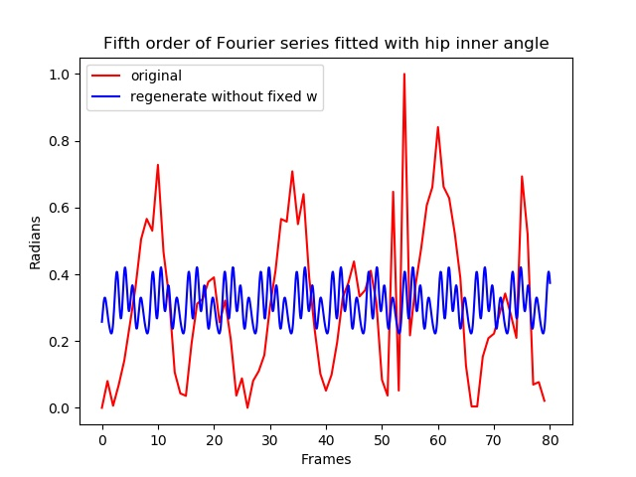
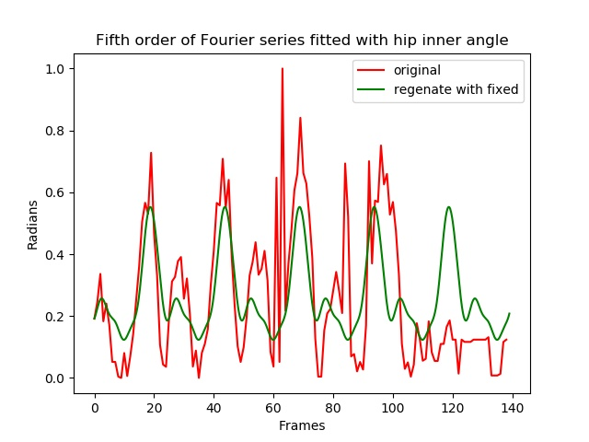
RESULTS
Fourier models from curve fitting
Curve fitting with known gait cycle
Not related: gait cycle from models did not fit to gait patterns.
Considerably improved: gait cycle from models partly fit to gait patterns.
16% correlation
56% correlation
Notes:
***Focus on Result
***Discussion
***Evaluation
Opinion
Analysis
Points out mistake and problem
Cannot determine w
Need algorithm to determine?
Pre-process such as smoothen to reduce confusion of curve fitting

Slide 9
CONCLUSIONS
Solution: Pose Estimation with MPI → Kinematic Calculation → Curve Fitting
Gait patterns: 1.inner angle’s rotation and 2. whole leg’s rotation.
Fourier models
with independent curve fitting did not represent gait patterns.
with known gait cycle partly represent gait patterns.
Key factors: accuracy of Pose Estimation and quality of gait signal.
Further study to determining gait cycle in Fourier Curve Fitting by:
Pre-processing, more accurate DNN or inset new algorithm for gait cycle

Slide 10
REFERENCES
GLV (2019) Fourier Series Square Wave [online] available from <https://www.youtube.com/watch?v=cUD1gMAl6W4> [7 September 2019]
Gupta, V. (2018). Deep Learning based Human Pose Estimation using OpenCV ( C++ / Python ). [online] Learnopencv.com. Available at: https://www.learnopencv.com/deep-learning-based-human-pose-estimation-using-opencv-cpp-python/ [Accessed 12 Jun. 2019].
Morgan, K. and Noehren, B. (2018) "Identification Of Knee Gait Waveform Pattern Alterations In Individuals With Patellofemoral Pain Using Fast Fourier Transform". PLOS ONE 13 (12)
Rahman, N., Kalpoma, K., and Hasan, T. (2015) Automated Person Identification System Using Walking Pattern Biometrics. International Journal of Scientific & Engineering Research 6(9), 2229-5518.
Ren, L., Jones, R. and Howard, D. (2007) "Predictive Modelling Of Human Walking Over A Complete Gait Cycle". Journal Of Biomechanics 40 (7), 1567-1574

Slide 11
THANK YOU
psxrw9@Nottingham.ac.uk

