Slide 1
Blockchain with some bitcoin
RAPEXA

Slide 2
YOU
Why ?
Who ?
How ?
What is this class ?

Slide 3
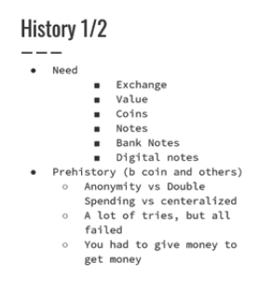

Slide 4
