Slide 1
Multi-Task Learning in Deep Learning
- Amath 563 Project Proposal
Raphael Liu

Slide 2
CONTENTS
01
02
03
04
Introduction
Data
Domain Knowledge
Possible limitations

Slide 3
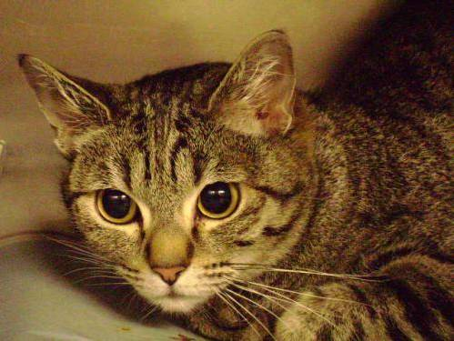
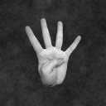

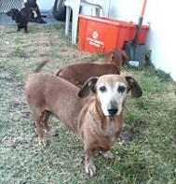
Generally, Multi-Task Learning (MTL) focus on optimizing more than one loss function
Introduction
Cat or dog? And what’s the breed?
...
Right hand or left hand? How many fingers?

Slide 4
These tasks are closely related, so we could build a MTL model. Split the tasks and learn at the same time.
FCs
CONV
CONV
CONV
Task A
Left or Right Hand
...
...
Task B
Count the fingers
...
FCs

Slide 5

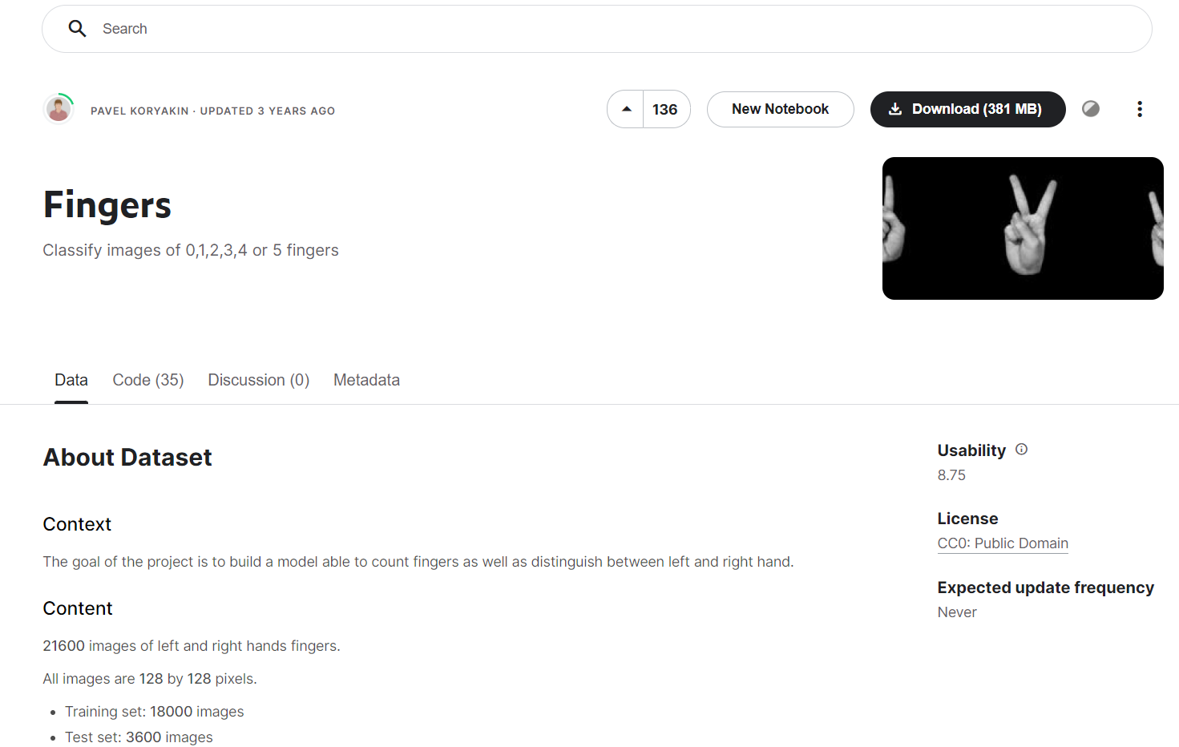
https://www.kaggle.com/datasets/koryakinp/fingers
Data
Planning to try more datasets!
For example, ImageNet, classifying objects and their colors at the same time

Slide 6
Two commonly used methods in MTL
Task A
Task B
Task C
Task A
Task B
Task C
Domain Knowledge
a) Hard parameter sharing
b) Soft parameter sharing
a) Share hidden layers in all tasks, then foward to task specific layers
b) Each task has its own model with its own parameters, but parameters are encouraged to be similar

Slide 7
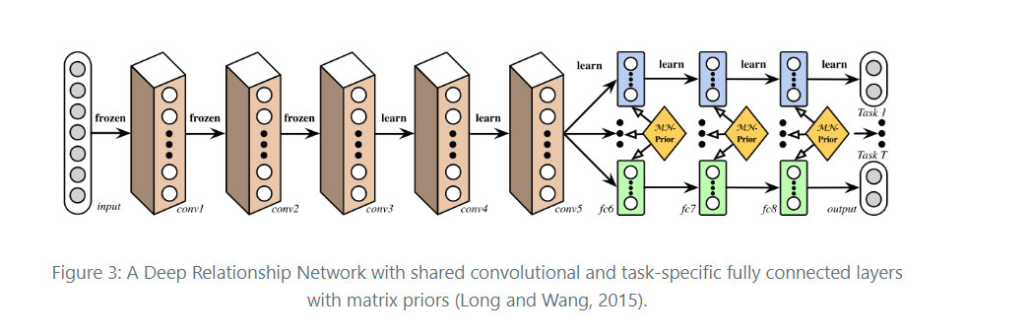



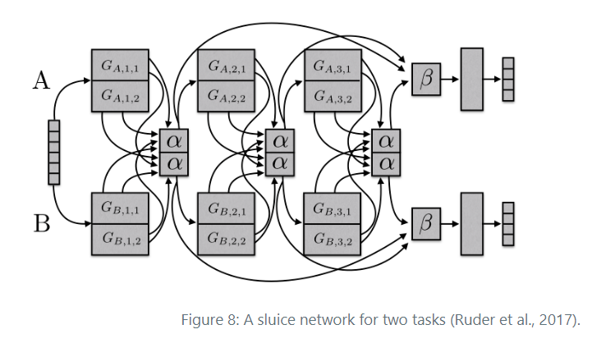
Going deeper...
Deep Relationship Networks^{[1]}
Computer vision problems, CNNs & MTL
Sluice Networks^{[2]}
Hard parameter sharing & cross-stitch networks & hierarchy flow
1. Long, M., & Wang, J. (2015). Learning Multiple Tasks with Deep Relationship Networks. arXiv Preprint arXiv:1506.02117. Retrieved from http://arxiv.org/abs/1506.02117
2. Ruder, S., Bingel, J., Augenstein, I., & Søgaard, A. (2017). Sluice networks: Learning what to share between loosely related tasks. Retrieved from http://arxiv.org/abs/1705.08142

Slide 8
MTL assumes that the tasks are very related or similar
Possible Limitations
Learning rate is very important but hard to control for different tasks
Not too much Pytorch libraries or other packages to help build MTL

Slide 9
THANK YOU!

