Slide 1
drug data reanalysis
Lozano-huntelman et al 2021, Tekin et al 2018

Slide 2
multiplicative model seems most appropriate?
If individual perturbations measured as fold-differences from negative control, multiplicative model seems most appropriate (Wagner 2015)
Lozano-huntelman et al 2021: "Because we are using relative fitness, the effect of each individual drug can be interpreted as a percent reduction in growth rate, so the null expectation for the combined effects of two non-interacting drugs would be the product of two percentages, corresponding to a multiplicative definition of no interaction."

Slide 3
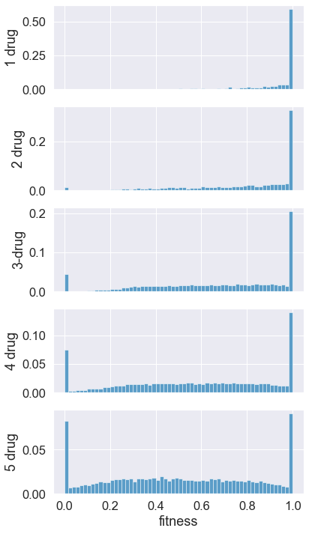
fitness distributions
Shown here are the fitness distributions of E. coli exposed to various drug combinations. Eight distinct drugs were used, but cells were only exposed to a maximum of 5 drugs simultaneously.
note: fitness appears to decline with exposure to additional drugs, and there are an increasing number of apparently lethal combinations.

Slide 4
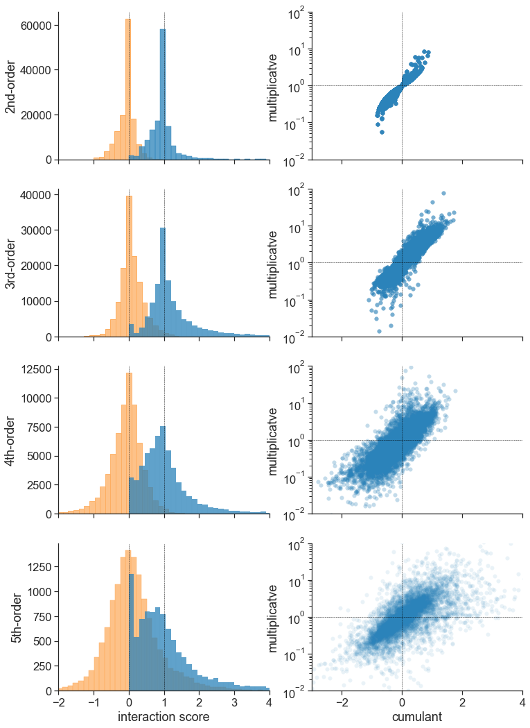
left column: distribution of interaction scores calculated with cumulants (orange) or multiplicative model (blue)
right column: scatterplot comparing individual interaction scores calculated with cumulants (x-axis) and multiplicative model (y-axis)
dashed black lines indicate the expected value of no interaction using cumulants (0) and multiplicative model (1)
caveat: based on experimental setup there are duplicate measurements, but they often have slightly different values b/c they’re basically biological replicates

Slide 5
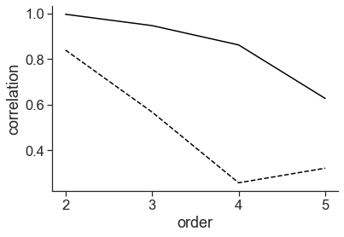
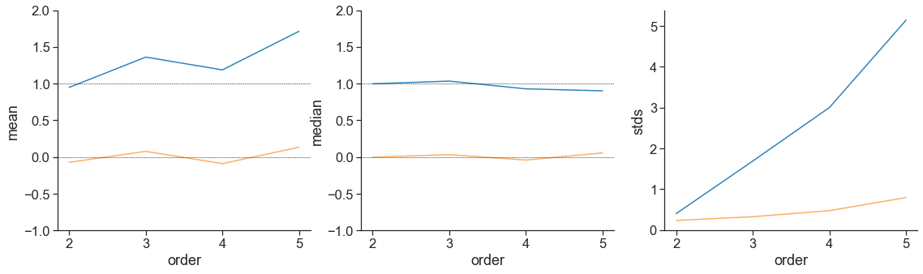
spearman and pearson correlations (solid and dashed lines, respectively) between interactions calculated using cumulants and multiplicative model
summary stats of the distribution of interaction scores calculated using cumulants (orange) or multiplicative model (blue)

Slide 6
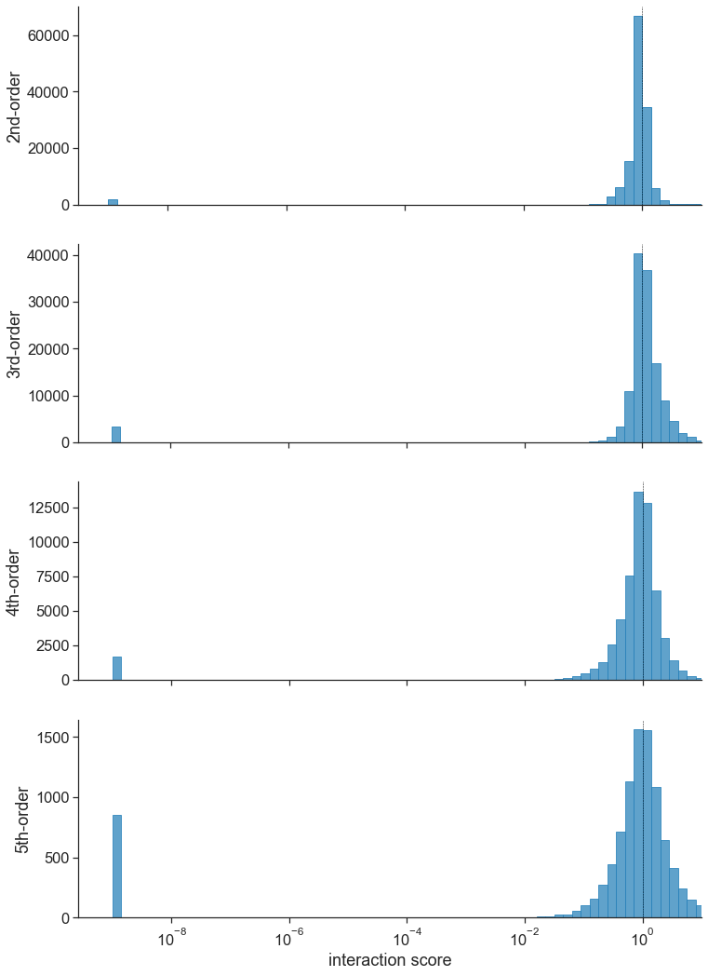
plotting the results on a multiplicative scale using a logged x-axis shows “0” values
note: 0 values reassigned to 1*10⁻⁹ so that they could be plotted on log scale
from before: more zero fitness values with higher drug combinations
Notes:
zeroes restricted to a particular plate/batch
how do they deal with lethals again?

Slide 7
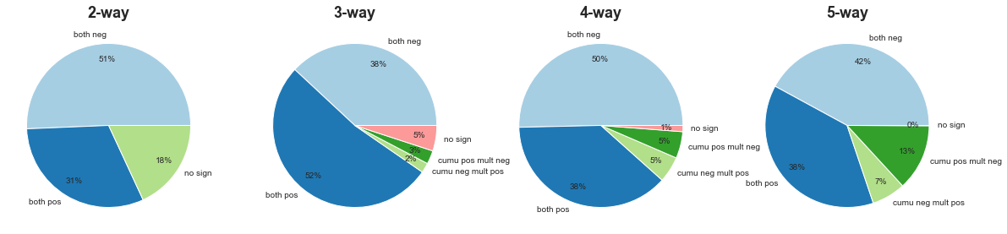
agreement b/t cumulant formula and multiplicative model
“cumu pos mult neg” means the cumulant gave a positive interaction while the multiplicative model gave a negative interaction, etc.
“no sign” indicated that at least 1 calculation gave an unsigned value for interaction (cumulant == 0 | multiplicative == 1), so hard to compare
note: for interactions that have the same sign on the 2 different scales, the magnitudes may still differ

Slide 8
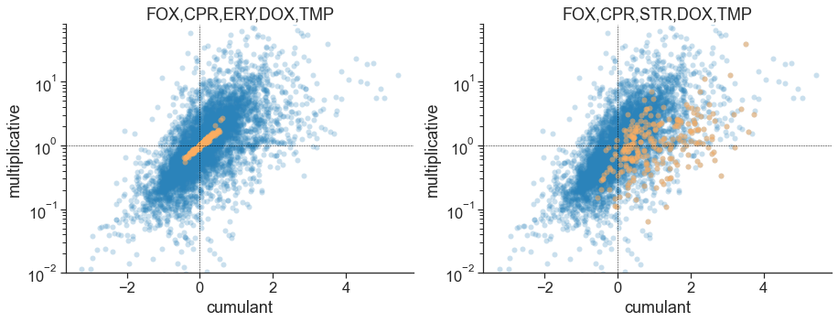
Do some 5-drug combinations have very different values b/t scales?
For each drug combo, I computed its rank on both the cumulant and multiplicative scale
I then calculated the difference (absolute value) in rank b/t scales
high values indicate highly different ranks b/t scales
I then looked for drug combos that tended to have the most similar ranks b/t scales (left plot) and the most diff ranks b/t scales (right plot)
note: lower right quadrant indicates positive on cumulant scale but negative on multiplicative scale
note: for a given combination each drug could have 1 of 3 diff concentrations, so a given drug combo represented multiple times (here, 3^5=243 times)
Notes:
repeat analysis accounting for concentration
treatment combination vs drug combination
highlight all treatment combos with high rank diffs
how do we summarize treatment combo diffs in a way they do
yeast paper does other associations to show results are biologically interesting, i.e. redo their analyses to see if/how story changes
-higher impact paper focuses on yeast?
-any way to check if our higher order interactions are more reasonable biologically
in lozano-huntelman 2021 paper, what bigger analysis/story to they do/tell, repeat on multiplicateive scale

Slide 9
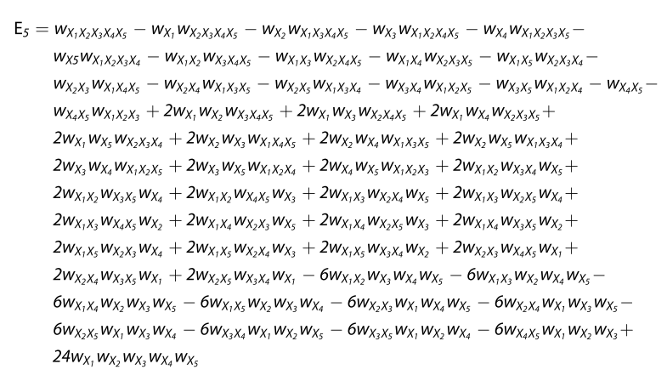
used this formula for 5-th order cumulant (Tekin et al 2018), assuming term in red box is an error (doesn’t follow general pattern)

Slide 10
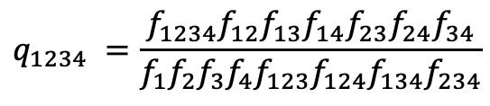
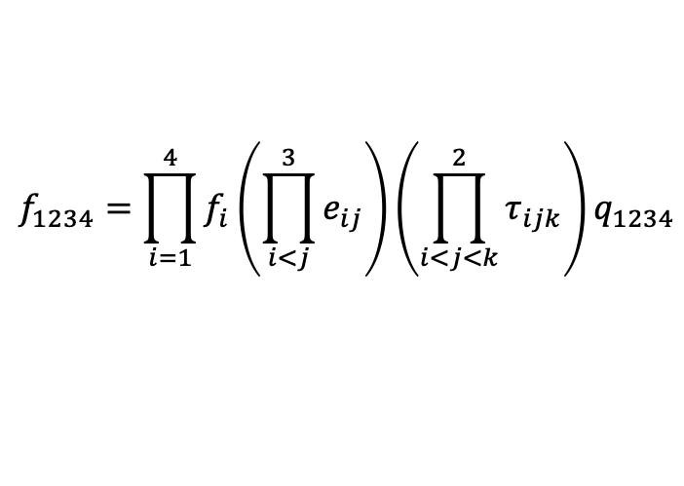
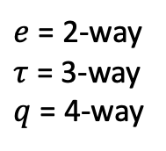
4-way interaction, multiplicative formula
$$f_{1234}=\prod_{i=1}^{4}{f_{i}\left(\prod_{i<j}^{3}{e_{ij}}\right)\left(\prod_{i<j<k}^{2}{τ_{ijk}}\right)}q_{1234}$$
$e$ = 2-way
$τ$ = 3-way
$q$ = 4-way
$f_{1234}=f_{1}f_{2}f_{3}f_{4}e_{12}e_{13}e_{14}e_{23}e_{24}e_{34}τ_{123}τ_{124}τ_{134}τ_{234}$ $q_{1234}$
$$q_{1234} =\frac{{f_{1234}f}_{12}f_{13}f_{14}f_{23}f_{24}f_{34}}{f_{1}f_{2}f_{3}f_{4}f_{123}f_{124}f_{134}f_{234}}$$

Slide 11
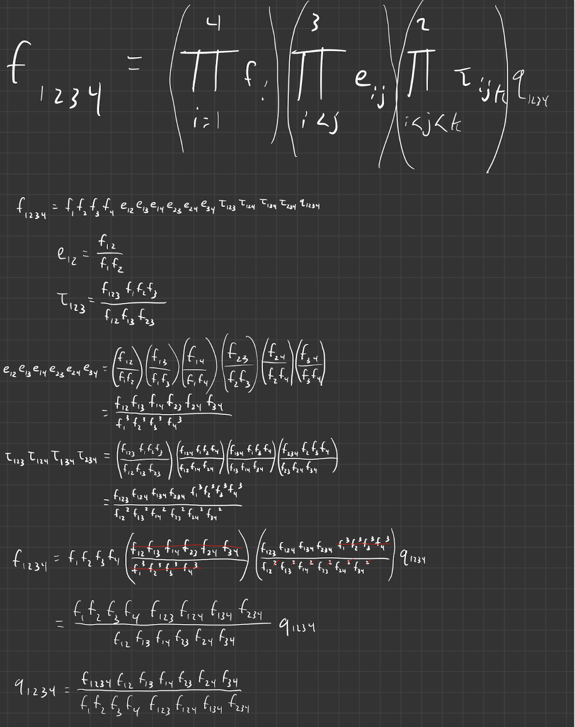
4-way interaction, multiplicative derivation

Slide 12
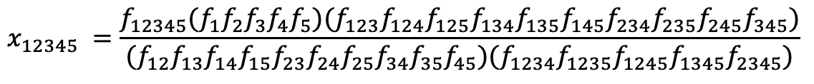
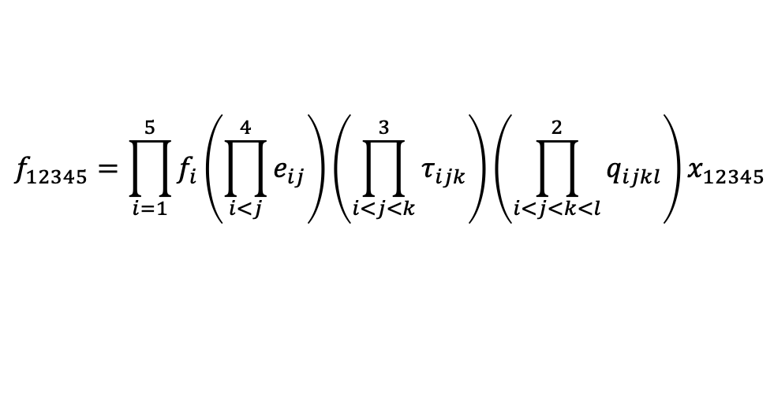
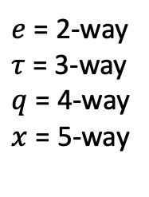
5-way interaction, multiplicative formula
$e$ = 2-way
$τ$ = 3-way
$q$ = 4-way
$x$ = 5-way
$$f_{12345}=\prod_{i=1}^{5}{f_{i}\left(\prod_{i<j}^{4}{e_{ij}}\right)\left(\prod_{i<j<k}^{3}{τ_{ijk}}\right)}{\left(\prod_{i<j<k<l}^{2}{q_{ijkl}}\right)x}_{12345}$$
$f_{1234}=f_{1}f_{2}f_{3}f_{4}e_{12}e_{13}e_{14}e_{15}e_{23}{e_{24}e_{25}e}_{34}e_{35}e_{45}τ_{123}τ_{124}{τ_{125}τ}_{134}τ_{135}τ_{145}τ_{234}τ_{235}τ_{245}τ_{345}q_{1234}$ $q_{1235}q_{1245}q_{1345}q_{2345}x_{12345}$
$$x_{12345} =\frac{f_{12345}{(f}_{1}f_{2}f_{3}f_{4}f_{5}){(f}_{123}f_{124}{f_{125}f}_{134}f_{135}f_{145}f_{234}f_{235}f_{245}f_{345})}{{(f}_{12}f_{13}f_{14}f_{15}f_{23}{f_{24}f_{25}f}_{34}f_{35}f_{45}{)(f}_{1234}f_{1235}f_{1245}f_{1345}f_{2345})}$$

Slide 13
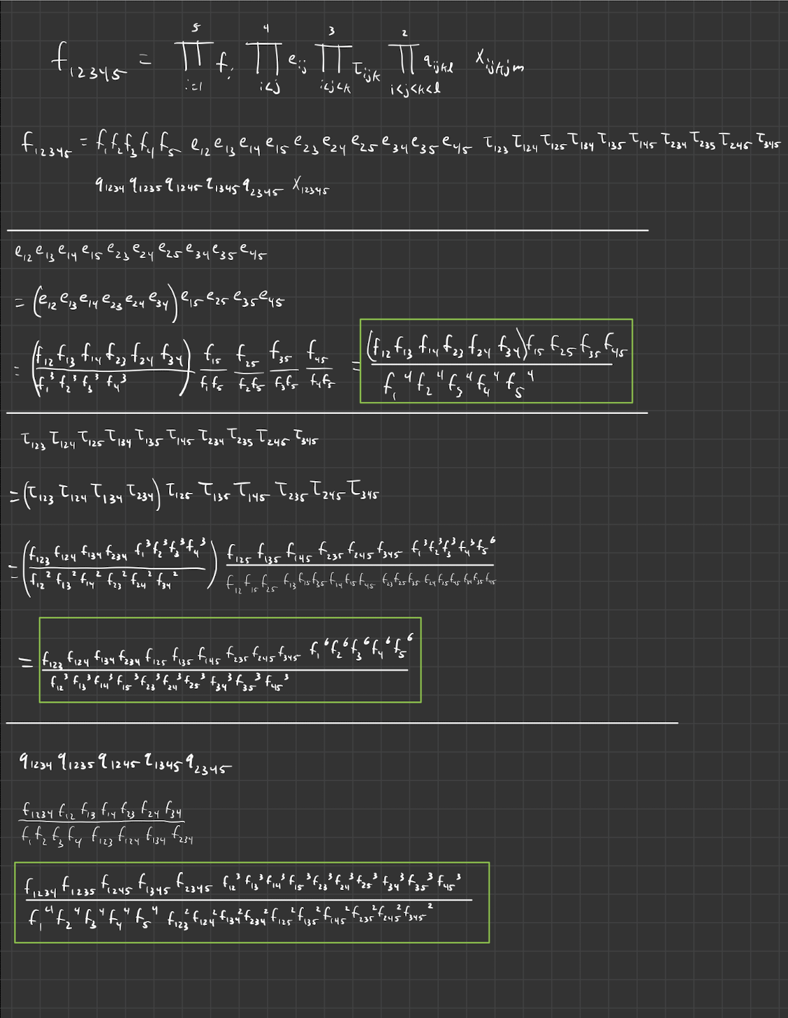
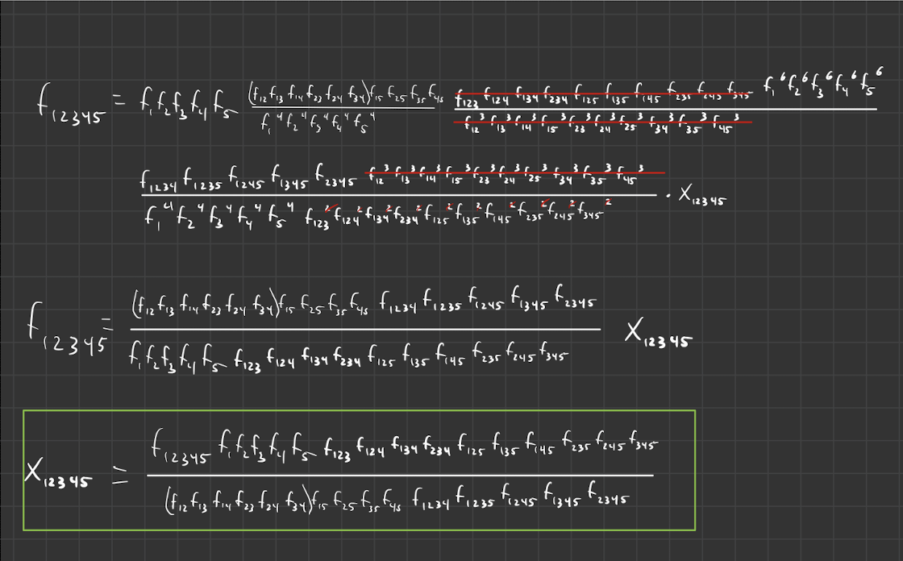
5-way interaction, multiplicative derivation

Slide 14
to do
repeat analyses using additive formula

Slide 15
Drug response lit review
Was looking for differences b/t multiplicative and chimeric model, but it’s arguable that multiplicative model isn’t even correct for these data
Lozano-Huntelman et al use chimeric model, refer to “deviation from additivity”, but in supplement say this is just for consistency with literature and saying deviation from independence more appropriate
However, “Bliss Additivity” is a distinct concept in literature, and some argue that it’s more appropriate when growth rates are used to quantify fitness differences (as opposed to population size)

Slide 16
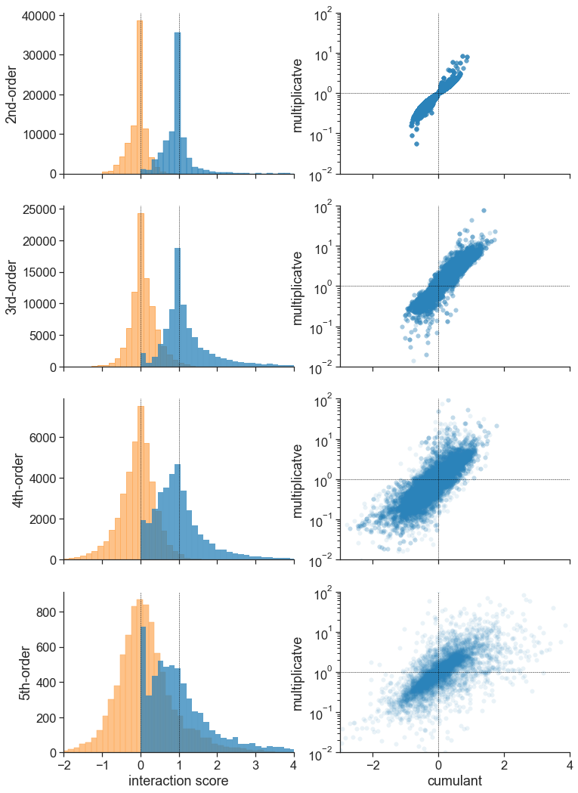
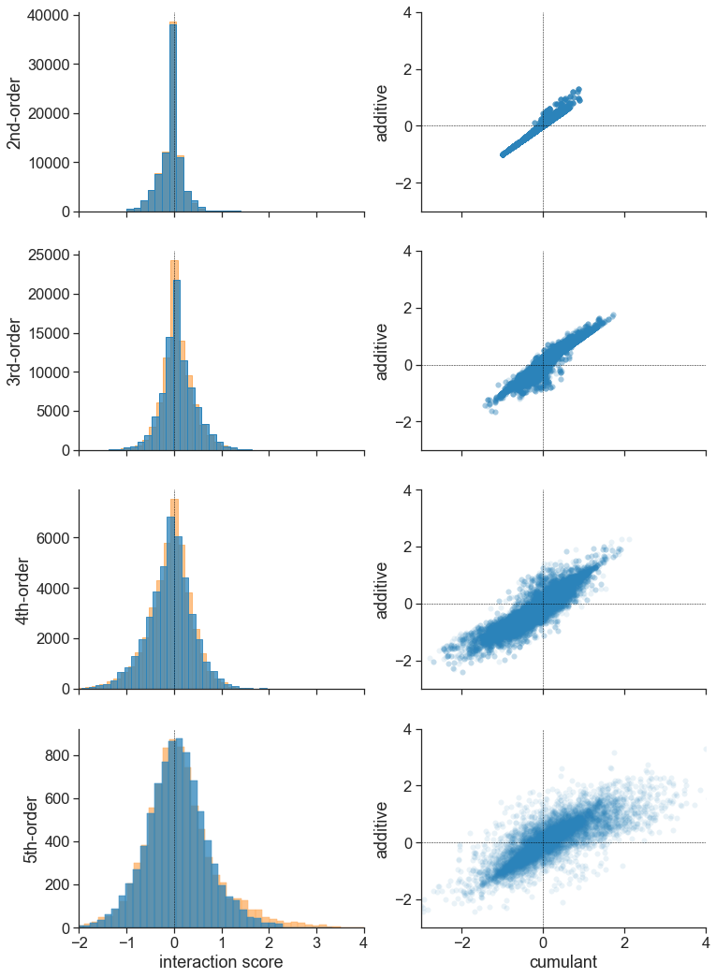

Slide 17
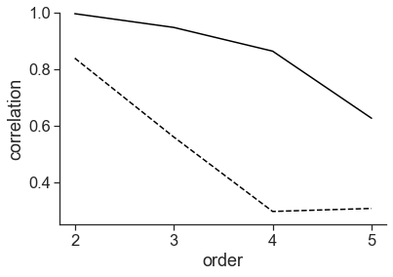
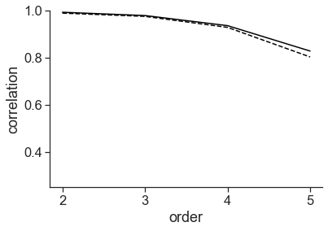
cumulant more similar to additive model
solid line: spearman
dashed line: pearson
multiplicative v. cumulant
additive v. cumulant

Slide 18
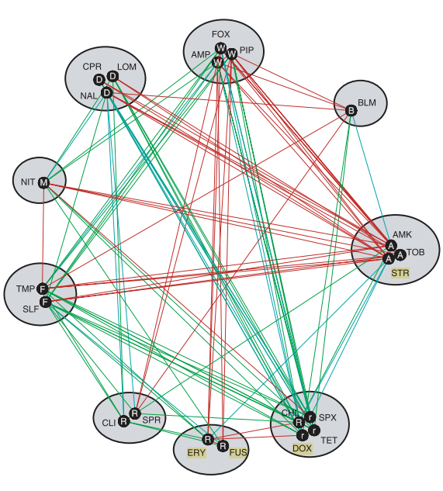
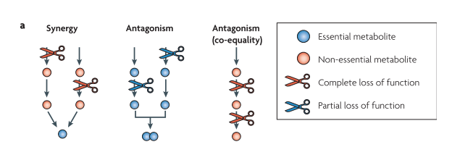
interpretations of interactions
Yeh et al 2009, NatRevMicro
extended ideas from epistasis to drug interactions
drug interactions can classify drugs by function they inhibit
expect neg. interaction if 2 redundant pathways perturbed, pos. interaction if 2 nonredundant pathways perturbed
mechanism of action interaction
drugs may slow growth or kill cells
antagonism b/t mechanisms b/c killing more efficient in actively dividing cells

Slide 19
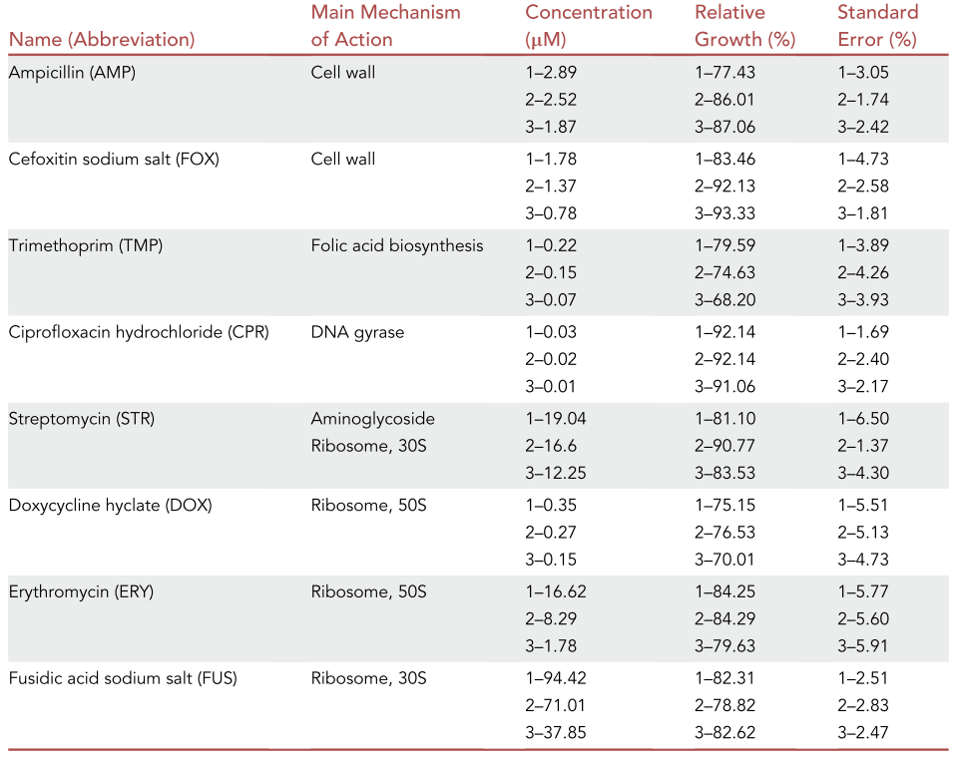
not many drug combos from same pathway
bactericidal
bacteriostatic: inhibits growth
bactericidal: kills cells
bactericidal
bacteriostatic
bactericidal
bactericidal
bacteriostatic
bacteriostatic
bacteriostatic

Slide 20
experiment notes
8 drugs studied in combinations of 5
binom(8,5) = 56 plates
within each plate, each drug in 1 of 3 concentrations
lower order combinations (2nd, 3rd, 4th order) present in duplicates

Slide 21
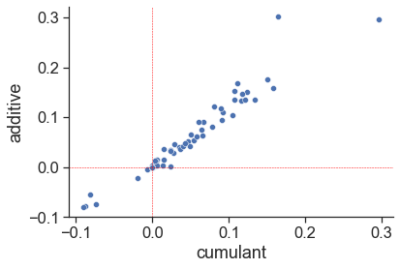
drug triplet analysis
each drug triplet represented binom(5,2) = 10 times
each at 1 of 3 concentrations
Following Yeh papers, took median (but didn’t rescale)

Slide 22
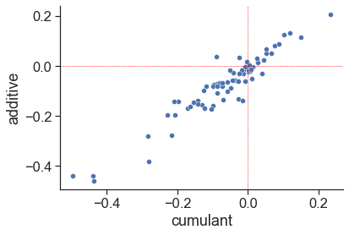
drug quartet analysis
each drug quartet represented binom(4,1) = 4 times
each at 1 of 3 concentrations
Following Yeh papers, took median (but didn’t rescale)

Slide 23
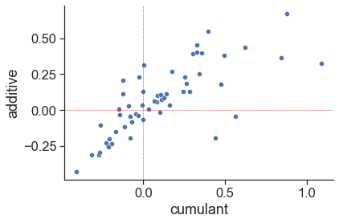
drug quintet analysis
each drug quintet represented once
each at 1 of 3 concentrations
Following Yeh papers, took median (but didn’t rescale)

Slide 24
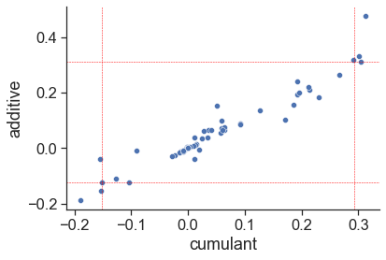
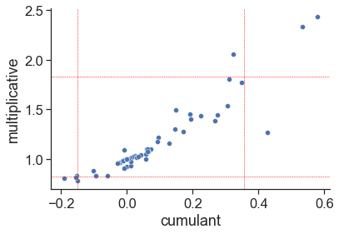
drug triplet analysis, concentration=1
each drug triplet represented binom(5,2) = 10 times
Following Yeh papers, took median (but didn’t rescale)

Slide 25
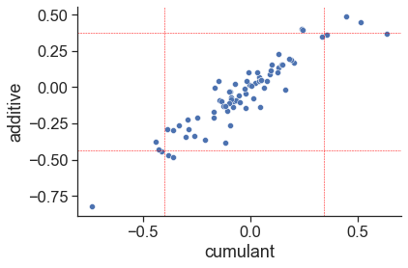
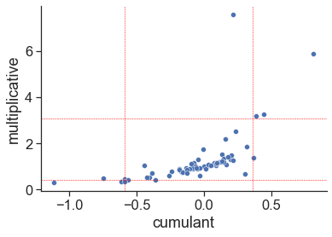
drug quartet analysis, concentration=1
each drug triplet represented binom(4,1) = 10 times
Following Yeh papers, took median (but didn’t rescale)

Slide 26
potential stories
additive model makes more sense if using growth rates, and the cumulant and additive model seem more similar (empirically at least) in terms of pearson/spearman correlation
benefit of additive model is it’s much more easily extended to higher order interactions

Slide 27
analyses with interactions
what do we expect, and does additive/multiplicative model verify those expectations more than chimeric model
higher-order interactions b/t bacteriostatic and bactericidal?
Action items
show protein synthesis inhibitors have antagonistic higher-order interactions? Since inhibiting one ribosomal subunit enough to diminish function? e.g. the two 50S drugs with one of the 30S drugs
show higher-order antagonism b/t bactericidal and bacteriostatic

Slide 28
