Slide 1
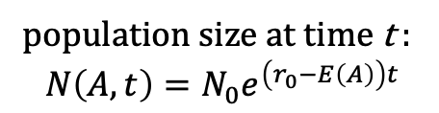
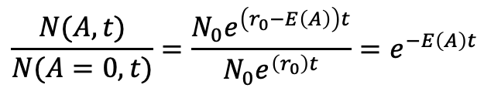
Modelling drug effect on growth rate
N population size
r₀ exponential growth rate in the absence of inhibitors
E(A) effect of inhibitor with concentration A
t time
assume populations all start at same size:
population size at t=0 is same for all inhibitor concentrations, so N(A, t=0) = N(A=0, t=0) = $N_{0}$
population size at time t :
$$N\left(A,t\right)=N_{0}e^{\left(r_{0}−E\left(A\right)\right)t}$$
compute proportion of population surviving effect of inhibitor at time t by comparing N(A,t) with N(A=0,t)
$$\frac{N(A,t)}{N(A=0,t)}=\frac{{N_{0}e}^{\left(r_{0}−E\left(A\right)\right)t}}{{N_{0}e}^{\left(r_{0}\right)t}}=e^{−E\left(A\right)t}$$

Slide 2
Survival probability of cell in presence of drug
p_{i} probability inhibitor i with concentration A_{i} kills a bacterial cell in time window of length t
1-p₁ survival probability in presence of inhibitor 1
1-p₂ survival probability in presence of inhibitor 2
survival probabilities (like fitness effects of mutations) are multiplicative:
(1-p₁₂) = (1-p₁)(1-p₂)

Slide 3

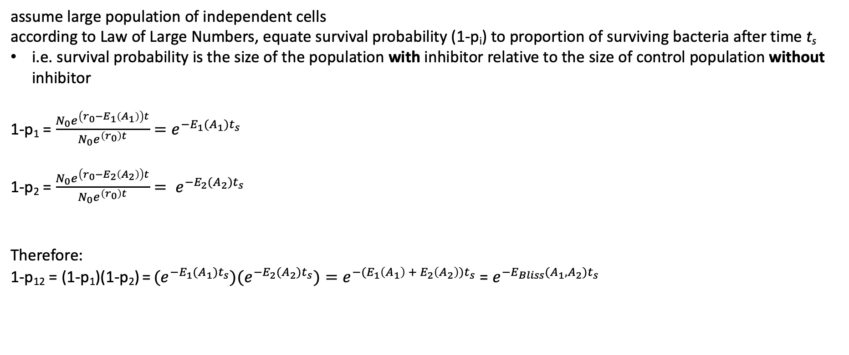
Survival probabilities -> growth rates
assume large population of independent cells
according to Law of Large Numbers, equate survival probability (1-p_{i}) to proportion of surviving bacteria after time t_{s}
i.e. survival probability is the size of the population with inhibitor relative to the size of control population without inhibitor
1-p₁ = $\frac{{N_{0}e}^{\left(r_{0}−E_{1}\left(A_{1}\right)\right)t}}{{N_{0}e}^{\left(r_{0}\right)t}}=e^{−E_{1}(A_{1})t_{s}}$
1-p₂ = $\frac{{N_{0}e}^{\left(r_{0}−E_{2}\left(A_{2}\right)\right)t}}{{N_{0}e}^{\left(r_{0}\right)t}}= e^{−E_{2}(A_{2})t_{s}}$
Therefore:
1-p₁₂ = (1-p₁)(1-p₂) = ${{(e}^{−E_{1}(A_{1})t_{s}}{)(e}^{−E_{2}(A_{2})t_{s}})=e}^{−(E_{1}\left(A_{1}\right) + E_{2}\left(A_{2}\right))t_{s}}$ = $e^{−E_{Bliss}(A_{1},A_{2})t_{s}}$
Where $E_{Bliss}(A_{1},A_{2})$ = $E_{1}\left(A_{1}\right) + E_{2}\left(A_{2}\right)$
Conclusion: if survival probabilities are multiplicative, growth rates are additive

