Slide 1
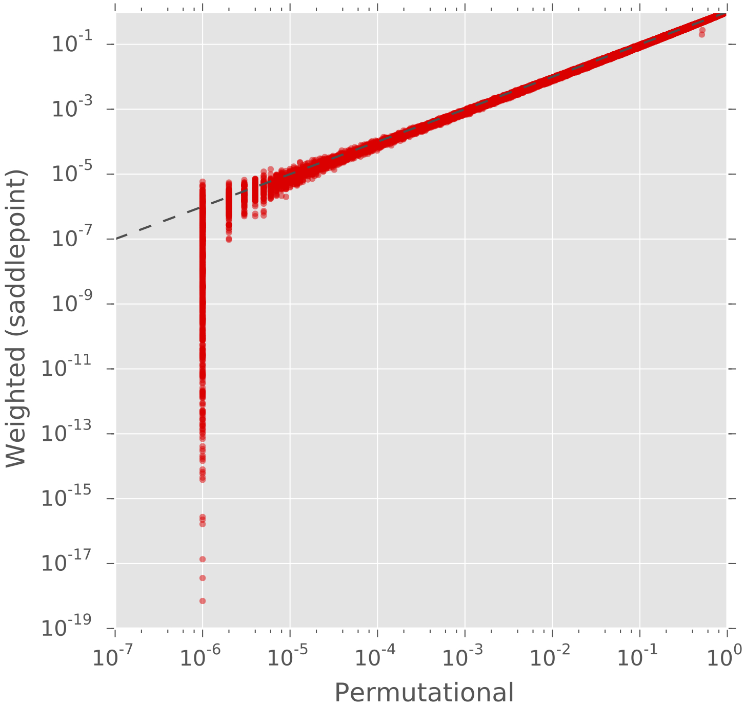









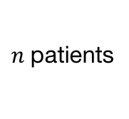
Mutation matrix $A$
Row sum =
# mutations per gene
Mutation weights/probabilities $W$
5
5
14
14
$$M$$
15
15
14
14
10
$m$ genes
10
$m$ genes
5
5
Weighted-Row p-value (sadlepoint)
7
7
14
14
12
12
9
9
3
3
3
2
3
2
7
3
2
3
2
6
3
4
3
2
3
3
2
4
3
2
7
2
3
2
3
4
2
2
2
3
2
2
2
1
3
3
3
2
3
2
7
3
2
3
2
6
3
4
3
2
3
3
2
4
3
2
7
2
3
2
3
4
2
2
2
3
2
2
2
$n$patients
$n$patients
1
Column sum =
# mutations per patient
Mutated
Exclusive mutation in $M$
1E-3
$$w_{ij}$$
1
Row-Column p-value ($\text{permutations}$)
Not mutated
Co-occurring mutation in $M$

