Slide 1
Sales Performance and Profitability Analysis for a Retail Business
BY: Raphael FLOKU AYERTEY

Slide 2
INTRODUCTION
PROBLEM STATEMENT
The retail business has collected large volumes of transaction data but struggles to extract actionable insights from it. This lack of visibility limits the company’s ability to segment customers, forecast demand, and tailor its sales strategies resulting in missed revenue opportunities and suboptimal customer satisfaction.

Slide 3
OBJECTIVES
The main objective of this Capstone project is to analyse sales performance and profitability patterns within the retail business to support data-driven decision-making. Specific objectives include:
To analyse sales trends across different years, months, and time periods.
To evaluate product category and brand performance in terms of sales volume and profit contribution.
To measure the effect of discounting on profitability and identify optimal pricing strategies.
To assess regional and city-level performance to identify high- and low-performing markets.

Slide 4
DATASET
It includes information on;
Regions
Cities
Product categories
Sub-categories
Product names
Quantity
Price
Discount
Sales
Profit
Payment

Slide 5
Data Cleaning Performed in Excel
To prepare the dataset for accurate analysis, several data cleaning steps were carried out in Microsoft Excel:
Removed Duplicates
  Checked for and removed duplicate rows based on Order ID and Product Name.
Handled Missing Values
  Identified blank cells in key fields such as Profit, Sales, Quantity, and Payment Mode.
  Filled or corrected missing entries where appropriate.
Corrected Inconsistent Category Names
  Ensured Category and Sub Category names were consistent.
Cleaned Customer Names and City Fields
  Removed extra spaces, fixed capitalization, and corrected spelling inconsistencies using TRIM.

Slide 6
ANALYSIS

Slide 7
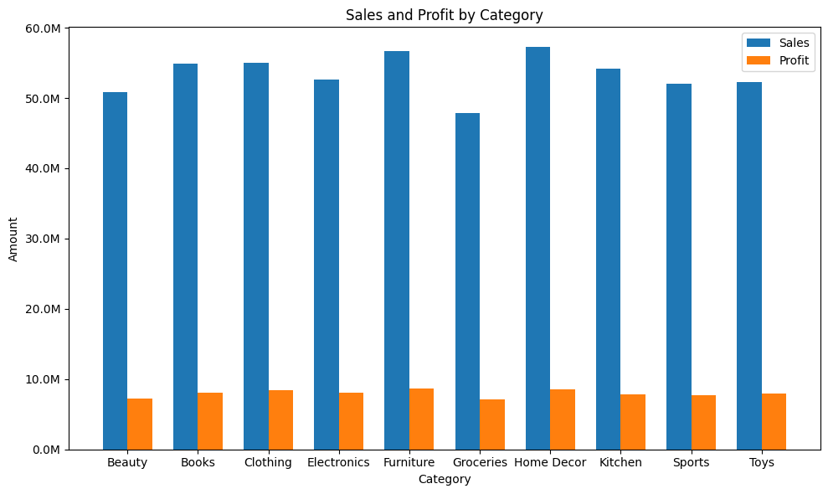
SALES AND PROFIT BY CATEGORY
Furniture recorded the highest in and profits while Home Home Decor leads in sales but does not convert proportionally into high profit, showing possible margin issues.

Slide 8
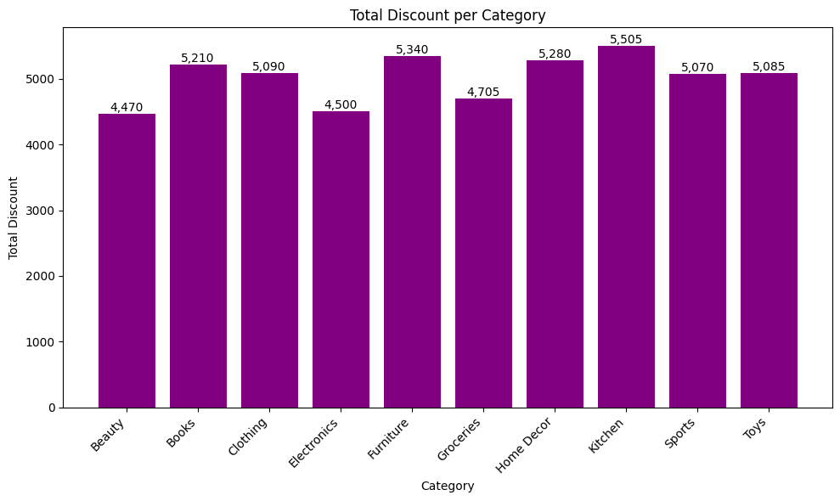
DISCOUNT PER CATEGORY
The graph shows that Kitchen received the highest discounts.

Slide 9
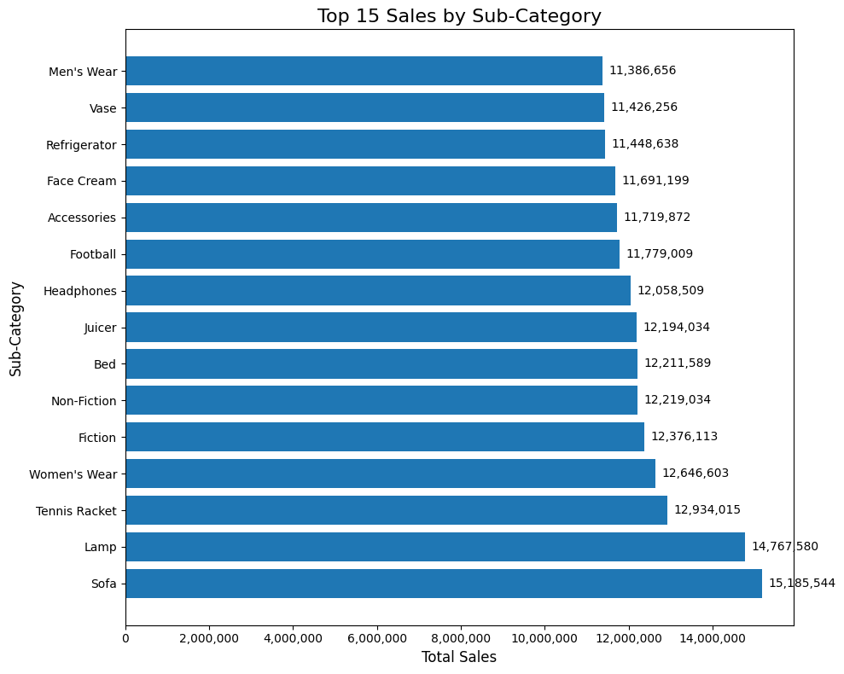
SALES PER SUB CATEGORY
Due to the number of sub-category, we focused on the top 15 products by sales. Sofa recorded the highest.

Slide 10
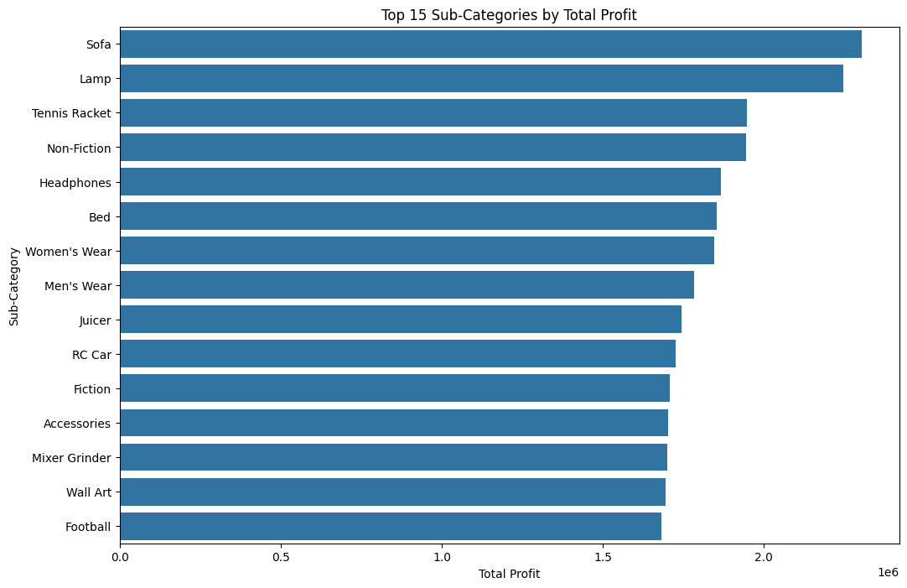
PROFIT PER SUB-CATEGORY
Sofa once again recorded highest profit in products sub-category.

Slide 11
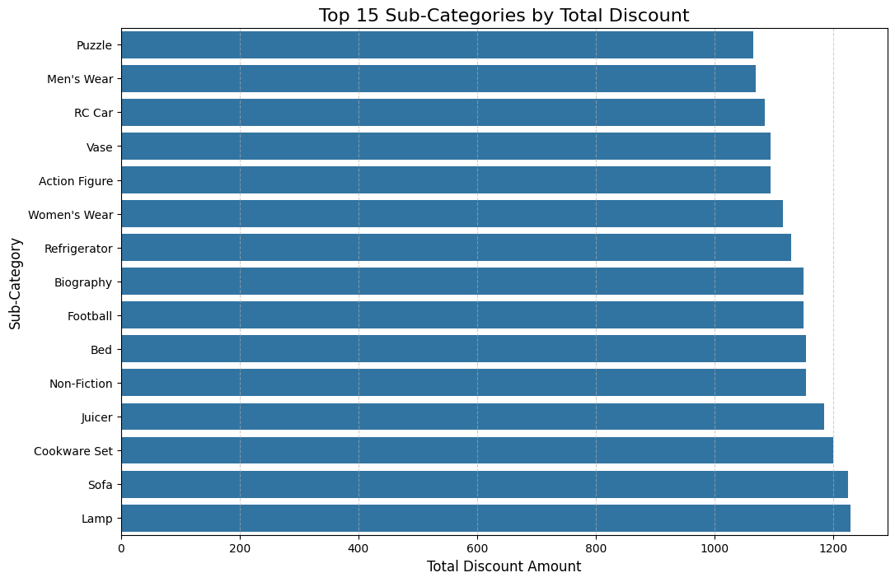
DISCOUNT BY SUB-CATEGORY
Lamp received highest discount followed by sofa. It can be contested that, Sofa's high sales and profits were driven by high discounts.

Slide 12
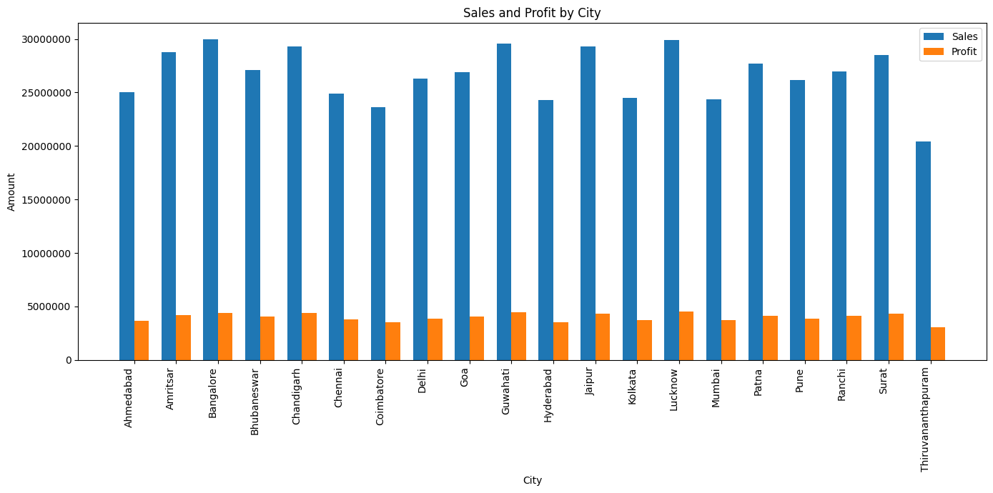
SALES AND PROFIT BY CITIES
Lucknow recorded the highest profit followed by Guwahati and Bangalore while Thiruvananthapuram recorded lowest profit.
For Sales, the top 3 maintained their positions but now Bangalore recorded highest followed by Lucknow and Guwahati. Thiruvananthapuram recorded once again the lowest sales.

Slide 13
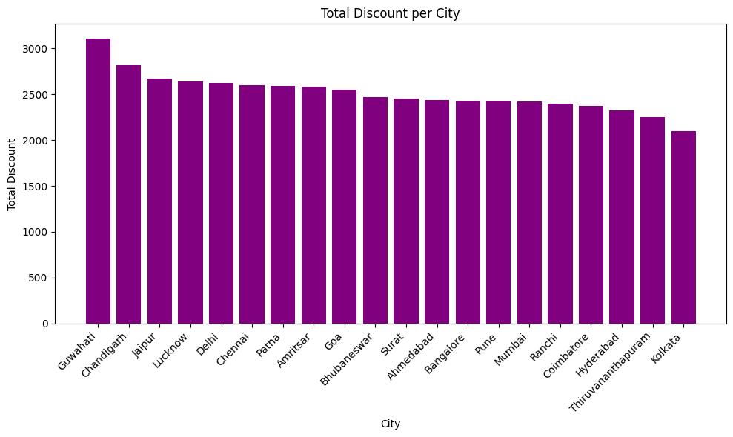
DISCOUNT BY CITIES
It can be noted that, the sales and profit by Guwahati was influenced by the number of discount placed on items in the city. Guwahati recorded the highest discount(i.e. 3110) which is not sustainable.

Slide 14
SALES & PROFIT BY REGION
The North and East Regions dominated the top two positions in both sales and profit while South and West also took the bottom two across metrics

Slide 15
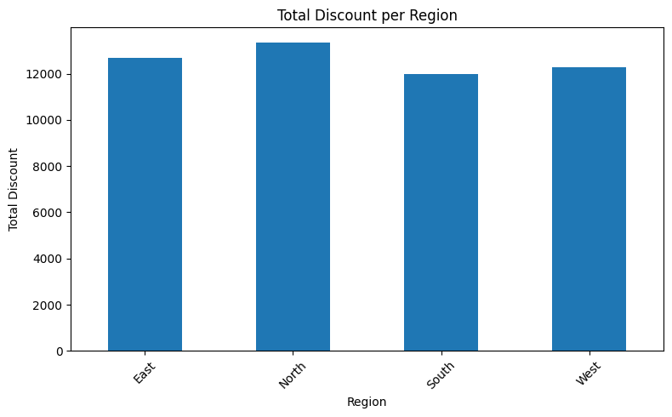
DISCOUNTS BY REGIONS
The North received higher discounts as well.

Slide 16
TOP 10 PRODUCTS FROM SALES AND PROFITS
Top selling items do not always translate to top profits. Some products (e.g., Lamp Enim, Bed Tenetur, Spices) appear in top sales but not top profit, showing low margins.

Slide 17
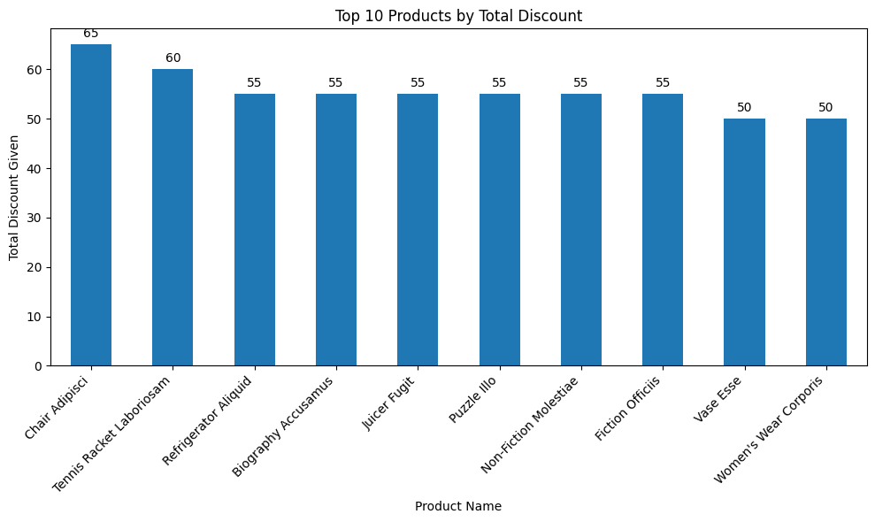
DISCOUNT PER TOP 10 PRODUCTS
Chair Adipisci recieved highest discount but it is missing in top 10 products for both sales and profit.

Slide 18
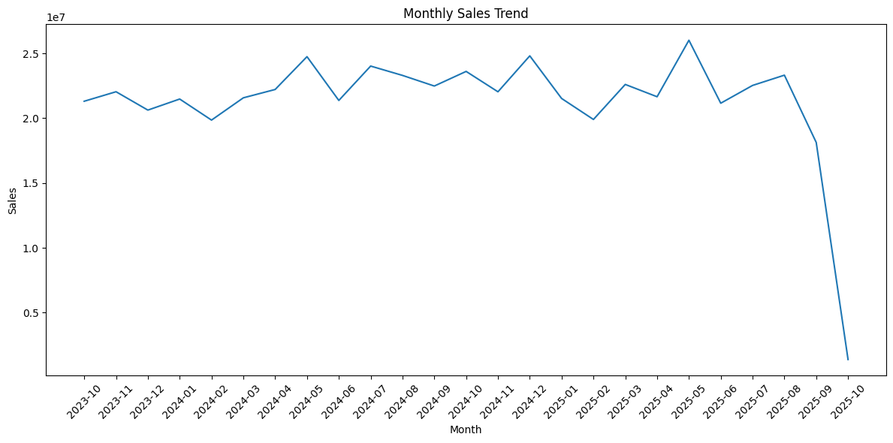
MONTHLY SALES TREND

Slide 19
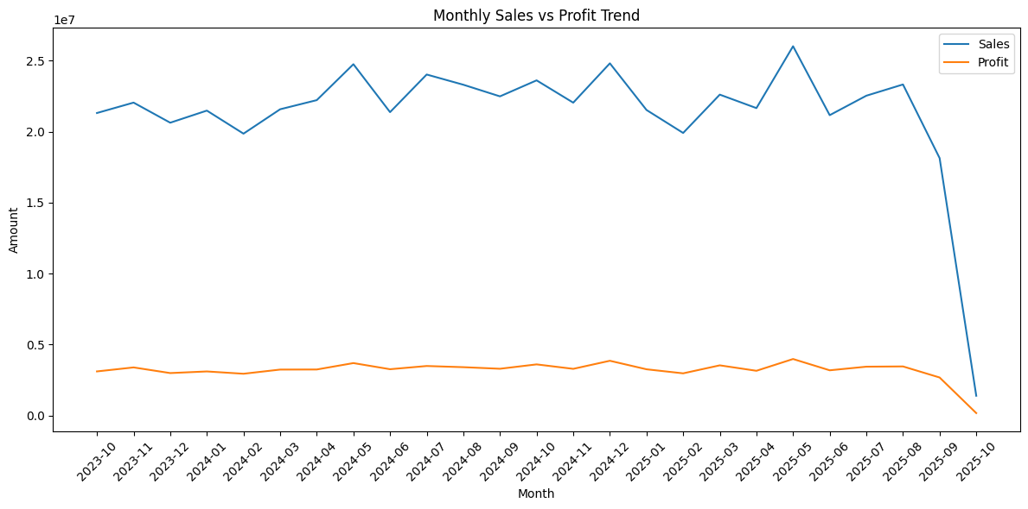
MONTHLY TREND BY SALES AND PROFIT
Monthly trends showing seasonality of how sales and profit fluctuate overtime. Both sales and profit follow the same seasonal pattern.

Slide 20
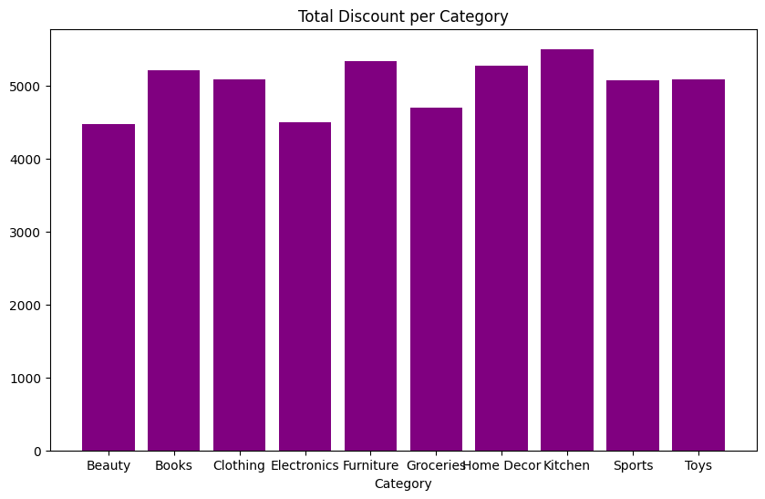
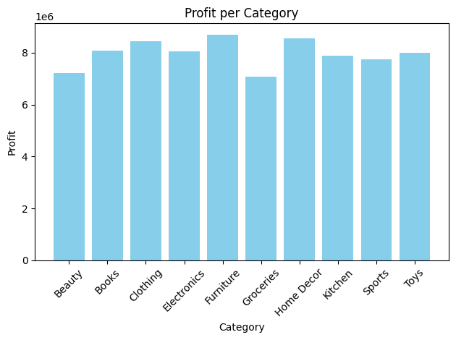
DISCOUNT AND PROFIT PER CATEGORY
From the graphs above, high discounts on furniture and kitchen translated into high profits while low discounts on Electronics translated into high profits. Despite Kitchen receiving highest discounts, it didn’t translate into making the highest profits.

Slide 21
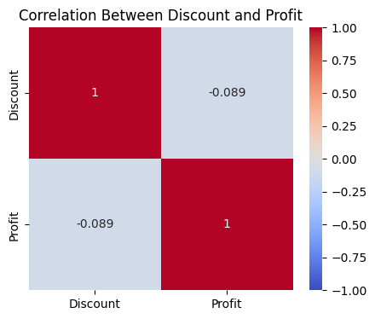
CORRELATION BETWEEN DISCOUNT AND PROFIT
The correlation between Discount and Profit is –0.089, indicating a very weak negative relationship, meaning that higher discounts are associated with slightly lower profits, but the effect is minimal.

Slide 22
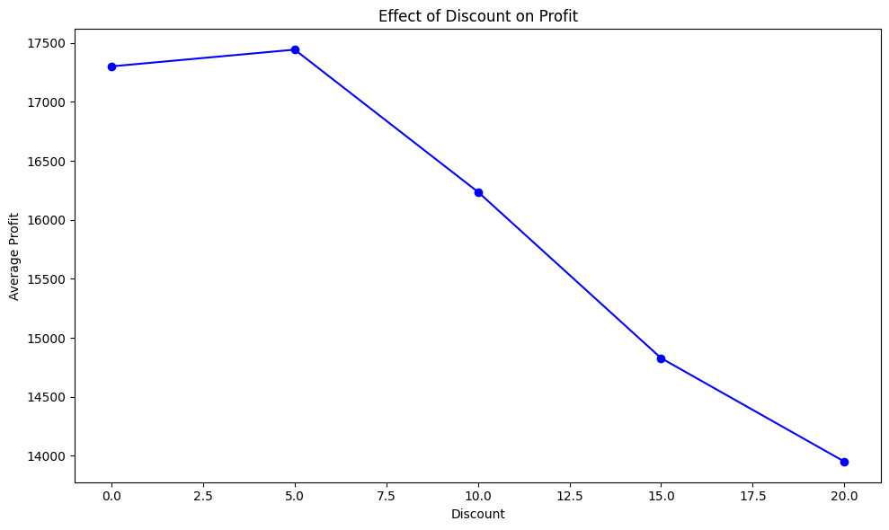
EFFECTS OF DISCOUNT ON PROFIT
It must be noted that highest discounts has a negative relationship with profit. From the diagram it is shown that as the discount percentage increases, discount decreases.

Slide 23
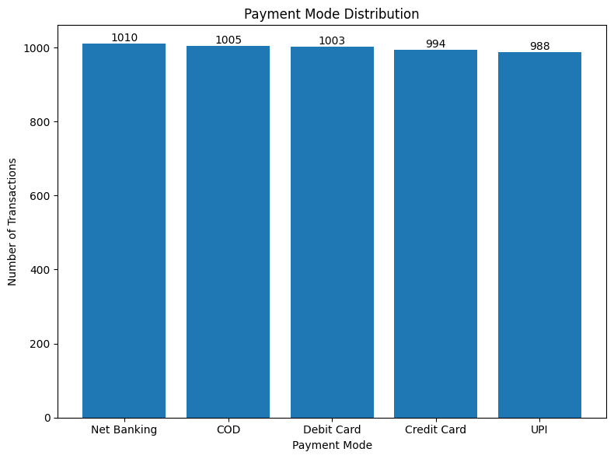
PAYMENT MODE DISTRIBUTION
Net Banking recorded the highest mode of payment for transactions.

Slide 24
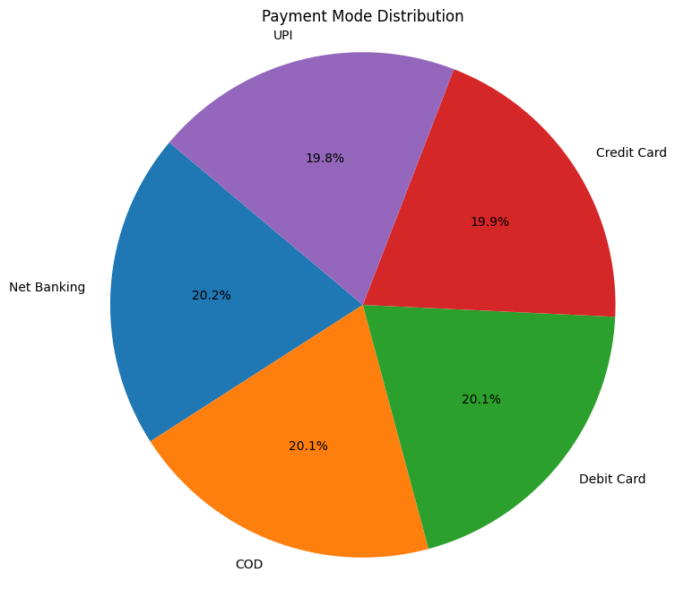
PIE CHART SHOWING PAYMENT MODE DISTRIBUTION

Slide 25
KEY FINDINGS
Higher discount percentages significantly boosted sales volume but reduced overall profit.
Some regions consistently outperformed others in both sales and profit, indicating strong market opportunities.
The South and West were bottom two in both sales and profit as well as discounts while North and East were top two across board.
Monthly sales trends revealed clear seasonality, with certain months showing peak performance.
Customers preferred specific payment modes often linked with higher order value.
Several products consistently appeared in the low-sales and low-profit category.
Profit did not always align with sales some categories with high revenue had poor profit margins.

Slide 26
RECOMMENDATIONS
1. Refine Discount Strategy: Reduce or eliminate discounts on high-demand, high-profit categories (Furniture, Electronics). Apply targeted discounts only to products with slow-moving inventory, seasonal demand, or naturally low margins. Re-evaluate the discount-heavy approach in Guwahati, as it artificially inflates sales but reduces profit.
2. Strengthen Underperforming Regions: Invest in market development campaigns for South and West regions, introduce regional promotions based on customer behaviour and seasonal demand improve distribution efficiency and product availability in weak regions.
3. Focus on High Value Cities: Increase inventory allocation in Lucknow, Bangalore, and Guwahati. Introduce loyalty programs for repeat customers in these top-performing markets.
4. Product Level Optimization: Re-price or repackage products that sell well but deliver low profit (e.g., Home Decor, Lamps, Beds) and promote bundles for low selling items to increase visibility and demand.
5. Seasonal Marketing Strategy: Launch major marketing campaigns in low-performing months
January, February, March, April, June, and September and also plan inventory and promotions ahead of peak months to maximize revenue.
6. Payment Method Optimization: Since Net Banking is most preferred, offer small cashback, loyalty points, or free delivery incentives
to encourage its continued use.
7. Improve Profit Margins: Re-evaluate suppliers and renegotiate prices for categories with high sales but low profit and limit discounting in categories where discount does not drive significant profit (Kitchen).

Slide 27
CONCLUSION
This capstone project analysed retail sales and profits using detailed transaction data across cities, regions, product categories, and time periods. The goal was to spot business patterns, identify top and low-performing areas, and see how pricing, discounts, and customer behaviour affect results.
The analysis found that the North and East regions consistently led in sales and profit, while the South and West lagged behind. Some cities, like Lucknow, Guwahati, and Bangalore, performed strongly, whereas Thiruvananthapuram had the lowest results. Notably, high sales did not always mean high profits for example, Home Decor generated good revenue but had weaker profit margins.
Overall, the insights help the business understand its market better and provide a foundation for smarter, data-driven decisions to boost revenue, profit, and customer engagement.

