Slide 1


Intelligent Systems 2:
MINI PROJECT
ChatPal:
Your Personal Companion in Learning and dealing with mental health

Slide 2
PROBLEM
Mental Health issues rising, particularly among students.
Access to Mental Health professionals is costly.
People are hesitant to seek help from friends and family.
Mental Health Hotlines are not always available.
Other mental health issues are not immediately recognized.

Slide 3

Introducting Pal
Pal is a Chatbot who talks to you about Mental health.
Pal can answer mental health FAQs and give you advices about mental health. Pal only wants the best for your mental health

Slide 4
Relevance
Accessible
Chatbots can provide support to people who may not have access to mental health services or professionals due to geographical location, financial issues, and others. Chatbots can be accessed from anywhere.
Anonymous
Chatbots can provide a private space for individuals to express their thoughts without fearing judgement. Privacy and Anonymity can be particularly important for those who are hesistant to seek traditional mental health services.
There are more reasons but in conclusion mental health chatbots play a valuable role in improving mental health outcomes and promoting overall well-being

Slide 5


Dataset : Mental Health Conversational Data
A dataset containing basic conversations, mental health FAQ, classical therapy conversations, and general advice provided to people suffering from anxiety and depression.
https://www.kaggle.com/datasets/elvis23/mental-health-conversational-data

Slide 6
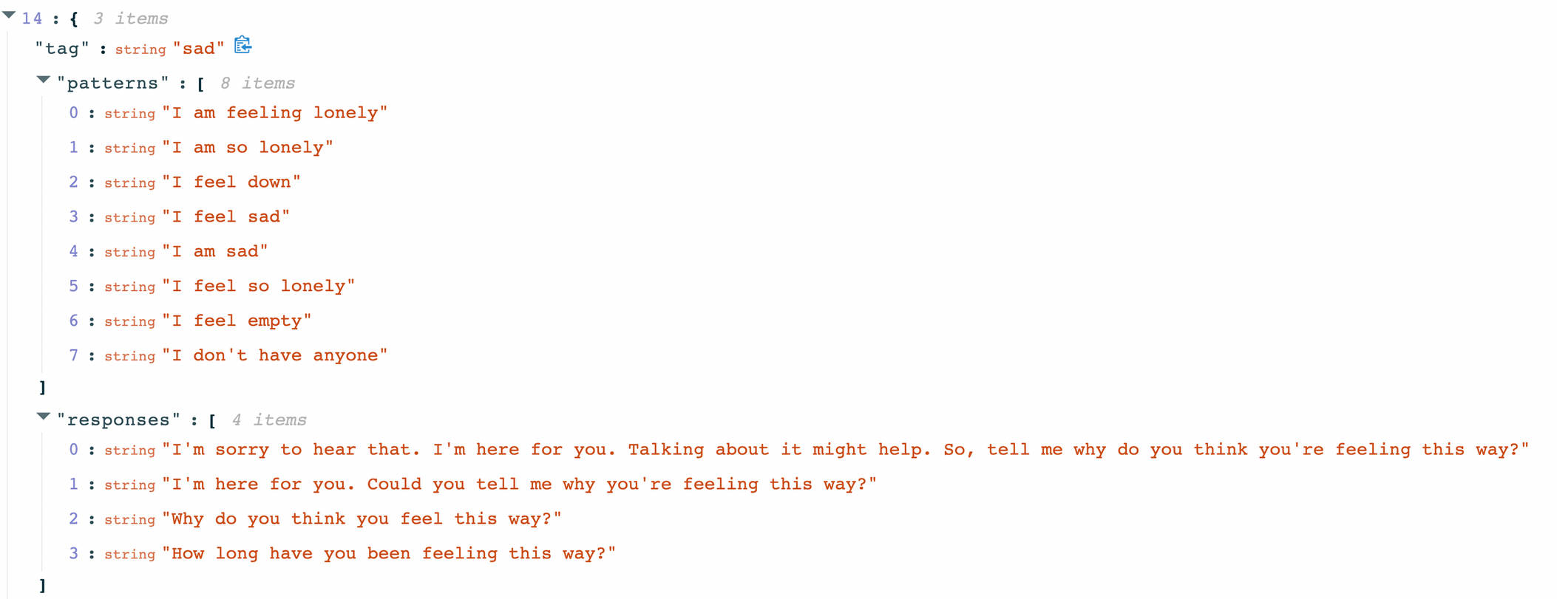
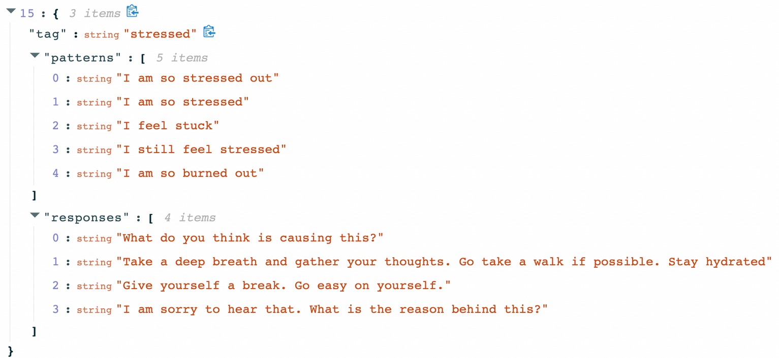

Slide 7

Model :
Sequential Model
ChatPal's model #1
A Sequential model is appropriate for a plain stack of layers where each layer has exactly one input tensor and one output tensor.

Slide 8





not appropriate
when ...
Your model has multiple inputs or multiple outputs
Any of your layers has multiple inputs or multiple outputs
You need to do layer sharing
You want non-linear topology (e.g. a residual connection, a multi-branch model)

Slide 9


cons
One of the big challenges when processing long sequences is that the neural network can 'forget' information from earlier in the sequence.
vanishing gradient

Slide 10

Long Short-Term Memory
LSTM is designed to address this problem by being able to remember important information from much earlier in the sequence, even if there are many steps in between.

Slide 11

What is LSTM?
Long Short-Term Memory (LSTM) is a type of neural network that is designed to analyze data that comes in a sequence, like text or speech
a special kind of neural network called a Recurrent Neural Network (RNN) that can remember important information from earlier parts of the sequence, so it can make better predictions about what comes next

Slide 12
introduces the concept of cell states, which provide "highways" for the gradient to flow backward through time freely.
consists of 3 gates input gate, forget gate, output gate.

Slide 13

main feature of LSTM cells is that they have a separate memory cell that can store long-term information without being affected by the current input or output.
Their advantage over simple RNN cells is that they have the ability to learn long-term dependencies and capture complex patterns in sequential data. (e.g., they can predict the next word in a sentence based on the previous words and the context)
they handle noisy or missing data better than simple RNN cells

Slide 14
cons
more expensive and require more memory and time to train and run due to their additional parameters and operations
prone to overfitting
harder to interpret and explain since they have more hidden layers and states than simple RNN cells

