Slide 1
Welcome to ACM – ALS Module November 2024
Presentation and delivery by:
Dr Raphael Pyo FANZCA

Slide 2
Welcome to ACM – ALS Module November 2024
Presentation and delivery by:
Dr Raphael Pyo FANZCA

Slide 3
Meet your faculty
Course Convener
Dr Raphael Pyo
Faculty Members
Dr Timothy McIver • Dr Heidi Thies
Simulation Team
Karen Archer
Dr Rebecca Zhao
Caroline Murray
Dr Libia Machado • Dr Pat Beall

Slide 4
The necessary housekeeping
Name badges
Restrooms
Mobile phone + other electronic device etiquette
Workshops
Allocated into 3 groups
Simulation
Allocated into 2 groups
Overall
Respect one another
This is a safe learning environment
CPD and delegate certificates

Slide 5
Format of ACM – ALS November 2024
Lecture
45m
Interactive Learning
Workshop 1
30m
Workshop 2
30m
Workshop 3
30m
Evaluation and Close
Simulation
45m

Slide 6
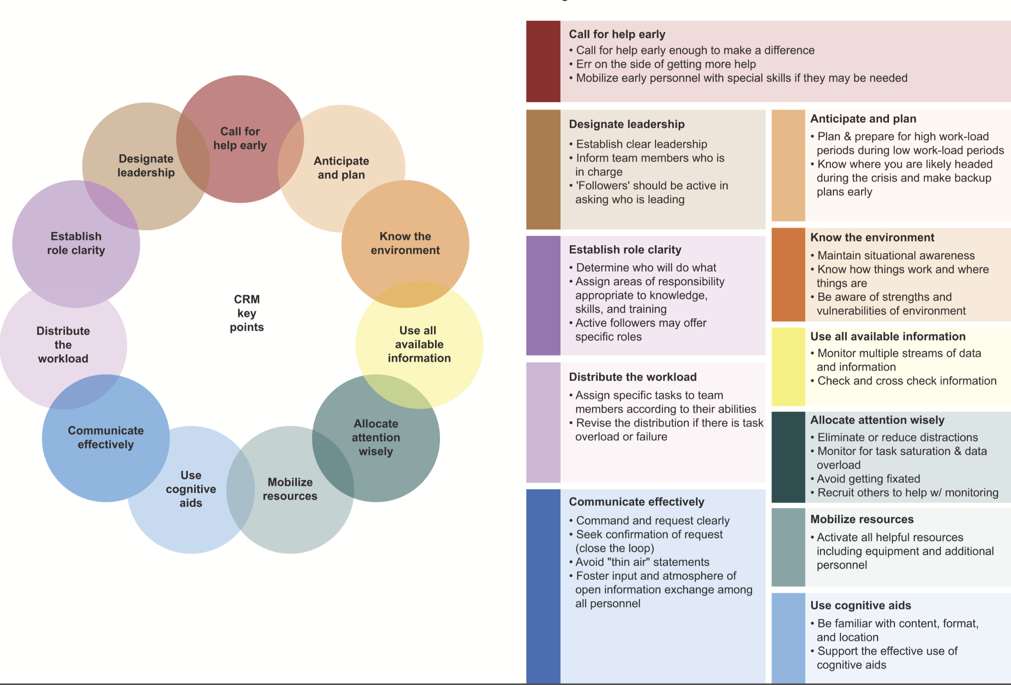
Crisis Resource Management

Slide 7
Questions
What are your questions?

Slide 8
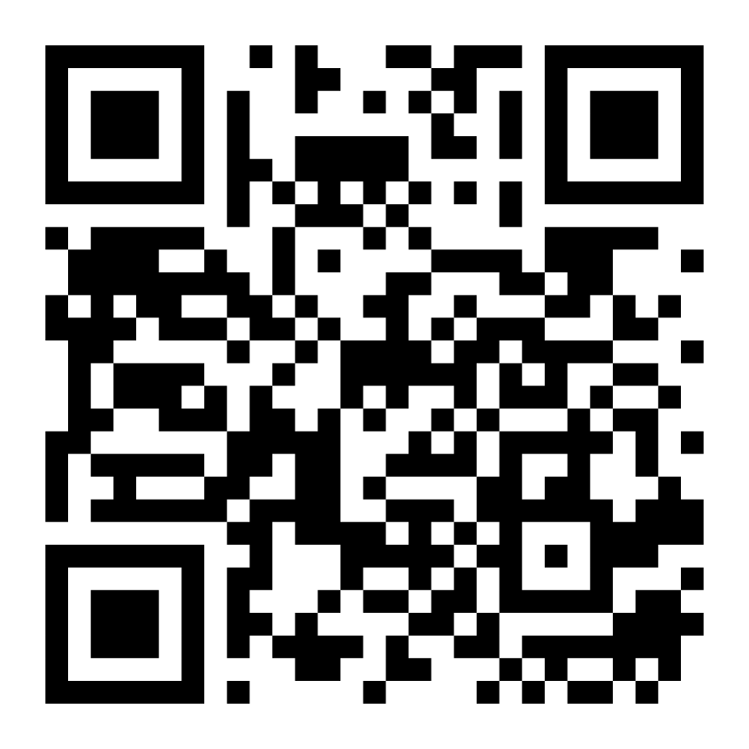
Course Evaluation

