Slide 1
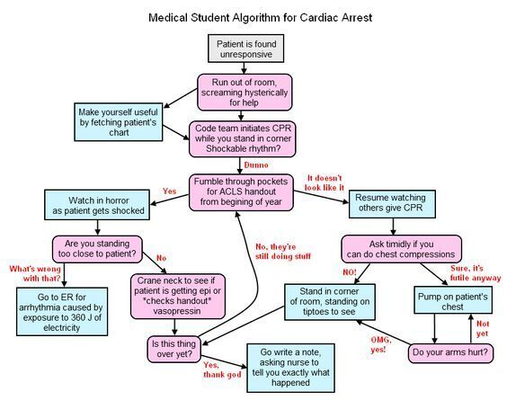

Slide 2
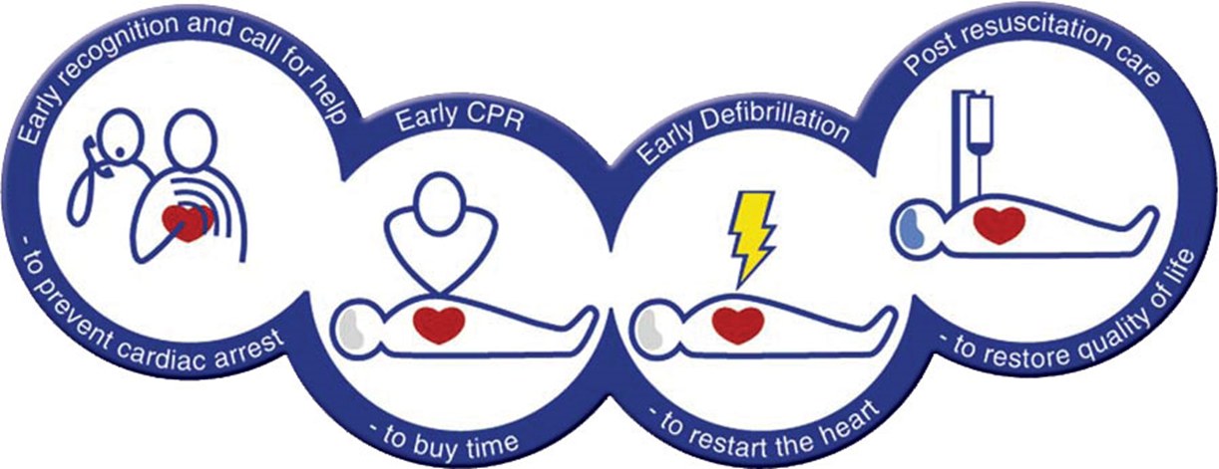
Cardiac Arrest in the Perioperative Environment
Dr Timothy McIver
Notes:
I clarify with participants at this stage that the full-day workshop will sign off relevant CPD requirements, depending on participant’s professional group:
Consultant Anaesthetists - CPD Emergency Responses requirements for Cardiac Arrest
Provisional Fellows – same as consultants
Anaesthetic Nurses – can claim for 10 hours of CPD (contact time plus preparation time)
Anaesthetic Registrars – Advanced Life Support training requirement for their current training period

Slide 3
Aim of session
ALS update in context of perioperative environment
Focussed on adults, but will include some discussion of paeds and neonates
NAP7 data
ANZCOR guidelines

Slide 4
Learning Objectives
Describe BLS and ALS algorithms, including ‘shockable’ and ‘non shockable’ pathways.
Recognise life-threatening/peri-arrest cardiac arrhythmias.
Recognise and initiate management of cardiac arrest.
Describe reversible causes of cardiac arrest
Explain appropriate airway management and ventilation strategies in ALS.
Describe the fundamentals of post-resuscitation care.
Notes:
These learning objectives will provide a framework for the talk. The objectives are derived from ANZCAs CPD Emergency Responses Workshops guidelines.
Will be focussing on areas of most interest to our craft groups in the peri-operative context.

Slide 5
Definitions from NAP7
Perioperative cardiac arrest
‘five or more chest compressions and/or defibrillation in a patient having a procedure under the care of an anaesthetist’
Patients under the care of an anaesthetist
patients undergoing general anaesthesia, regional anaesthesia/analgesia, sedation, local anaesthesia or monitored anaesthesia care with an anaesthetist or anaesthesia associate present.
Perioperative period
FROM
either the WHO sign-in or first hands-on contact with a patient
TO
24 h after the handover of the patient to recovery or another clinician OR
when the patient leaves the hospital .
Exclusions
defibrillation during electrophysiological procedures when this was a planned, normal or expected part of the procedure (eg during VT ablation)
brain-dead patients being prepared for or undergoing organ donation

Slide 7
Prevention of cardiac arrest
Two core strategies
Risk stratification
Recognition of deterioration

Slide 8
Risk assessment
more common in
older patients
frailer patients
male patients
high-risk surgery
urgent or emergency surgery
specific surgical specialties
orthopaedic trauma
lower gastrointestinal surgery
cardiac surgery and interventional cardiology
vascular surgery

Slide 9
Risk Assessment Tools
SORT advocated by NAP7
Scoring system based on
Surgical specialty
Particularly Vascular, Thoracics or Gastrointestinal
Severity of Surgery
Urgency of Surgery
Active malignancy
ASA score
Age
Clinical Risk Assessment

Slide 10
Outcomes from cardiac arrest
Better than average outcomes:
children (but not those awaiting transfer to a tertiary centre)
cardiac surgery patients
suspected anaphylaxis
airway complications
Poorer outcomes:
vascular surgery
Interventional cardiology
Interventional radiology,
frailer and older patients
cases due to major haemorrhage
obese patients (BMI > 40 kg m-2)
critically ill children awaiting transfer to tertiary care.

Slide 11

Notes:
Check that people have perspective on the chain of survival

Slide 12
Basic Life Support
Notes:
The aim of the BLS discussion is to get them thinking about basic principles of evaluating a collapsed patient.
Given that we work in a very monitored environment, there is potential to neglect these basic principles.

Slide 13
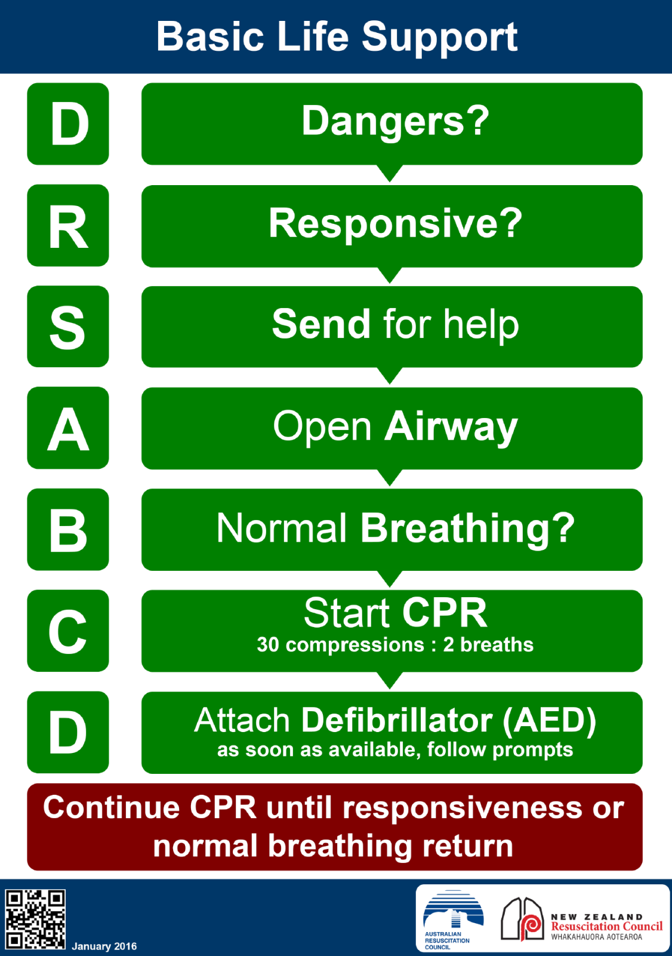
Notes:
So, suggested questions:
How do you confirm cardiac arrest (i.e. decide to initiate CPR)?
Issue of checking for a pulse.
Note that there are scenarios in PACU where the ARC recommendations do not apply (e.g. a narcotised patient may be unresponsive and not breathing!).
So, acknowledge that the ARC guidelines are not always completely applicable in the perioperative environment
stress that the ARC guidelines are a generic set of recommendations, and serve as a means of having a standardised approach to resuscitation across professional groups.
.Discussion re CPR techniques
What rate do you perform compressions at? Depth? Ratio? Location?
How are children and neonates different?
Discuss underlying evidence of outcome benefits related to effective CPR.
Why is defibrillation in Basic Life Support?
Explain survival benefit of early defibrillation. Talk about AEDs on ward vs manual defibs in Critical Care areas.
How is BLS modified in Pregnancy?
Manual uterine displacement vs wedge
Location mid sternum vs lower-half

Slide 14
Priorities
Good quality, minimally interrupted CPR
Reducing time to defibrillation
The amplitude and waveform of VF deteriorate as high-energy phosphate stores in the myocardium decrease.
This rate of decrease can be slowed, or even reversed by effective basic life support (BLS).
Notes:
Noting 'stuff that works'

Slide 15
Good quality CPR
lower half of the sternum
depth of at least 5 cm
rate of approx 100 to 120 per minute
minimising interruptions to compressions at all times
COACHED approach to safe defib

Slide 16
Advanced Life Support

Slide 17
Notes:
ask a scenario based question aimed at getting people to apply the algorithim
For patients in VF, insert patient in various circumstances to keep things fresh – e.g. football club, airport, outside Zouki, etc.
Make the point that shockable rhythms are most common outside of hospital.
For non-shockable, make it on the ward.
To describe scenario, state that chest compressions have been initiated and defib pads applied.
get one participant to go through the Shockable pathway, and describe the cycles of CPR and relevant drugs/shocks. Timing of adrenaline and amiodarone are important points to clarify.
get another participant to describe the non-shockable pathway. Point out the frequency of adrenaline is the same, it just varies when you start giving it.

Slide 18
Reversible causes of Cardiac Arrest
Notes:
Get them to name the 4 Hs and 4Ts!!!!

Slide 19
Hypoxia
Hypovolaemia
High or low electrolytes and metabolic disorders
Hypo/hyperthermia
Tension pneumothorax
Tamponade
Toxins
Thrombosis: pulmonary or coronary

Slide 20
We’re a bit different….
Reversible causes of cardiac arrest are more common in Theatre environment than the wards
Shockable rhythms are uncommon – most arrests are PEA (at least initially)
‘Common’ causes of cardiac arrest in theatre:
Hypovolaemia
Hypoxia
Drugs
Anaphylaxis
Sepsis
Acute Renal Failure/Electrolyte Disturbances
Malignant Hyperthermia
Local Anaesthetic toxicity
Notes:
Worth relating them back to the 4Hs and 4Ts.
Drugs fitting into toxins is worthwhile - worth reminding people that adverse effects can be due to:
unanticipated effects of intentional dosing (e.g. anaphylaxis)
effects of drugs that are ‘unintentionally’ given (e.g. excess dose, syringe swap, poor timing of drug admin).

Slide 21
A quick note re Pulmonary Embolism
ANZCOR suggestions:
PE is the suspected cause of cardiac arrest:
administer fibrinolytic drugs
PE is the known cause of cardiac arrest:
administer fibrinolytic drugs or
surgical embolectomy or
percutaneous mechanical thrombectomy

Slide 22
Frequencies from NAP7
Most common causes of periop cardiac arrest:
major haemorrhage (17%)
bradyarrhythmia (9.4%)
cardiac ischaemia (7.3%)
varies by surgical specialty.
Anaphylaxis was likely overestimated as a cause of cardiac arrest
many of these cases judged by the NAP7 panel to have other causes.
Notes:
Noting experience of our health service with regards to over-estimation of anaphylaxis as a cause of cardiac arrest – rings true!

Slide 23
Initial rhythm and Survival
Initial Rhythm
Non-shockable = 82%,
17% required defibrillation (NB vs community)
Successful resuscitation and survival:
Highest rate
Bradycardic cardiac arrest (86% and 60%)
Lowest rate
Pulseless electrical activity (68% and 34%)

Slide 24
Patient vs Surgery vs Anaesthesia
Identified contributors
PATIENT FACTORS = 82%
ANAESTHESIA FACTORS = 40%
SURGICAL FACTORS = 35%
INEVITABLE = 31% of fatalities

Slide 25
Frequencies from NAP7 (cont’d)
drug choice and/or dosing
judged to have contributed to a substantial proportion of perioperative cardiac arrests.
occurred more commonly in:
patients who were older and frailer
higher ASA grade or acute illness
perhaps with propofol and remifentanil based TIVA.
Lower doses, slower induction, use of vasopressors and sometimes different drug choices may have prevented some cardiac arrests.

Slide 26
Adrenaline Dosing

Slide 27
Use of Vasopressors in ALS
ANZCOR:
Giving vasopressor drugs routinely during human cardiac arrest has not been shown to increase the rate of neurologically intact survival to hospital discharge.
It is however reasonable to continue to use vasopressor drugs on a routine basis to:
achieve ROSC
provide the opportunity for additional therapies to potentially improve outcomes.

Slide 28
NAP7 - Scenarios of Adrenaline use
deteriorating with profound hypotension, low flow state
initially use small doses of intravenous adrenaline
e.g 50 μg in adults, 1 μg/kg in children OR
infusion of adrenaline
when initial small doses of adrenaline fail
low flow state and ROSC is not achieved within the first four minutes of cardiac arrest
give further adrenaline using the standard adrenaline dose for cardiac arrest (1 mg in adults, 10 μg/kg in children).

Slide 29
NAP7 recommendation
Avoid using a standard cardiac arrest bolus dose of adrenaline (1 mg in adults, 10 μg/kg in children) when there is an intact but low flow circulation or when a circulation has already been restored.

Slide 30
Initiating Chest Compressions

Slide 31
Initiating chest compressions
monitored perioperative adult patient who is deteriorating despite initial treatment of the underlying cause
start chest compressions if the systolic blood pressure remains below 50 mmHg.
e.g. following anaphylaxis

Slide 32
Special Circumstances

Slide 33
Pregnancy
Aetiology of cardiac arrest
Haemorrhagic disease
Embolic disease
Eclampsia
Modifications to BLS
Role of endotracheal intubation
Perimortem Caesarean Section

Slide 34
Paediatrics
Aetiology of Cardiac arrest
15:2
Drug and Fluid Doses
Adrenaline
Amiodarone
Fluid Bolus
Defibrillation Energy

Slide 35
Neonatal Resuscitation
Aetiology of Cardiac Arrest
Ventilation/Oxygenation vs Chest Compressions
3:1
Temperature

Slide 36


Slide 37

Airway Management in Cardiac Arrest

Slide 38
Airway issues in critical illness
Consider some ‘common’ aetiologies of cardiac arrest in the Operating Theatre:
Hypoxia!!
Anaphylaxis
Hypovolaemia
LA Toxicity
Malignant Hyperthermia
Consider the role of definitive airway management in these scenarios…..

Slide 39
Code Blue Practice Points:
Issue of ? endotracheal intubation in cardiac arrest
appropriate training and experience essential:
otherwise, unacceptable rate and severity complications
ETT may be an advantage in hands-off time
Inadequate evidence to define optimal timing of endotracheal intubation during cardiac arrest.
may defer until ROSC to avoid substantial interruptions in chest compressions
ANZCOR: Consider airway adjuncts (e.g., supraglottic airway (SGA) or endotracheal tube (ETT)), but attempts to secure the airway should not interrupt CPR for more than 5 seconds [Good Practice Statement].
Notes:
Both a BMV and an Advanced Airway are frequently used in the same patient as part of a stepwise approach to airway management
this has not been formally assessed

Slide 40
Confirmation of ETT placement
Routine confirmation required to avoid serious complications
Waveform capnography is GOLD STANDARD
Two studies demonstrated 100% sensitivity and 100% specificity in cardiac arrest
If unavailable, the following alternatives are comparable:
Clinical assessment
Non wave form capnometer (100% specificity, decreased sensitivity)
colorimetric ETCO2 detectors

Slide 41
Airway issues from NAP7
six cases of unrecognised oesophageal intubation.
conversely:
rates of emergency front of neck airway and pulmonary aspiration appeared notably lower than in previous large studies, including NAP4.

Slide 42
Use of Capnography
confirming and monitoring ETT position
monitoring ventilation
Feedback regarding rate
assessing quality of CPR
early indicator of ROSC has been achieved

Slide 43
Titration of Adrenaline with ETCO2
Options include:
Combining high-quality chest compressions and adrenaline to increase the end-tidal CO2 .
IF arterial line is in place, titrating adrenaline aiming to increase the diastolic blood pressure during chest compressions
aim for a diastolic blood pressure greater than 25 mmHg (expert opinion ).

Slide 44
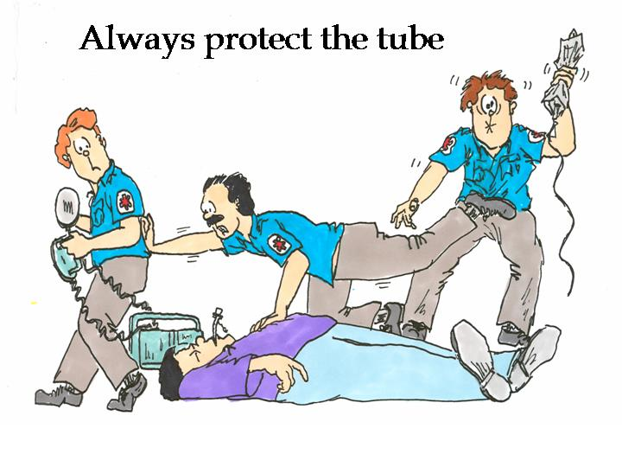
Ventilation

Slide 45
Hyperventilation
may be harmful!
hyperventilation is associated with:
increased intrathoracic pressure
decreased coronary and cerebral perfusion
(in animals) decreased return of spontaneous circulation
Notes:
(secondary analysis of a case series)
patients with advanced airways, out-of-hospital cardiac arrest
ventilation rates of >10 per minute and inspiration times >1 second
associated with no survival.
(animal model of severe shock)
6 vs ≥12 ventilations per minute
similar oxygenation
better haemodynamics

Slide 46
Frequency of ventilation during CPR
Without an advanced airway:
ventilation should be continued at a ratio of 30 compressions to 2 ventilations
After an advanced airway:
rate of 6 to 10 ventilations per minute
Without substantial pausing during chest compressions to deliver ventilations.
Can coordinate with person doing compressions (e.g. every 15)
Notes:
Simultaneous ventilation and compression may adversely effect coronary perfusion and has been associated with decreased survival
Avoid delivering breath at peak of compression

Slide 47
Mechanical vs Manual Ventilation
Insufficient evidence to support one or the other
Advantages and disadvantages of the two techniques:
Manual Ventilation
Risk of hyperventilation
Occupies staff member
Immediate feedback of Ventilation quality
Mechanical Ventilation
Hands-free technique
Risk of hypoventilation

Slide 48

Defibrillation

Slide 49
Types of Waveforms
Monophasic waveform
no longer in clinical use in Australia
single direction energy delivery
higher peak current
Biphasic waveforms
Improved conversion rates compared to monophasic
bidirectional energy delivery
less peak current
Biphasic Truncated Exponential (BTE)
dynamic current and duration, fixed shape
Rectilinear Biphasic Waveform (RBW)
dynamic current and shape, short fixed duration

Slide 51
Default Energy Level
typically 200J for initial shock
Other energy levels may be used providing there is relevant clinical data for a specific defibrillator that suggests that an alternative energy level provides adequate shock success
Usually greater than 90%
Applies to 150J defibrillators
No demonstrable difference between waveforms
most widely used defibrillation waveforms (BTE and RBW) have the same conversion rates from 50J to 200J

Slide 52
Escalating Shock Energy
Flexibility in guidelines
EH policy if first shock is unsuccessful:
increase the energy to 360J for subsequent shocks
may prevent the risk of refibrillation
Is there potential for myocardial damage associated with higher energy level shocks?
Suggested by several animal studies
Human studies have not shown harm with energy levels up to 360J
as indicated by biomarker levels, ECG findings, and ejection fractions

Slide 53
Emerging Defibrillation Strategies
Treatment of refractory ventricular defibrillation.
Double sequential external defibrillation (DSED)
Vector change defibrillation (VCD)
N Engl J Med. Volume 387(21):1947-1956. November 24, 2022
Above strategies improved survival as compared with standard defibrillation.

Slide 54
Approach:
first three defib attempts for all patients using standard defibrillation
Pads in anterior–lateral position
after three consecutive shocks, progressed to one of three types of defibrillation:
standard defibrillation
all subsequent defib = pads remain in anterior–lateral configuration
VC defibrillation
all subsequent defib = pads changed to anterior–posterior
DSED
second set of defibrillation pads applied in anterior-posterior
all subsequent defib = two near-simultaneous defib shocks provided by two defibrillators.
short delay (<1 second) required between shocks
created by having a single operator depress the “shock button” on each defibrillator in rapid sequence
anterior–lateral followed by anterior–posterior

Slide 55
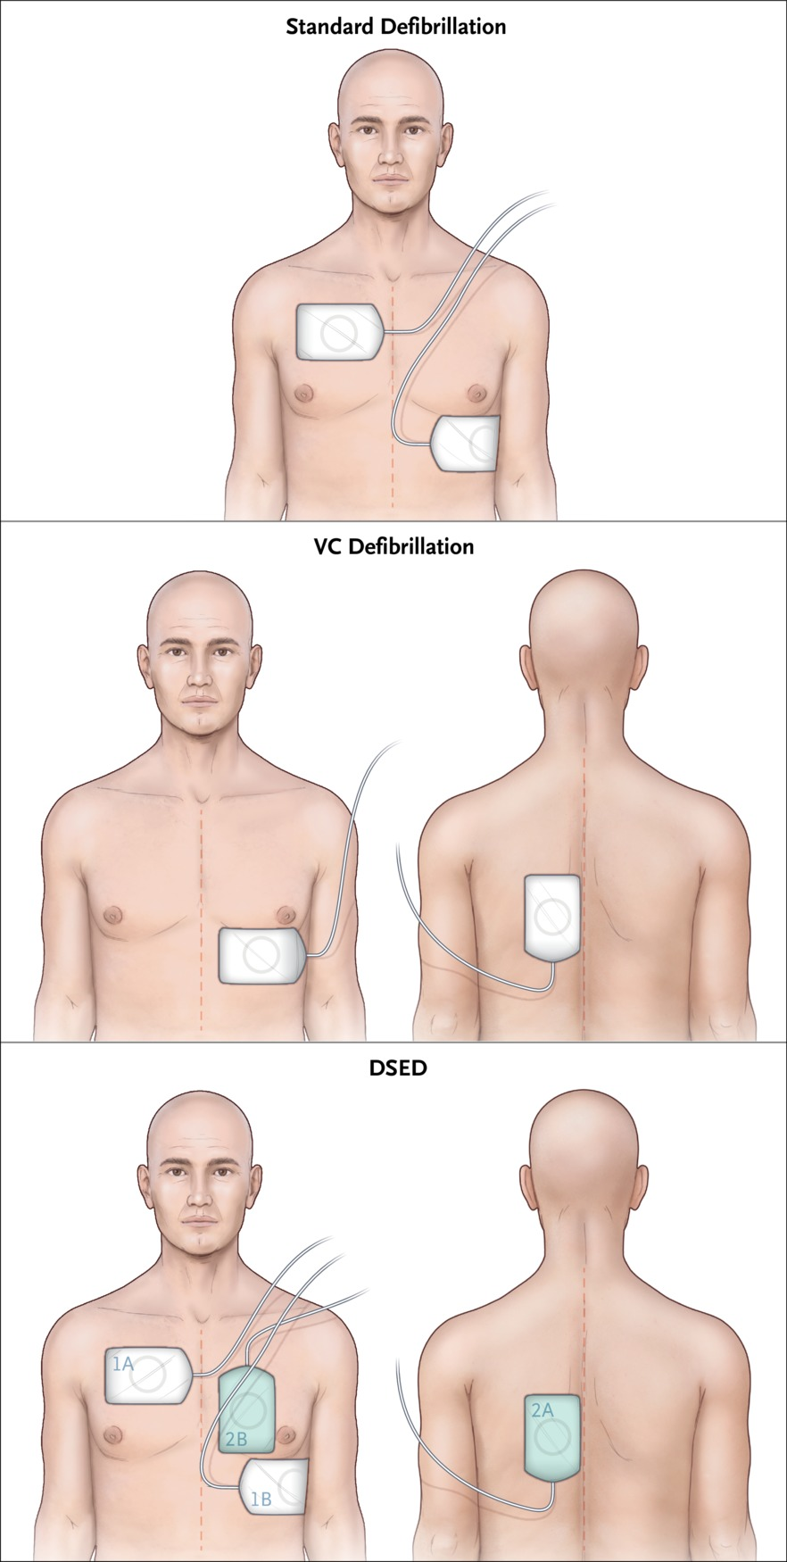

Cheskes S et al. N Engl J Med2022;387:1947-1956
Notes:
Figure 1 Pad Placement in the Three Defibrillation Strategies. Pad placement for standard defibrillation, vector-change (VC) defibrillation, and double sequential external defibrillation (DSED) is shown. In the bottom panel, defibrillation pads 2A and 2B are those of the second defibrillator, with the pads placed in the posterior and anterior positions. For all strategies, the first three shocks occurred with pads placed in the configuration used for standard defibrillation.

Slide 56

Circulatory Support

Slide 57
Automated Mechanical Chest Compression Devices
e.g. LUCAS device, Corpuls device
Equivalent to high quality manual CPR
should not be routinely used to replace manual chest compressions.
Useful in situations where sustained high-quality manual chest compressions are impractical or compromise provider safety.
e.g. Cath Lab procedure in arrested patient

Slide 58
ECMO - eCPR
Optimal CPR/chest compressions = 25–30% of normal cardiac output.
insufficient to prevent neurological and end‐organ damage, particularly in prolonged cardiac arrests.
eCPR = ECMO in context of cardiac arrest
implemented during cardiac arrest, before ROSC.
utilises VA ECMO with femoral cannulation
useful in refractory out of hospital cardiac arrest
Distinct population from in-hospital cardiac arrest
Aims to achieves near normal cerebral, coronary and end‐organ perfusion pending definitive treatment.

Slide 59
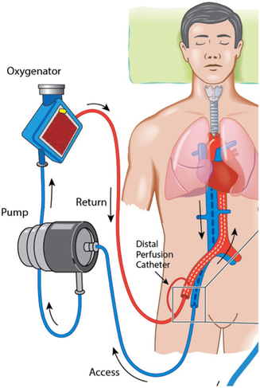

Slide 60

Notes:
Questions?

