Slide 1
Large language models for genomics
Raphaël MOURAD, Associate Prof.
MIAT INRAe
Université Paul Sabatier, Toulouse III

Slide 2
Quick intro to large language models

Slide 3
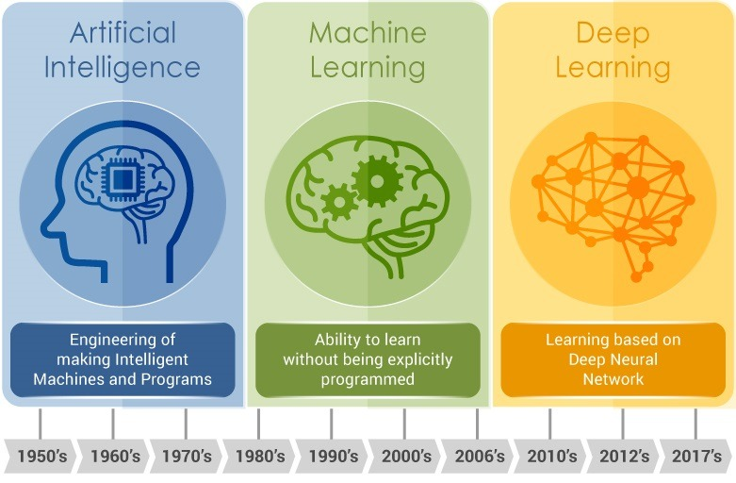
Deep learning as a branch of AI

Slide 4
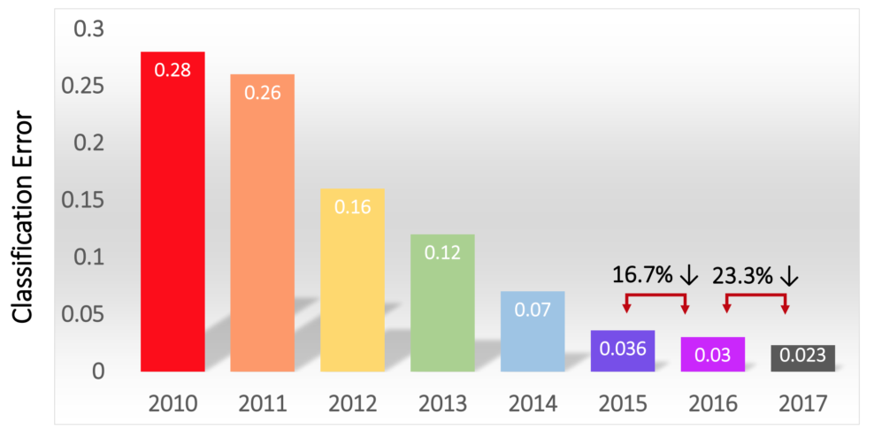
Success of deep learning since 2012: Example of computer vision
2012: AlexNet (convNet)
2013: ZFNet
2014:
VGGNet (deeper, simpler)
InceptionNet (faster)
2015: ResNet (deeper)
2016: Ensemble networks
Image classification
(ImageNet challenge)
With deep learning

Slide 5
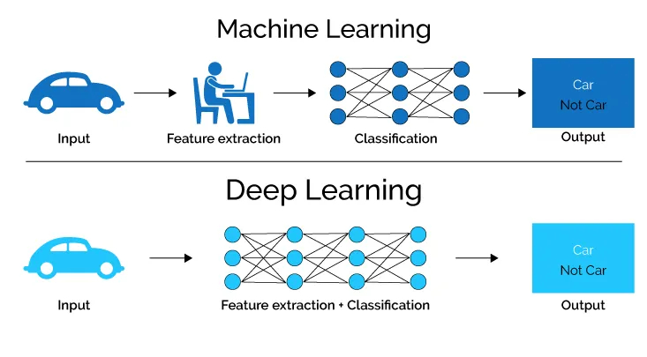
Difference between machine and deep learning

Slide 6
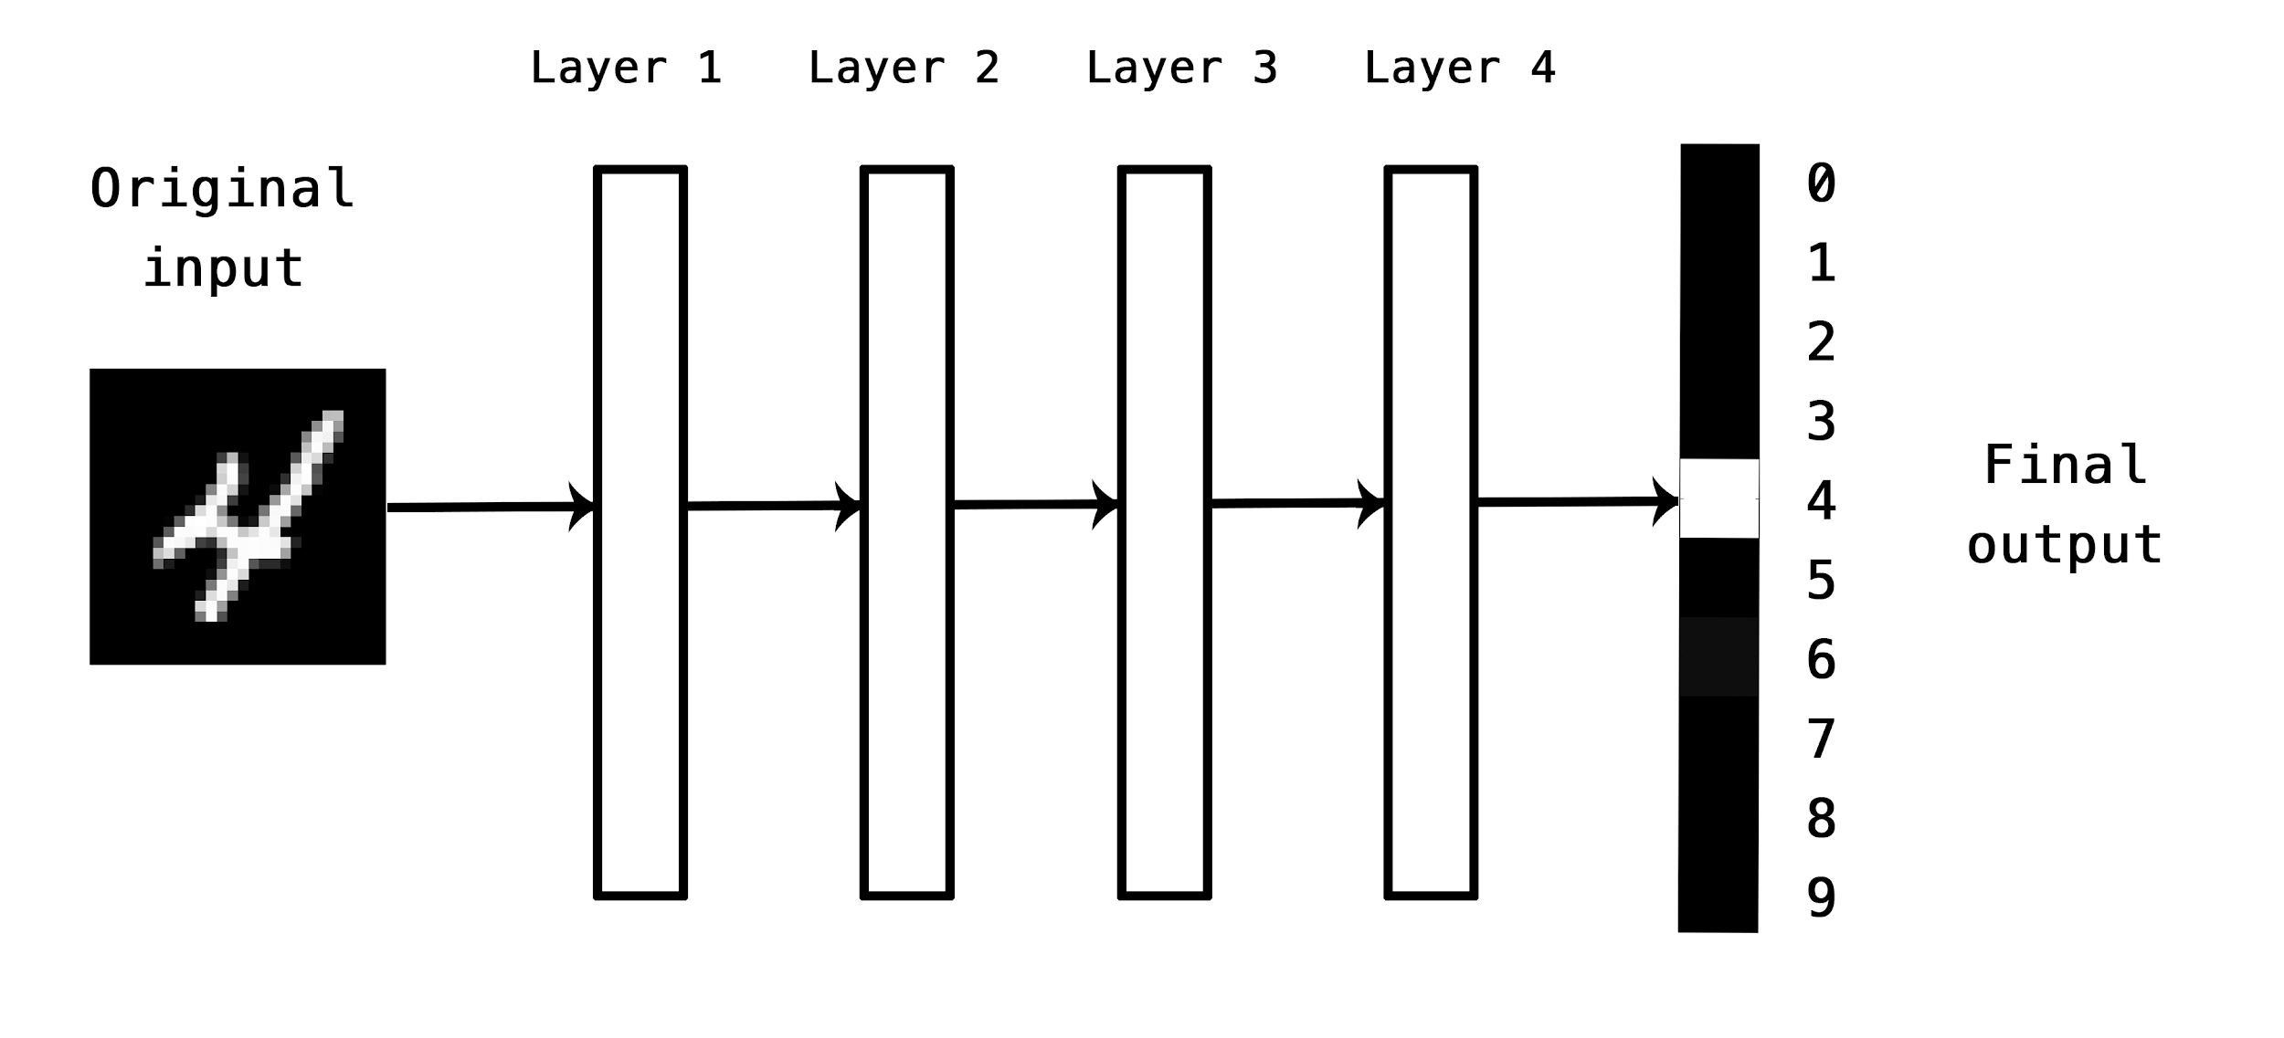
Deep learning as neural networks
Deep learning is based on a deep neural network which is the stacking of different neuronal layers to predict a final output.

Slide 7
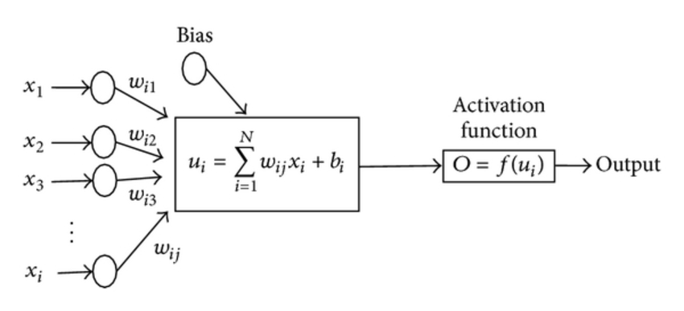
Neural networks
In a neural network, multiple inputs x_{i} are combined through a linear combination (with weights w_{i}), and then an activation function is used for a non-linear transformation to obtain the output.

Slide 8
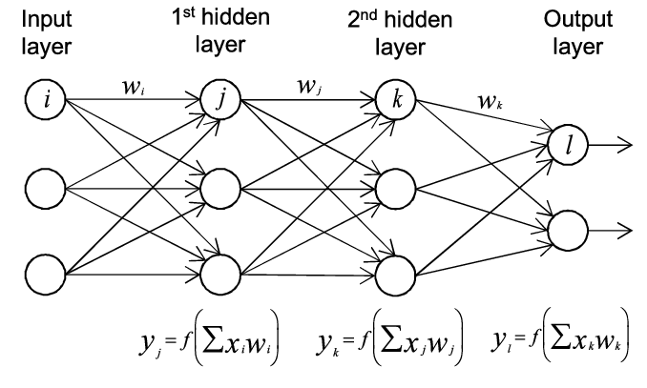
Deep neural networks
A deep neural network (DNN) is an neural network (NN) with multiple layers between the input and output layers. Each hidden layer linearly combines the output from the previous layer and then does a non-linear transformation.

Slide 9
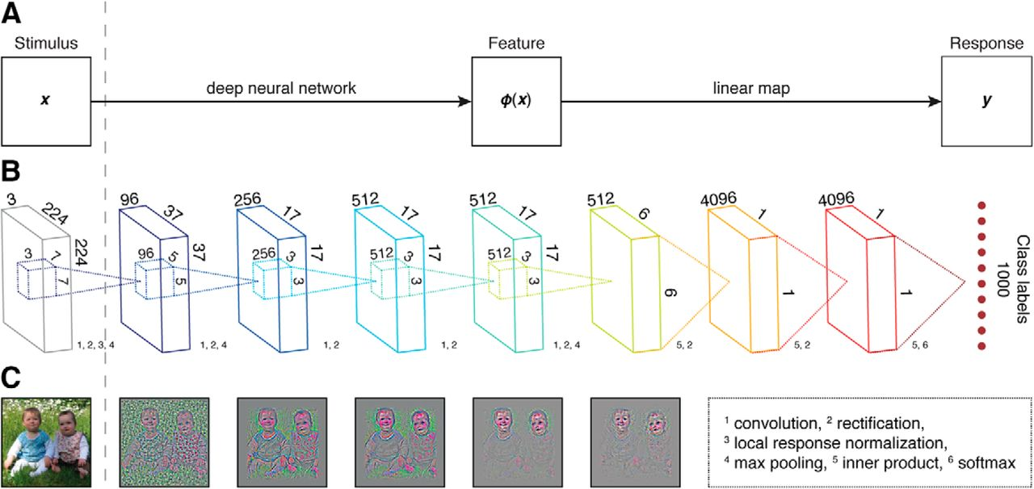
Principle of deep learning : stacking many different sorts of layers
Building a deep neural network is like assembling a lego toy where every lego brick is a layer.

Slide 10
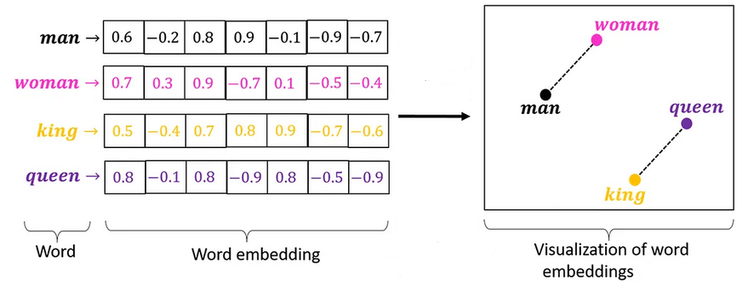
Word embedding
Embeddings are vectors representing word meaning (word semantic). Embeddings can be produced by an LLM (last layer of the model).

Slide 11
Word embedding
The embedding of a word is computed given its context (eg the sentence or the paragraph of the word).
For instance, the word “original” can mean:
"authentic, traditional", or
"novel, never done before“.
The embeddings of the same word but with different meanings depending on the context will have different values.

Slide 12
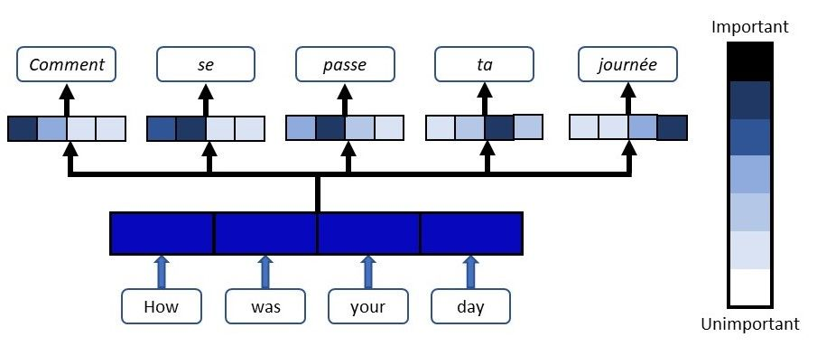
Attention
Here, attention is used to weight different words from English to translate into French.
For instance, to translate “how” to “comment”, you don’t only need the word “comment” (high weight) but you need other words such as the word “was” (moderate weight).

Slide 13
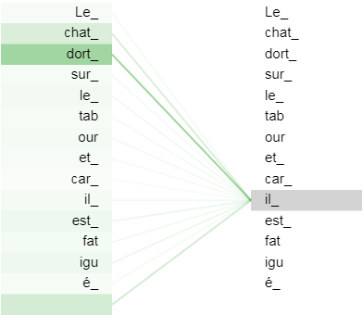
Self-attention in transformer model
Self-attention is similar to attention, except that it is applied to the input sequence itself.
Self-attention allows to model long-range dependencies between any word in a sequence.
Self-attention is not directional as compared to RNN (LSTM or GRU), allowing parallel computing.

Slide 14
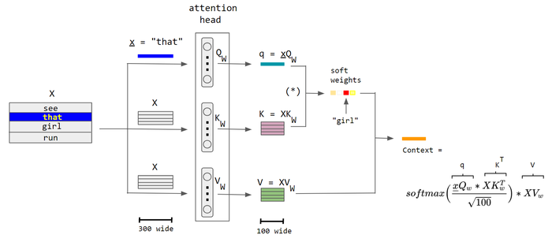
How to compute self-attention weights
Attention weight
Neuron

Slide 15
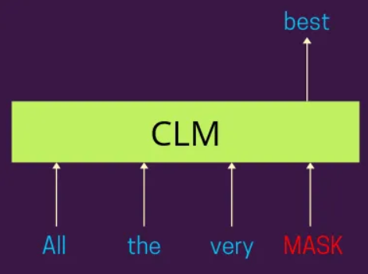
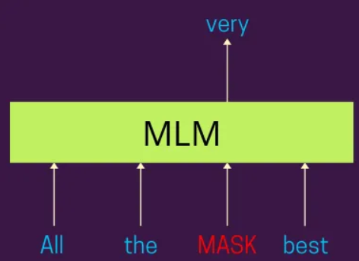
Causal language modeling (CLM) vs masked language modeling (MLM)
Output
Output
Input:
Unidirectional (left -> right)
Input
Bidirectional

Slide 16
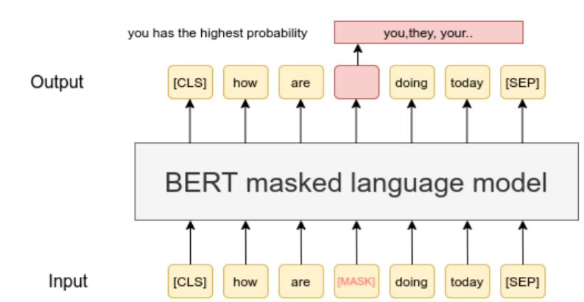
BERT model (masked language model)
In a masked language model, the task is to predict some words that were masked using the context of the words.
Together with self-attention, it was used for the BERT model (Bidirectional Encoder Representations from Transformers).

Slide 17
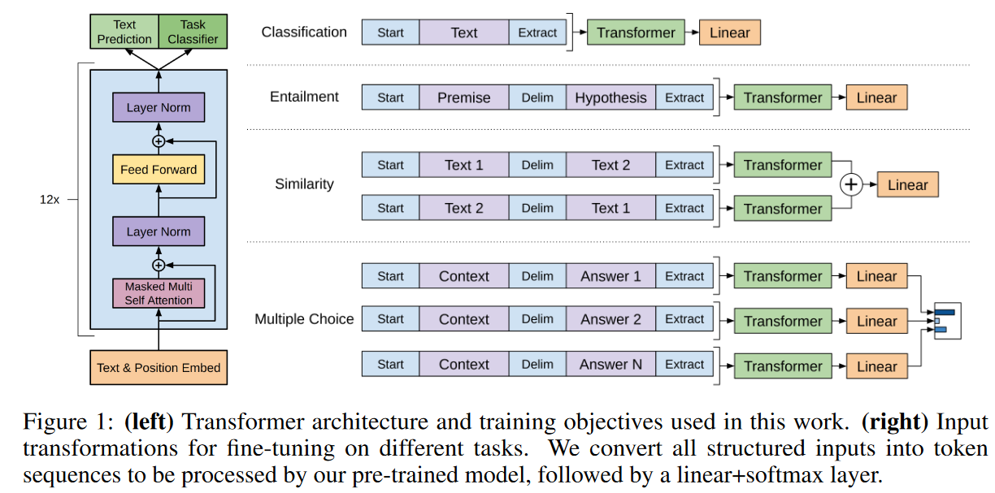
GPT-1 model (causal language model)
GPT-1 implements the transformer architecture (self-attention).

Slide 18
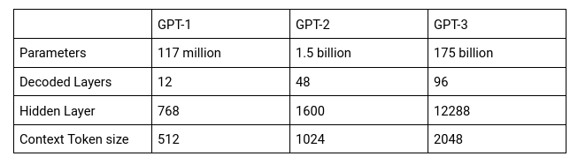
GPT-1, GPT-2 and GPT-3
Number of parameters increasing over time.

Slide 19
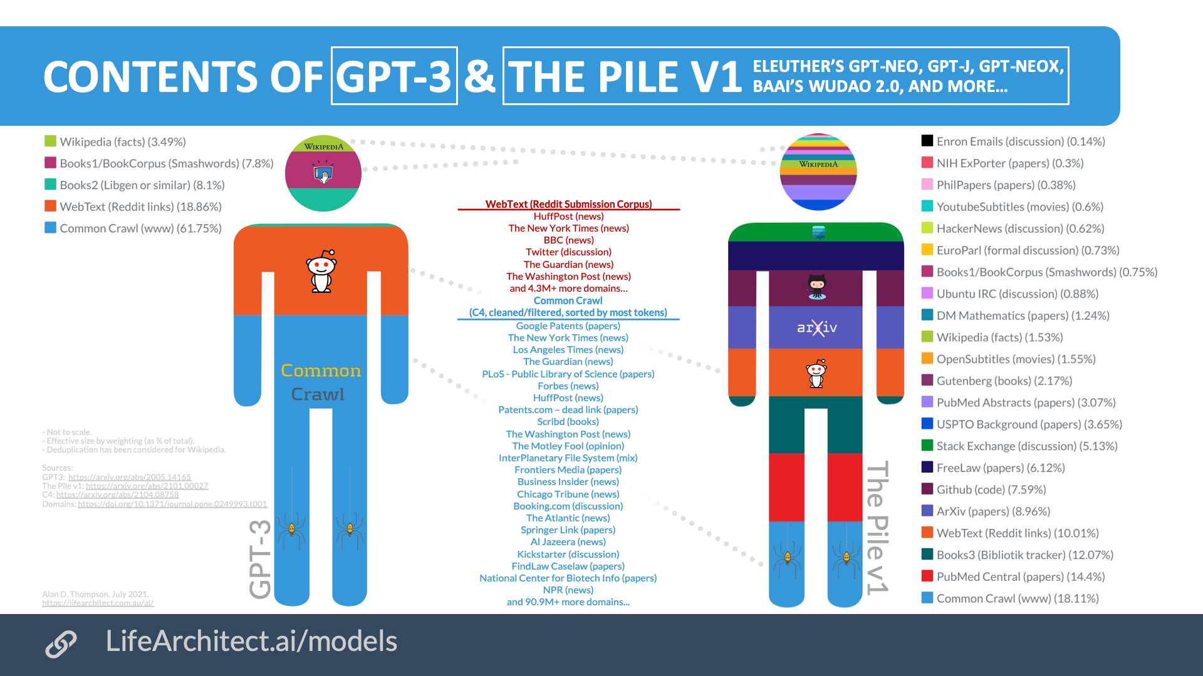
GPT-3 training data

Slide 20
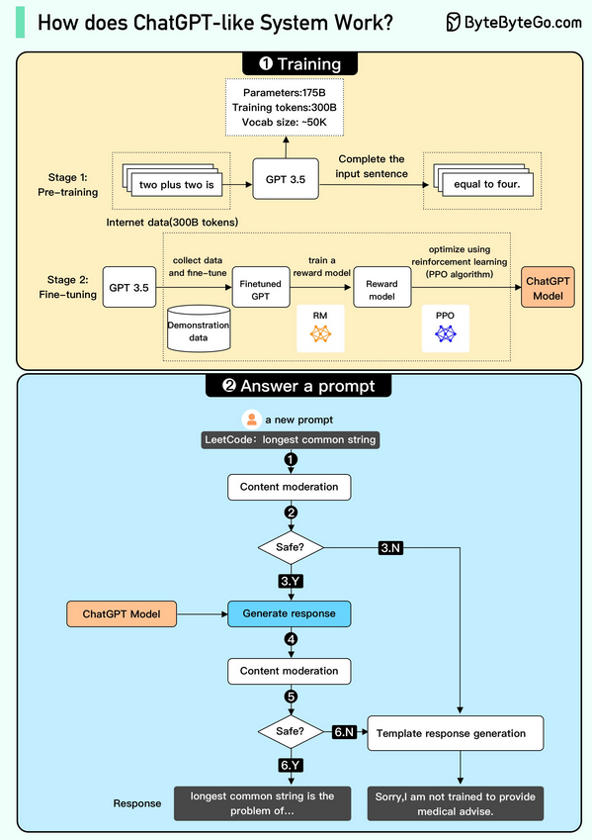
chatGPT
Based on gpt3.5 (pretraining), with fine-tuning (stage 2) and reinforcement learning with human feedback (in blue).

Slide 21
Deep learning for genomics

Slide 22
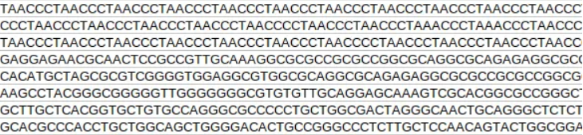
Human genome
The human genome is composed on 22 autosomal chromosomes, two sex chromosomes and a mitochondria. It is composed of 3,3 billion DNA letters (A, T, G, C).
Bellow is an example of a DNA sequence:

Slide 23
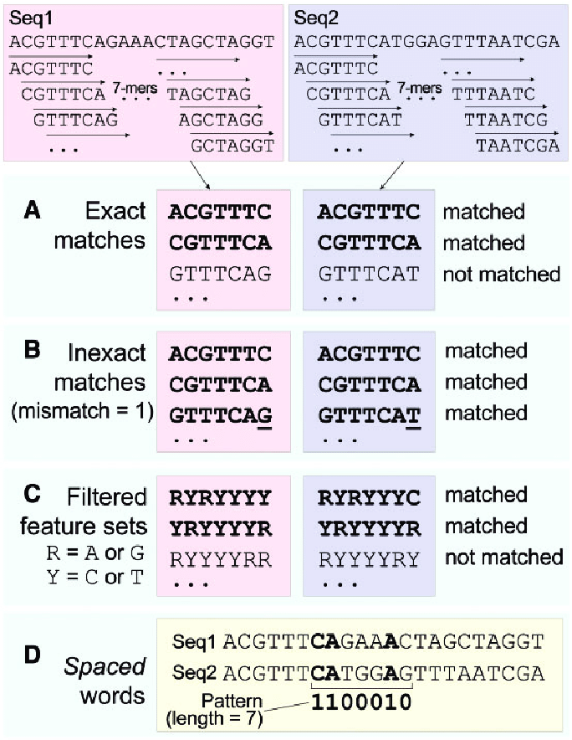
How to represent a DNA sequence for a large language model?
K-mers (for instance: ATCTC or ATTTC, …): very powerfull approach since almost no prior information (except k) is needed to build the features.

Slide 24
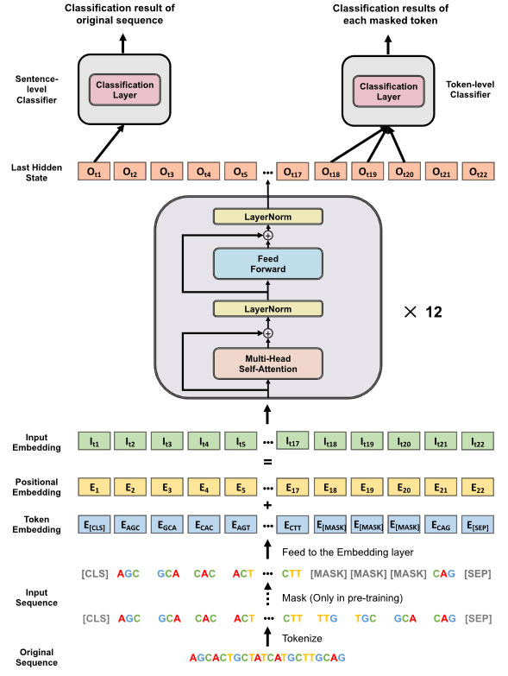
DNABERT
The self-attention model DNABERT is trained by masking some kmers in the DNA sequence and then by trying to predict them using the other k-mers in the DNA sequence (context).
At the end, the model provides features that encode DNA sequences in a very efficient way for any predictive task.

Slide 25
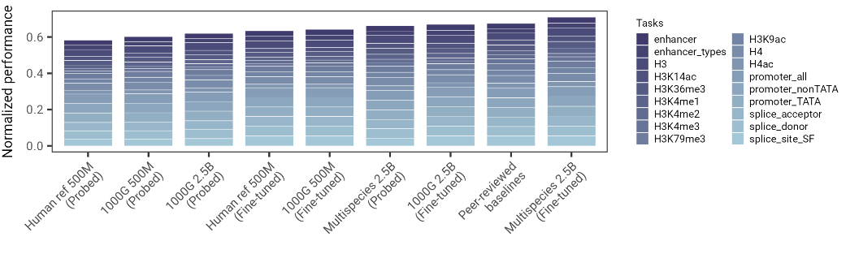
Nucleotide Transformer
BERT model trained not only from the human genome (3.3 Gb) like DNABERT, but trained from thousands of human and animal genomes!
The prediction performance increases with the number of genomes used during training.

Slide 26
Mistral-DNA
Mistral-DNA is an LLM based on Mixtral-8x7B-v0.1 model.
Causal language model.
Based on Byte pair encoding (BPE) tokenizer:
AGCCTTTCTCT -> AGCZTTZZ, where Z=CT
Allows to identify most frequent k-mers
Sparse mixture of Experts: reduces number of parameters used during inference (prediction)

Slide 27
Mistral-DNA
Prediction:
The model is « pretrained » using this strategy. Given a DNA sequence, it tries to predict the next k-mer (=next word).
Token 1
Token 2
Token 3
Token 4
ATGT GTA CGG
TGGG
Input sequence
Sequence to predict

Slide 28
applications

Slide 29
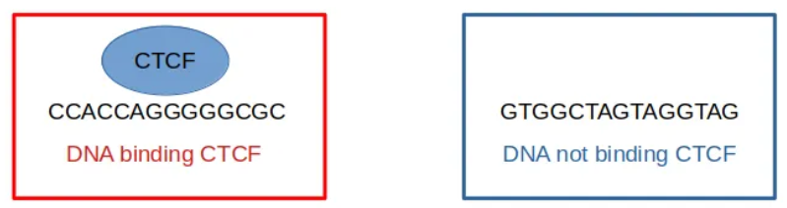
1) Finetuning for classification
1st step: modify the model
2nd step: train the model on labeled sequences (=finetuning).
Classification node
Add classification node at the top of the LLM.
Pretrained LLM
Label 1
Label 0

Slide 30
1) Finetuning for classification
Chromosome
CTCF
ChIP-seq
Predicted
peaks
The finetuned model can be used to predict CTCF binding peaks along the genome.

Slide 31
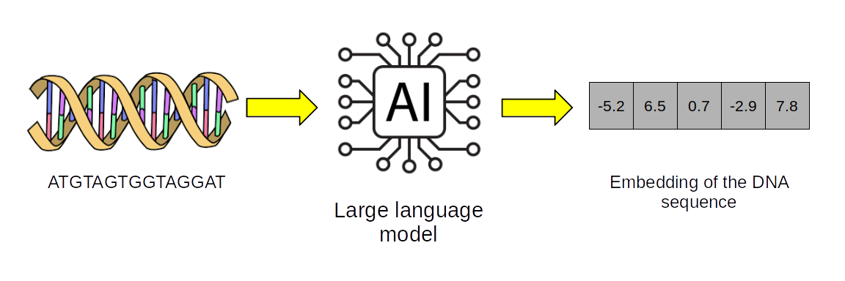
2) Assessing the impact of a SNP
The LLM is a way to convert a DNA sequence into a vector of numbers (an embedding).
We can assume that if two sequences are functionally different, they should have different embeddings.

Slide 32
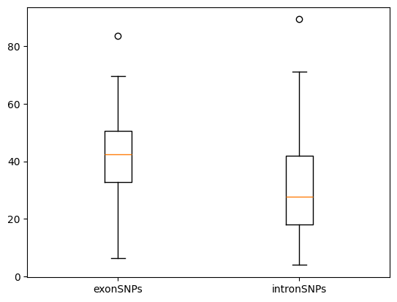
2) Assessing the impact of a SNP
Easy way to assess the impact of a SNP:
Predict the embedding for a sequence with the reference allele C:
ATGTAGTGGGTACCCTGTGTAGAAGCCA
Predict the embedding for a sequence with the reference allele T:
ATGTAGTGGGTACCTTGTGTAGAAGCCA
Compute the L2 distance (for instance) between the two embeddings.
On the right, L2 distances computed for a set of SNPs inside exons and a set of SNPs inside introns.

Slide 33
3) Synthetic DNA sequence generation (only works with CLM models)
Predict a synthetic DNA sequence:
Repeat same task iteratively:
CLM model
Token 1
Token 2
Beginning of sentence
TGA
Input sequence
Sequence to predict
CLM model
Token 1
Token 2
Token 3
Beginning of sentence
TGA
GCC
Input sequence
Sequence to predict

Slide 34
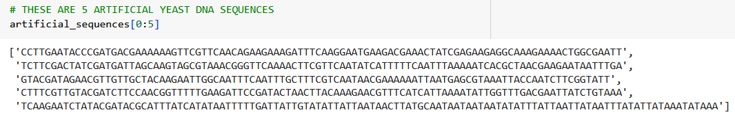
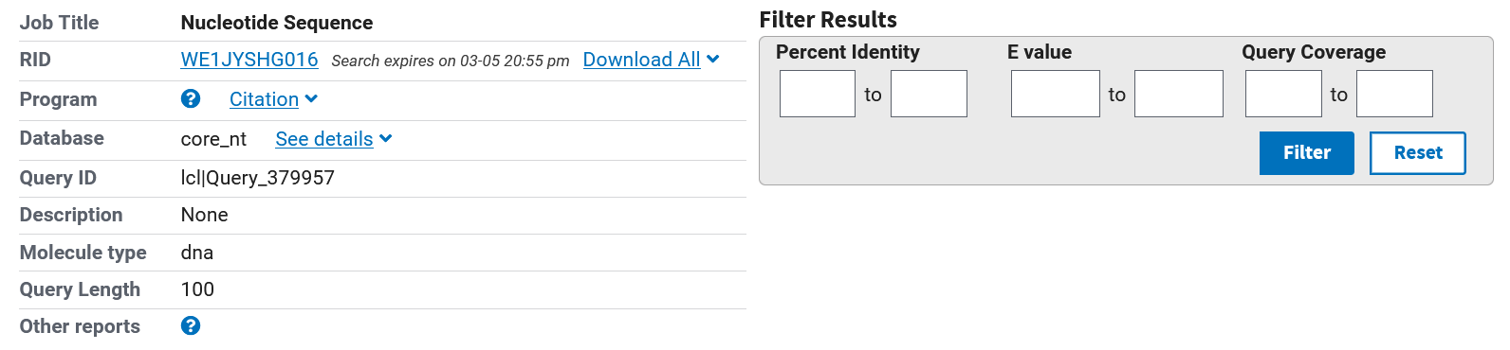
3) Synthetic DNA sequence generation
For instance, for the 1st sequence, BLAST shows no matching to any known DNA sequence:

Slide 35
4) DNA sequence optimization
DNA sequence optimization consists in finding the sequence with a highest (or lowest) score predicted by a previously training model.
For instance, we have finetuned an LLM for promoter prediction. We can take a given DNA sequence and optimize it to be a strong promoter (high score).
Initial sequence:
TCCGATGT
Best sequence:
TGGATCGT
Predicted score
DNA sequence space

Slide 36
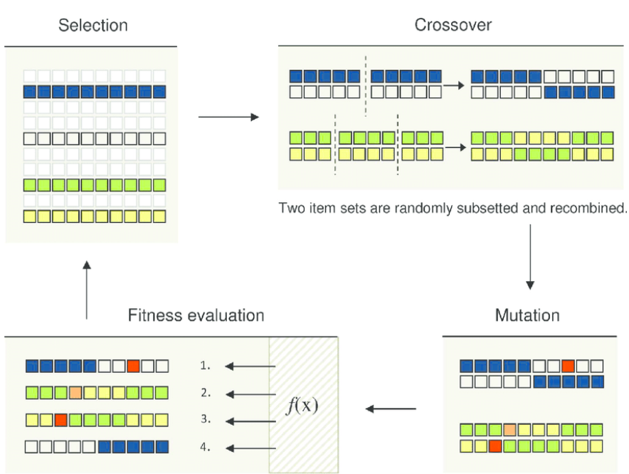
4) DNA sequence optimization
We can use black box optimization algos:
For instance, evolutionary algorithms;
Discrete optimization: A T G or C are not quantitative variables;
Here the classifier

