Slide 1


Jenkins e-Portfolio
Raphael Müßeler, SAP
December 05, 2018

Slide 2
Agenda
Continuous integration tools (CI)
What are continuous integration tools?
Purpose
Hudson / Jenkins
General information
Installation (for Ubuntu)
Blue Ocean Plugin
Multibranch Pipelines
GitHub Integration
Demo

Slide 3

Continuous integration tools
Notes:
Tools!!!

Slide 4
What are continuous integration tools? Steps from Development to Deployment
Deployment
Development
Testing
Build

Slide 5
What are continuous integration tools for? Purpose
Main Purpose: Automate Everything!
Preventing integration problems (“integration hell”)
Improve productivity

Slide 6

Hudson / Jenkins

Slide 7
Hudson / Jenkins General Information
CI tools
Written in Java
Hudson was created by Kohsuke Kawaguchi, Sun Microsystems / Oracle.
Hudson is no longer maintained and was announces as obsolete in 2017.
Jenkins is considered as a fork of Hudson

Slide 8
Hudson / Jenkins Installation (for Ubuntu)
Requirements:
Java JDK 8
Adding Jenkins Debian repository
wget -q -O - https://pkg.jenkins.io/debian/jenkins.io.key | sudo apt-key add –
sudo sh -c 'echo deb http://pkg.jenkins.io/debian-stable binary/ > /etc/apt/sources.list.d/jenkins.list'
Installing Jenkins:
sudo apt update
sudo apt install jenkins
Check Jenkins service
sudo systemctl status jenkins

Slide 9
Hudson / Jenkins Installation (for Ubuntu)
Adjusting firewall (ufw)
sudo ufw allow 8080
sudo ufw status
Setting up Jenkins
Enter Token ( sudo cat /var/lib/jenkins/secrets/initialAdminPassword )
Install suggested plugins
Create administrative user
Configure Jenkins URL mapping
Let’s get started! 😉

Slide 10
Hudson / Jenkins Blue Ocean Plugin
Plugin within Jenkins
Considered as the next generation of Jenkins
Improved UI with better user experience
Contains only some features of the “old” Jenkins

Slide 11
Hudson / Jenkins Multibranch Pipelines
“Jenkins pipeline […] is a suite of plugins that supports implementing and integrating continuous delivery pipelines into Jenkins”
Integration of version control system
Defining own steps

Slide 12
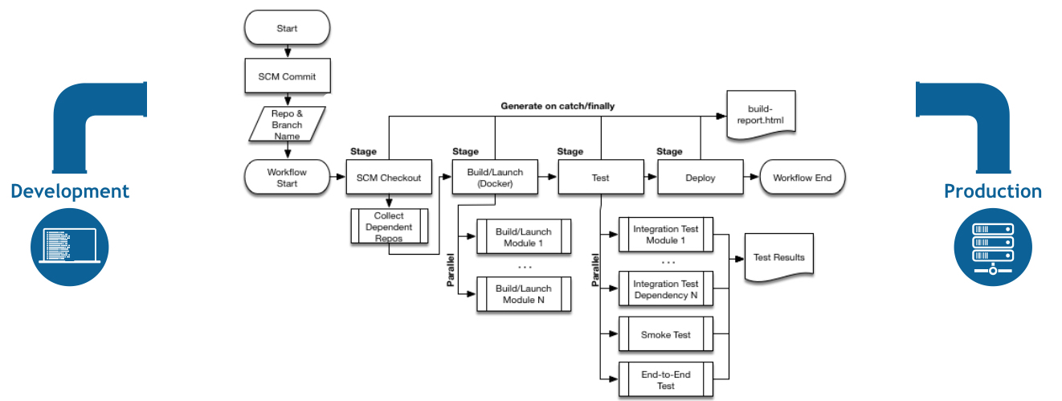
Hudson / Jenkins Multibranch Pipelines

Slide 13
Hudson / Jenkins Multibranch Pipelines
Jenkinsfile
JSON Format
Pipeline build for all branches and pull requests
Code review with builds
Example:
pipeline {
agent any
stages {
stage('Build') {
steps {
// build steps
}
}
stage('Test') {
steps {
// test steps
}
}
stage('Deploy') {
steps {
// deploy steps
}
}
}
}

Slide 14
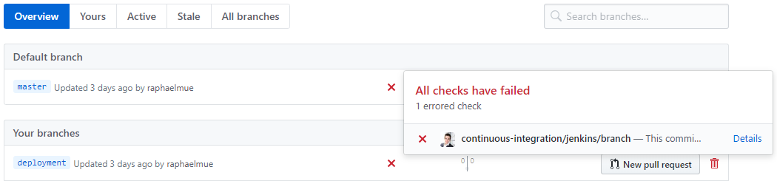
Hudson / Jenkins GitHub integration
Branches
Pull Requests

Slide 15
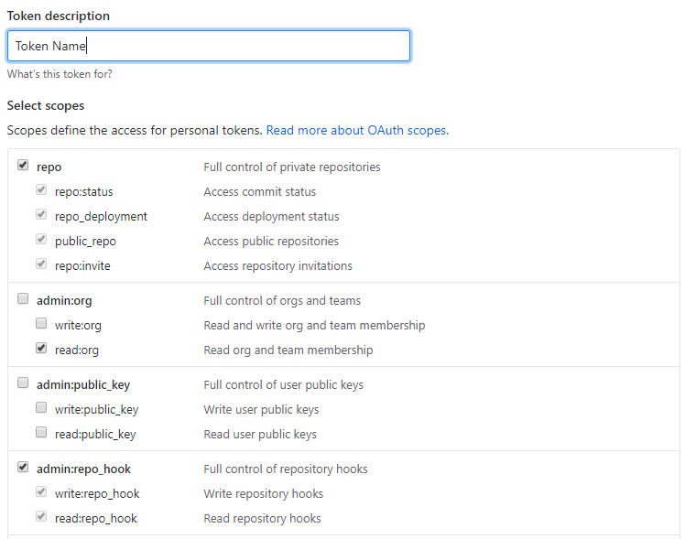
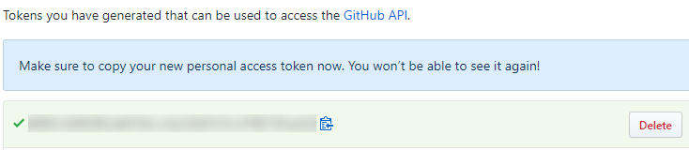
Hudson / Jenkins GitHub Integration (Tutorial)
Generate a token
Settings → Developer Settings → Personal Access Tokens
Enter a name
Select repo, read:org, admin:repo_hook, user:read, user:email
Copy token!!!
Enter token in Jenkins

Slide 16

Demo

Slide 17
Thank you.
Contact information:
Raphael Müßeler
Student
raphael.muesseler@sap.com

