Slide 1
OS^{V}
Raphael S. Carvalho
Cloudius Systems

Slide 2
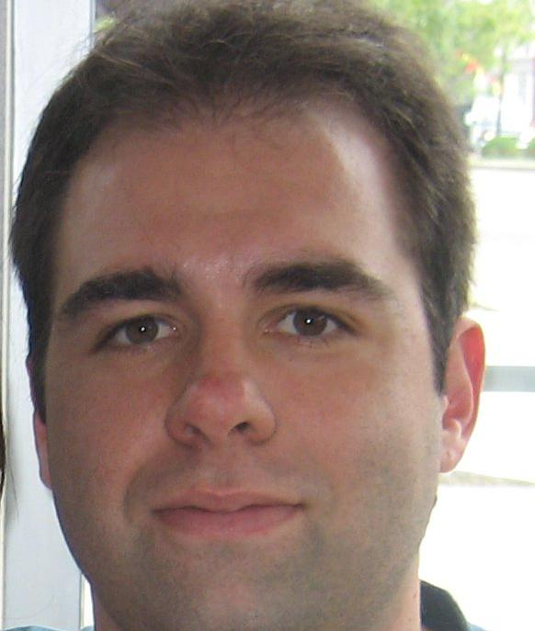
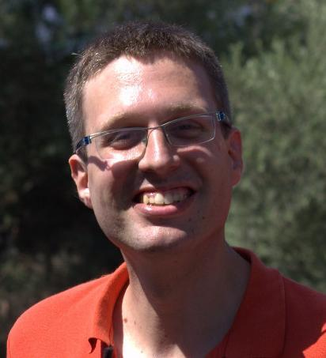
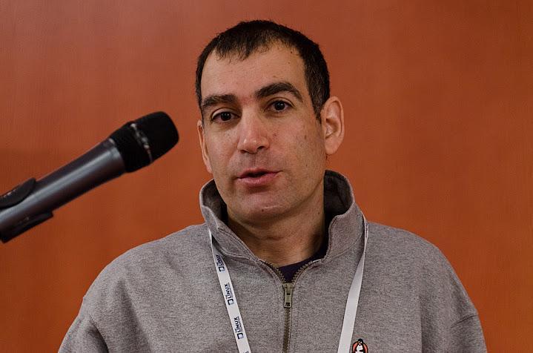


OS^{V}
Glauber Costa
KVM, Containers, Xen
Nadav Har’EL,
Nested KVM
Avi Kivity KVM originator
Pekka Enberg,
kvm, jvm, slab
Dor Laor, Former kvm project mngr
Developers distributed across 9 countries.

Slide 3
The story so far
In the beginning there was hardware
… and then they added
an application
… and then they added
an operating system
… and then they added
a hypervisor
… and then they added
managed runtime
Notice the pattern?

Slide 4
Typical Cloud Stack
Your App
Application Server
JVM
Operating System
Hypervisor
Hardware

Slide 5
Our software stack
Congealed into existence.

Slide 6
A Historical Anomaly
Your App
Application Server
JVM
provides protection and abstraction
Operating System
provides protection and abstraction
Hypervisor
provides protection and abstraction
Hardware

Slide 7
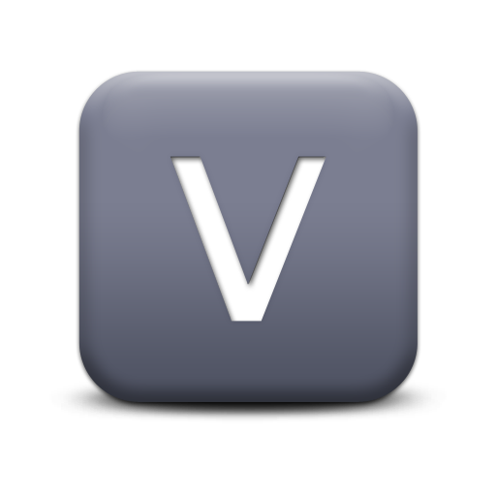
Too Many Layers, Too Little Value
Property/Component
VMM
OS
runtime
Hardware abstraction
Isolation
Duplication
Resource virtualization
Backward compatibility
Security
Memory management
I/O stack
Configuration
Notes:
Hypervisors starting to provide more services, e.g. Amazon S3

Slide 8
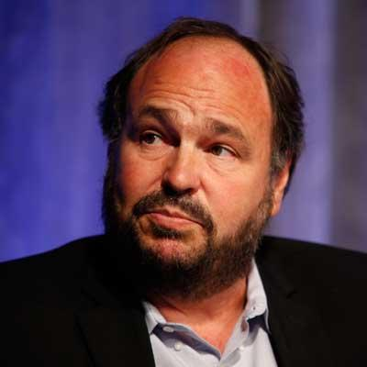
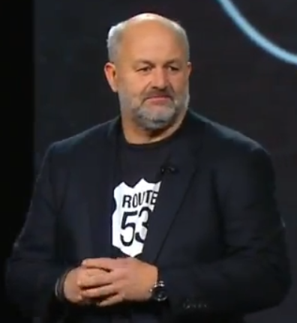
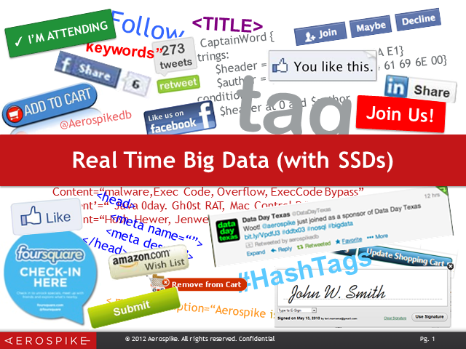
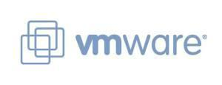
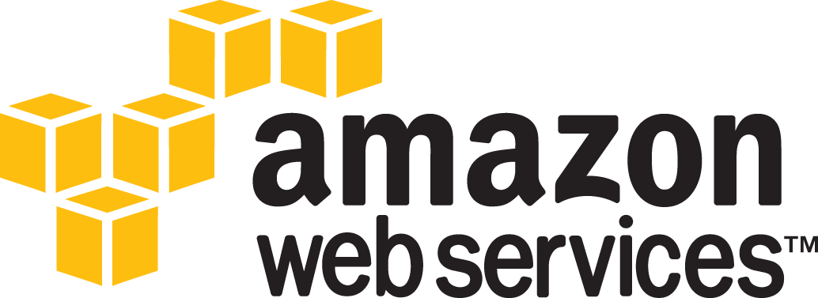
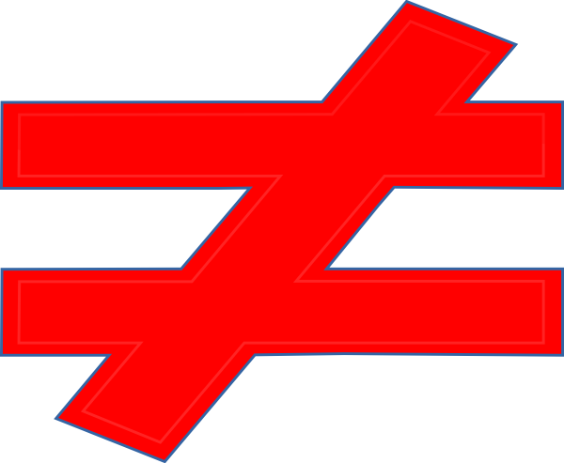
Virtualization
Virtualization 1.0
Virtualization 2.0
Virtualization 2.0, Massive Scale
Scalability
Transformed the enterprise from physical2virtual
Compute node
virtual server

Slide 9
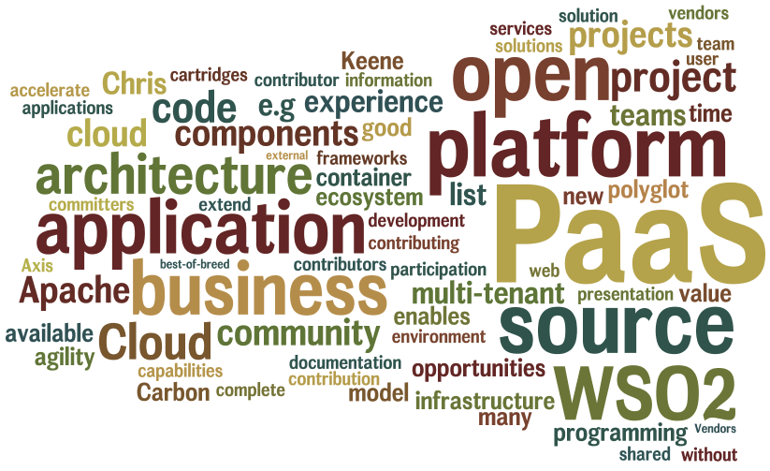
Virtualization 2.0, Dev/Ops

Slide 10
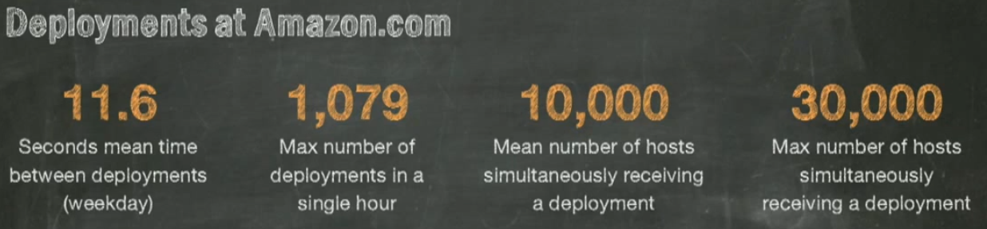
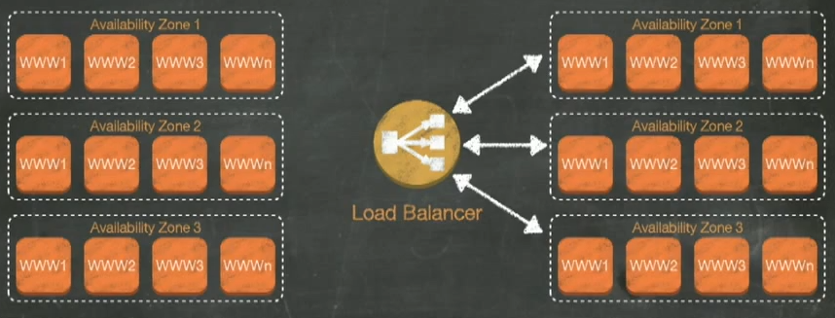
Virtualization 2.0, agility!
Rolling upgrade within seconds and a fall back option

Slide 11
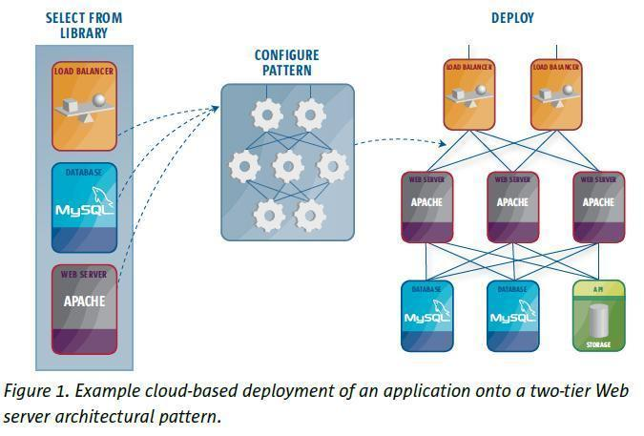

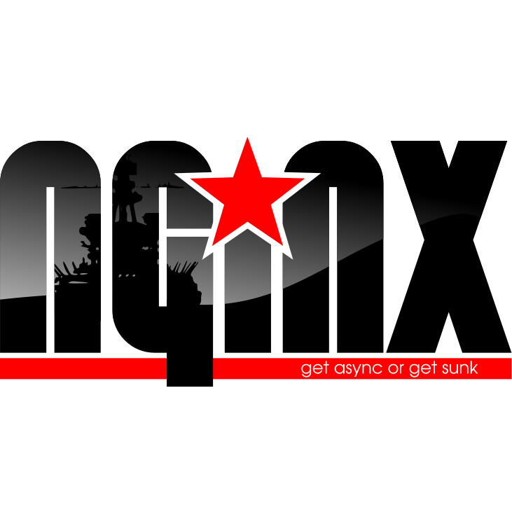
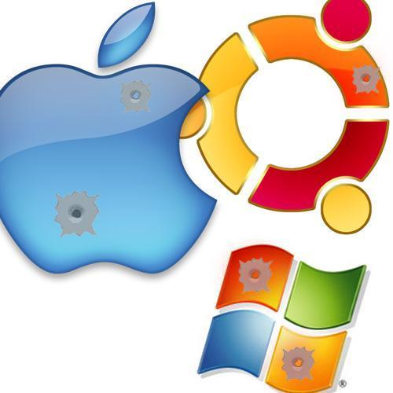
Virtualization 2.0
Architecture
vServer OS 1.0
No Hardware
No Users
No app(S)
Yes Complexity

Slide 12
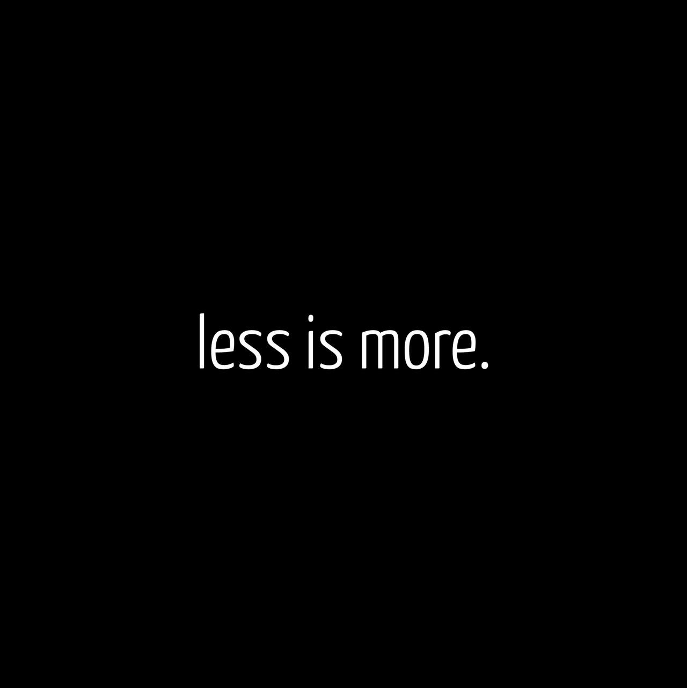

Slide 13
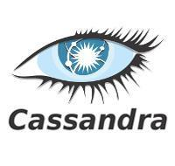
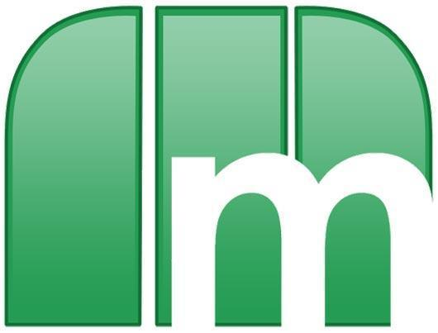


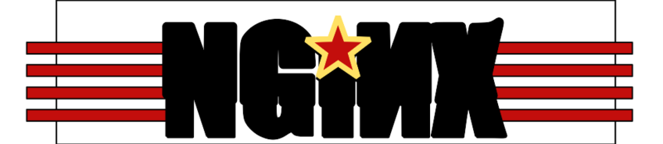
Mission statement
Be the best OS
powering virtual machines
in the cloud
Your App
Your App
Your App
OS^{v} + Jazz JVM
Hypervisor
OS^{v}
OSv
Hardware
OS^{v} + Jazz JVM
Hypervisor
OS^{v} + Jazz JVM
Hypervisor
Hypervisor
Hardware
Hypervisor
Hardware
Hardware
Hardware

Slide 14
The new Cloud Stack - OS^{v}
Linked to existing JVMs
Single Process
Your App
Application Server
App sees no change
Kernel space only
JVM
Core
Hypervisor
Hardware
Notes:
The three major layers today are hypervisor, OS, runtime (JVM). Other minor layers exist.
Need layered cake graphic, or something

Slide 15
The new Cloud Stack - OS^{v}
Memory
Huge pages, Heap vs Sys
I/O
Zero copy, full aio, batching
Scheduling
Lock free, low latency
Tuning
Out of the box, auto
CPU
Low cost ctx, Direct signals,..
Notes:
The three major layers today are hypervisor, OS, runtime (JVM). Other minor layers exist.
Need layered cake graphic, or something

Slide 16
In Depth

Slide 17
OSv’s kernel design principles
Single address space.
No processes, just threads.
No separate kernel address space.
No protection between user-space and kernel.
No “system calls”, just function calls.
Runs Linux shared-objects by implementing the Linux/Glibc ABI.
No copy of the system call arguments.
New non-Posix APIs can be really zero-copy.

Slide 18
OSv’s kernel design principles
Cheap threads and context switches.
No interrupt context - just wake up handler thread.
No spinlocks.
Spinlocks are notorious for VM OSs: cause lock holders preemption problem.
Needed in interrupt context - which we don’t have.
We have lock-free mutexes.

Slide 19
OSv’s kernel design principles
Linux emulation.
Enough for running common runtimes (JVM) and important applications.
But not more than necessary. OSv is not Linux.
New OSv APIs for applications/JVM
New APIs for really zero-copy I/O.
New APIs giving the single application more access, e.g., JVM can use page table dirty bits instead of emulating this feature slowly.

Slide 20
Why C++11
Forget all they told you about C++!
We didn’t choose C++ for creating complex type hierarchies.
C++11 finalized in August 2011.
C++11 is about:
Avoiding boilerplate repetition
Easy and safe reuse of data structures
Rich standard library (STL, Boost)
No runtime overhead
Support for concurrent memory access (atomic variables, memory ordering)

Slide 21
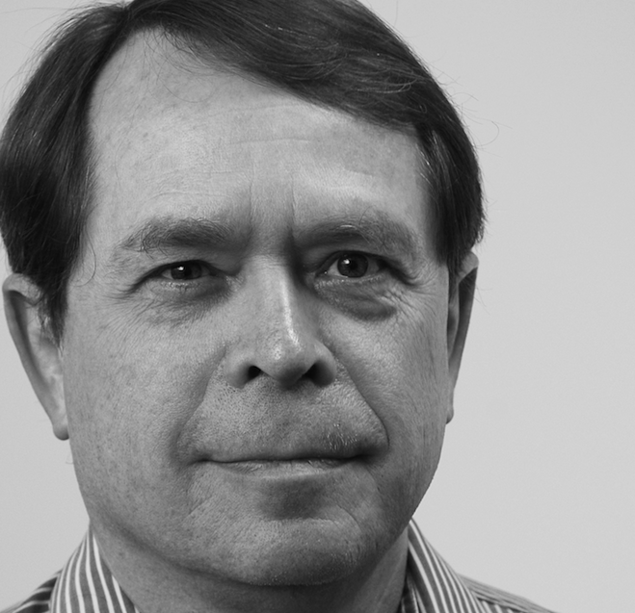
Van Jacobson Net Channels
Do as much processing as possible on the CPU where the application is running.

Slide 22
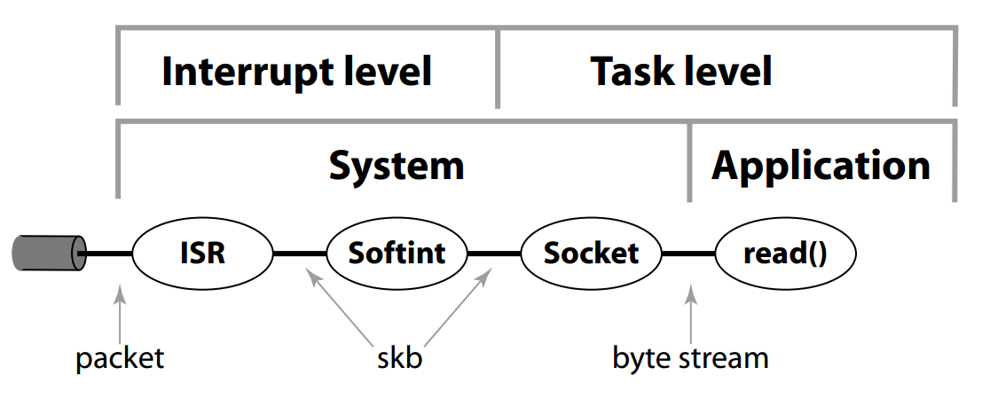
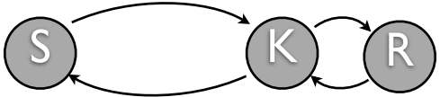
Van Jacobson == TCP/IP
Common kernel network stack
Leads to servo-loop:
Notes:
The three major layers today are hypervisor, OS, runtime (JVM). Other minor layers exist.
Need layered cake graphic, or something

Slide 23
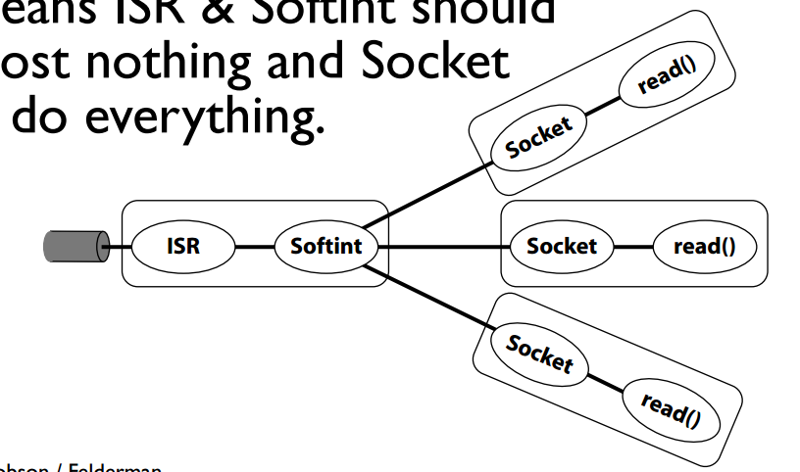
Van Jacobson == TCP/IP
Net Channel design:
Notes:
The three major layers today are hypervisor, OS, runtime (JVM). Other minor layers exist.
Need layered cake graphic, or something

Slide 24
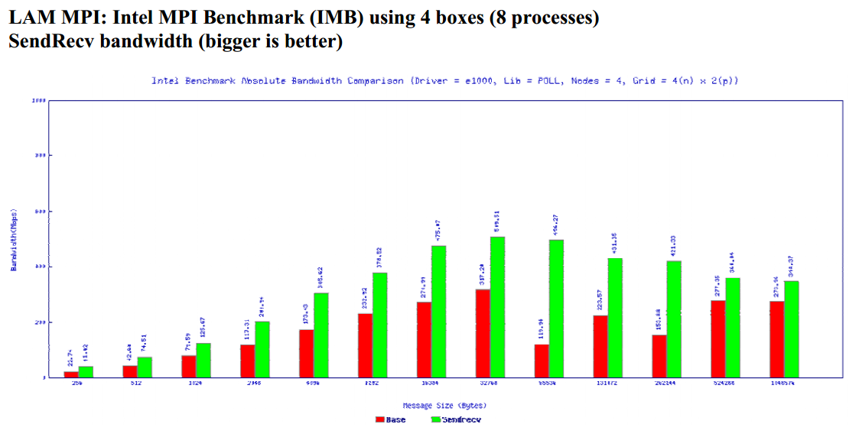
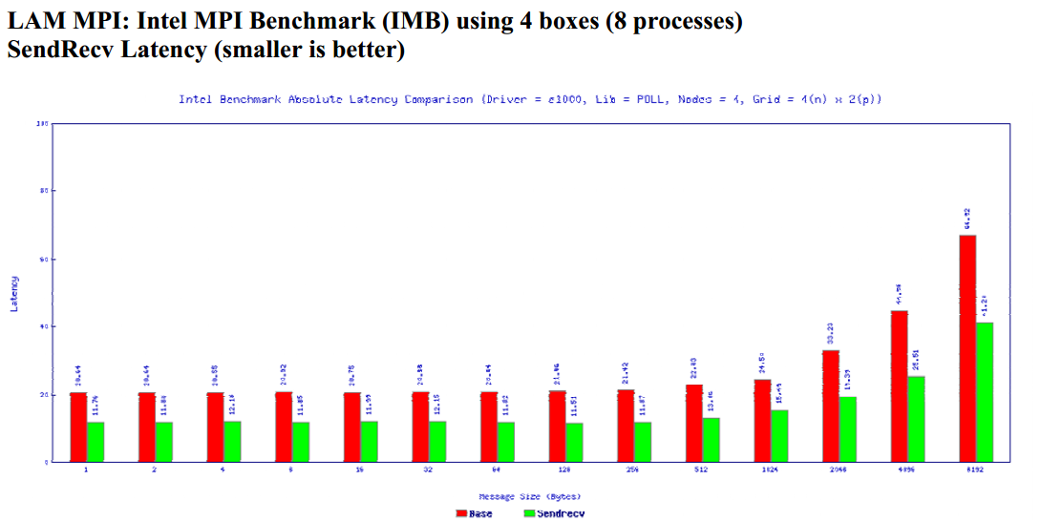
Van Jacobson == TCP/IP
Notes:
The three major layers today are hypervisor, OS, runtime (JVM). Other minor layers exist.
Need layered cake graphic, or something

Slide 25
Dynamic heap, sharing is good
JVM Memory
Lend memory
System memory

Slide 26
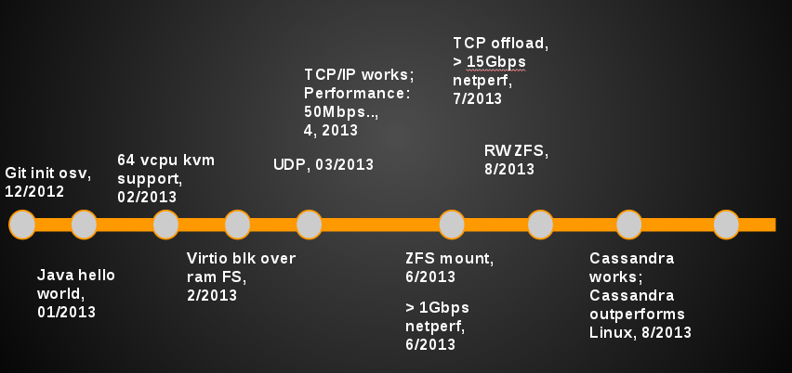
Milestones
OSS launch, Memcached outperform by 40%, 9/2013
KVM, networking, 04/2013
First OEM revenue, Q1/2015
Formation, 12/2012
OSS launch, 09/2013
Outperform Other OSs, 07/2013
limited GA, Beginning 2014
Seed, 02/2013

Slide 27
Status
Runs:
Java, C, JRuby, Scala, Groovy, Clojure, JavaScript
Outperforms Linux:
SpecJVM, MemCacheD, Cassandra, TCP/IP
400% better w/ scheduler micro-benchmark
< 1sec boot time
ZFS filesystem
Huge pages from the very beginning

Slide 28
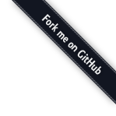

Open Source
These days, credibility == open source
Looking for cooperation:
Kernel-level developers
Management stack
Dev/ops workflow
BSD-style license
Already have contributions from multiple companies

Slide 29
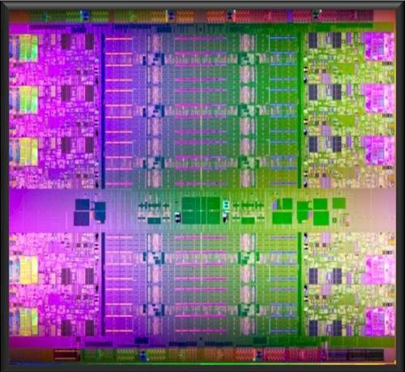
Architecture ports
64-bit x86
KVM - running like a bat out of hell
Xen HVM - running (still work in progress)
VMware - planned in 2 months
64-bit ARM - planned
Others - patches welcome

Slide 30
Integrating the JVM into the kernel
Dynamic
Heap
Memory
Your App
Application Server
TCP in the
JVM + App
context
JVM
Fast inter
thread wakeup
Core

Slide 31
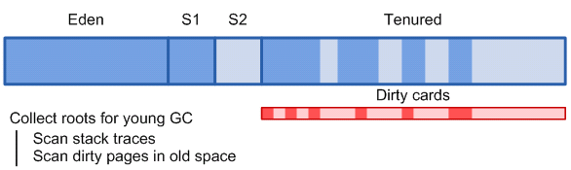
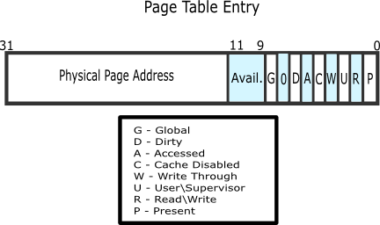
Integrating the JVM into the kernel

Slide 32
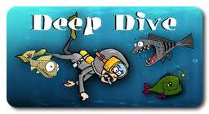
Technical deep dive
C++
Performance and tracing
Virtio-app

Slide 33
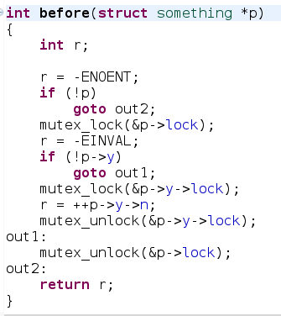
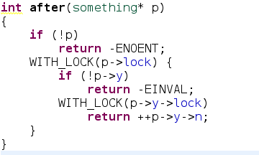
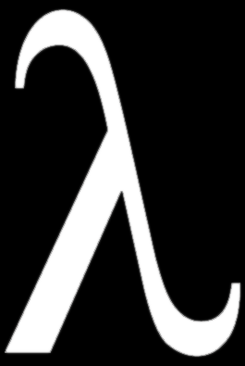
C++

Slide 34
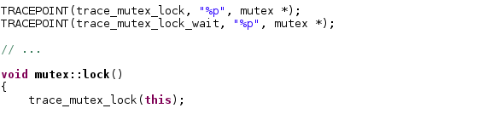
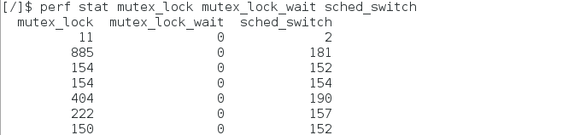
Performance and tracing

Slide 35

Virtio-app || Data plane
For specialized applications, bypass the I/O stack completely
Application consumes data from virtio rings
User
Kernel

Slide 36

OS that doesn’t get in the way
NO Tuning
NO State
NO Patching
4 VMs per sys admin ratio
http://www.computerworld.com.au/article/352635/there_best_practice_server_system_administrator_ratio_/

Slide 37
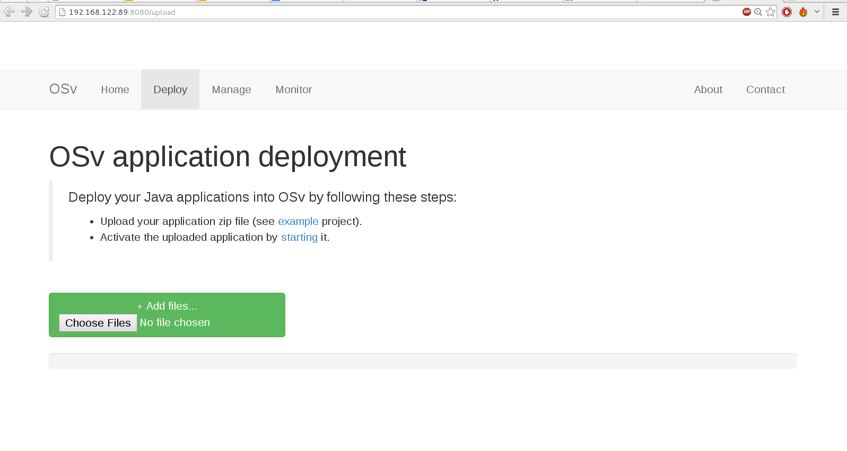

Management

Slide 38
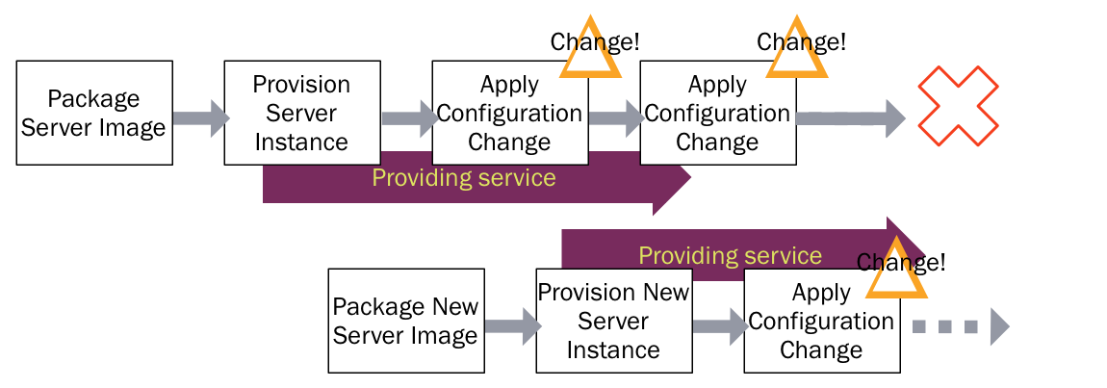
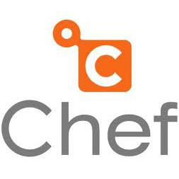
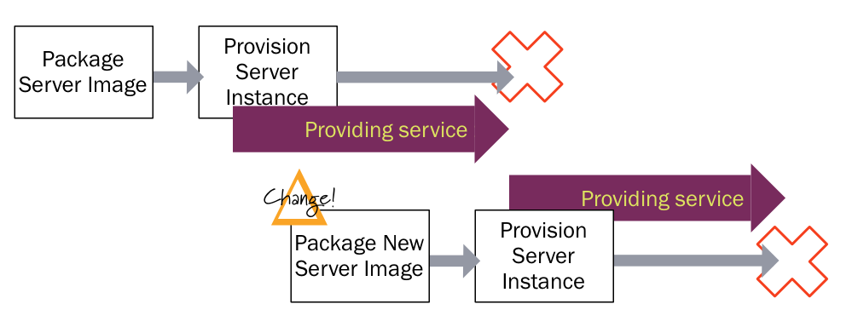
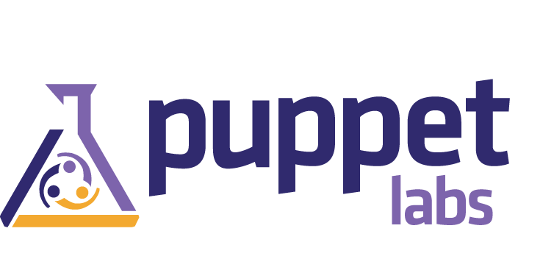
Virtualization 2.0: Stateless servers

Slide 39
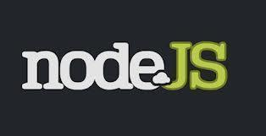
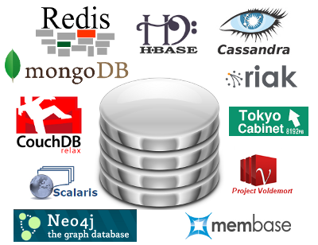

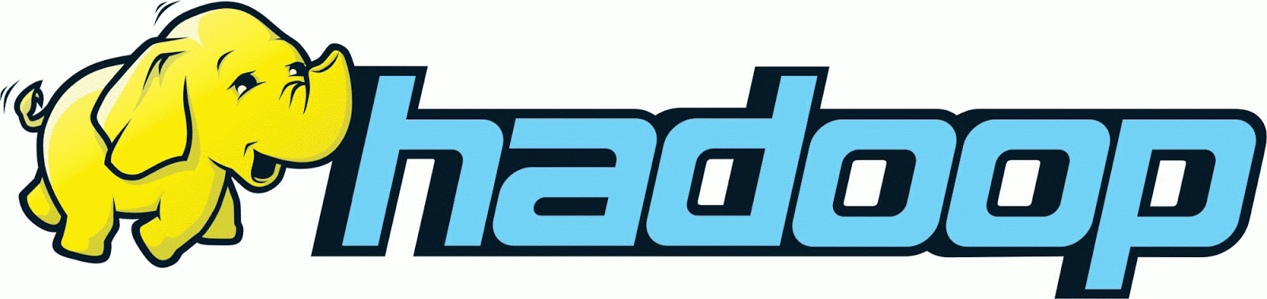
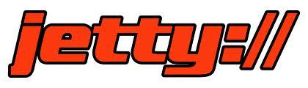
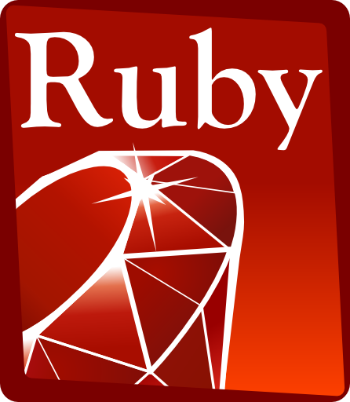
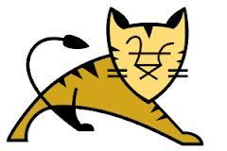

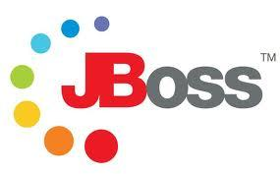

Let’s Build A COMMUNITY

Slide 40
Porting a JVM application to OS^{V}
Done*
* well, unless the application fork()s

Slide 41
Porting a C application to OS^{V}
Must be a single-process application
May not fork() or exec()
Need to rebuild as a shared object (.so)
Other API limitations apply

Slide 42

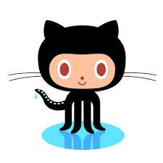


Resources
http://osv.io
https://github.com/cloudius-systems/osv
@CloudiusSystems
osv-dev@googlegroups.com

Slide 43
OS^{v}@Cloudius

Slide 44
Cloudius Systems, OS Comparison
Feature/Property
OS^{v}
Traditional OS
Good for:
Machete: Cloud/Virtualization
Swiss knife: anything goes
Typical workload
Single app * VMs
Multiple apps/users, utilities, anything
kernel vs app
Cooperation
distrust
API, compatibility
JVM, POSIX
Any, but versions/releases..
# Config files
0
1000
Tuning
Auto
Manual, requires certifications
Upgrade/state
Stateless, just boots
Complex, needs snapshots, hope..
JVM support
Tailored GC/STW solution
Yet another app
Lines of code
Few
Gazillion
License
BSD
GPL / proprietary
Notes:
Hypervisors starting to provide more services, e.g. Amazon S3

