Slide 1


ZFS on
Raphael Carvalho, Software Engineer at Cloudius Systems
raphaelsc@cloudius-systems.com

Slide 2
ZFS on OSv
WHO AM I?

Slide 3
What's OSv at the first place?
New operating system designed for the modern cloud era.
ZFS was one of unique components re-used.
ZFS is used as the root file system, ported from FreeBSD.
OSv is licensed under BSD (allowed to integrate into core).
Follow Linux ABI (few exceptions)
Further info can be found at: http://osv.io

Slide 4
Why ZFS?
Clear? No?
First of all, ZFS is a great file system per se.
ZFS provides effortless management capabilities with pools and other features (definitely matches OSv principles).
Almost zero-cost snapshots.
Reliability
Among other things...

Slide 5
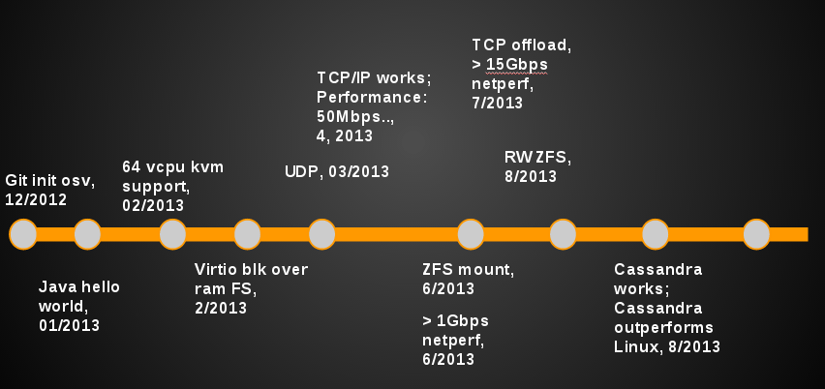
Milestone

Slide 6
Porting ZFS...
ZFS Posix Layer (VFS ↔ ZPL)
Block I/O layer integration.
ARC (ZFS primary cache) reclaiming integration
Dependent code integration (Solaris layer)
ZFS import and mount integrated into boot process.
Lots of testing (features, integrity, etc)

Slide 7
ZFS POSIX Layer
Virtual File System
Layer (VFS)
Other FSes
ZFS
File System Consumers

Slide 8
ARC reclaiming integration
General
Reclaimer
From O.S.
ARC
reclaimer
Other reclaimers

Slide 9
Changes into ZFS for OSv
ZFS Posix Layer (VFS ↔ ZPL)
Bits of ARC reclaiming policy
ARC buffer sharing: directly reading ARC buffers for memory mapping performance improvement.
ZFS root pool with more than one vdev.

Slide 10
ZFS ARC buffer sharing
ZFS ARC
read-side proof of concept
ADDRESS
SPACE
ZFS ARC BUFFER
ARC BUFFER
ZFS
FILE-BACKED
MEMORY
MAPPING
(MMAP)
RO PAGES
RO PAGES
ARC BUFFER
RO PAGES
ARC BUFFER
RO PAGES

Slide 11
ZFS ARC buffer unsharing
Upon a write to mapped region? COW by now.
ZFS ARC
PAGECACHE
ADDRESS SPACE
ARC BUFFER
RW PAGES
RW PAGES
ARC BUFFER
RW PAGES
RW PAGES
ARC BUFFER
RW PAGES
RW PAGES

Slide 12
Plans for the future
Synchronicity with other ZFS platforms.
Share our modifications in ZFS with other platforms, those that would help them.
Bring contributions to OpenZFS project.

Slide 13
The End
Thank you,
Any questions?
Raphael Carvalho
raphaelsc@cloudius-systems.com

