Slide 1


Slide 2
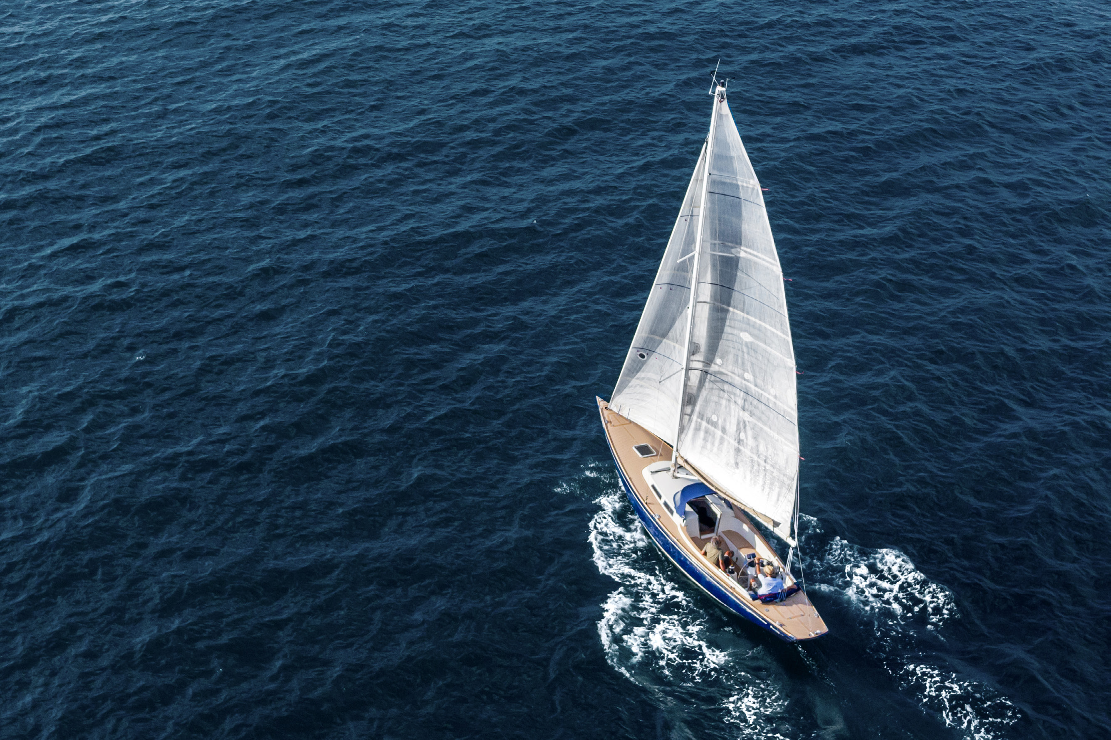
A Unique Heritage
Sails Into the Future

Slide 3
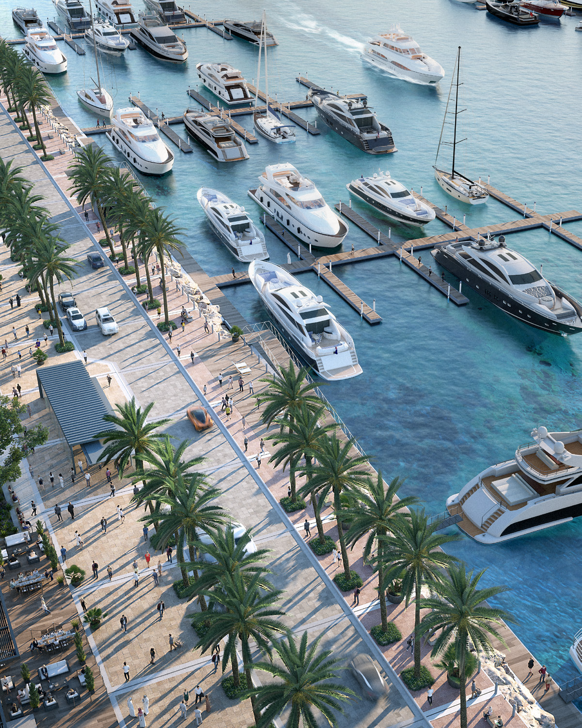
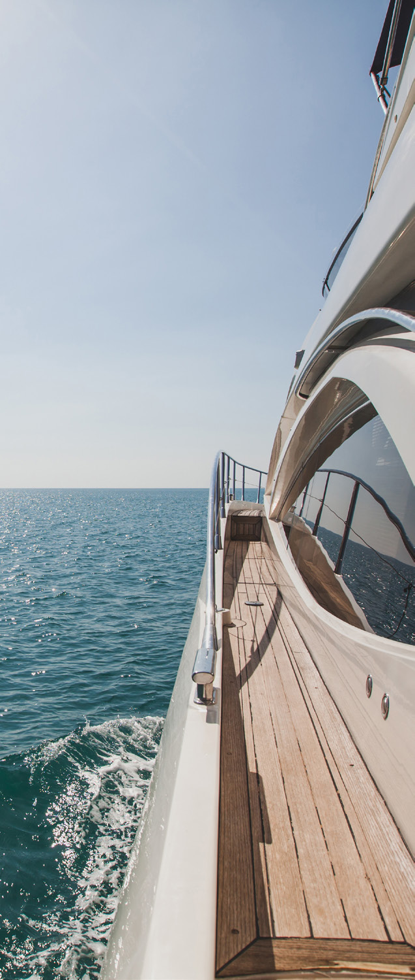
Rashid Yachts
& Marina
A celebration of life, freedom,
indulgence, and beauty, Rashid
Yachts & Marina invites you to
embrace the essence of luxurious
waterfront living and discover a
world where the marina becomes
your playground.
World Class
Chic Marina
Yacht Club
Promenade
Unique Retail
Signature
Experiences
Hotels

Slide 4
P
A
L
M
ISLA
N
D
THE
W
O
RLD
ISLAND
DUBAI
M
ARINA
E
M
A
A
R
BEACHF
RONT
JEBEL
A
L
I
FREE ZONE
SHEI
K
H ZA
DUBAI
Y
ED ROA
D
F
RAM
E
SHE
I
K
H
Z
A
YED
ROA
D
D
A
BURJ
K
HALIF
A
YED RO
A
Z
H
K
SHEI
AL
QUO
Z
INDUSTRIA
L
AREA
E
M
IRATES
DEIRA
LIVING
EXPO
DOWNTOWN
LIVING
DUBA
I
A
L
KHA
IL ROAD
AL K
H
A
IL
R
O
A
D
DUBAI
INTERNATIO
N
A
L
DUBAI HILLS
AIRPO
R
T
SHEIKH MOHA
ESTA
T
E
M
MED BIN
THE
ZA
Y
ED RO
A
D
O
ASIS
DUBA
I
INVESTM
ENT
P
A
R
K
DUBA
I
CREEK
ARABIA
N
H
A
RBOUR
EXPO
CITY
R
A
NCHES
DUBA
I PO
L
O
&
EQUISTRIA
N
CLUB
ABU DHABI
SHARJAH
ARABIA
N
SHEI
K
R
A
NCHES II
H
MOHA
M
MED
BIN
Z
AY
ED
R
O
A
D
GRAND
A
L
M
A
K
T
O
U
M
EMAAR
POLO
SHE
INTERNA
TIO
N
A
L
IK
H
Z
A
IRP
ORT
A
SOUTH
YED
BIN H
A
EMIRATES R
MDAN
O
A
D
A
L
N
A
EMIRATES
HY
A
N
STREE
R
O
A
D
T
ARA
BIAN
D
A
O
R
TES
A
EMIR
RANCHES III
EMIRATE
D
S
ROA
D
A
THE
O
R
N
I
Perfectly
V
ALLEY
A
L
A
-
I
A
B
U
D
DUBA
I
METRO
LINES
Connected
R
E
D LINE
GREEN LINE
F
UTURE
BLUE
LINE
25 mins
15 mins
20 mins
30 mins
drive to Downtown Dubai
drive to Al Shindagha Heritage District
drive to Dubai International Airport
drive to Dubai Marina

Slide 5
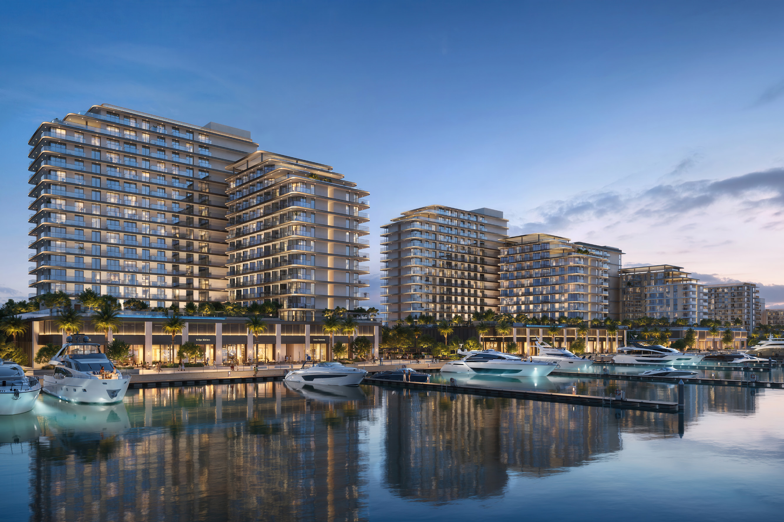
Welcome to

Slide 6
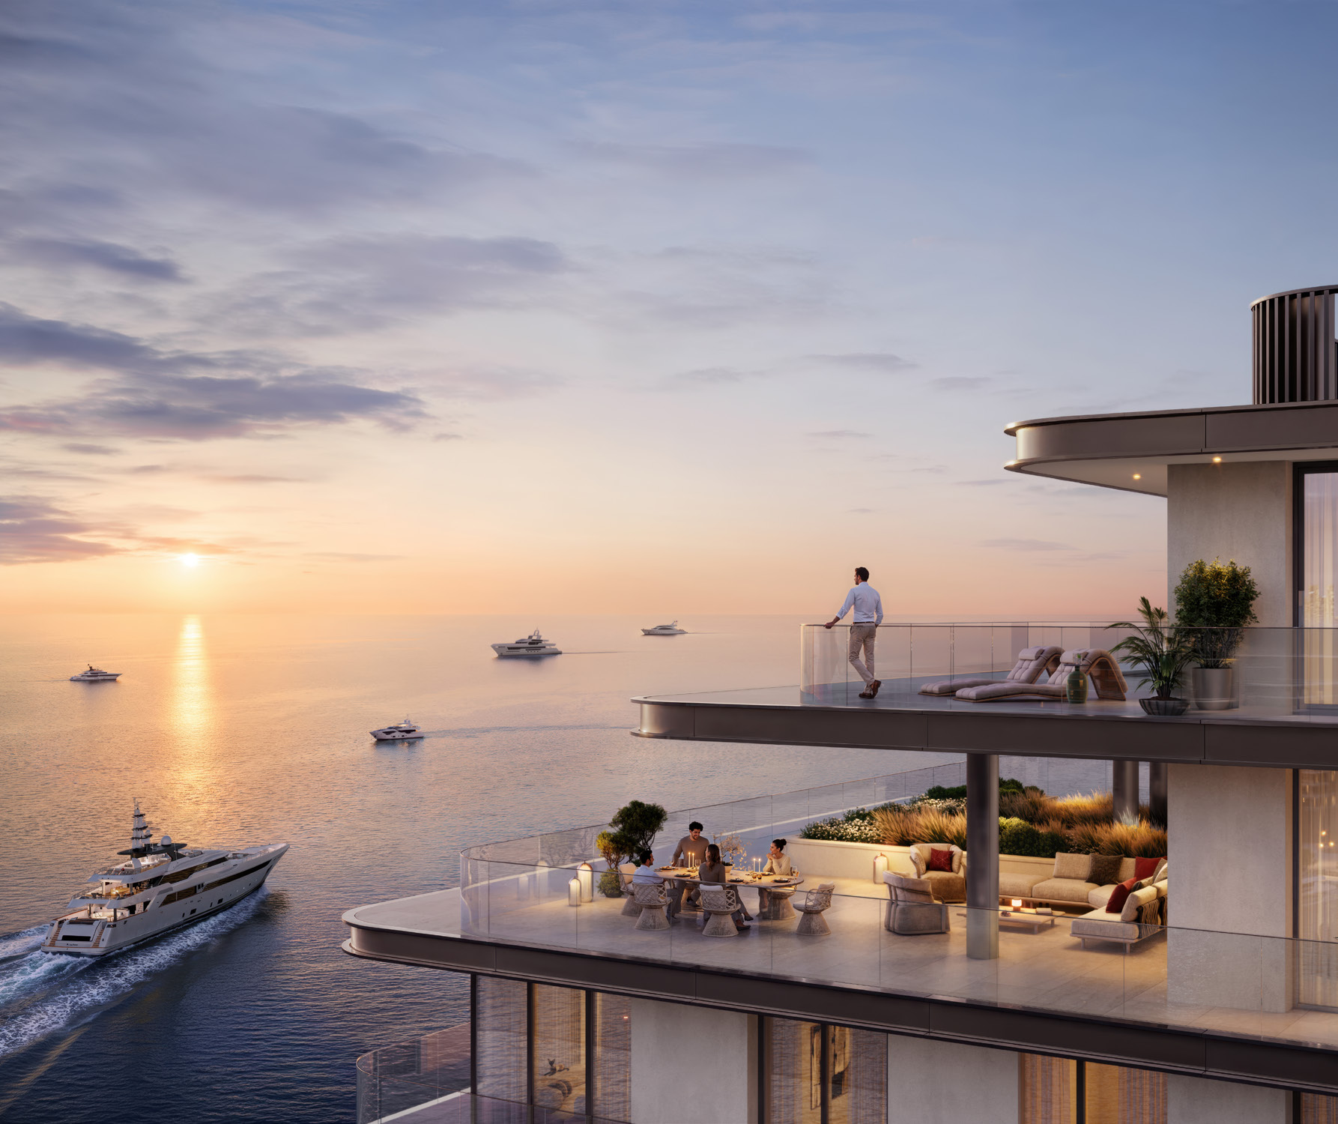
THE PROPERTY
Waterfront
Aspirations
Become Reality
Tucked along the pristine waters of Rashid
Yachts & Marina, Fior 1 unveils a new era
of waterfront opulence and exclusivity.
Embark on a connoisseur’s journey, from
breathtaking marina vistas and the allure
of Downtown Dubai skyline panoramas,
complemented by rich green spaces and a
lively promenade filled with retail, dining,
and leisure experiences.

Slide 7
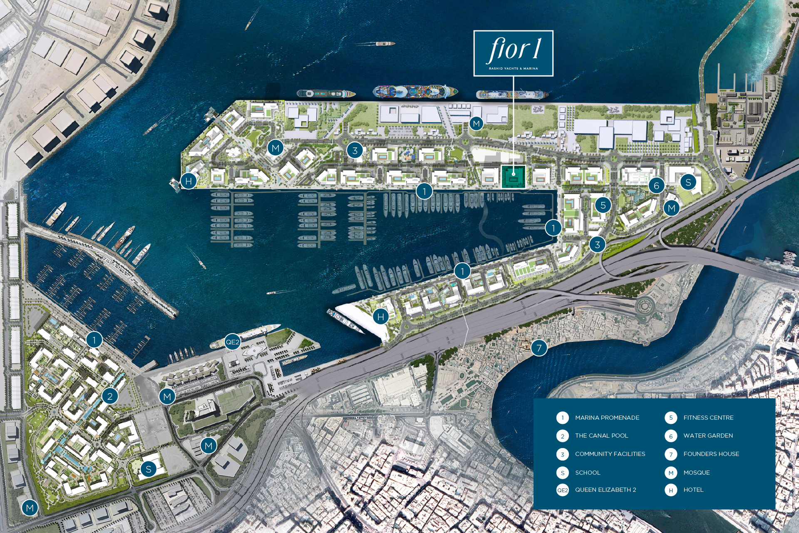

Slide 8
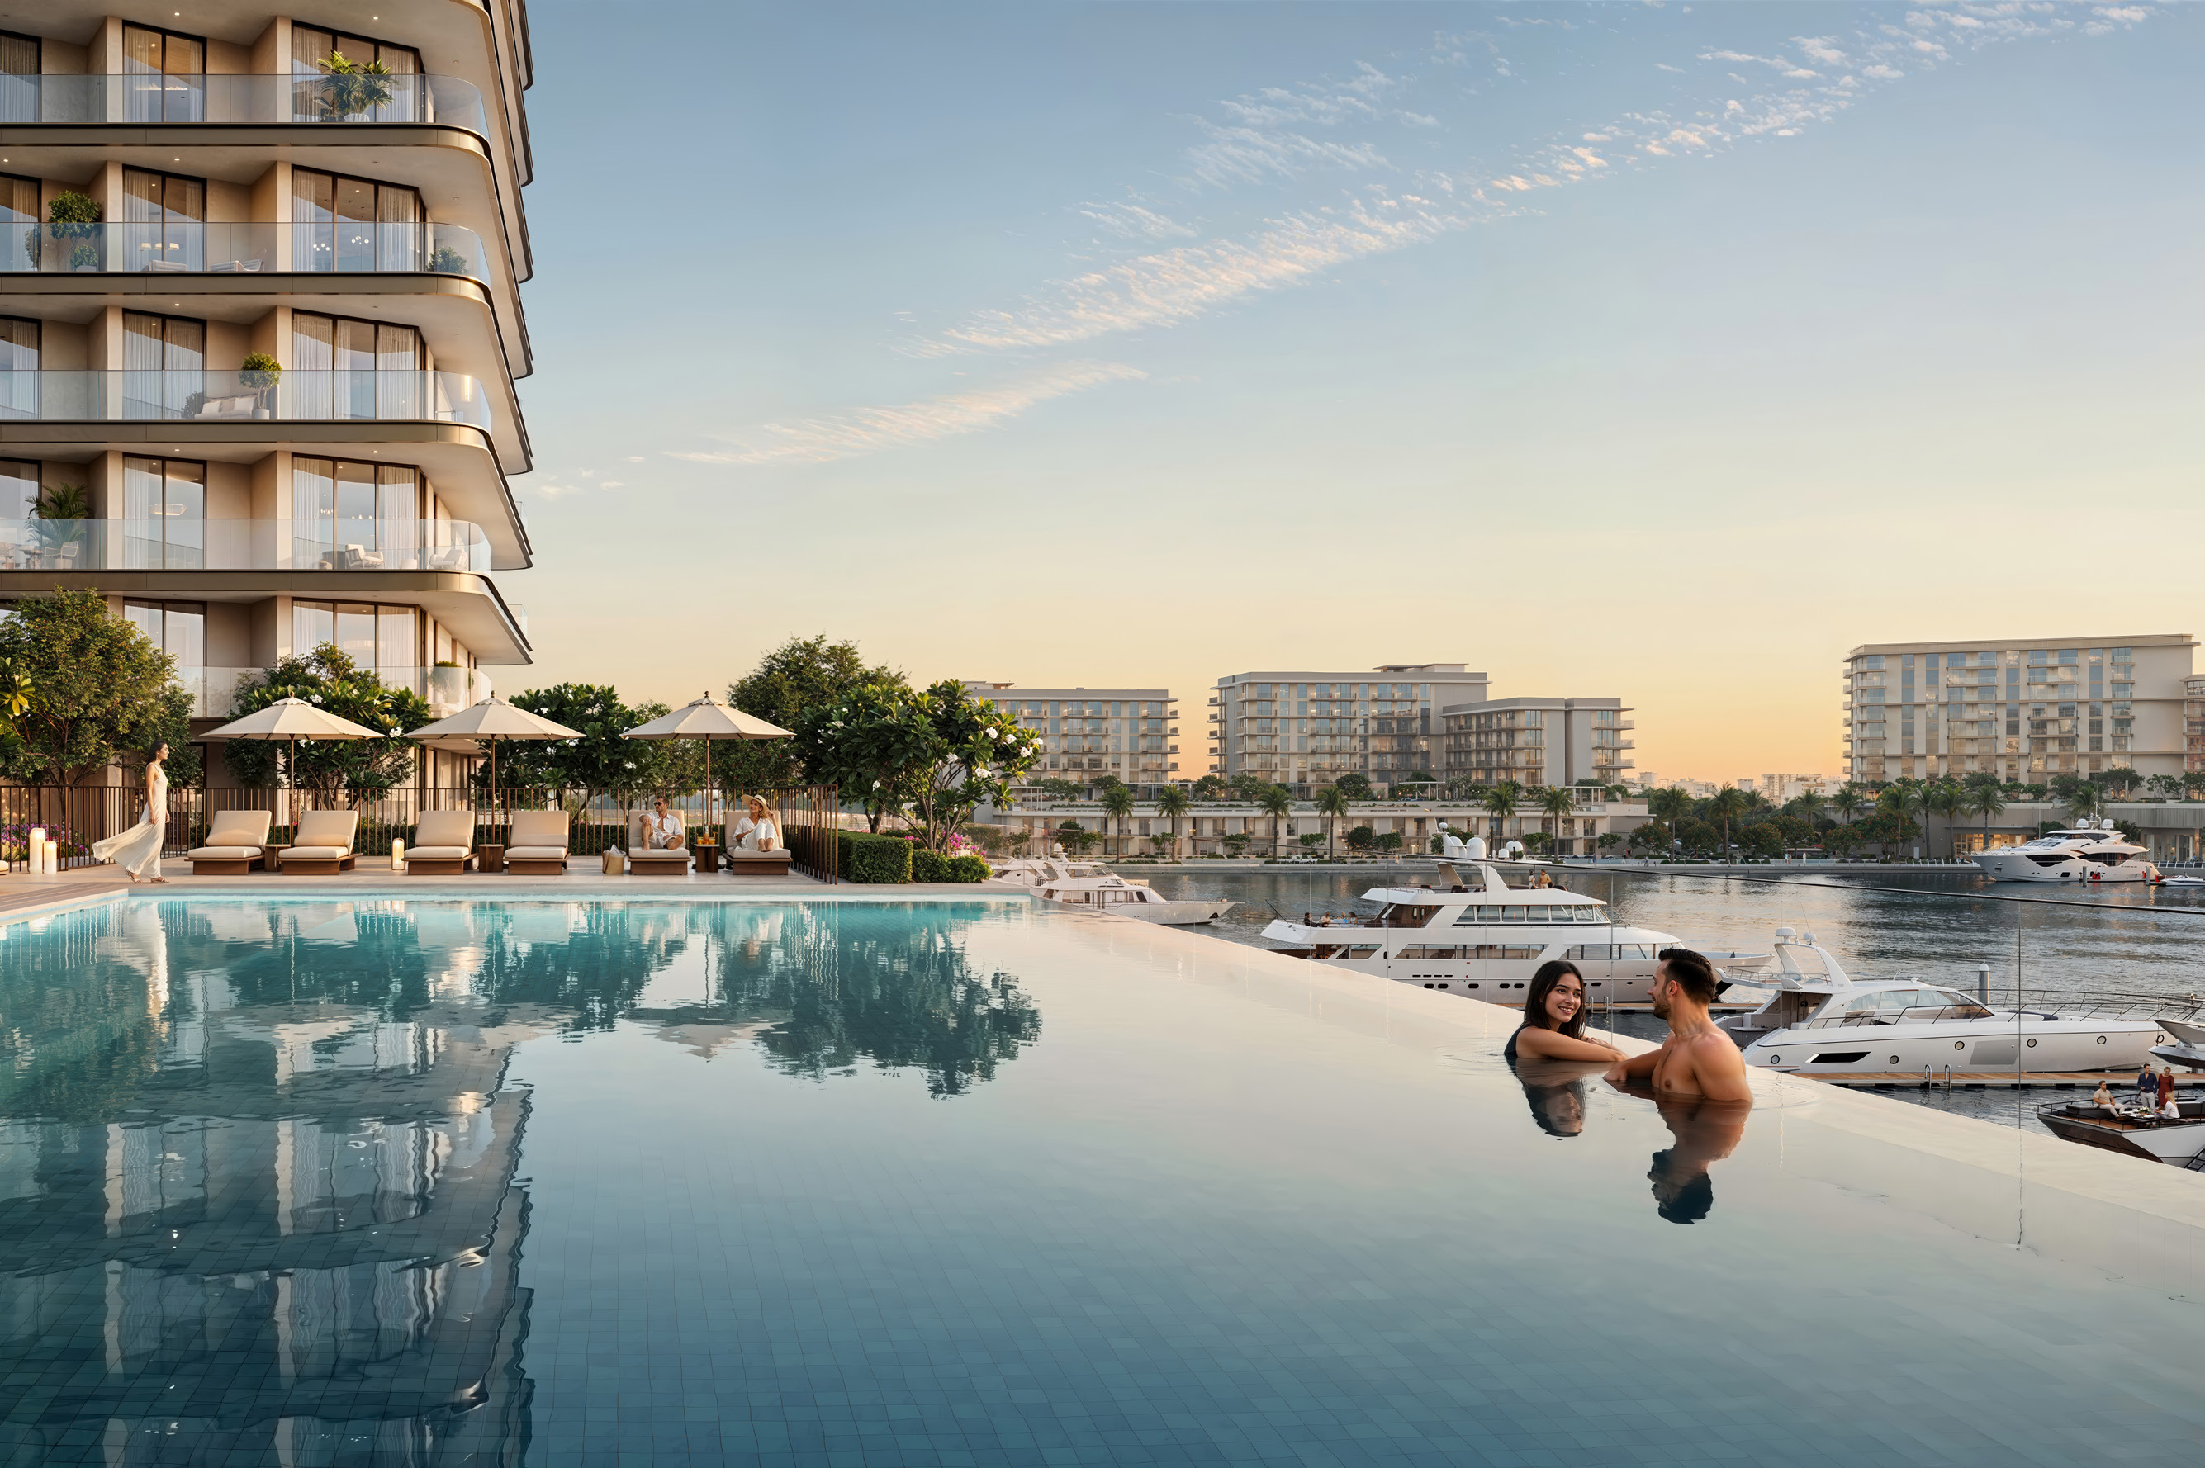
At Fior 1, every experience uplifts the spirit. Set against the
Leisure, Built
soothing waters of the marina, life unfolds effortlessly, from
moments of relaxation and mindful rituals to lively social
for Distinction
interactions. Balance and well-being are at the heart of daily
life, where connections are nurtured, memories are made,
and each day tells a story of refined, timeless elegance.

Slide 9
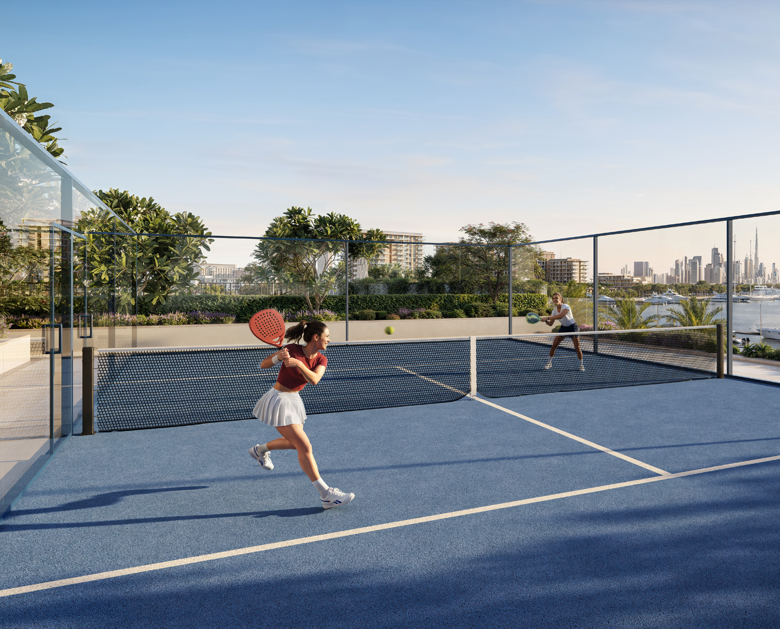
AMENITIES
Abundant Living Where
Well-Being Thrives
Within this azure sanctuary, a dynamic
lifestyle awaits, offering space to move,
gather, play, and grow. Residents can
embrace a mosaic of experiences, from
vibrant social spaces and peaceful retreats.
Rooted in the essence of holistic living,
Fior 1 stands as a gateway to a true sense of
community.
Adult & Kids'
Splash
Pool
Pad
Outdoor
Padel
Gym
Court
BBQ
Outdoor Yoga
Area
Area
Outdoor Kids’
Event
Play Area
Lawn

Slide 10
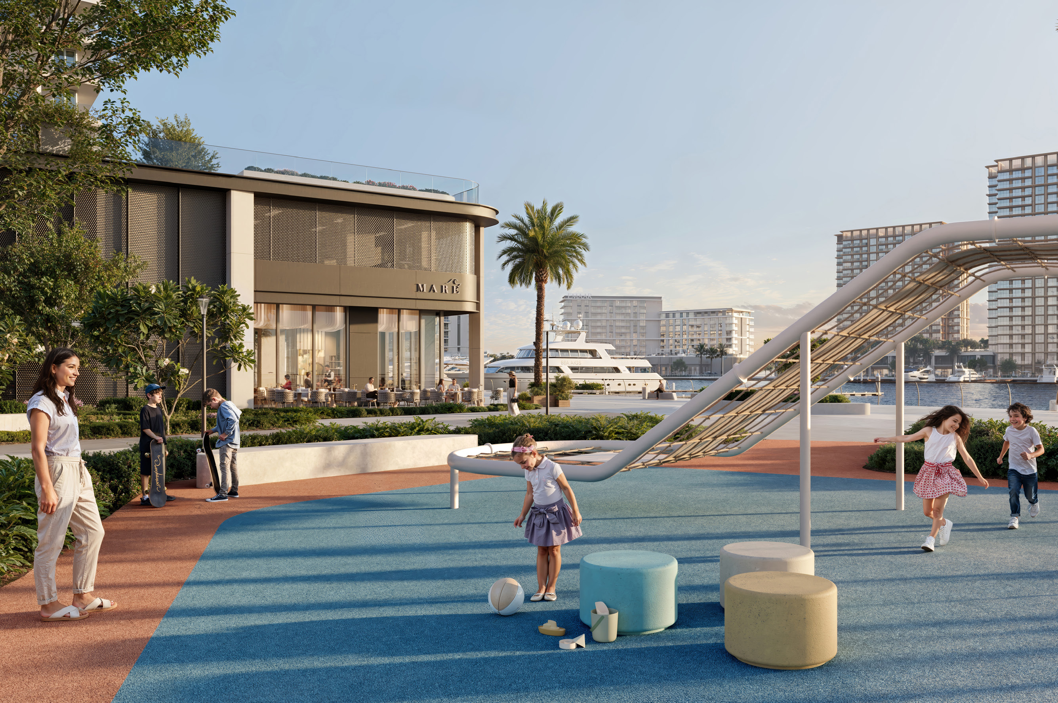

Slide 11
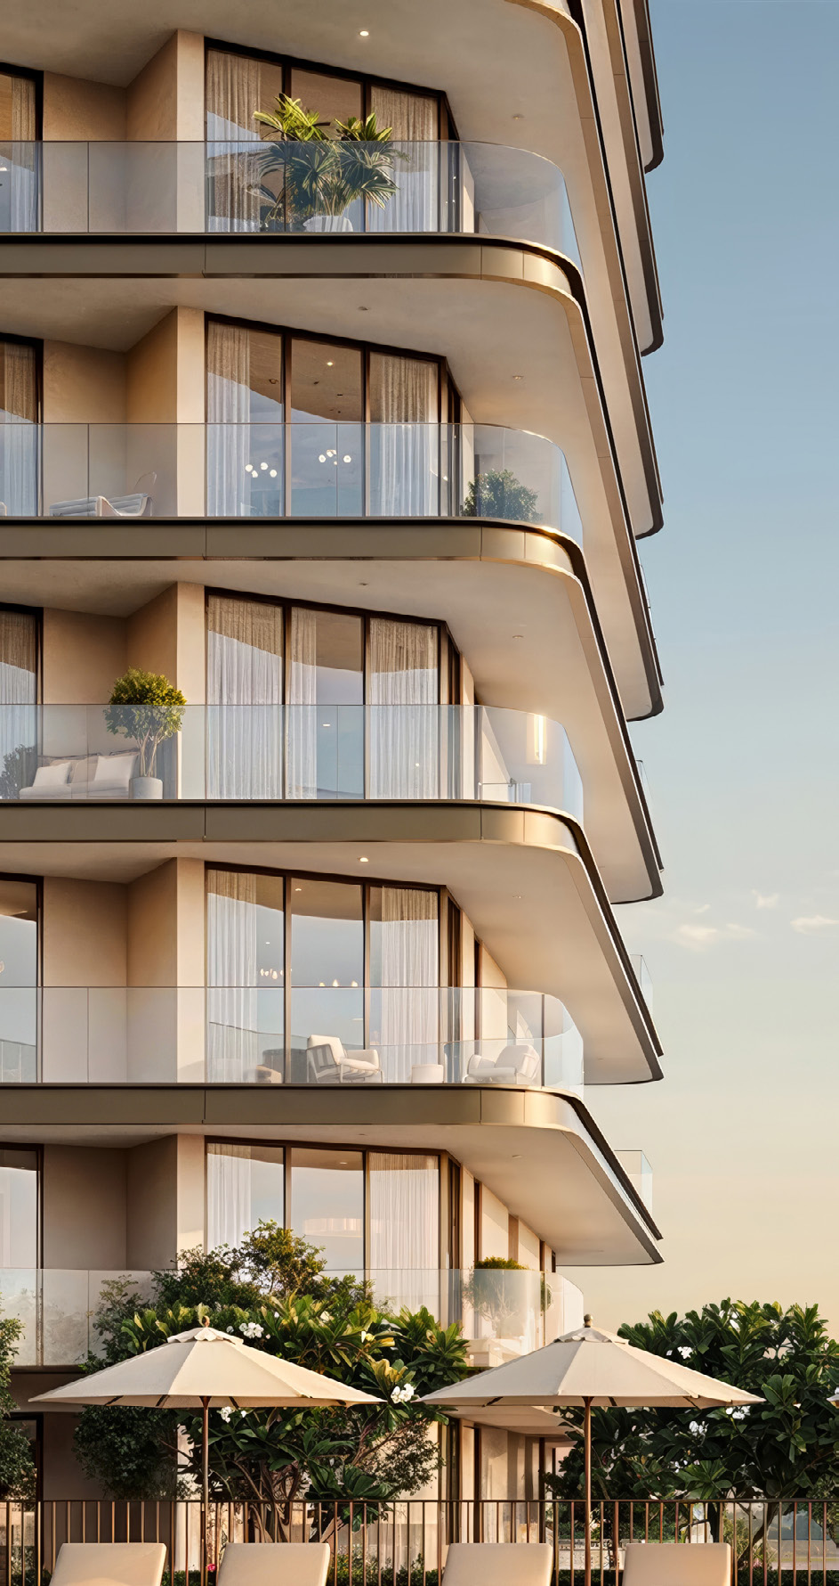
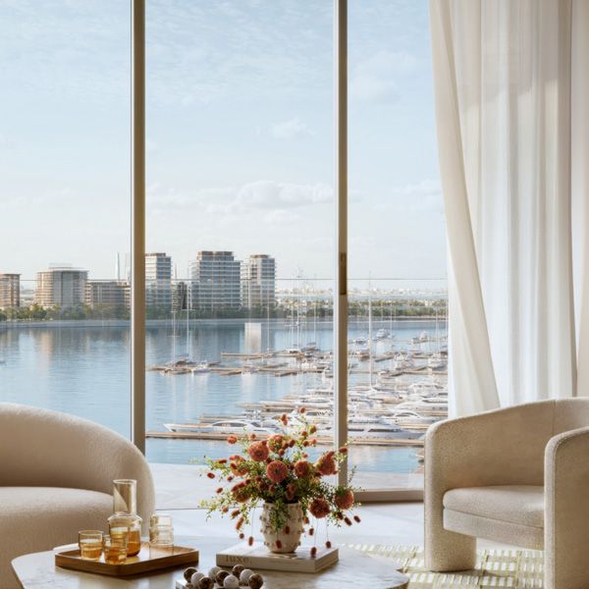
Bold by Design,
Refined by Detail
Exquisitely envisioned and designed, Fior 1 stands as
a striking architectural statement at Rashid Yachts &
Marina. This landmark fuses Dubai’s maritime heritage
with contemporary luxury, balancing sophistication
and serenity. The facade opens to the marina and
skyline, amplifying views, light, and privacy, while
every detail re_x001D_ects elevated design.

Slide 12
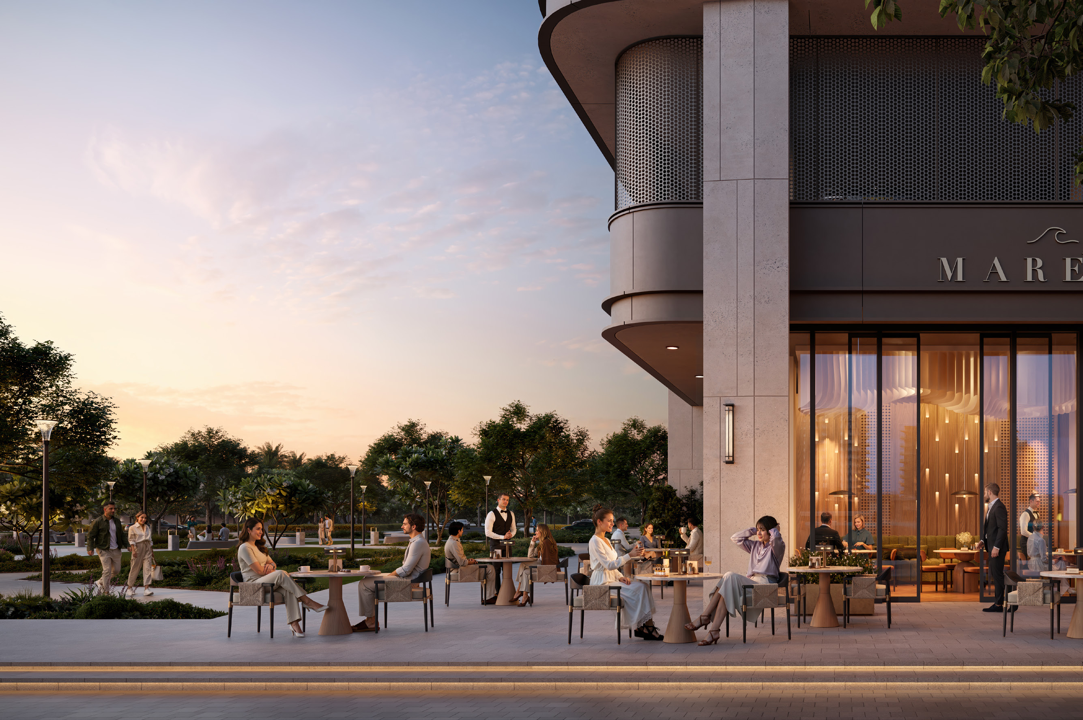

Slide 13
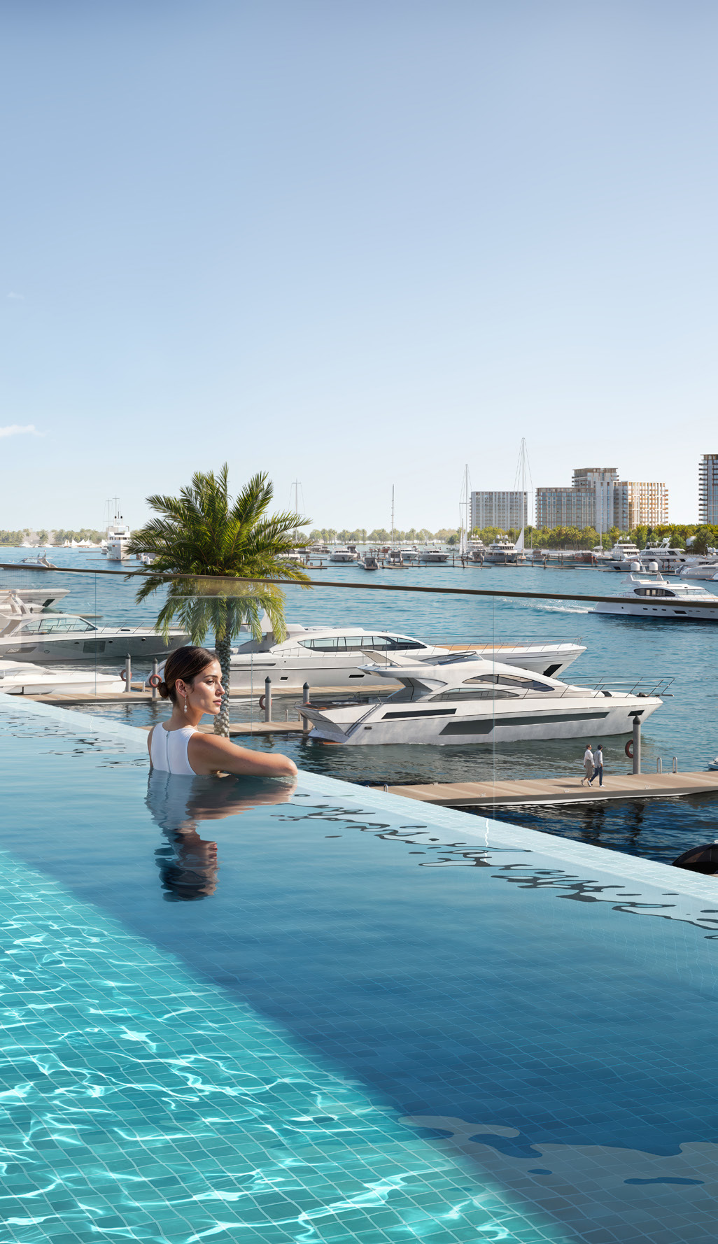
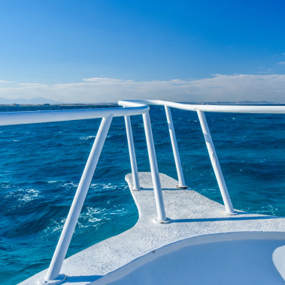
RESIDENTIAL UNIT TYPES
Cultivating
Curiosity
Indulge in restorative and nurturing places,
all framed by the calming waterfront
opulence. Offering 1 to 3-bedroom
apartments, each home combines unrivaled
style with refined architectural precision,
complemented by contemporary elements
and layouts that maximize waterfront views.

Slide 14
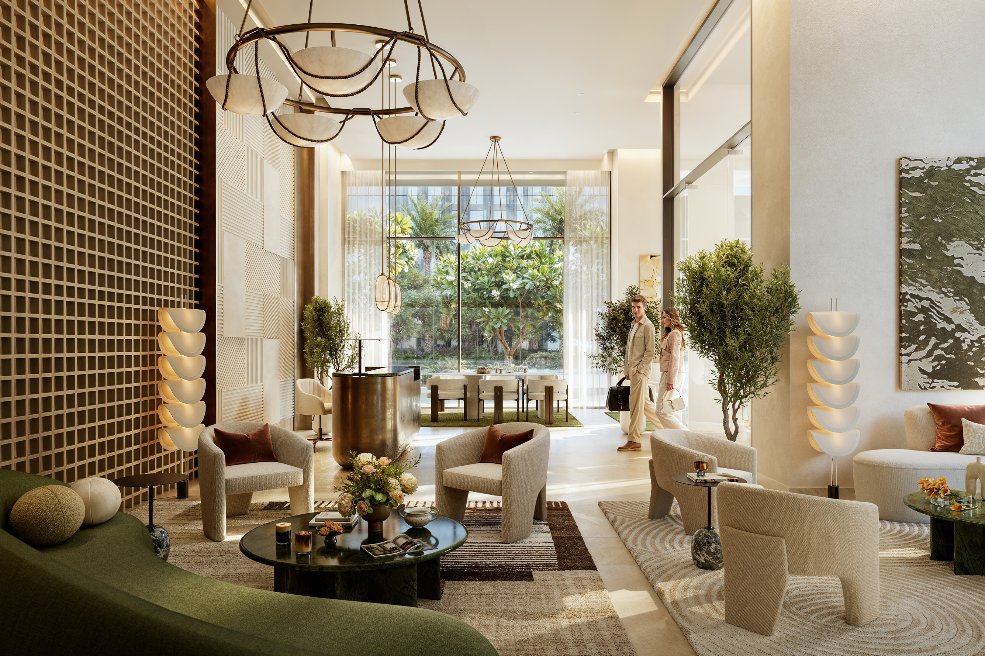

Slide 15

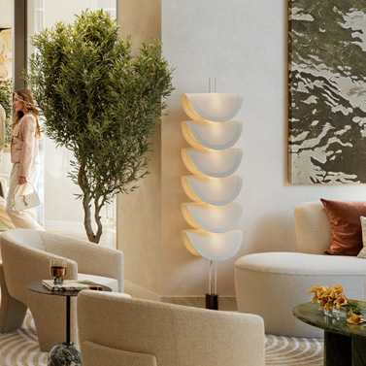
INTERIORS
Intimate Luxury,
Harmonious
Spaces
Each room evokes a sense of refined
calm, with neutral color palettes and
curated furnishings creating an intimate
ambiance of elegance and calm. The
very essence of sophisticated lifestyle
and expert craftsmanship warms
these distinctive homes, giving them a
signature design identity.

Slide 16
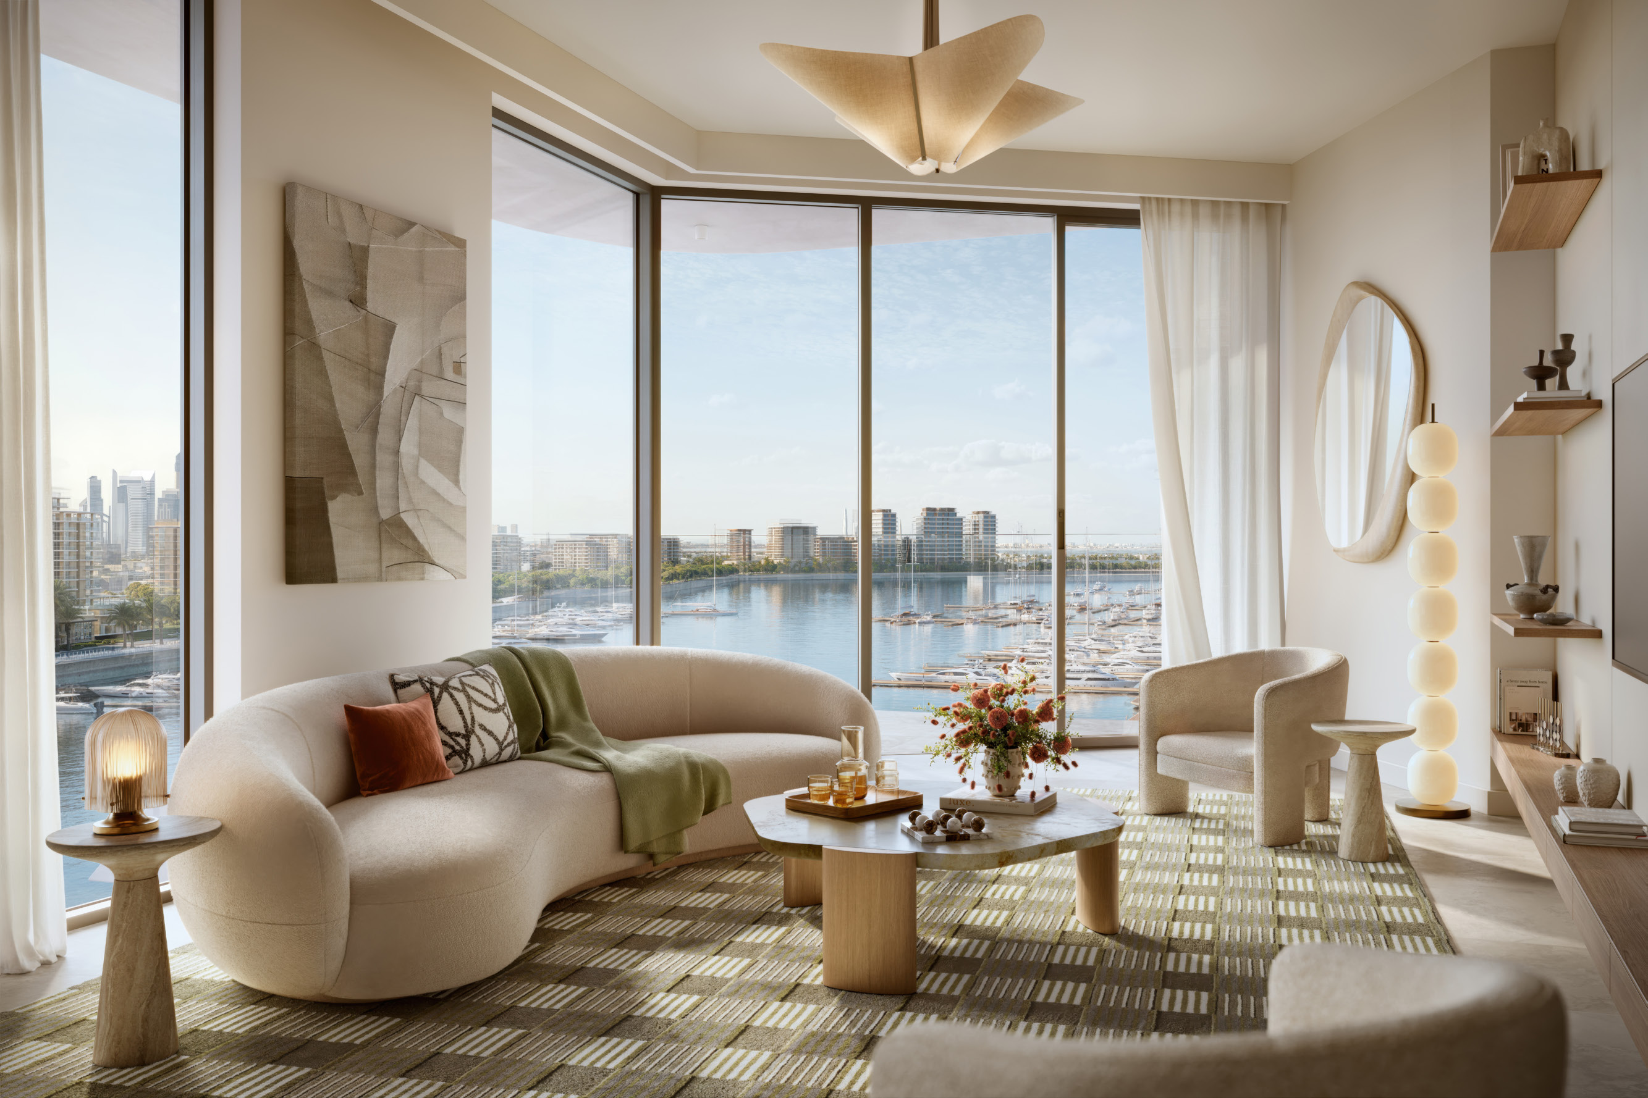

Slide 17
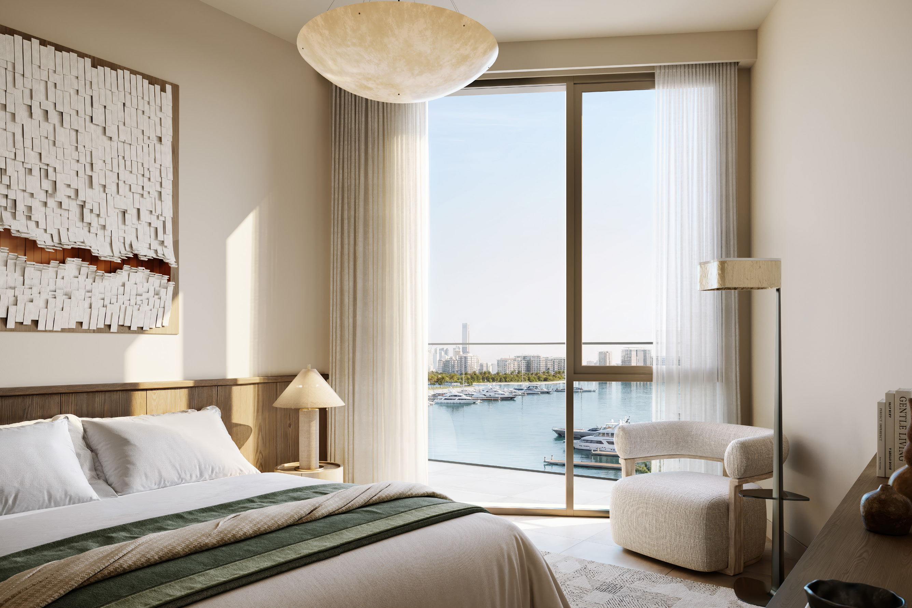

Slide 18

NEARBY ATTRACTIONS
Premier
Superyacht
Club
At the very heart of Rashid Yachts &
Marina lies a world-class destination for
superyachts, featuring 430 wet berths
accommodating vessels up to 100 metres.
With flexible options for short-term visits,
seasonal docking, or year-round mooring,
yacht owners enjoy seamless access to the
marina while experiencing the vibrancy of
Dubai’s iconic coastline.

Slide 19
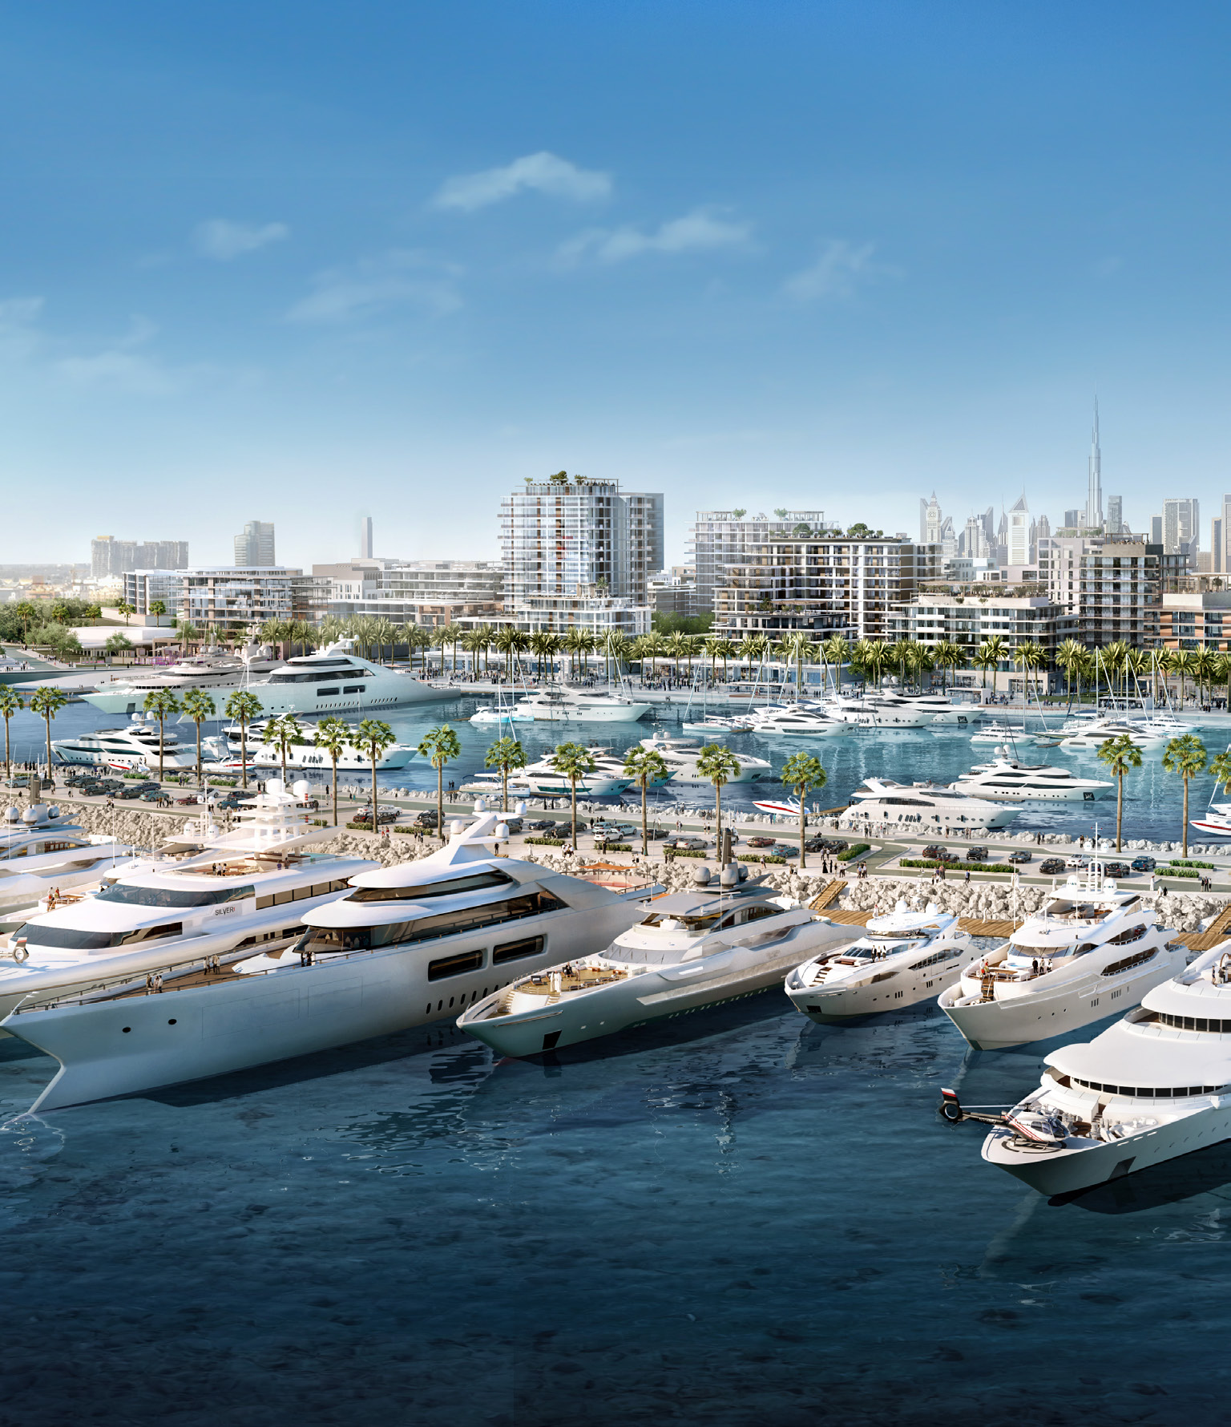
NEARBY ATTRACTIONS
Vibrant Marina
Promenade
Just steps from Fior 1, the Marina
Promenade is a vibrant waterfront hub.
From trendy boutiques and gourmet
restaurants to curated leisure spaces, the
boulevard pulses with energy while being
framed by lush parks and open green areas.
It’s where the rhythm of city life blends with
the calm of the marina, o_x001E_ering residents
endless opportunities to dine, shop, relax,
and connect.

Slide 20
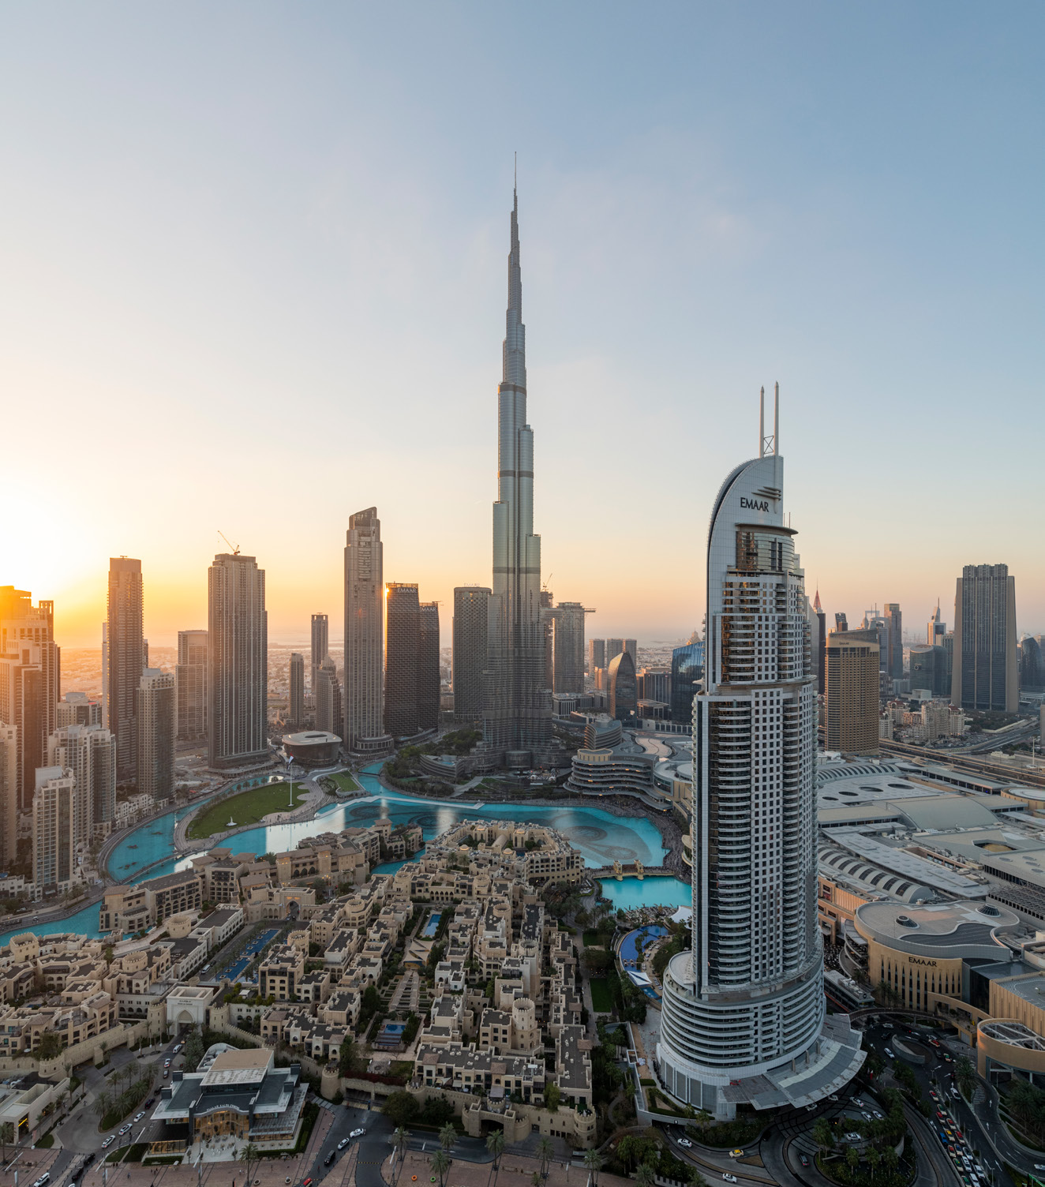
Global Lifestyle
Developer
A leader in the global real estate market, EMAAR has grown over
the years to become the largest real estate developer outside of
China. You will be investing with one of the best-regarded brands
in the world*.
AED 71.7 Bn
115,000+
Market Cap - FY 2023
Residential Units Delivered
AED 14.4 Bn
12+
Revenue – As on 30 June 2024
Global Market Presence
AED 5.3 Bn
42,200+
Net Profit - H1 2024
Residential Units
Currently Under Development
*As on 30 June 2024

Slide 21
For more information please call 800 36227 (UAE) / +971 4 366 1688 (International) or talk to our Property Advisor directly at
+971 4888 8844 from 9 AM to 7 PM (GST), Monday to Friday.
Visit our online sales centre at emaar.com or any of our Sales Centres across the UAE.
DUBAI
Emaar Sales Centre | Next to Souqa Al Bahar, Downtown Dubai
9:30 AM to 10 PM, Sunday - Friday
9:30 AM to 7 PM, Saturday
Dubai Hills Estate Sales Pavilion| Umm Suqeim Road
Dubai Creek Harbour Sales Pavilion | Ras Al Khor
From 9:30 AM to 7 PM, Sunday - Saturday

