Slide 1
Resistance Gene Identifier (RGI)
Prediction of antimicrobial resistance (AMR) genes in metagenomic sequencing data
Amogelang R. Raphenya (MSc, B. Eng)
Lead CARD developer - McArthur Lab
McMaster University, Hamilton, Ontario, Canada

Slide 2
01
Objective
Identify AMR genes from metagenomic samples without the need for assembly

Slide 3
02
Methods
Use RGI*BWT and CARD datasets

Slide 4
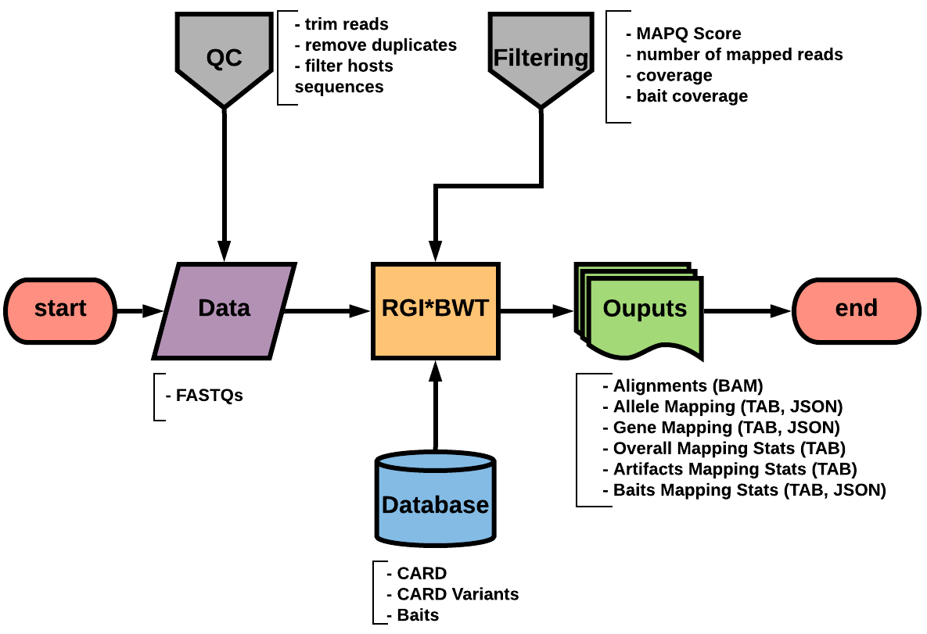
Pipeline: RGI*BWT
https://github.com/arpcard/rgi

Slide 5
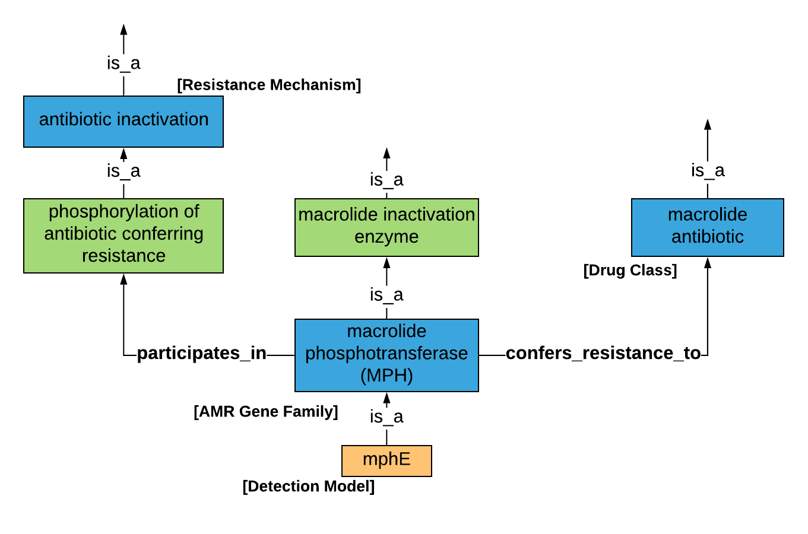
Data: CARD-Canonical

Slide 6
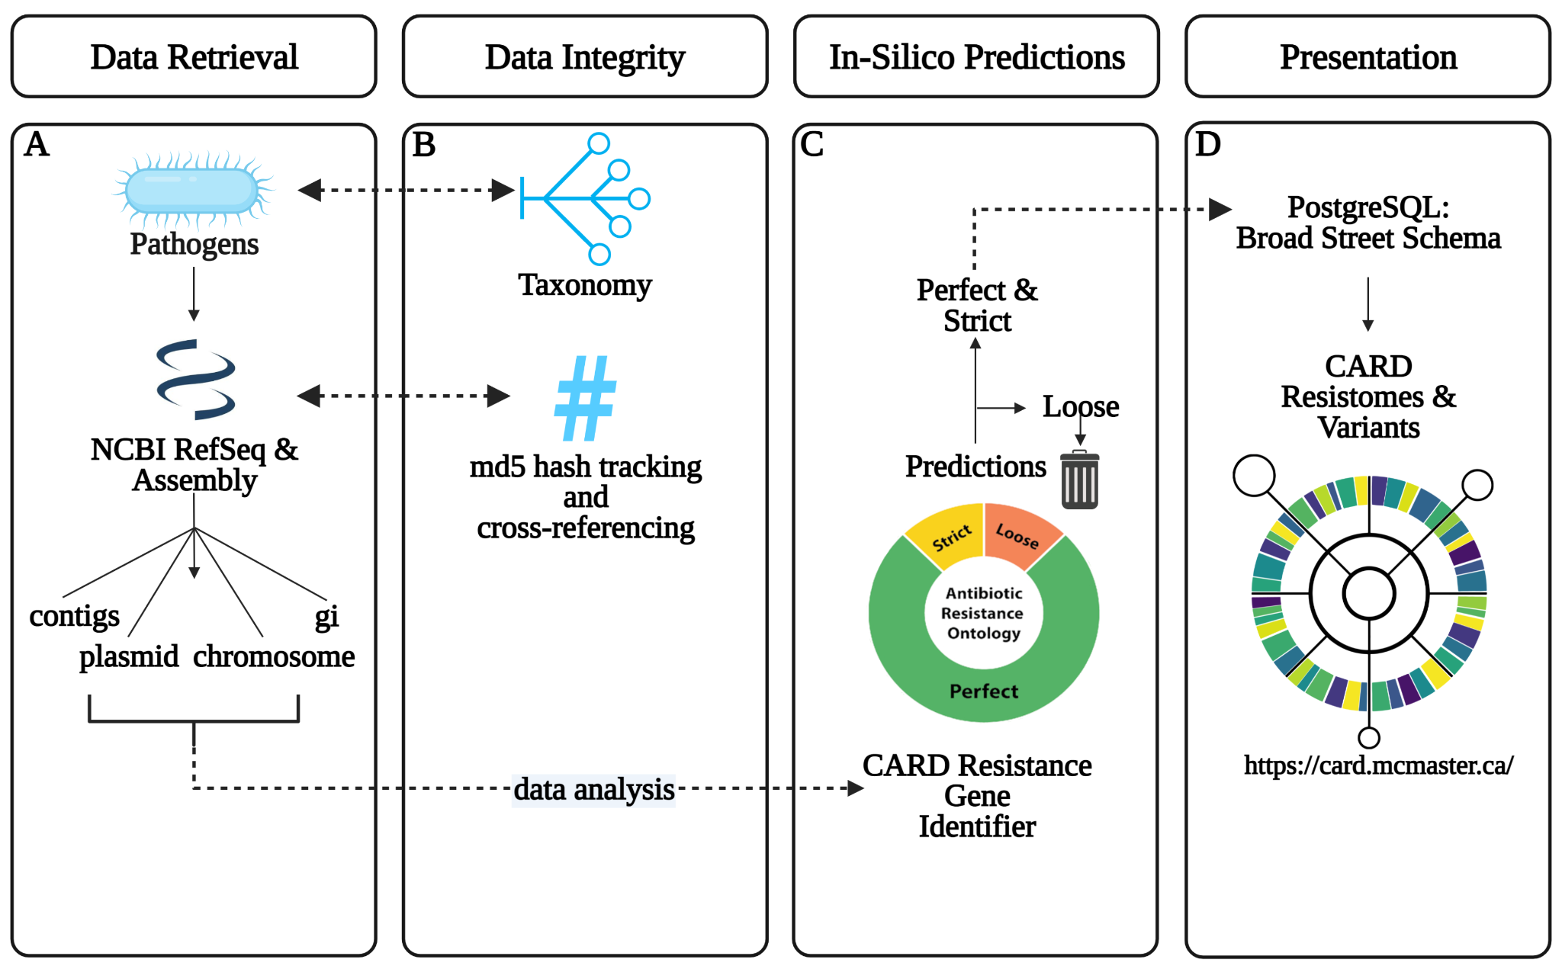
DATA: CARD-Variants
doi:10.1093/nar/gkac920

Slide 7
03
Results
Predicting AMR genes from clinical and wastewater samples

Slide 8
Clinical Samples
Type of data
Clinical isolates
Motives
Evaluate CARD AMR baits Version 1 to pull AMR genes
14 samples
Data collection
Sampled from Hamilton, Ontario, Canada
Sequencing
Target bait capture (CARD baits V1) and shotgun

Slide 9
Wastewater Samples
Type of data
Metagenomic wastewater samples
Motives
Evaluate new CARD AMR baits to pull AMR genes
2 samples
Data collection
Sampled from Hamilton wastewater treatment plant in November 2022 and March 2023
Sequencing
Enriched with allCARD(AC), clinicalCARD (CC), Arbor-synthesized (AO), In-house-synthesized (HO) baits, and Shotgun (SG)

Slide 10
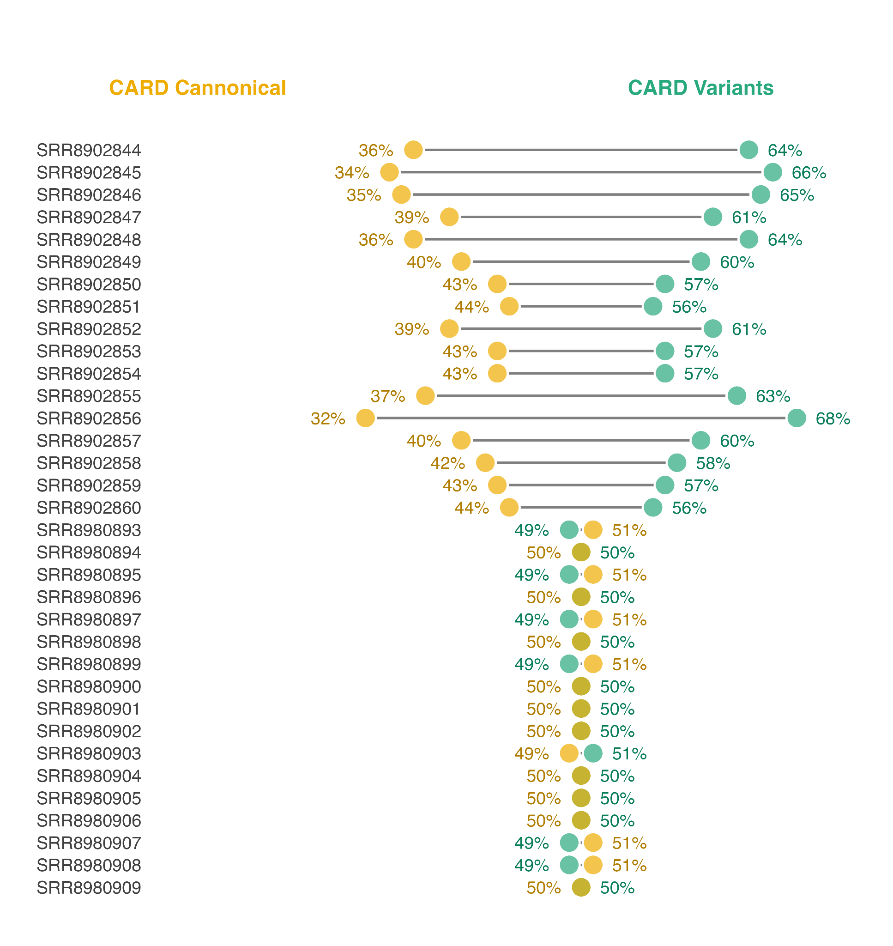
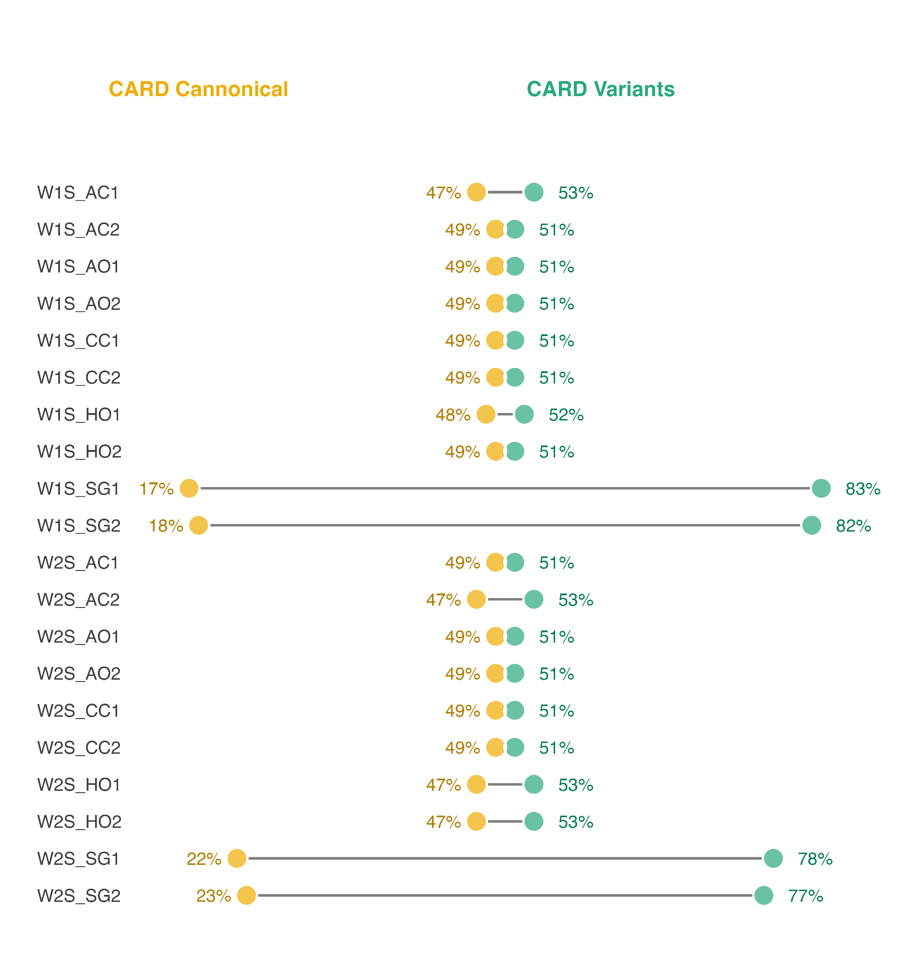
Results
Clinical
Wastewater
shotgun
Enriched
shotgun
Enriched
Enriched
shotgun

Slide 11
04
Conclusion
Bait capture methods and CARD in silico variants helps recover more AMR-related reads

Slide 12
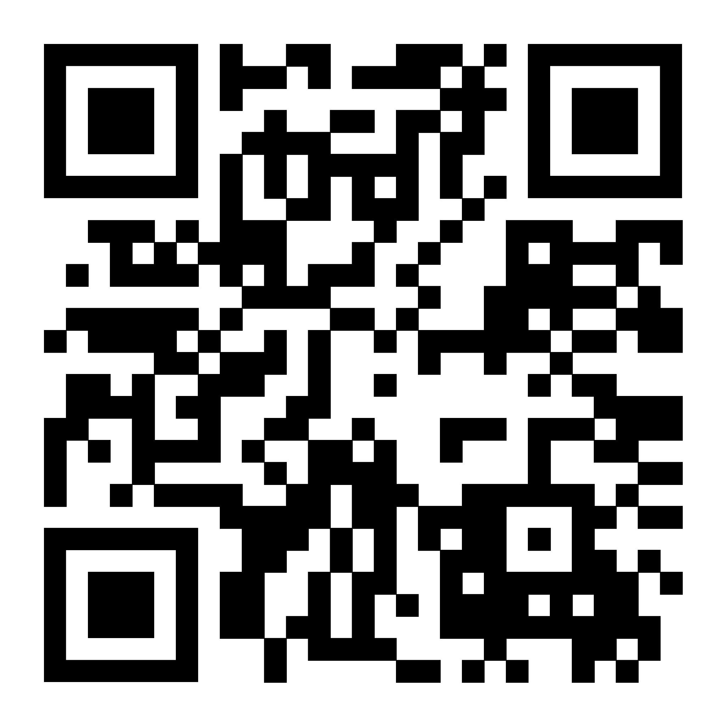
Thanks!
Do you have any questions?
raphenar@mcmaster.ca
My poster is #151 - Poster Session B

Slide 13
05
Supplementary

Slide 14
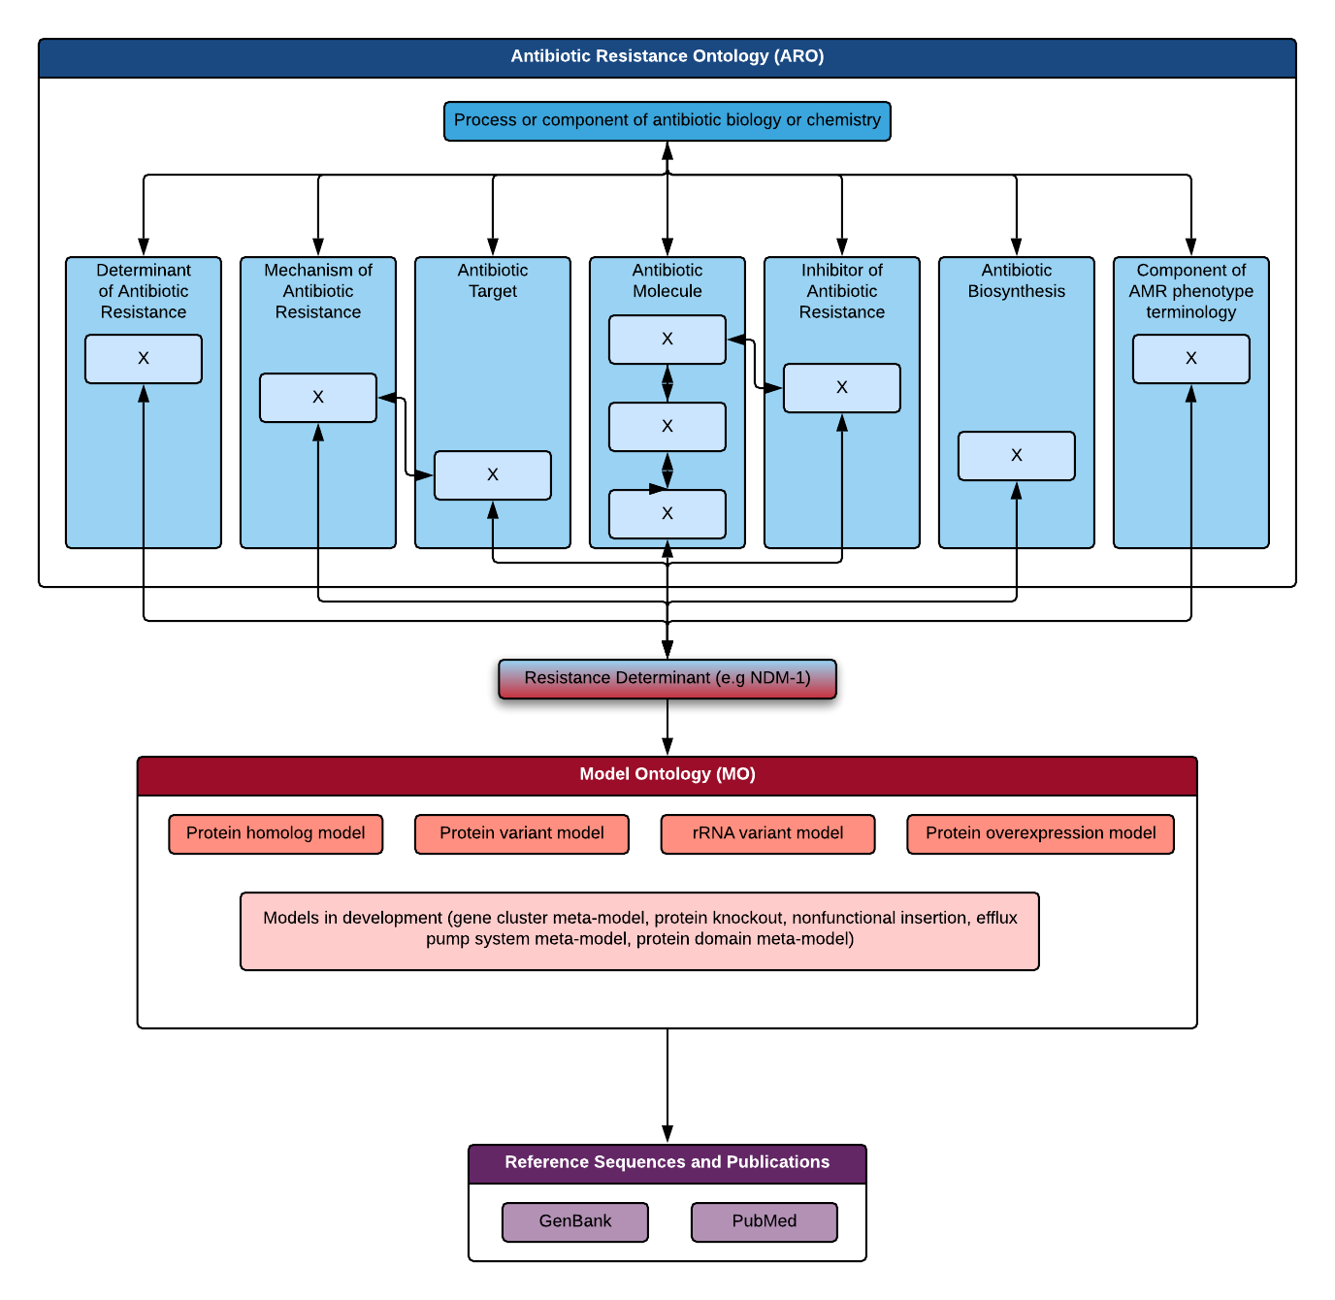
Data: CARD-Canonical

