Slide 1



Preliminary Analysis of the Energy Market
Objective of the Analysis:
Understand the key factors influencing consumers when choosing an energy provider.
Identify and compare the top 5 competitors of Total in the French B2C energy market.
Methodology & Tools Used:
We rely on "Energie-Infos" official price comparator to analyze offers.
Simulations on electricity and gas consumption help compare different providers based
on real-world data.
Criteria for comparison include price, customer service, energy source, and contract flexibility.
Why is this important?
Energy providers vary in pricing, service quality, and sustainability.
Consumers need a clear benchmark to make informed decisions.
The market is evolving, with increased competition and growing focus on
green energy solutions.

Slide 2
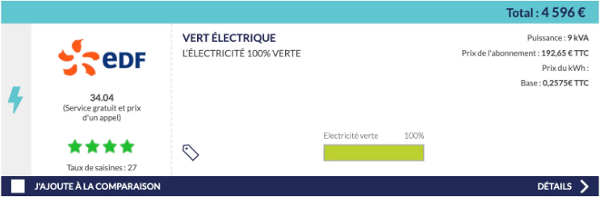
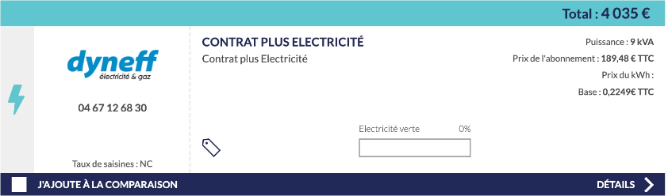
Identification of Key Consumer Criteria
What Matters Most to Consumers?
Price – Competitive pricing per kWh for electricity and gas.
Customer Service – Availability, responsiveness, and quality of support. (Particuliers.Engie.fr)
Energy Source – Preference for renewable energy vs traditional sources. (TRANSITION-ENERGETIQUE.ECO)
Contract Flexibility – Terms, duration, cancellation fees, and payment options. (BOUYGUES-IMMOBILIER.COM)
Provider Reputation – Reliability, customer satisfaction, and market trust. (BON-ENERGIE.COM)
Price, Reputation & Green Energy Simulation: EDF vs. Dyneff

Slide 3
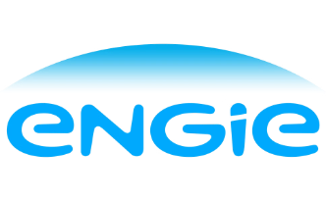




Identification of Total's Top 5 Competitors in France
EDF: The historical electricity provider in France, offering both regulated and market-based tariffs, with a strong
customer base.
Engie: Formerly GDF Suez, France's historical gas provider, focusing on green energy solutions and flexible pricing.
Eni: An Italian energy supplier operating in France, known for competitive pricing and innovative contract options.
Vattenfall: A Swedish provider specializing in green energy offers, promoting sustainability in the French market.
Iberdrola: A Spanish provider offering green electricity plans in the French market.
These companies dominate the French B2C energy market and are key competitors for Total in the French energy ecosystem. They offer varied pricing models, renewable energy options, and service quality levels. Consumers frequently compare these providers when switching energy plans.

Slide 4
Benchmark
Criteria
EDF
Iberdrola
Engie
Eni
Vattenfall
Urban vs Rural
Covers nearly all of France and has no specific rural surcharges.
Covers most of France though promotional deals may vary regionally.
Also nationwide coverage, no major price differences based on location.
Nationwide coverage using standard French distribution networks (no large location-based price differences).
Similar nationwide coverage. Typically no rural vs. urban price gap.
Housing Size
Regulated plus market-based offers. Pricing scales by kWh usage—helpful for different home sizes.
Typically offers tiered contracts (small/medium/large consumption). Online simulator available.
Offers dual-fuel (gas + electricity) tariffs; online tools to estimate costs by home size & consumption.
Multiple contract tiers (small/medium/large usage). Online simulator refines offer by estimated kWh consumption.
Provides green plans with tiered consumption; costs can be estimated through their online simulation tools.
Green evergy
"Vert Électrique" plan is 100% renewable‐backed, but also offers non‐green regulated tariffs.
Provides green add‐ons (100% renewable electricity) or mixed sources, depending on the contract.
Focuses heavily on green transition (ex‐GDF Suez). "Engie Vert" adds a 100% renewable option for electricity.
Partial or full‐green offers ("Eco" or "Green Power") mixing renewables & conventional sources.
Specializes in renewable electricity. Some contracts approach 100% green supply.
Price
Slightly higher on regulated tariffs; market‐based EDF offers can be competitive.
Known for attractive discounts, especially on dual‐fuel plans and online signup deals.
Often competitive for both gas and electricity, especially with new‐customer promotions.
Known to undercut regulated tariffs. Often promotes discounts on dual‐fuel contracts.
Competitive for green energy plans; can offer lower prices if you choose e‐billing/autopay.
Customer Service
Large incumbent with extensive call centers; reliability is generally strong.
Mostly online service; phone support available. User reviews suggest good responsiveness overall.
Solid phone and online support, known for quicker response times. Brand trust is fairly high in France.
Mixed customer reviews on wait times but generally decent.
Smaller share of the French market, but feedback on service is often positive for those seeking green solutions.
Contract Flexibility
No exit fees on market offers; regulated tariffs likewise have no penalty for switching.
Standard 12–24 month contracts, but early termination fees tend to be low or waived for new signups.
Generally month‐to‐month with easy cancellation. Some offers lock in price but allow early cancellation without big fees.
Month‐to‐month or fixed plans; exact exit fees can vary by promotion. Usually minimal.
Typically no exit fee for standard offers; promotional contracts can have short lock‐in periods.
Reputation
Historical electricity provider (ex‐EDF–GDF). Well‐established but sometimes seen as pricier.
Spanish energy giant expanding in France; recognized for competitive rates & green add‐ons.
Formerly GDF Suez—very recognizable in France, has pivoted strongly to greener solutions.
Italian multinational with growing French presence; known for aggressive pricing strategies.
Swedish firm recognized for sustainability leadership. French market share is smaller but growing.

