Slide 1
Campus Green Care Platform
CSE 496
First Presentation
Ahmet Baha ÇEPNİ & Rabia ÇERÇİ
Advisor: Assoc. Prof. Dr. Habil KALKAN
March 2026

Slide 2
Contents
Project Definition
Project Design
Project Requirements
Success Criteria (There will be at least 3)
Project Timeline (with monthly granularity)
References

Slide 3
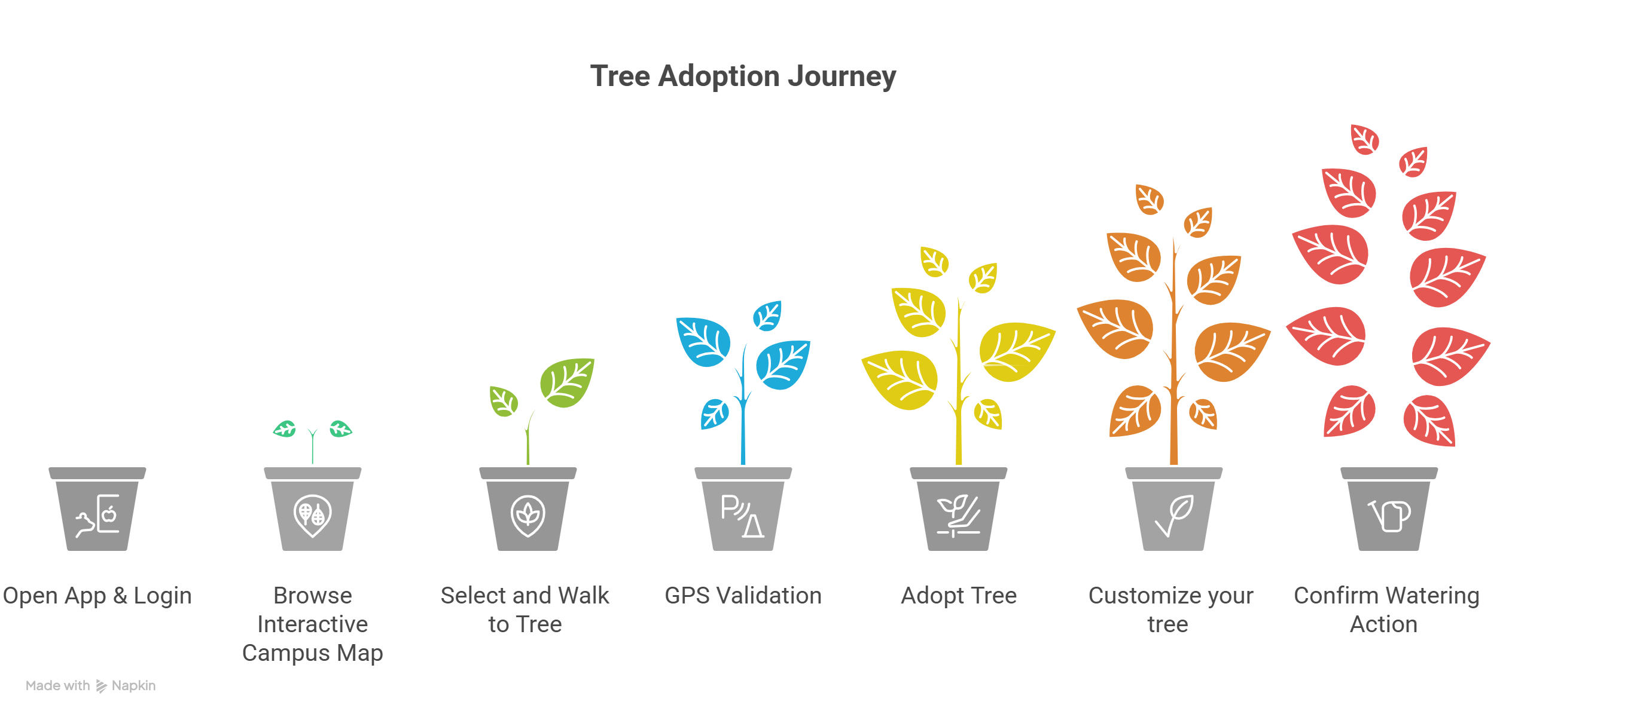
Project Definition
Campus Green Care Platform is a mobile application that digitally tracks campus trees and enables students to adopt and maintain them through watering action that is GPS-verified.

Slide 4
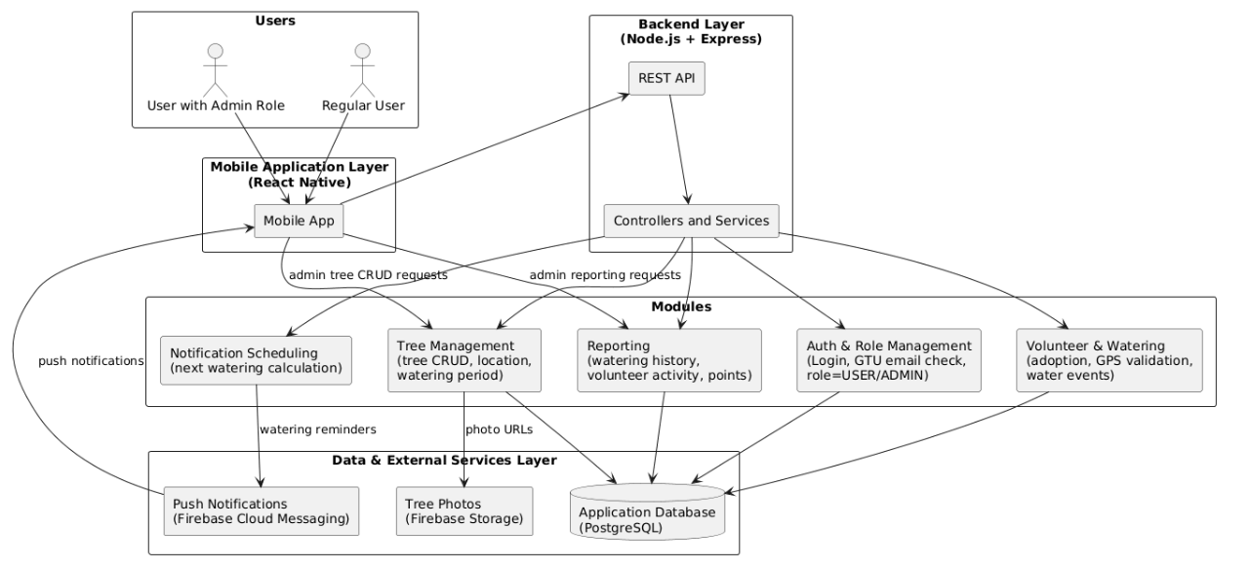
Project Design

Slide 5
Project Requirements
Mobile App (React Native)
Technologies
React Native (TypeScript)
Maps SDK (Mapbox)
Device GPS/location APIs
Firebase Messaging to push notifications
Responsibilities
Render all UI: auth, map, tree detail, adoption, watering, notes, chat, profile, admin screens.
Read device GPS and send coordinates to the backend for watering validation.
Call backend REST APIs to work on database (trees, volunteers, watering events, reports).
Receive push notifications and navigate to the relevant tree or screen when tapped.

Slide 6
Project Requirements
Backend API (Node.js + Express)
Technologies
Node.js with Express and TypeScript
JWT authentication
Firebase Messaging integration
Node-cron module
Responsibilities
Provide REST endpoints for auth, trees, volunteers, watering, notifications, and reports.
Authenticate users, enforce roles (USER/ADMIN), and authorize admin-only operations.
Run scheduled jobs to detect due waterings and send push notifications via FCM.

Slide 7
Project Requirements
Database & External Services
Technologies
PostgreSQL as the main relational database.
Firebase Storage for handling tree photos and other media.
Firebase Cloud Messaging for push notifications to mobile devices.
Responsibilities
Use a reliable, fast relational database that can handle many users and complex relationships
Store and serve tree images via public/secure URLs referenced from the database.
Deliver push notifications generated by the backend (watering reminders, system messages) reliably to user devices.

Slide 8
Success Criteria
Authentication
The system must allow registration only with email addresses ending with @gtu.edu.tr.
The system must authenticate users with JWT and passwords must be stored using hashed encryption.
Performance
The system must correctly display all tree locations on the map.
Tree markers must load on the map within ≤ 2 seconds after the map screen is opened.
The system must support at least 50 concurrent users without performance degradation.
Application Functionality
Each tree must be adoptable by a maximum of 4 users.
Each user must be able to adopt a maximum of 10 trees.
The system must allow watering confirmation only if the user is within 10 meters of the tree.
Every watering action must be recorded in the database.
The system must notify users when the watering time for a tree has arrived.
Users who adopted the same tree must be able to communicate via a chat system.
Users must be able to add notes to a tree page.

Slide 9
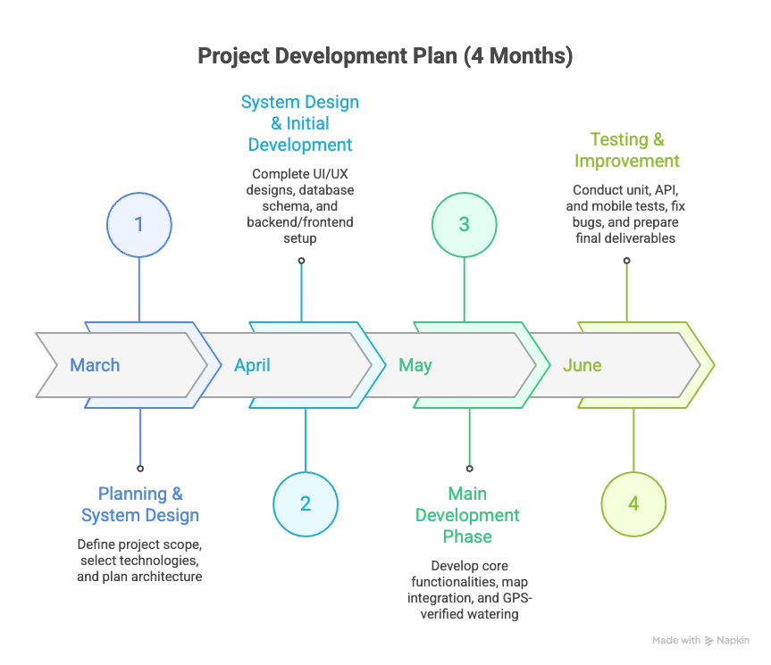
Project Timeline

Slide 10
References
Gautham Vijay, " React Native Geolocation Tracking with React Native Mapbox- Android & İOS Implementation», 2025
PubNub, " Real-Tiem Geolocation Tracking with Native " , 2022

