Slide 1

Metasploit External Resources Portal (codename: MetaKitty)
RapidReach
Submission 2014

Slide 2
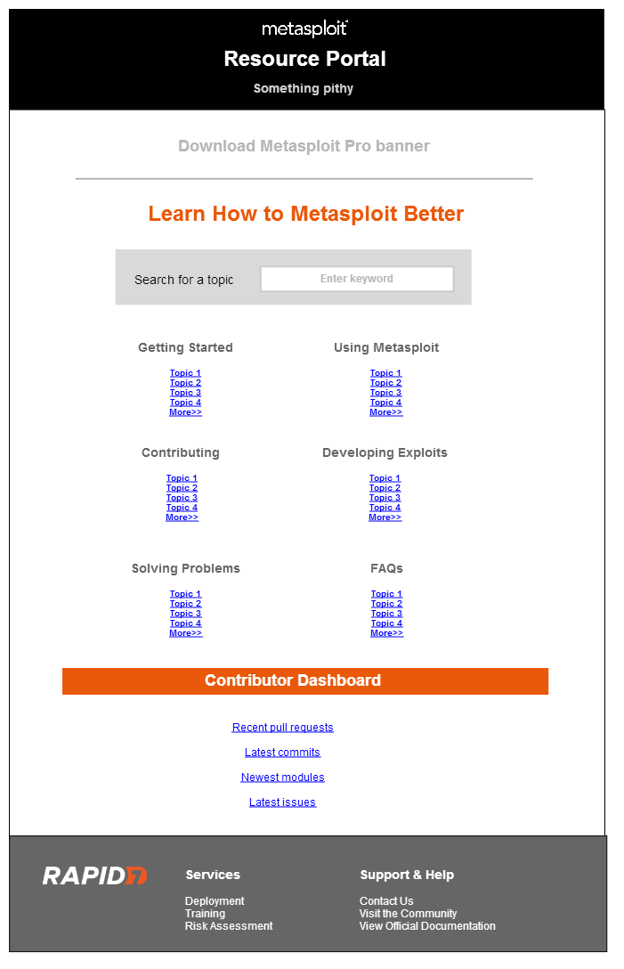

What is the External Resources Portal?
The External Resources Portal is a web application that provides access to Rapid7-approved 3rd party educational and training content for penetration testing and exploit development with Metasploit.
It will be the official, single source of externally created references that we will be able to confidently provide to our customers who want content beyond our official product documentation.
All content will be continuously audited and validated by the Metasploit documentation team and open source community to ensure that only the most accurate content is available to our customers.
EXAMPLE

Slide 3
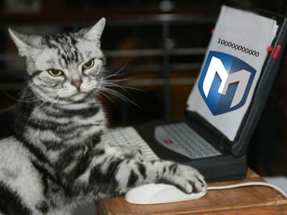

Why do we need the External Resources Portal?
Because there’s a lot of content available online. There are over 65,000 videos on YouTube and almost 1,000,000 Google results related to Metasploit. It’s time consuming and inefficient for our customers to search for up-to-date content using these sources. We need to enable our users to quickly find accurate and reliable content.
True Story.
Recently, Schneider Electric, wanted to learn how to do exploit development, but Rapid7’s “official” documentation couldn’t provide them with the type of content they needed.

Slide 4
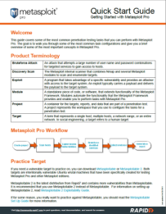






What are we trying to accomplish?
The Peoples’ Republic of Metasploit
“Official” Rapid7 Content
Metasploit User
Super Cool 3rd Party Content
Rapid7 Certified external content

Slide 5
How will we build the portal?
The portal (and all of its website assets) will be built and hosted through GitHub Pages, which enables us to easily create web pages and manage the content with a public repository.
We will build a single web page that links to official R7 documentation and external third party resources that have been certified by Rapid7.
We will need to compile a list of Rapid7-certified external resources to which we will direct our customers.
In addition to the home page, we will build a Contributor Dashboard to track metrics and content for the Metasploit Framework.
Notes:
Fix flowchart (add loop arrow for maintenance)

Slide 6
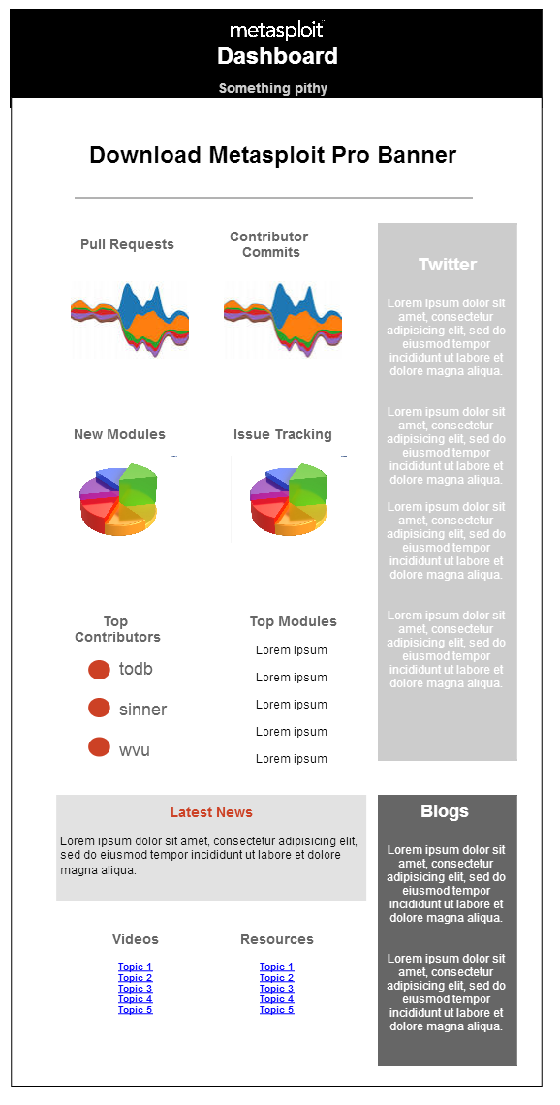
What is the Contributor Dashboard?
The Contributor Dashboard is a web interface that displays the latest Metasploit Framework statistics and provides access to the most recent content and news.
EXAMPLE

Slide 7

Why do we need the Contributor Dashboard?
Because we currently track and share Metasploit Framework statistics through GoogleDocs.
Boring!
The Metasploit Content Team spends a bunch of time creating bi-weekly sprint reports for pull requests, commits, and module stats. The Dashboard will help automate this process for them and present this data in real-time for internal and external stakeholders.
And inefficient!

Slide 8

Why can’t users just go to SecurityStreet?
We have some great content on the Community. Customers can still go there to search the forums and blogs for information. However, as we’ve mentioned, there’s a lot of content available on the internet. We want to point our customers to the best quality content that is out there and control the experience they have with external content.
And because like Google and YouTube, there’s a lot of content on the Community. Trying to search through all of the blogs and discussion threads to find relevant information can be a frustrating process.

Slide 9
How do we decide what goes on the resources list?
Audit content
Validate content
Publish content
Maintain content
Identify the categories of resources we want to cover (e.g., Getting Started, Writing Exploit Code, Contributing, Pro-Tips, etc.).
Create an initial list of popular resources.
Validate the content.
Identify at least 10 resources for each resource category.
Continuously update and validate the list.

Slide 10
How can the community contribute?
By using a public repository, we enable the open source community to help us maintain content.
Pull the repo
Add/update content
Submit pull request
R7 reviews the PR
Merge the PR
Guess what?? This is exactly how we manage community code contributions!!
Of course, it’s our responsibility to ensure that the content on the portal is always valid and up to date.

Slide 11
Why will the portal be useful?
Centralizes resources
Quickly find up-to-date, Rapid7 certified, third party educational content.
Controls quality
Ensures that customers have access to the best quality content available.
Manages content
Easily manage and update portal via pull requests.
Streamlines workflow
Automate sprint reports and stats for the Framework.

Slide 12
What are our goals?
Compile an initial list of popular and accurate third-party sources and identify the resources that are frequently used to address common Metasploit issues.
Define the resource categories.
Review the resources and create an official Rapid7 certified list of externally created Metasploit content that we can share with our users.
Create the GitHub repository to store the portal assets.
Create the web assets for the portal. (Build the website)
Create the web assets for the dashboard.
Test and validate the portal.
Define the processes that will be used to maintain the repository.

Slide 13
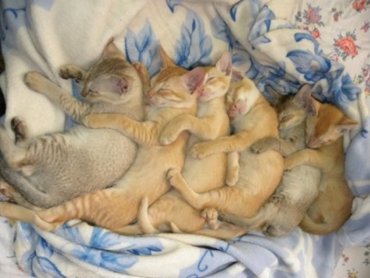
Teamwork!
Tod Beardsley - Set up GitHub repo and create portal assets.
Thao Doan - Curate and validate content.
Alan Lipton – Define requirements and manage and oversee the project.
Nate Sanders - Test and validate portal functionality.
William Vu – Create portal assets.

Slide 14
Milestones
Phase 0 Q2 2014
Create a mockup of the portal. (Thao)
Research GitHub pages, Twitter bootstrap, etc. (Tod/Will)
Set up the GitHub repository for the portal.(Tod/Will)
Identify the resource categories.
Phase 1 Q3 2014
Compile a list of popular resources. (Thao)
Begin content validation. (Thao)
Create the first version of the portal (web pages). (Tod)
Phase 2 Q4 2014
Continue validating resources. (Thao)
Build the dashboard.
Compile a final list of resources for the portal. (Thao)
Create a wiki for maintaining the repository and managing pull requests to the repo.
Phase 3 Q1 2015
Testing and validation occurs. (Nate/Will)
Launch the portal. (Tod)

Slide 15
Schedule and Deliverables
2014
2015
2H14
Create proposal
3H14
Compile an initial list of popular resources
4H14
Content validation continues
1H15
Testing and validation occurs
Portal launch
Research GitHub pages
Set up the GitHub repository
Identify the resource categories
Build web pages
Compile final list of resources
Create a wiki for maintaining the repository
Finish building web pages and assets
Create wireframes
Develop project plan
Begin content validation

Slide 16

Thank you!

