Slide 1



Fractals as a Bridge Between Human Vision and Neuromorphic Computing
Practical Applications with Robert Newport, PhD.
Rapid Analysis PTY LTD, Computational NeuroSurgery Lab.

Slide 2

Background
Honorary member of Computational NeuroSurgery (CNS) Lab
Machine Learning and AI Consultant: Weburban PTY LTD
Embedded Hardware Developer: Rapid Analysis PTY LTD
Research PhD awarded by Macquarie University
MSE & RI Practicum from Carnegie Mellon University
https://scholar.google.com/citations?user=TWC3FrYAAAAJ
* Not a clinician or biologist

Slide 3
What is Neuromorphic computing?
Neuro meaning brain and morphic meaning structure.
Communication where information is transmitted through discrete event-driven rather than continuous activation signals.
Highly energy efficient and sparse.
Computation and power consumption are asynchronous enabling
massive parallelism.
Wang, X.; Zhu, Y.; Zhou, Z.; Chen, X.; Jia, X. Memristor-Based Spiking Neuromorphic Systems Toward Brain-Inspired Perception and Computing. Nanomaterials 2025, 15, 1130.

Slide 4
Presentation Hypothesis
Given: The brain's visual system is widely considered the best understood of the five sensory systems.
Given: Multiple large filtering mechanisms exists between retinal visual processing and the brain’s executive function.
Posit: Fractals can be a useful tool to assist in emulating human perception by measuring and filtering complexity during computational machine vision processing.

Slide 5
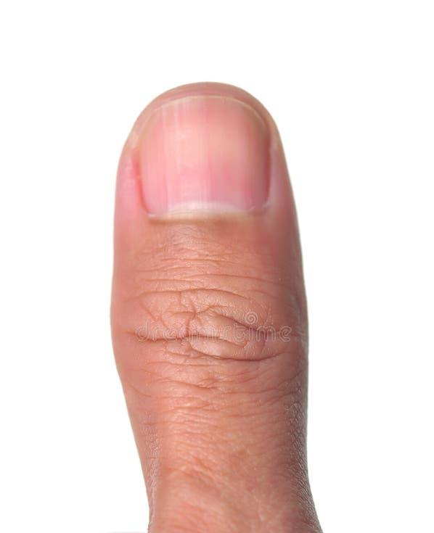
The User Illusion: Physical Demonstration
Tor, Norretranders. "The User Illusion." New York5 (1991).

Slide 6
Human Biological Visual Processing Speeds
Measurement Point | Information Rate
Sensory Gathering | ~1 Billion (10⁹) bits per second
Retinal Bandwidth | 10 to 11 million bits per second
Optic Nerve Bandwidth | ~6 million bits per second
Visual Cortex (V1) Bandwidth | ~10,000 bits per second
Conscious Thought & Awareness | ~10 to 60 bits per second
Zheng, Jieyu, and Markus Meister. "The unbearable slowness of being: Why do we live at 10 bits/s?." Neuron 113.2 (2025): 192-204.

Slide 7
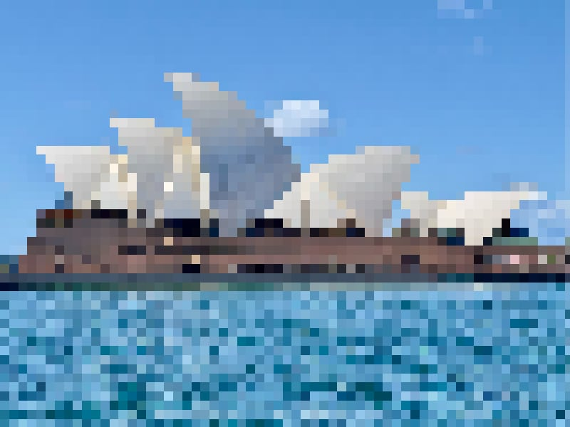
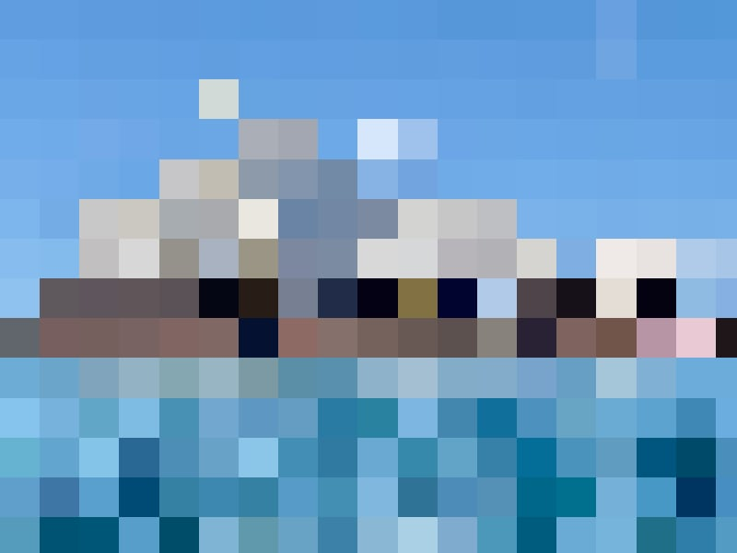
Machine Vision

Slide 8
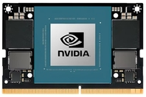
Machine Visual Processing Speeds
Measurement Point | Information Rate
Sensory Gathering (Sensor) | 576 million bits per second
Retinal Bandwidth (MIPI CSI-2 interface) | 20 billion bits per second
Optic Nerve Bandwidth (Memory Bandwidth) | 102 billion bits per second
Visual Cortex (V1) (CUDA Processing) | 120 billion bits per second
Conscious Thought & Awareness | 10 bits represent 1000 classes in ResNet
Measurements for the NVIDIA Jetson Orin Nano (around $500 USD).

Slide 9
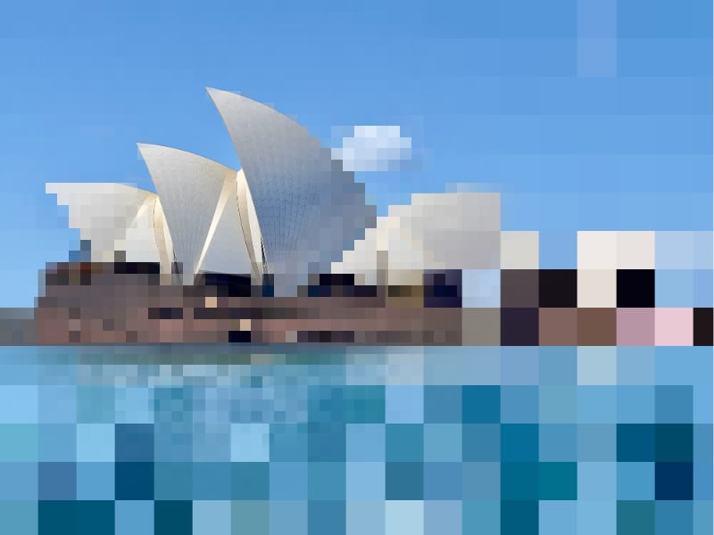
Foveated Rendering
Gaze-contingent and spatial acuity-based rendering by Guenter, Brian, et al. "Foveated 3D graphics." ACM transactions on Graphics (tOG) 31.6 (2012): 1-10.

Slide 10
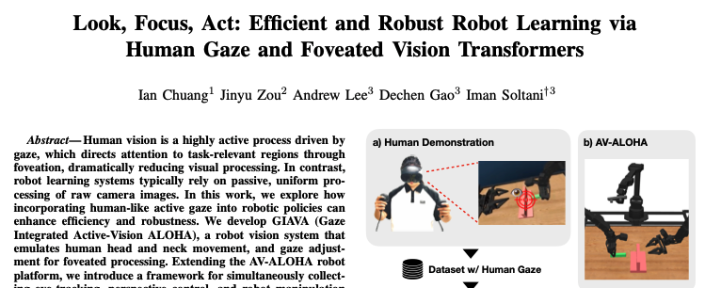
Robotic Perception
“Human vision is a highly active process driven by gaze, which directs attention to task-relevant regions through foveation, dramatically reducing visual processing. In contrast, robot learning systems typically rely on passive, uniform processing of raw camera images.”

Slide 11
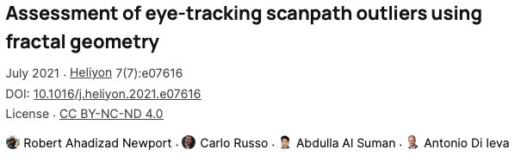
Fractals Dimension and Gaze Outliers
Fractal Dimension can be used to measure gaze outliers, hinting at the likelihood of a physiological average gaze fractal dimension.

Slide 12
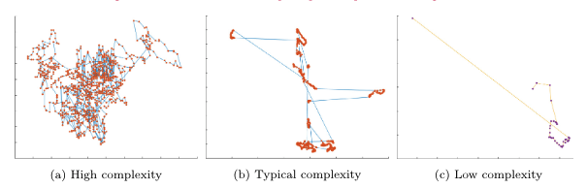
Fractals used to find outliers
Scanpaths illustrating the relationship between geometrical complexity and HFD values, (a) high complexity HFD = 1.9596, (b) average complexity HFD =1.5672, and (c) low complexity HFD = 1.1515.

Slide 13
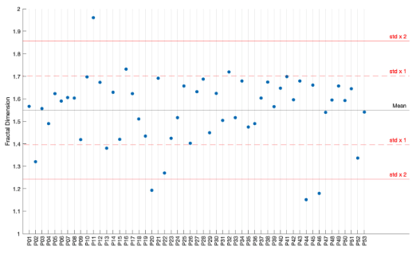
Fractals used to find outliers
Scatter plot with two standard deviations from the mean of all contributing participant Higuchi fractal dimensions (HFDs).

Slide 14
Pseudo Code Demonstrating Inattentive Machine Gaze
A simple demonstration approximates a fractal dimension of ~1.5 using fractional Brownian motion (fBm) to generate correlated randomness.
Given a stimulus boundary of width and height, and a finite number of points, and a naive step value of 5 to simulate gaze distance, we can perform some simple pseudo code as a basic neuromorphic robotic vision scanner.
See next page.

Slide 15
width = 1920 # stimulus boundary
height = 1080
N = 100 # number of fixation points
H = 0.5 # Hurst exponent → fractal dimension ≈ 1.5
step = 5 # distance between fixations
x, y = 960, 540 # start near centre to simulate orbital reserve
points = [] # array of fixation points
for i in 1..N:
# sample a random value from a normal distribution
dx = gaussian_noise(mean=0, std=step) * (i ^ -H)
dy = gaussian_noise(mean=0, std=step) * (i ^ -H)
x = clamp(x + dx, 0, width)
y = clamp(y + dy, 0, height)
points.append((x, y))

Slide 16
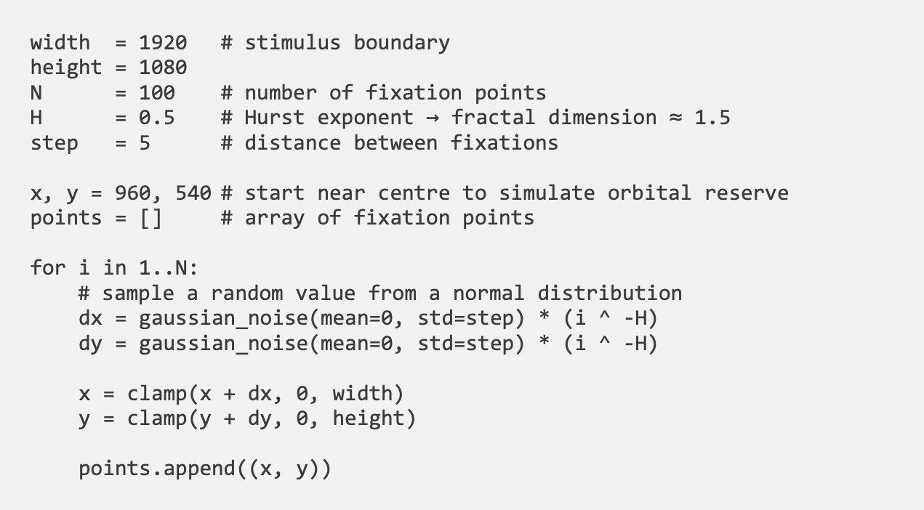

Slide 17
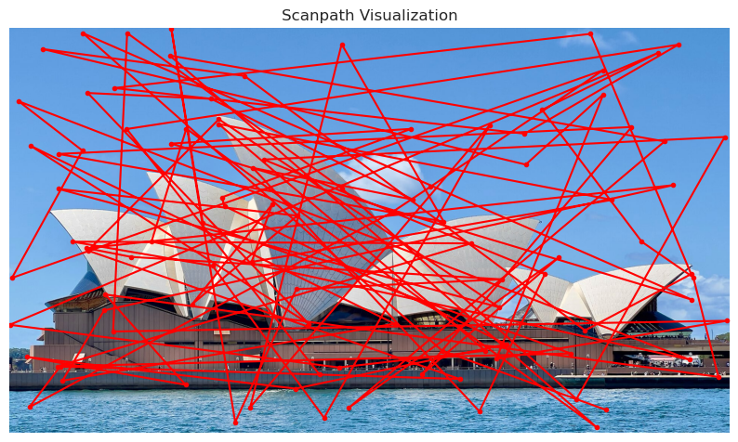
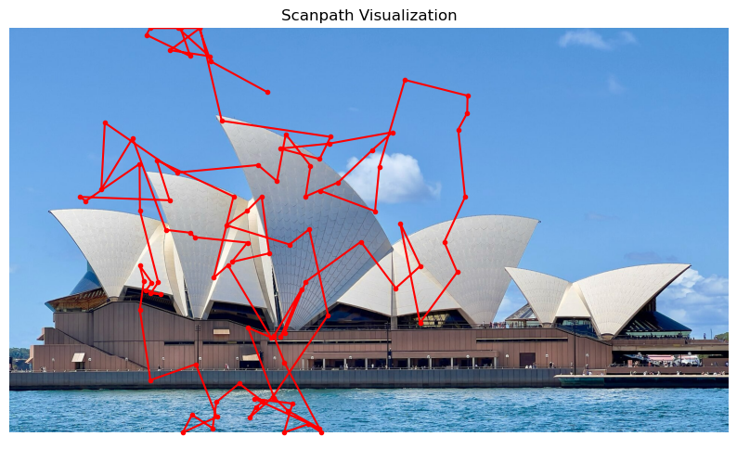
Random, n=100
Fractal, n=100

Slide 18
Conclusion
Current state of the art in neuromorphic machine vision systems can be adapted using fractal dimension to perform visual search.
Compute resources for image processing can be scaled up to better scrutinise details in regions of interest to increase performance, as demonstrated by neurological filters in human vision.
Future work can incorporate other visual effect such as inhibition of return, anisotropic effects, Gestalt Grouping Principles, Contrast Adaptation, visual attraction mechanisms, and others.

