Slide 1

CAFÉ BILLING SYSTEM

Slide 2
INDEX
OBJECTIVE
FEATURES / FUNCTIONALITY
REQUIREMENTS
PROJECT MANAGEMENT
BILLING SYSTEM DATA FLOW DIAGRAM
OUTPUT SCREENSHOT
CONCLUSION
FUTURE ENHANCEMENT

Slide 3
OBJECTIVE
Automate the current manual bill generation system and maintain the searchable customer, products database and product invoice, maintain the data security, user rights.

Slide 4
FEATURES 1-login section –In computer security , “logging in” is the process by which an individual gains access to a computer system by identifying . 2-customer details-CRM(customer –relationship management) is more important than ever to business because it can help you to gain new customer . 3-BILLING- billing software design to handle time and billing tracking as well as invoicing customers for services and products.

Slide 5
REQUIREMENTS
USER REQUIREMENTS’
SYSTEM REQUIREMENTS’

Slide 6
USER REQUIREMENTS
BASIC UNDERSTANDING OF UNIX ENVIORNMENT TO COMPILE THE CODE SUCESSFULLY.

Slide 7
SYSTEM REQUIREMENTS
SOFTWARE REQUIREMENT
FRONT END- C
Operating System – UNIX/LINUX

Slide 8
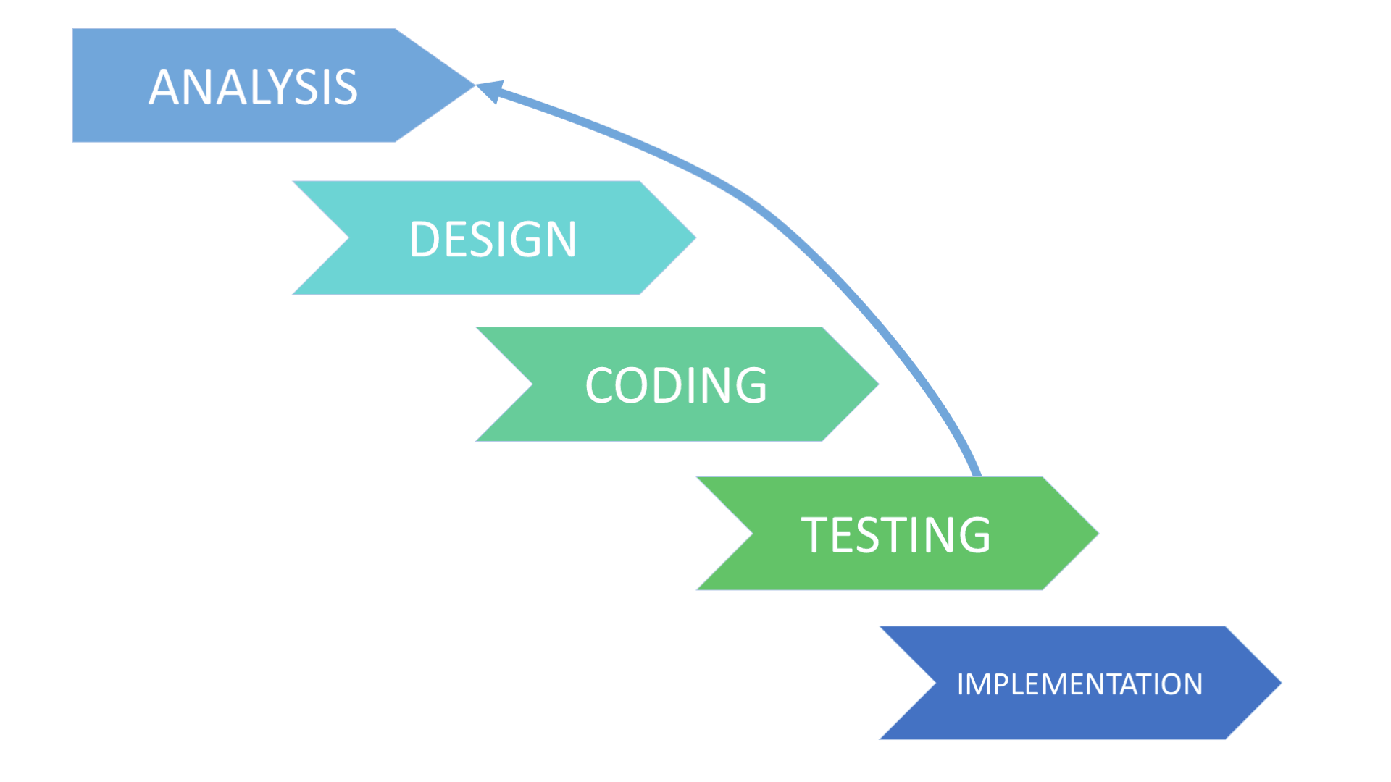
PROJECT MANAGEMENT

Slide 9
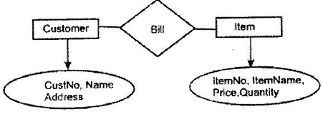
DATA FLOW

Slide 10
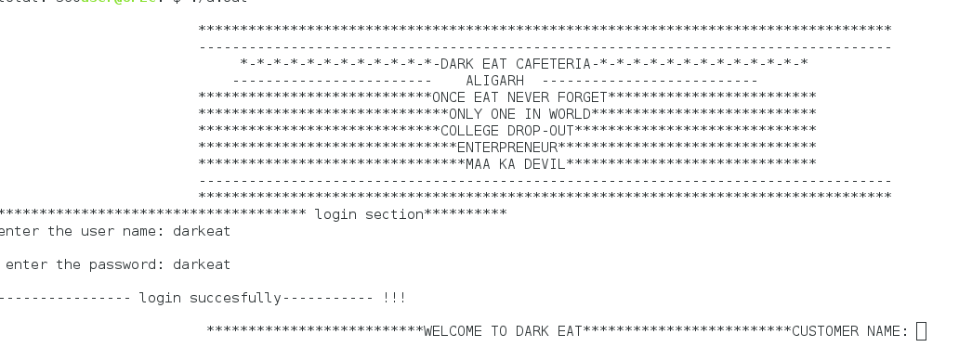
SNAPSHOTS

Slide 11
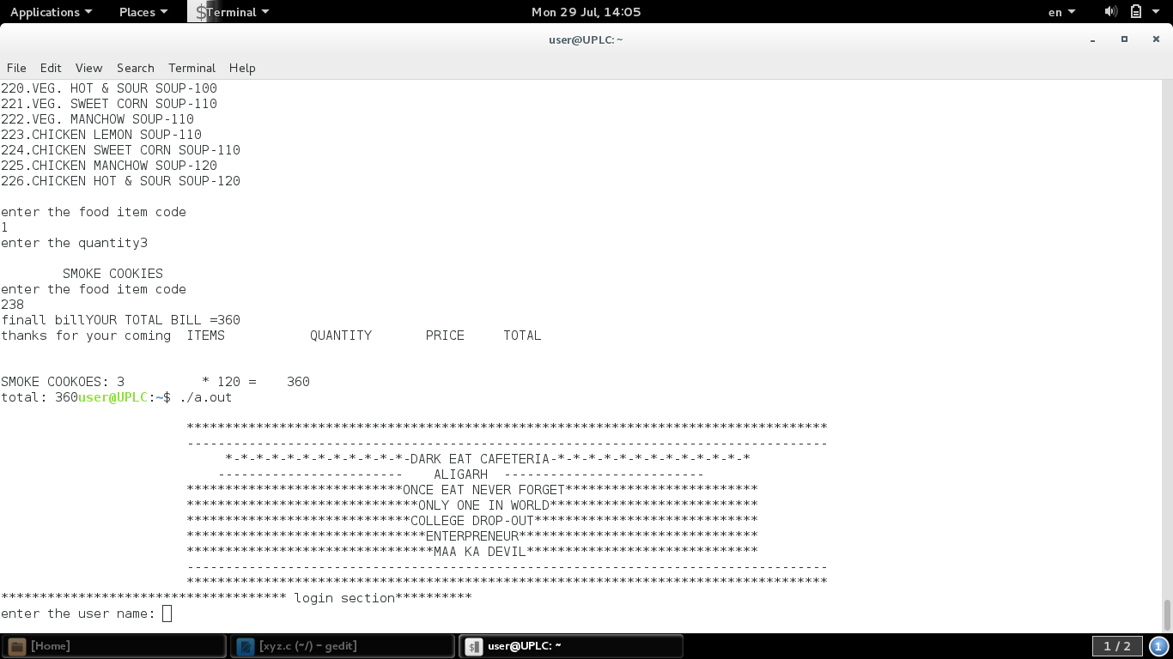
MENU WINDOW

Slide 12
CONCLUSION
This project was developed to fulfill user and business requirement for making the billing process fast and accurate. It also maintains the history of bills produced by the organization. However there are lots of scopes to improve the performance of the Billing System in the area of user interface, database performance, and query processing time.

Slide 13
FUTURE ENHANCEMENT
The future enhancements that are possible in the project are as follows.
Linking and integration of any legacy system for accounting.
Integration with travel agent through Web Services.
In the area of data security and system security.
To optimize the query which is embedded in the system.

Slide 14
