Slide 1

(ตอน:การใช้ “name parameter” แทน link path parameter ใน route table)
การทำmenuบนApp ด้วยVue Router 4 –EP3
สามารถฝึกปฏิบัติแบบออนไลน์จาก source code
ผ่านลิงก์(link) ในคำอธิบายใต้คลิป YouTube

Slide 2
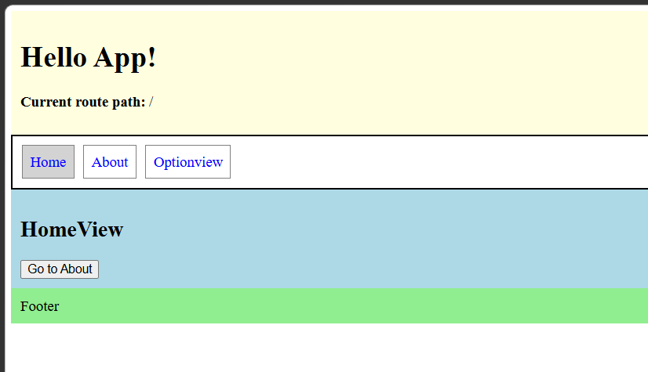
โจทย์ : https://onecompiler.com/vue/44pt8226u
Header
Navigation/Menu
Main content
Footer

Slide 3
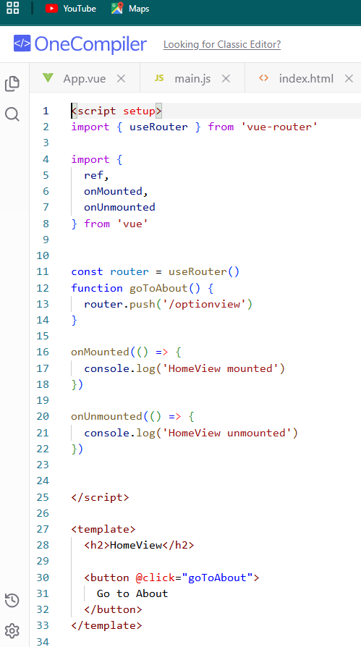
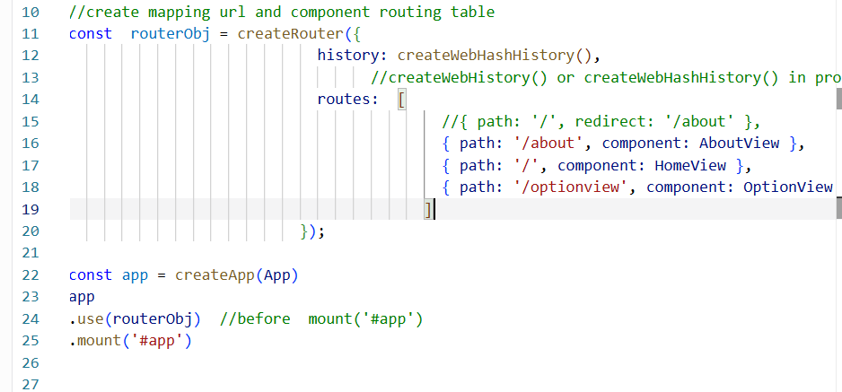
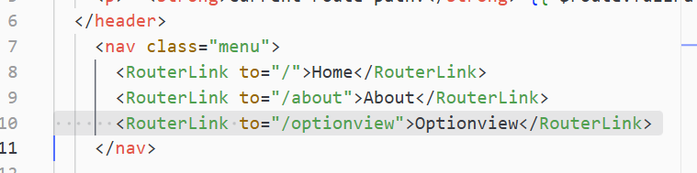
https://onecompiler.com/vue/44pt8226u
main.js
HomeView.vue
App.vue

Slide 4
main.js
https://onecompiler.com/vue/44sd6m5zs
routes: [
//{ path: '/', redirect: '/about’ },
{ path: '/about', component: AboutView,name:'vabout' },
{ path: '/', component: HomeView, name:'vhome' },
{ path: '/optionview', component: OptionView ,name:'voption'},
]
});
Step: 1

Slide 5
App.vue
https://onecompiler.com/vue/44sebppku
<nav class="menu">
<RouterLink :to="{ name: 'vhome’} " >
Home</RouterLink>
<RouterLink to="/about">About</RouterLink>
<RouterLink :to="{ name:'voption' }">
Optionview</RouterLink>
</nav>
App.vue

Slide 6
https://onecompiler.com/vue/44rumvfu3
HomeView.vue
const router = useRouter()
function goToAbout() {
router.push( { name: 'voption'} )
}

Slide 7
main.js
https://onecompiler.com/vue/44rumvfu3
routes: [
//{ path: '/', redirect: '/about’ },
{ path: '/about', component: AboutView,name:'vabout' },
{ path: '/', component: HomeView, name:'vhome' },
{ path: '/optionview', component: OptionView ,name:'voption'},
]
});
Step: 1
HomeView.vue
<nav class="menu">
<RouterLink :to="{ name: 'vhome’} " >
Home</RouterLink>
<RouterLink to="/about">About</RouterLink>
<RouterLink :to="{ name:'voption' }">
Optionview</RouterLink>
</nav>
const router = useRouter()
function goToAbout() {
router.push( { name: 'voption’} )
}
App.vue
Step: 2
Step: 2

