Slide 1

Vue Component Lifecycle

Slide 2
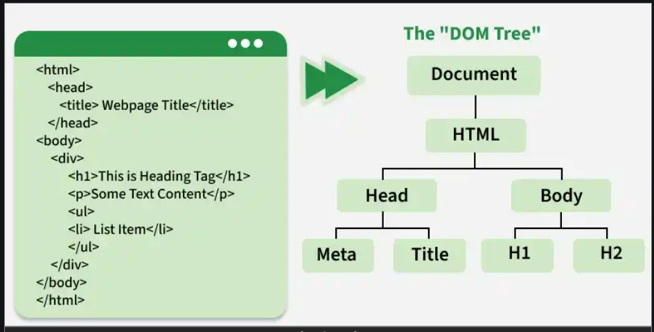
HTML DOM (Document Object Model)
Vue : create DOM Based component concept
https://www.geeksforgeeks.org/javascript/dom-document-object-model/

Slide 3
กระบวนการ render component ของ VUE
แบ่งเป็น 4 Phase
Creation Phase:
Component is initialized, but not yet in DOM
Mounting Phase:
Component is inserted into the DOM
Updating Phase:
Triggered when reactive data changes
Unmounting Phase:
Component is removed from DOM

Slide 4
VUE3 Hook Function
Creation Phase: Component is initialized, but not yet in DOM
setup() (Composition API)
beforeCreate() (Options API - rarely used now)
created()
Mounting Phase: Component is inserted into the DOM
onBeforeMount()
onMounted()
Updating Phase: Triggered when reactive data changes
onBeforeUpdate()
onUpdated()
Unmounting Phase: Component is removed from DOM
onBeforeUnmount()
onUnmounted();

Slide 5
lifecycle hook Vue(

