Slide 1

(ตอน:ตัวอย่างการทำ menu App แบบง่าย)
การทำmenuบนApp ด้วยVue Router 4 –EP2
สามารถฝึกปฏิบัติแบบออนไลน์จาก source code
ผ่านลิงก์(link) ในคำอธิบายใต้คลิป YouTube

Slide 2
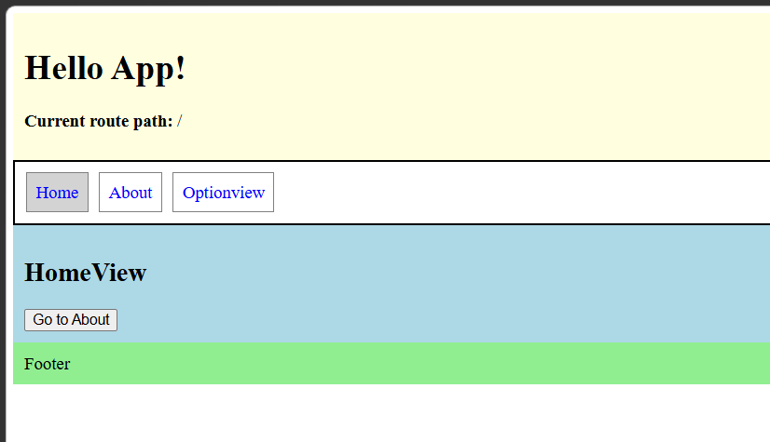
โจทย์
Header
Navigation/Menu
Main content
Footer

Slide 3
แนวคิดในการทำ:กำหนด page layout แบบ general HTML
Sematic Html
Header section
<header>
<nav>
Navigation/Menu
section
<a href=“/">Home</a>
Main content
section
<a href=“/about">About</a>
<main>
<a href=“/ Optionview ">Optionview</a>
<footer>
Footer section

Slide 4
<body>
<header>
<h1> Hellow …..
</header>
<nav>
<a href=“/">Home</a>
<a href=“/about">About</a>
</nav>
<main>
Home View
</main>
<footer>
Footer
</footer>
</body>
HTML tag

Slide 5
Vue page layout
Sematic template
Header
<header>
<nav>
Navigation/Menu
<a href=“/">Home</a>
<Child Component>
Main content
<RouterLink to="/">Home</RouterLink>
<footer>
Footer

Slide 6
Vue page layout
<template>
<header>
<h1> Hellow …..
</header>
<nav>
<RouterLink to="/">Home</RouterLink>
<RouterLink to="/about">About</RouterLink>
</nav>
<main>
<RouterView />
</main>
<footer>
Footer
</footer>
</template>
Vue template
<body>
<header>
<h1> Hellow …..
</header>
<nav>
<a href=“/">Home</a>
<a href=“/about">About</a>
</nav>
<main>
Home View
</main>
<footer>
Footer
</footer>
</body>

Slide 7
1.ติดตั้ง vue-router Package
Package.json
{
"name": "vue",
"version": "0.0.0",
"private": true,
"type": "module",
"scripts": {
"dev": "vite --host",
"build": "vite build --base ./",
"preview": "vite preview --host"
},
"dependencies": {
"vue": "^3.3.11",
"vue-router": "^4.3.0"
},
"devDependencies": {
"@vitejs/plugin-vue": "^4.5.2",
"vite": "^5.0.10"
}
}
https://onecompiler.com/vue/44pt8226u
Notes:
{
"name": "vue",
"version": "0.0.0",
"private": true,
"type": "module",
"scripts": {
"dev": "vite --host",
"build": "vite build --base ./",
"preview": "vite preview --host"
},
"dependencies": {
"vue": "^3.3.11",
"vue-router": "^4.3.0"
},
"devDependencies": {
"@vitejs/plugin-vue": "^4.5.2",
"vite": "^5.0.10"
}
}

Slide 8
สร้าง landing page layout template :
App.Vue
https://onecompiler.com/vue/44pt8226u
<template>
<header>
</header>
<nav>
<RouterLink to="/">Home</RouterLink>
<RouterLink to="/about">About</RouterLink>
<RouterLink to="/optionview">Optionview</RouterLink>
</nav>
<main>
<RouterView />
</main>
<footer>
</footer>
</template>
Notes:
<!-- App.vue -->
<template>
<header style="background-color:lightyellow; padding:10px;">
<h1>Hello App!</h1>
<p> <strong>Current route path:</strong> {{ $route.fullPath }} </p>
</header>
<nav class="menu">
<RouterLink to="/">Home</RouterLink>
<RouterLink to="/about">About</RouterLink>
<RouterLink to="/optionview">Optionview</RouterLink>
</nav>
<main style="background-color:lightblue; padding:10px;">
<RouterView />
</main>
<footer style="background-color:lightgreen; padding:10px;">
Footer
</footer>
</template>
<style>
.menu {
width: 100%;
border: 2px solid black;
padding: 10px;
display: flex;
gap: 10px;
}
.menu a {
color: blue;
border: 1px solid gray;
padding: 8px;
text-decoration: none;
}
.menu a.router-link-active {
background: lightgray;
}
</style>

Slide 9
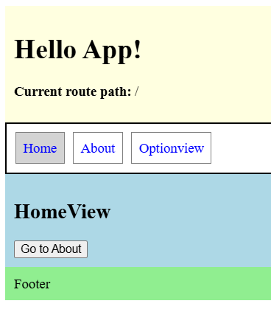
สร้าง Child Vue Component : HomeView.vue
<template>
<h2>HomeView</h2>
<button @click="goToAbout">
Go to About
</button>
</template>
Notes:
<script setup>
import { useRouter } from 'vue-router'
import {
ref,
onMounted,
onUnmounted
} from 'vue'
const router = useRouter()
function goToAbout() {
router.push('/about')
}
onMounted(() => {
console.log('HomeView mounted')
})
onUnmounted(() => {
console.log('HomeView unmounted')
})
</script>
<template>
<h2>HomeView</h2>
<button @click="goToAbout">
Go to About
</button>
</template>

Slide 10
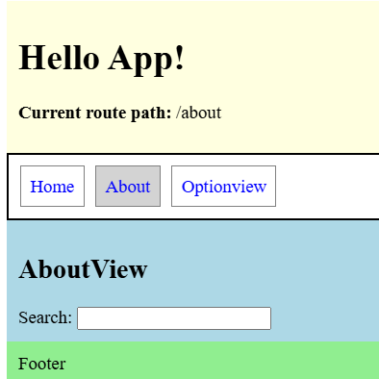
สร้าง Child Vue Component : AboutView.vue
<template>
<h2>AboutView</h2>
<label>
Search:
<input v-model.trim="search" maxlength="20">
</label>
</template>
Notes:
<script setup>
import {
ref,
onMounted,
onUnmounted
} from 'vue'
const search = ref('')
onMounted(() => {
console.log('AboutView mounted')
})
onUnmounted(() => {
console.log('AboutView unmounted')
})
</script>
<template>
<h2>AboutView</h2>
<label>
Search: <input v-model.trim="search" maxlength="20">
</label>
</template>

Slide 11
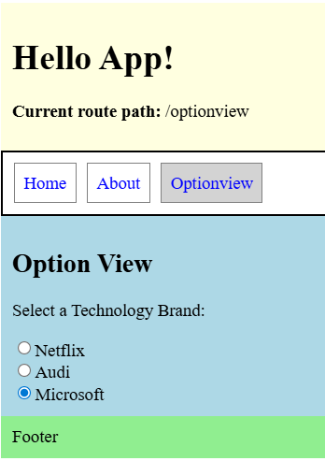
สร้าง Child Vue Component : OptionView.vue
<template>
<h2>Option View</h2>
<p>Select a Technology Brand:</p>
<div>
<input type="radio"
id="Netflix"
name="brand"
value="Netflix">
<label for="Netflix">Netflix</label>
</div>
<div>
<input type="radio"
id="Audi"
name="brand"
value="Audi">
<label for="Audi">Audi</label>
</div>
<div>
<input type="radio"
id="Microsoft"
name="brand"
value="Microsoft" checked>
<label for="Microsoft">Microsoft</label>
</div>
</template>
Notes:
<script setup>
import {
ref,
onMounted,
onUnmounted
} from 'vue'
const search = ref('')
onMounted(() => {
console.log('OptionView mounted')
})
onUnmounted(() => {
console.log('OptionView unmounted')
})
</script>
<template>
<h2>Option View</h2>
<p>Select a Technology Brand:</p>
<div>
<input type="radio"
id="Netflix"
name="brand"
value="Netflix">
<label for="Netflix">Netflix</label>
</div>
<div>
<input type="radio"
id="Audi"
name="brand"
value="Audi">
<label for="Audi">Audi</label>
</div>
<div>
<input type="radio"
id="Microsoft"
name="brand"
value="Microsoft" checked>
<label for="Microsoft">Microsoft</label>
</div>
</template>

Slide 12
Create routing page table mapping Child Component
import { createApp } from 'vue'
import App from './App.vue'
import HomeView from './HomeView.vue'
import AboutView from './AboutView.vue'
import OptionView from './OptionView.vue'
import { createMemoryHistory, createRouter,
createWebHashHistory ,createWebHistory} from 'vue-router'
const routerObj = createRouter({
history: createWebHashHistory(),
//createWebHistory() or createWebHashHistory() in production
routes: [
//{ path: '/', redirect: '/about' },
{ path: '/about', component: AboutView },
{ path: '/', component: HomeView },
{ path: '/optionview', component: OptionView },
]
});
const app = createApp(App)
app
.use(routerObj) //ต้องทำการ mount('#app')
.mount('#app')
Notes:
import { createApp } from 'vue'
import App from './App.vue'
import HomeView from './HomeView.vue'
import AboutView from './AboutView.vue'
import OptionView from './OptionView.vue'
import { createMemoryHistory, createRouter,
createWebHashHistory ,createWebHistory} from 'vue-router'
const routerObj = createRouter({
history: createWebHashHistory(),
//createWebHistory() or createWebHashHistory() in production
routes: [
//{ path: '/', redirect: '/about' },
{ path: '/about', component: AboutView },
{ path: '/', component: HomeView },
{ path: '/optionview', component: OptionView },
]
});
const app = createApp(App)
app
.use(routerObj) //ต้องทำการ mount('#app')
.mount('#app')

Slide 13
<template>
<header>
</header>
<nav>
<RouterLink to="/">Home
<RouterLink to="/about">About
<RouterLink to="/optionview">Optionview
</nav>
<main>
<RouterView />
</main>
<footer>
</footer>
</template>
const routerObj = createRouter({
history: createWebHashHistory(),
routes : [
{ path: '/', component: HomeView },
{ path: '/about', component: AboutView },
{ path: '/optionview', component: OptionView }, ]
});
const app = createApp(App)
app
.use(routerObj) //ต้องทำการ mount('#app')
.mount('#app')

Slide 14
Binding
Header
Navigation/Menu
Main content
Footer

Slide 15
กำหนด Vue Layout
Header
Navigation/Menu
Main content
Footer

