Slide 1

State variable in Vue

Slide 2
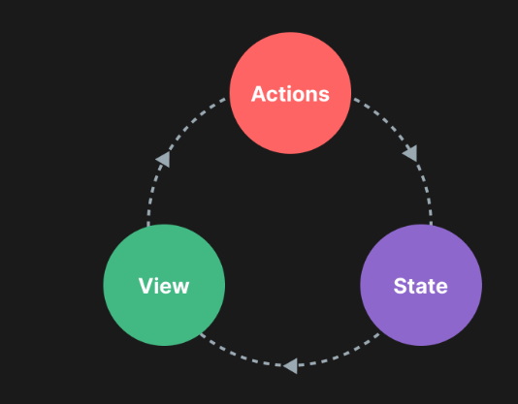
State variable
ตัวแปรที่มีการกำหนดค่าเริ่มต้นด้วย ref()/reactive()
เมื่อค่าขอตัวแปรเปลี่ยนจะมีผลทำให้ ui update
ref()
const var1 = ref(0);
var1.value =10
reactive()
const storeVar = reactive( {
var1: 0
}
storeVar.var1 = 10

Slide 3
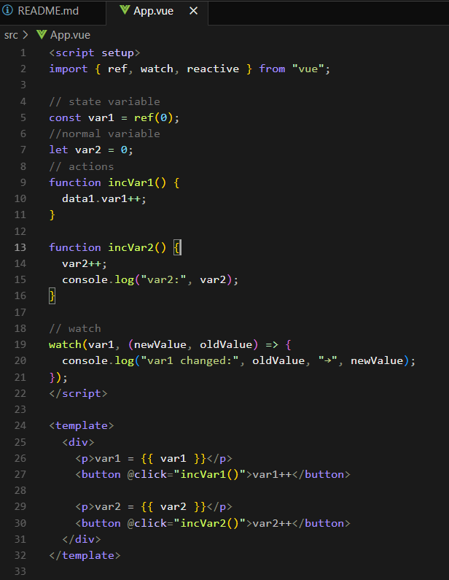
Notes:
<script setup>
import { ref, watch, reactive } from "vue";
// state
const var1 = ref(0);
//normal variable
let var2 = 0;
// actions
function incVar1() {
data1.var1++;
}
function incVar2() {
var2++;
console.log("var2:", var2);
}
// watch
watch(var1, (newValue, oldValue) => {
console.log("var1 changed:", oldValue, "→", newValue);
});
</script>
<template>
<div>
<p>var1 = {{ var1 }}</p>
<button @click="incVar1()">var1++</button>
<p>var2 = {{ var2 }}</p>
<button @click="incVar2()">var2++</button>
</div>
</template>

