Slide 1
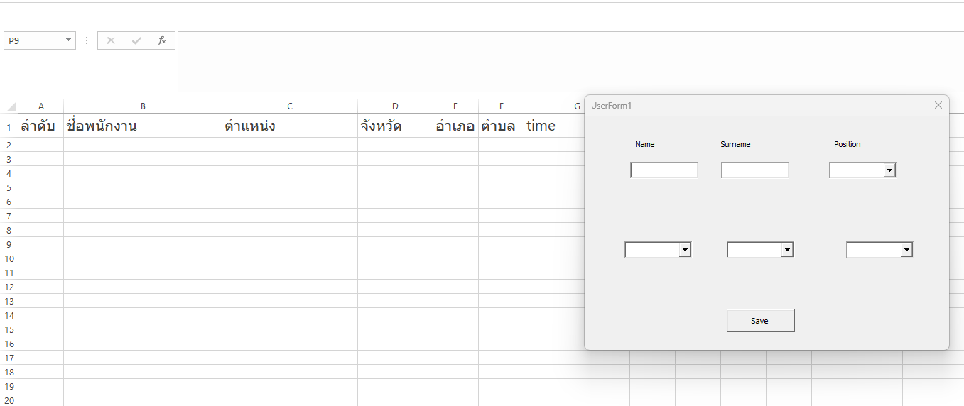

การทำ FORM การทำ employee form

Slide 3
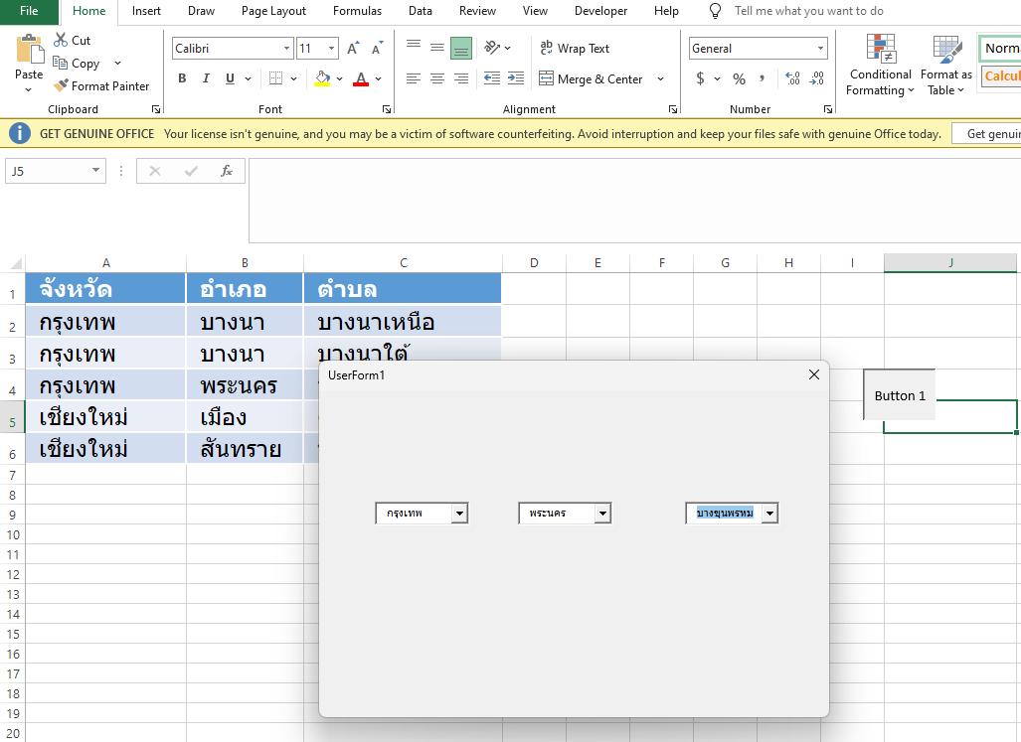
ทบทวน Book1.xlsm
“data” sheet เก็บข้อมูลจังหวัด
2.“userForm1” สำหรับเก็บ form

Slide 4
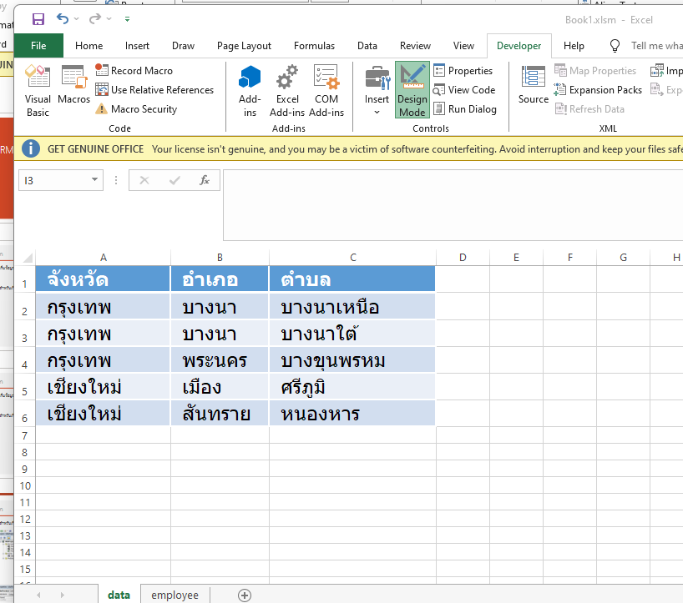
ทบทวน Book1.xlsm
“data” sheet เก็บข้อมูลจังหวัด

Slide 5
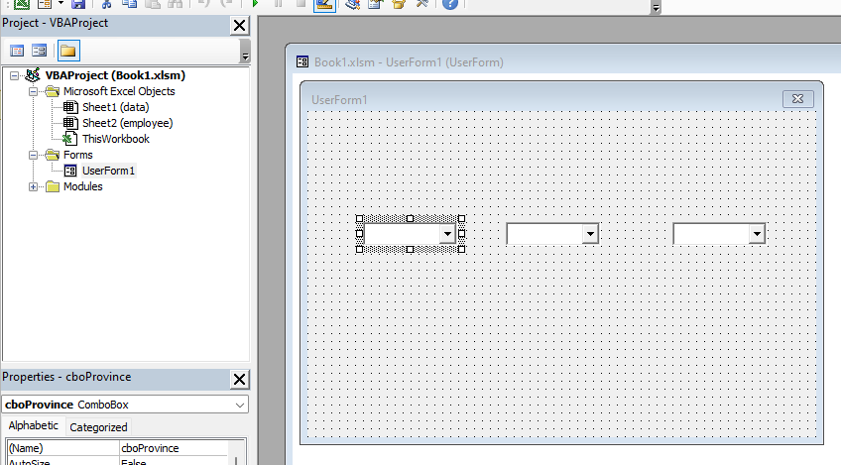
ทบทวน Book1.xlsm
2.“userForm1” สำหรับเก็บ form
- cboProvince
- cboDistrict
- cboSubDistrict

Slide 6
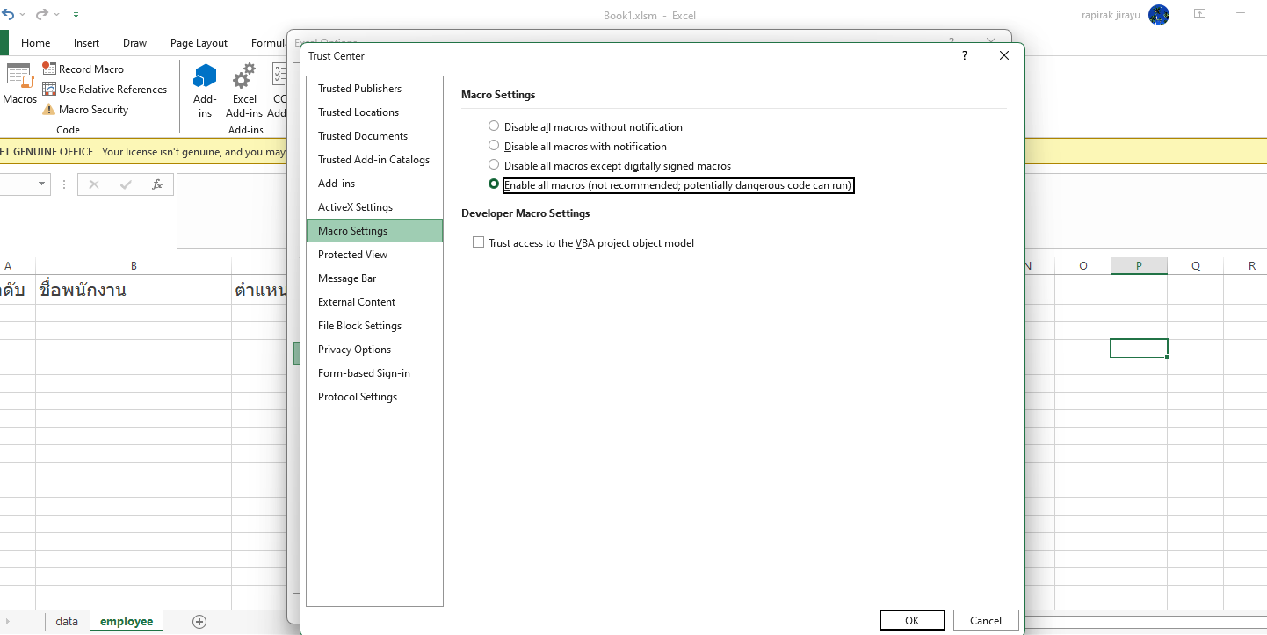
Enable Macro : Option->Trust Center ->Trust setting->enable macro

Slide 7
แก้ไขแฟ้ม Book1.xlsm
1.เปิดแฟ้ม Book1.xlsm
- “data” sheet เก็บรายชื่อจังหวัด
2.สร้าง “employee” sheet
- เพิ่ม header line ใน “employee” sheet
- ลำดับ,ชื่อพนักงาน ,ตำแหน่ง, จังหวัด ,อำเภอ,ตำบล , time
3.สร้าง ปุ่มในการ User1Form ใน “exmployee” sheet
4.แก้ไข User1Form
- textbox : txtName
- textbox : txtSurname
- combobox : cboPosition
- commandButton: btnSave

Slide 8
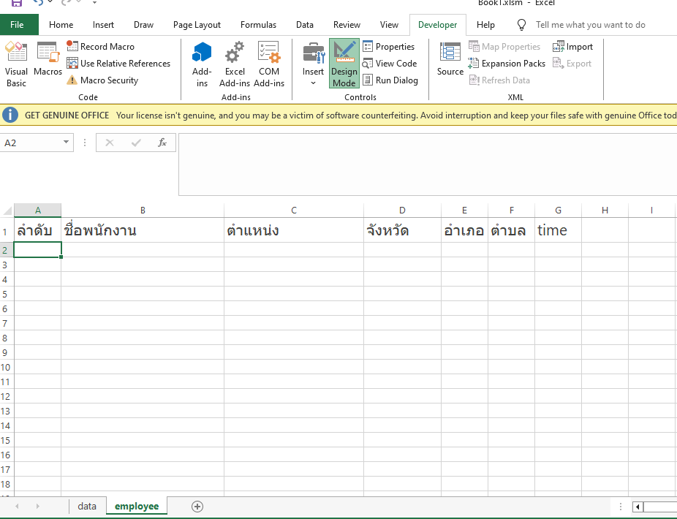
สร้าง “employee” sheet
- เพิ่ม header line ใน “employee” sheet
- ลำดับ
- ชื่อพนักงาน
- ตำแหน่ง
- จังหวัด ,อำเภอ,ตำบล ,
- time

Slide 9
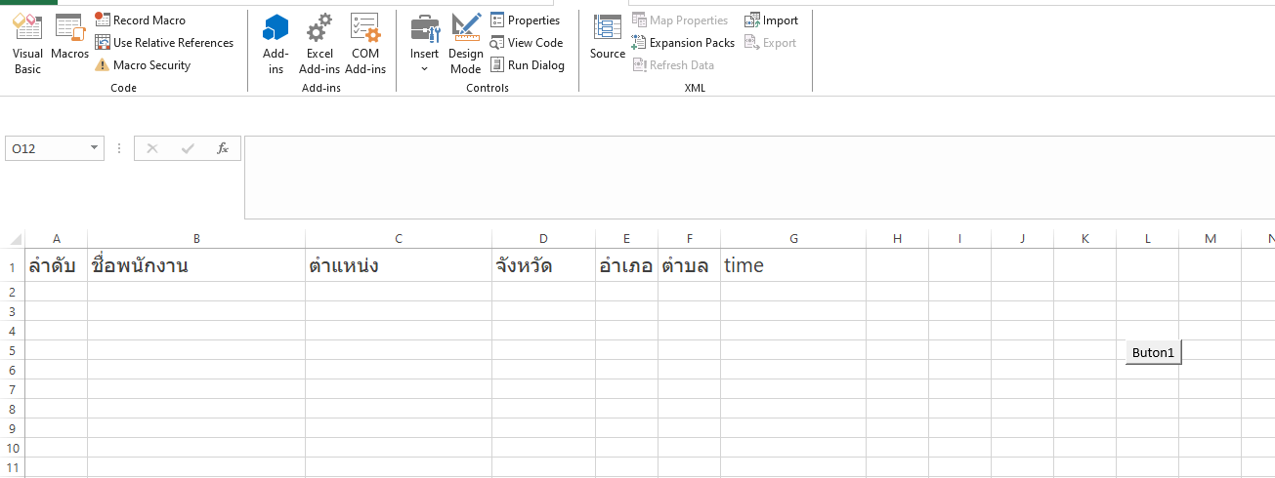
สร้างปุ่มแสดง “UserForm1” ใน “employee” sheet

Slide 10
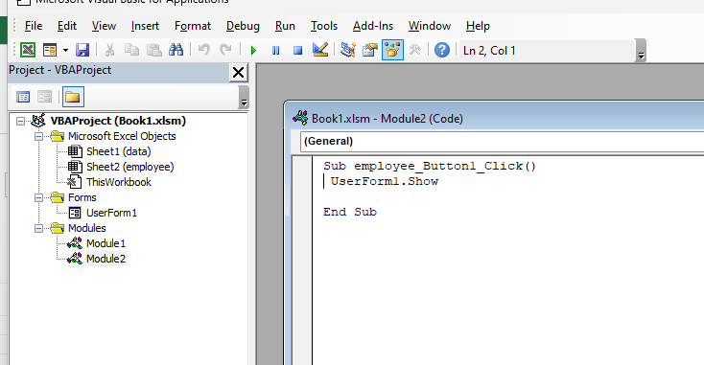
สร้างปุ่มในการ “UserForm1” ใน “employee” sheet

Slide 11
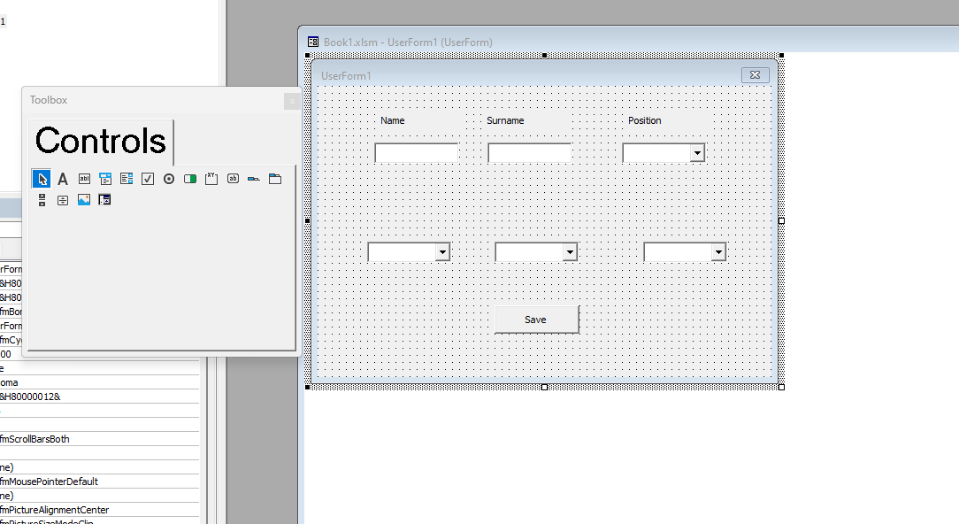
UserForm :
แก้ไข User1Form เพิ่ม
- textbox : txtName
- textbox : txtSurname
- combobox : cboPosition
- CommandButton : btnSave
Note:
cboPosition : style “fmStyleDropDownList”
เพื่อไม่ให้ edit ข้อมูลได้

Slide 12
แก้ไข code : Initialize เพิ่ม initial ตำแหน่ง
Private Sub UserForm_Initialize()
Dim ws As Worksheet
Dim lastRow As Long
Dim dict As Object
Dim i As Long
cboPosition.List = Array("manager", "employee", "worker")
Set ws = ThisWorkbook.Sheets("Data")
lastRow = ws.Cells(ws.Rows.Count, 1).End(xlUp).Row
Set dict = CreateObject("Scripting.Dictionary")
For i = 2 To lastRow
If Not dict.exists(ws.Cells(i, 1).Value) Then
dict.Add ws.Cells(i, 1).Value, Nothing
End If
Next i
cboProvince.List = dict.keys
End Sub

Slide 13
สร้างฟังก์ชันบันทึกข้อมูล “employee”sheet
Private Sub btnSave_Click()
Dim ws As Worksheet
Dim lastRow As Long
Dim nextRow As Long
Dim newID As Long
Dim i As Long
Dim fullName As String
Set ws = ThisWorkbook.Sheets("employee")
' ÃÇÁª×èÍ + ¹ÒÁÊ¡ØÅ
fullName = Trim(txtName.Value) & " " & Trim(txtSurname.Value)
' ===== check all fields =====
If txtName.Value = "" Or _
txtSurname.Value = "" Or _
cboProvince.Value = "" Or _
cboDistrict.Value = "" Or _
cboSubDistrict.Value = "" Or _
cboPosition.Value = "" Then
MsgBox "user must input all fields"
Exit Sub
End If
' ===== find last row =====
lastRow = ws.Cells(ws.Rows.Count, 1).End(xlUp).Row
' ===== check duplicate =====
For i = 2 To lastRow
If ws.Cells(i, 2).Value = fullName And _
ws.Cells(i, 3).Value = cboProvince.Value And _
ws.Cells(i, 4).Value = cboDistrict.Value And _
ws.Cells(i, 5).Value = cboSubDistrict.Value Then
MsgBox "data duplicate"
Exit Sub
End If
Next i
' ===== Running ID =====
If lastRow < 2 Then
newID = 1
nextRow = 2
Else
newID = ws.Cells(lastRow, 1).Value + 1
nextRow = lastRow + 1
End If
' ===== save data =====
ws.Cells(nextRow, 1).Value = newID
ws.Cells(nextRow, 2).Value = fullName
ws.Cells(nextRow, 3).Value = cboProvince.Value
ws.Cells(nextRow, 4).Value = cboDistrict.Value
ws.Cells(nextRow, 5).Value = cboSubDistrict.Value
ws.Cells(nextRow, 6).Value = cboPosition.Value
ws.Cells(nextRow, 7).Value = Now
MsgBox "save success (ID = " & newID & ")"
' clear field
txtName.Value = ""
txtSurname.Value = ""
cboProvince.Value = ""
cboDistrict.Value = ""
cboSubDistrict.Value = ""
cboPosition.Value = ""
End Sub
Notes:
Private Sub btnSave_Click()
Dim ws As Worksheet
Dim lastRow As Long
Dim nextRow As Long
Dim newID As Long
Dim i As Long
Dim fullName As String
Set ws = ThisWorkbook.Sheets("employee")
' ÃÇÁª×èÍ + ¹ÒÁÊ¡ØÅ
fullName = Trim(txtName.Value) & " " & Trim(txtSurname.Value)
' ===== check all fields =====
If txtName.Value = "" Or _
txtSurname.Value = "" Or _
cboProvince.Value = "" Or _
cboDistrict.Value = "" Or _
cboSubDistrict.Value = "" Or _
cboPosition.Value = "" Then
MsgBox "user must input all fields"
Exit Sub
End If
' ===== find last row =====
lastRow = ws.Cells(ws.Rows.Count, 1).End(xlUp).Row
' ===== check duplicate =====
For i = 2 To lastRow
If ws.Cells(i, 2).Value = fullName And _
ws.Cells(i, 3).Value = cboProvince.Value And _
ws.Cells(i, 4).Value = cboDistrict.Value And _
ws.Cells(i, 5).Value = cboSubDistrict.Value Then
MsgBox "data duplicate"
Exit Sub
End If
Next i
' ===== Running ID =====
If lastRow < 2 Then
newID = 1
nextRow = 2
Else
newID = ws.Cells(lastRow, 1).Value + 1
nextRow = lastRow + 1
End If
' ===== save data =====
ws.Cells(nextRow, 1).Value = newID
ws.Cells(nextRow, 2).Value = fullName
ws.Cells(nextRow, 3).Value = cboProvince.Value
ws.Cells(nextRow, 4).Value = cboDistrict.Value
ws.Cells(nextRow, 5).Value = cboSubDistrict.Value
ws.Cells(nextRow, 6).Value = cboPosition.Value
ws.Cells(nextRow, 7).Value = Now
MsgBox "save success (ID = " & newID & ")"
' clear field
txtName.Value = ""
txtSurname.Value = ""
cboProvince.Value = ""
cboDistrict.Value = ""
cboSubDistrict.Value = ""
cboPosition.Value = ""
End Sub

Slide 14
สร้างฟังก์ชันบันทึกข้อมูล “employee”sheet
' ===== find last row =====
lastRow = ws.Cells(ws.Rows.Count, 1).End(xlUp).Row
' ===== check duplicate =====
For i = 2 To lastRow
If ws.Cells(i, 2).Value = fullName And _
ws.Cells(i, 3).Value = cboProvince.Value And _
ws.Cells(i, 4).Value = cboDistrict.Value And _
ws.Cells(i, 5).Value = cboSubDistrict.Value Then
MsgBox "data duplicate"
Exit Sub
End If
Next i
' ===== Running ID =====
If lastRow < 2 Then
newID = 1
nextRow = 2
Else
newID = ws.Cells(lastRow, 1).Value + 1
nextRow = lastRow + 1
End If
' ===== save data =====
ws.Cells(nextRow, 1).Value = newID
ws.Cells(nextRow, 2).Value = fullName
ws.Cells(nextRow, 3).Value = cboProvince.Value
ws.Cells(nextRow, 4).Value = cboDistrict.Value
ws.Cells(nextRow, 5).Value = cboSubDistrict.Value
ws.Cells(nextRow, 6).Value = cboPosition.Value
ws.Cells(nextRow, 7).Value = Now
MsgBox "save success (ID = " & newID & ")"
' clear field
txtName.Value = ""
txtSurname.Value = ""
cboProvince.Value = ""
cboDistrict.Value = ""
cboSubDistrict.Value = ""
cboPosition.Value = ""
End Sub
Notes:
Private Sub btnSave_Click()
Dim ws As Worksheet
Dim lastRow As Long
Dim nextRow As Long
Dim newID As Long
Dim i As Long
Dim fullName As String
Set ws = ThisWorkbook.Sheets("employee")
' ÃÇÁª×èÍ + ¹ÒÁÊ¡ØÅ
fullName = Trim(txtName.Value) & " " & Trim(txtSurname.Value)
' ===== check all fields =====
If txtName.Value = "" Or _
txtSurname.Value = "" Or _
cboProvince.Value = "" Or _
cboDistrict.Value = "" Or _
cboSubDistrict.Value = "" Or _
cboPosition.Value = "" Then
MsgBox "user must input all fields"
Exit Sub
End If
' ===== find last row =====
lastRow = ws.Cells(ws.Rows.Count, 1).End(xlUp).Row
' ===== check duplicate =====
For i = 2 To lastRow
If ws.Cells(i, 2).Value = fullName And _
ws.Cells(i, 3).Value = cboProvince.Value And _
ws.Cells(i, 4).Value = cboDistrict.Value And _
ws.Cells(i, 5).Value = cboSubDistrict.Value Then
MsgBox "data duplicate"
Exit Sub
End If
Next i
' ===== Running ID =====
If lastRow < 2 Then
newID = 1
nextRow = 2
Else
newID = ws.Cells(lastRow, 1).Value + 1
nextRow = lastRow + 1
End If
' ===== save data =====
ws.Cells(nextRow, 1).Value = newID
ws.Cells(nextRow, 2).Value = fullName
ws.Cells(nextRow, 3).Value = cboProvince.Value
ws.Cells(nextRow, 4).Value = cboDistrict.Value
ws.Cells(nextRow, 5).Value = cboSubDistrict.Value
ws.Cells(nextRow, 6).Value = cboPosition.Value
ws.Cells(nextRow, 7).Value = Now
MsgBox "save success (ID = " & newID & ")"
' clear field
txtName.Value = ""
txtSurname.Value = ""
cboProvince.Value = ""
cboDistrict.Value = ""
cboSubDistrict.Value = ""
cboPosition.Value = ""
End Sub

Slide 15
สร้างฟังก์ชันบันทึกข้อมูล “employee”sheet
' ===== save data =====
ws.Cells(nextRow, 1).Value = newID
ws.Cells(nextRow, 2).Value = fullName
ws.Cells(nextRow, 3).Value = cboProvince.Value
ws.Cells(nextRow, 4).Value = cboDistrict.Value
ws.Cells(nextRow, 5).Value = cboSubDistrict.Value
ws.Cells(nextRow, 6).Value = cboPosition.Value
ws.Cells(nextRow, 7).Value = Now
MsgBox "save success (ID = " & newID & ")"
' clear field
txtName.Value = ""
txtSurname.Value = ""
cboProvince.Value = ""
cboDistrict.Value = ""
cboSubDistrict.Value = ""
cboPosition.Value = ""
End Sub
Notes:
Private Sub btnSave_Click()
Dim ws As Worksheet
Dim lastRow As Long
Dim nextRow As Long
Dim newID As Long
Dim i As Long
Dim fullName As String
Set ws = ThisWorkbook.Sheets("employee")
' ÃÇÁª×èÍ + ¹ÒÁÊ¡ØÅ
fullName = Trim(txtName.Value) & " " & Trim(txtSurname.Value)
' ===== check all fields =====
If txtName.Value = "" Or _
txtSurname.Value = "" Or _
cboProvince.Value = "" Or _
cboDistrict.Value = "" Or _
cboSubDistrict.Value = "" Or _
cboPosition.Value = "" Then
MsgBox "user must input all fields"
Exit Sub
End If
' ===== find last row =====
lastRow = ws.Cells(ws.Rows.Count, 1).End(xlUp).Row
' ===== check duplicate =====
For i = 2 To lastRow
If ws.Cells(i, 2).Value = fullName And _
ws.Cells(i, 3).Value = cboProvince.Value And _
ws.Cells(i, 4).Value = cboDistrict.Value And _
ws.Cells(i, 5).Value = cboSubDistrict.Value Then
MsgBox "data duplicate"
Exit Sub
End If
Next i
' ===== Running ID =====
If lastRow < 2 Then
newID = 1
nextRow = 2
Else
newID = ws.Cells(lastRow, 1).Value + 1
nextRow = lastRow + 1
End If
' ===== save data =====
ws.Cells(nextRow, 1).Value = newID
ws.Cells(nextRow, 2).Value = fullName
ws.Cells(nextRow, 3).Value = cboProvince.Value
ws.Cells(nextRow, 4).Value = cboDistrict.Value
ws.Cells(nextRow, 5).Value = cboSubDistrict.Value
ws.Cells(nextRow, 6).Value = cboPosition.Value
ws.Cells(nextRow, 7).Value = Now
MsgBox "save success (ID = " & newID & ")"
' clear field
txtName.Value = ""
txtSurname.Value = ""
cboProvince.Value = ""
cboDistrict.Value = ""
cboSubDistrict.Value = ""
cboPosition.Value = ""
End Sub

