Slide 1




Wei-Cheng Chen
mento0513@gmail.com
http://myweb.ncku.edu.tw/~f74002060/Course5.rar Department of Computer Science and Information Engineering National Cheng Kung University
Tainan, Taiwan
made by electron & kk & rabbit125
made by mento0513

Slide 2
Backtracking
What is backtracking?
A searching technique
Goal
Find solutions under some constraints
Try to list out all kinds of possible ways
Concept
Enumerate ( 枚舉 ) Pruning ( 剪枝 )
made by electron & kk & rabbit125

Slide 3
Example
Goal
give 5 numbers ( 1~5 )
choose 3 numbers and list out by its order
possible solution
– 1 2 3 、 2 3 4 、 3 4 5 …
想想怎麼用recursive實作，想通你就會一半了
made by electron & kk & rabbit125

Slide 4
Example
made by electron & kk & rabbit125

Slide 5
Example
1
made by electron & kk & rabbit125

Slide 6
Example
1
1 | 2
made by electron & kk & rabbit125

Slide 7
Example
1
1 | 2
1 | 2 | 3
made by electron & kk & rabbit125

Slide 8
Example
1
1 | 2
1 | 2 | 3
made by electron & kk & rabbit125

Slide 9
Example
1
1 | 2
1 | 2 | 3
1 | 2 | 4
made by electron & kk & rabbit125

Slide 10
Example
1
1 | 2
1 | 2 | 3
1 | 2 | 4
made by electron & kk & rabbit125

Slide 11
Example
1
1 | 2
1 | 2 | 3
1 | 2 | 4
1 | 2 | 5
made by electron & kk & rabbit125

Slide 12
Example
1
1 | 2
1 | 2 | 3
1 | 2 | 4
1 | 2 | 5
made by electron & kk & rabbit125

Slide 13
Example
1
1 | 2
1 | 2 | 3
1 | 2 | 4
1 | 2 | 5
made by electron & kk & rabbit125

Slide 14
Example
1
1 | 2
1 | 3
1 | 2 | 3
1 | 2 | 4
1 | 2 | 5
made by electron & kk & rabbit125

Slide 15
Example
1
1 | 2
1 | 3
1 | 2 | 3
1 | 2 | 4
1 | 2 | 5
made by electron & kk & rabbit125

Slide 16
Example
1
1 | 2
1 | 3
After a while . . .
1 | 2 | 3
1 | 2 | 4
1 | 2 | 5
made by electron & kk & rabbit125

Slide 17
Example
You find all the solution
123 | 234 | 345
124 | 235
125 | 245
134
135
145
made by electron & kk & rabbit125

Slide 18
Strategy
Enumerate possible solution
by DFS order
Set the end point (or stack overflow)
return when find out a solution
Answer Array
maintain possible solution during searching
Prune
Skip unnecessary search
made by electron & kk & rabbit125

Slide 19
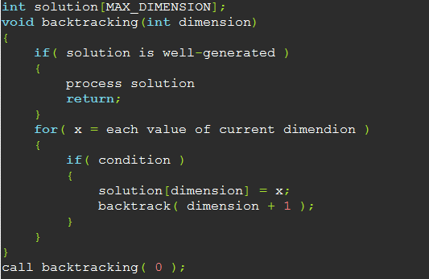
Pseudo Code
made by electron & kk & rabbit125

Slide 20
Practice
Uva 441
Uva 167
made by electron & kk & rabbit125

Slide 21
HOMEWORK
Uva :
167,200,291,441,524,574,624,750,989,10305,10503,11085,11686
POJ :
367,1094,1128,1101

Slide 22
made by electron & kk & rabbit125

