Slide 1
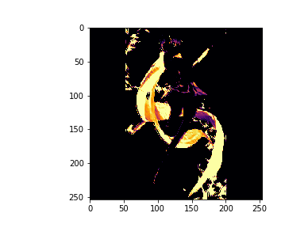
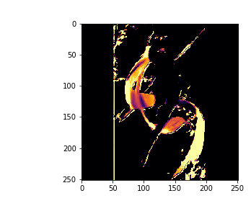
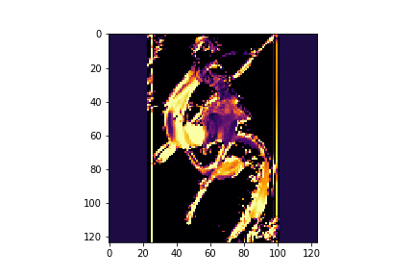
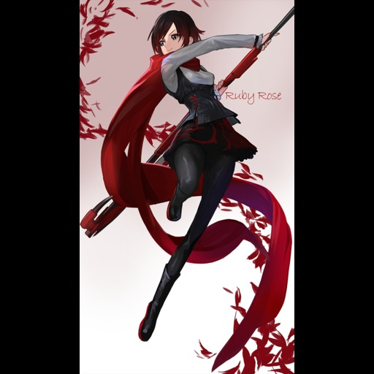
Tag | Truth | Thresh | Ave
1girl | 1 | 0 | 0
long_hair | 0 | 1 | 1
blush | 0 | 1 | 1
smile | 0 | 1 | 0
short_hair | 1 | 0 | 1

