Slide 1
World economic analysis
Members
- Roberto Antonio Mapa
- Nattanit Kowit

Slide 2
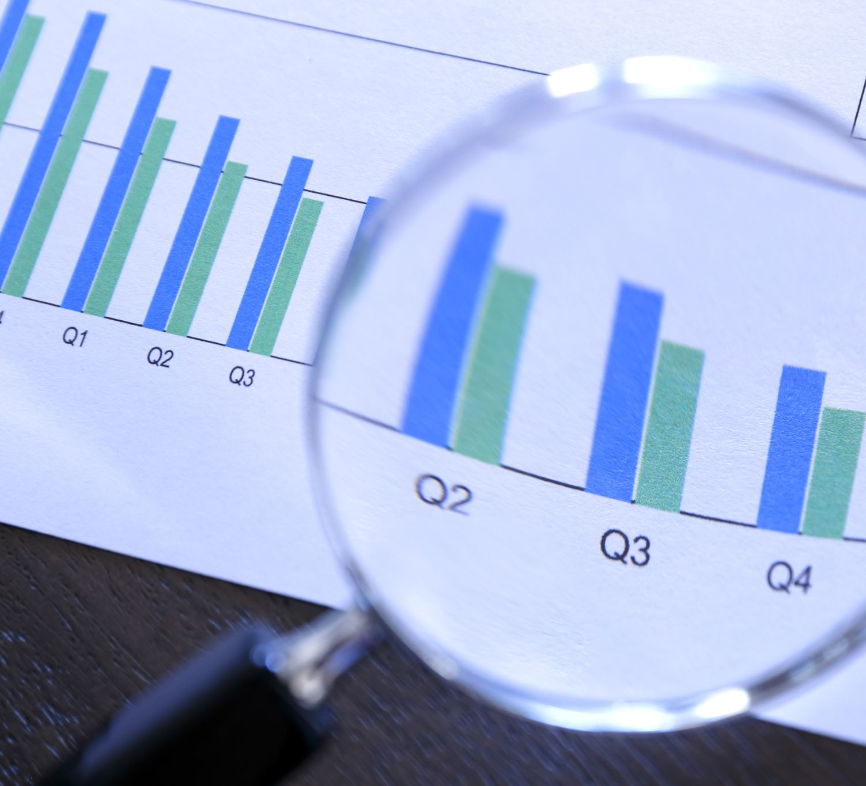
Context
Company ABC is planning to expand its premium real estate services to other countries. However, the company is currently short of the insights needed to determine the most opportunistic markets.
As ABC's consultant, we were hired to analyze the overall current world economy and ultimately propose the areas we believe would be the most best bet for the client.

Slide 3
Data frames
1) corruption.csv:
annual_income
corruption_index
2) cost of living.csv:
cost_index
monthly_income
purchasing_power
3) richest_countries.csv:
gdp_per_capita
4) tourism.csv:
tourism_in_millions
receipts_in_billions
receipts_per_tourist
percentage_of_gdp
5) unemployment.csv:
unemployment_rate
Source: https://www.kaggle.com/datasets/madhurpant/world-economic-data

Slide 4
DATA VISUALIZATION CHARTS OVERVIEW
Unemployment rate by country
Correlation between corruption index and annual income
Top 10 countries by GDP per capita
Correlation between cost index and monthly income
Top 10 most visited countries
Countries with tourist visits greater than the average

Slide 5
charts and insights

Slide 6
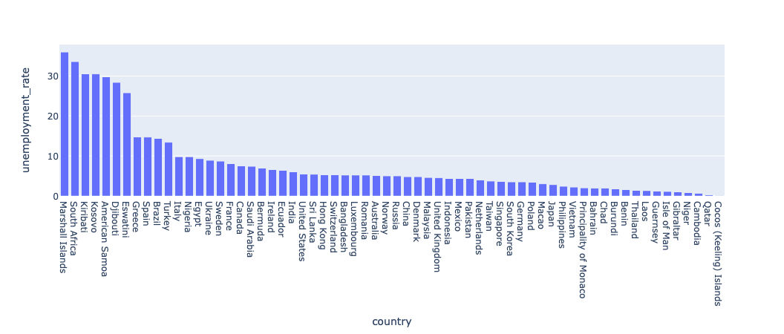
Unemployment rate by country
Only 11 countries have an unemployment rate higher than 10...
… while the rest have an unemployment rate below 10.
There is a huge gap between the top 7 countries with unemployment as compared to the rest.
Interestingly, among the top 10 countries with unemployment, there are 3 from Europe, 3 from Africa, and 3 from Oceania.
Unemployment DataFrame

Slide 7
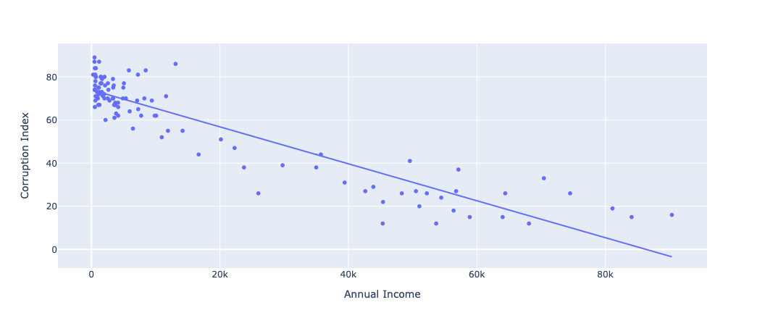
Correlation between corruption index and annual income
There is a negative correlation between Annual Income and Corruption
There is a high concentration of countries with an annual income lower than 20 and a corruption index between 60 to 80.
Generally, the higher the annual income of a country, the less corruption there is.
Corruption DataFrame

Slide 8
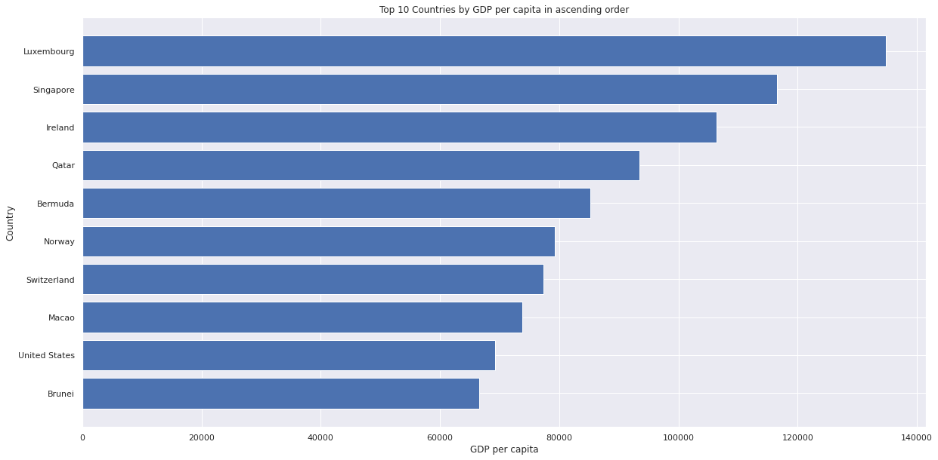
Top 10 countries with highest GDP per capita
Luxembourg has the highest GDP per capita
7 out of the 10 countries in the previous slide are also present in the top 10 list of countries with the highest GDP per capita
Richest Countries DataFrame

Slide 9
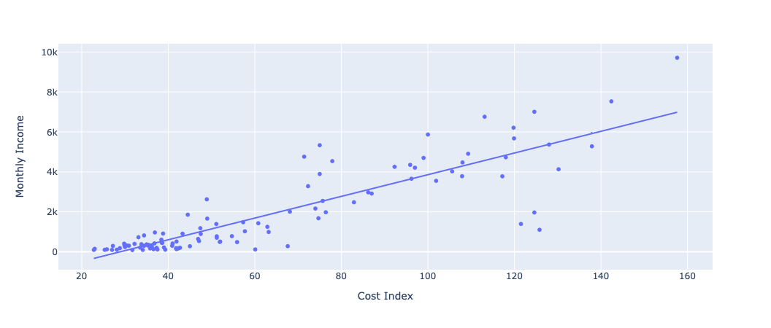
Correlation between cost index & monthly income
Cost Index
has a positive correlation to
Monthly Income
Cost of living DataFrame
Generally, the higher a country's average cost of living, the higher the average monthly income. However, the higher up you go in the cost index, the less correspondence there is between the 2 variables. Therefore, while it is common monthly income and cost index to have a positive correlation, especially for poorer countries, it is not always automatic.

Slide 10
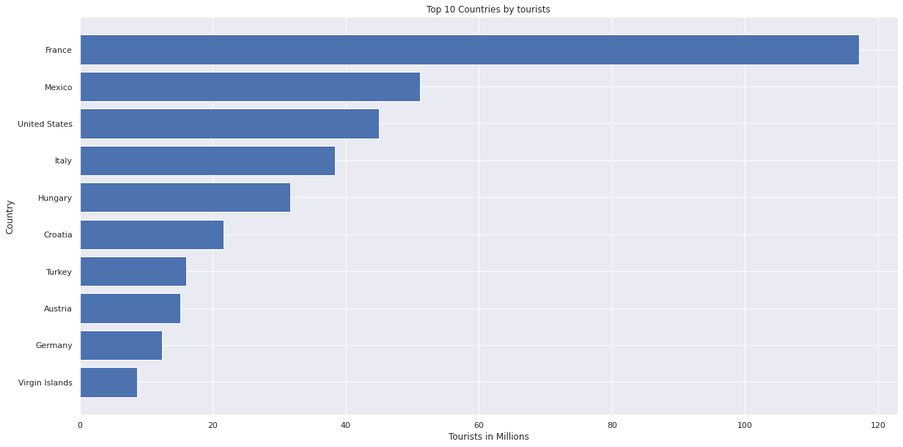
Top 10 most visited countries
France has roughly twice
the number of tourists visiting the country
as compared to Mexico
Tourism DataFrame

Slide 11
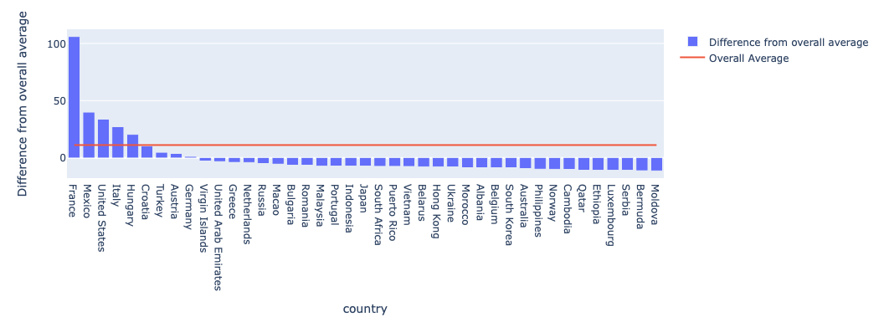
Countries with tourist visits greater than the average
Tourism DataFrame
A few of the Northerwestern and Northern European countries that lead in monthly income, GDP, and low corruption, are also among the top 40 most visited countries, making for rather strong economies
Only 5 countries
have number of tourists
more than the average

Slide 12
RECOMMENDATION
In determining which geographical areas would be the most attractive investments for the real estate company ABC, we have taken into account the balance between the presence of corruption, the cost of living, the purchasing power of the people, the general economic stability of the area, and the volume of tourism. In keeping in line with company ABC's premium brand whose services primarily cater to high net worth individuals, we recommend expanding the client's footprint into Northwestern and Northern Europe where the economy and the market seem to be stable; the residents carry huge purchasing power without living costs significantly eating into their earnings; and the number of tourists seeking premium accommodations can be an additional revenue stream.

Slide 13
Contact
roberto.mapa@gsom.polimi.it
nattanit.kowit@gsom.polimi.it

