Slide 1
GGPLOT
Programming
in R
10527071 : Abhilash
10531069 : Sharan
10529705 : Shantan
10533248 : Rapol
10532765 : Manmeet
10532863 : Chirag
10532113 : Hemlata
10532928 : Vishal

Slide 2
Introduction
What is R and Rstudio?
R is a programming language widely used among statisticians and data miners for developing statistical software and data analyses. RStudio is an Integrated Development Environment (IDE) for R.
What is ggplot?
ggplot is a library for Data Visualization in R that offers powerful graphics language to create elegant and complex plots created by Hadley Wickham.
It is Grammar of Graphics : breaks complex graphs into semantic components such as scales and layers.

Slide 3
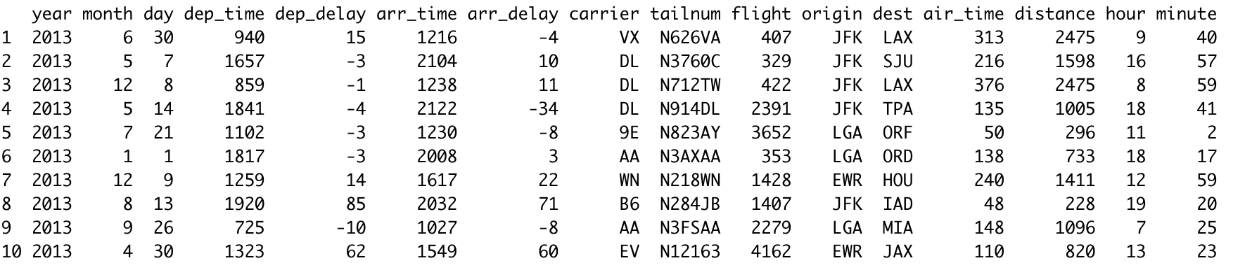
Data visualization
Graphical representation of data through maps or charts to access and understand trends, outliers and patterns in the data.
Data used : nycflights
head(nycflights, n=10L)

Slide 4
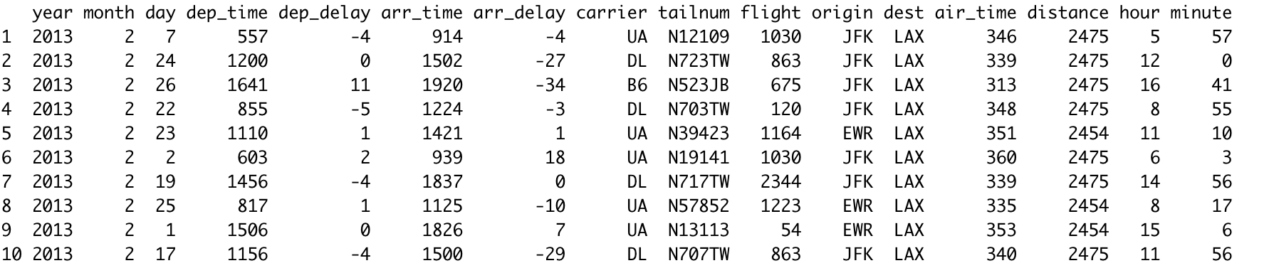
Continued…
lax_feb_flights <- nycflights %>% filter(dest == "LAX" , month == 2)
head(lax_feb_flights, n=10L)

Slide 5
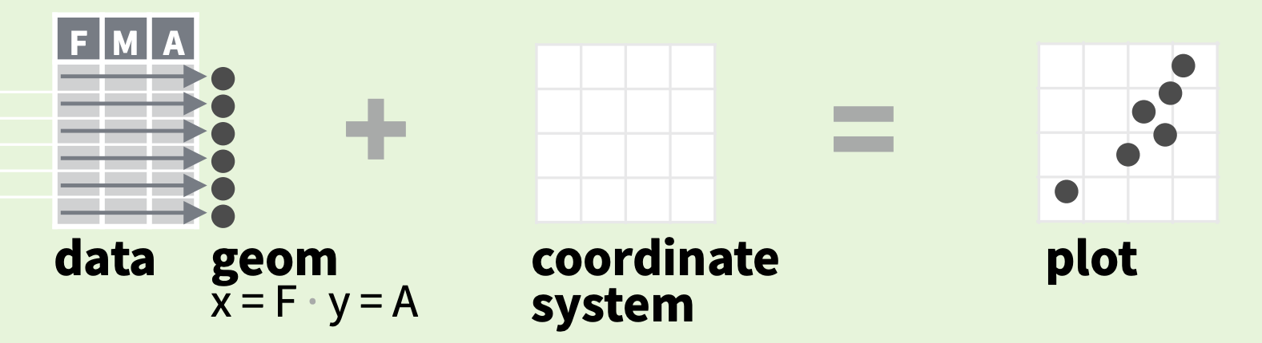
Basic structure of a plot
Data - a data frame with the variables to be plotted.
Geometry - the kind of plot, scatter or histogram, or…?
Aesthetic - the x and y coordinates of the plot.
ggplot(data, aes(x=A, y=B)) + geom_histogram()

Slide 6
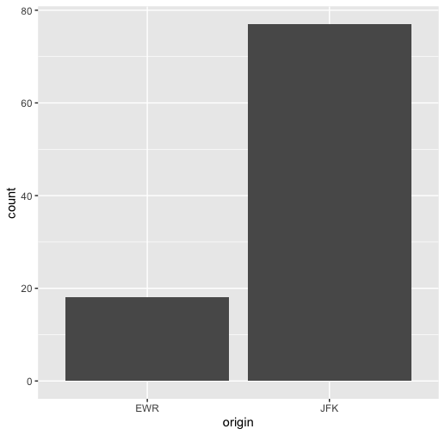
Graph
Boxplot
Gives count of flights from origin in the month of February.
ggplot(data = lax_feb_flights, aes(x = origin)) + geom_bar()

Slide 7
Geometry
Name | Description
geom_point | Scatterplot
geom_bar | Bar Plot
geom_histogram | Histogram
geom_density | Probability Distribution Plot
geom_boxplot | Box and Whiskers Plot
geom_text | Textual Annotations in a plot
geom_errorbar | Error Bars

Slide 8
Fundamentals
ggplot(data = mpg, aes(x = cty, y = hwy))
Begins a plot that you finish by adding layers to. Add one geom function per layer.
qplot(x = cty, y = hwy, data = mpg, geom = “point")
Creates a complete plot with given data, geom, and mappings. Supplies many useful defaults.
last_plot()
Returns the last plot
ggsave("plot.png", width = 5, height = 5)
Saves last plot as 5’ x 5’ file named "plot.png" in working directory.

Slide 9
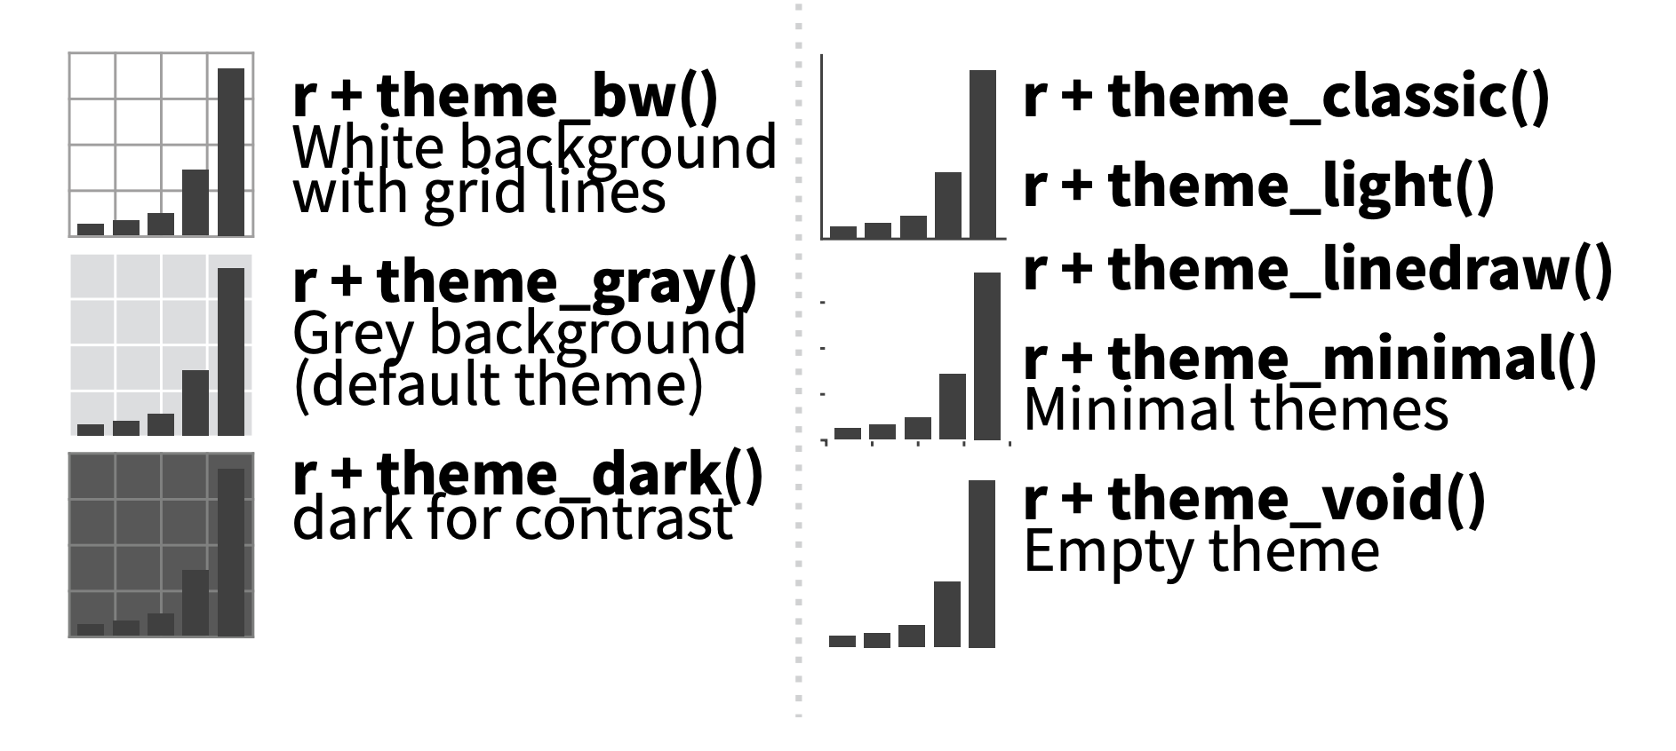
Themes

Slide 10
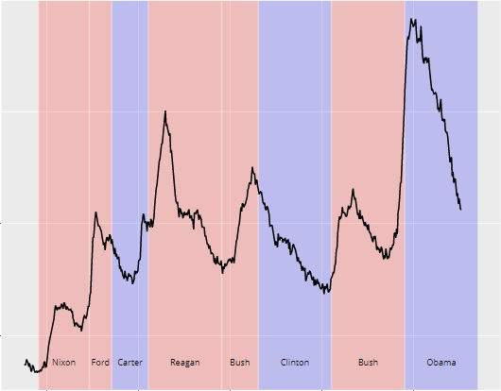
GRAPHICAL PRIMITIVES
Facility to draw basic graphs and shapes like rectangle, curve, path, point etc…
Examples :
geom_path()
geom_text()
geom_rect()

Slide 11
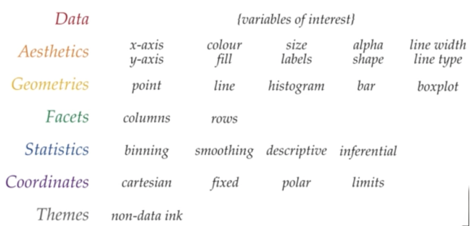
Aesthestics
X-> x values
Y-> y values
Alpha-> transparency (default = 1)
Colour-> colour with which a geom is outlined
Fill -> colour with which a geom is filled
Group -> controls which rows of the data get grouped together
Linetype -> type of line
Size -> size of the shape or text

Slide 12
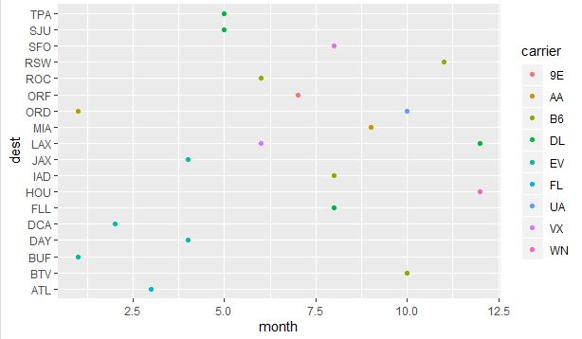
Example
few <- head(nyc flights, n=20L)
ggplot(few,aes (month, dest)) + geom_point(aes(colour=carrier))

Slide 13
layers
One can add layers, colours and shapes using the Rgraphics
Used to visualize the data effectively
One layer per geom function

Slide 14
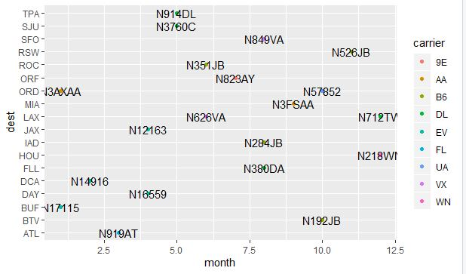
example
ggplot(few, aes(month, dest)) + geom_point(aes( colour=carrier))
+ geom_text(aes (label= tailnum))

Slide 15
One variable
geom_area
geom_density
geom_dotplot
geom_freqpoly
geom_histogram
geom_qq
CONTINUOUS
X
DISCRETE
geom_bar

Slide 16
Two variable
geom_blank
geom_jitter
geom_point
geom_quantile
geom_rug
geom_smooth
geom_text
Continuous x,
Continuous y
x
geom_bar(stat = identity)
geom_boxplot
geom_dotplot
geom_voilin
Discrete x,
Continuous y
y
Discrete x,
Discrete y
geom_jitter

Slide 17
Continuous Bivariate function
Constructing, plotting and evaluating bivariate probability distribution that includes probability mass function, probability density functions and cumulative distance functions.
geom_bin2d() : Divides planes into rectangles, counts the number of cases in each rectangle, maps them to rectangle fill.
h+geom_bin2d(binwidth=c(5,5))
{x, y, alpha, colour, fill, linetype, size, weight}

Slide 18
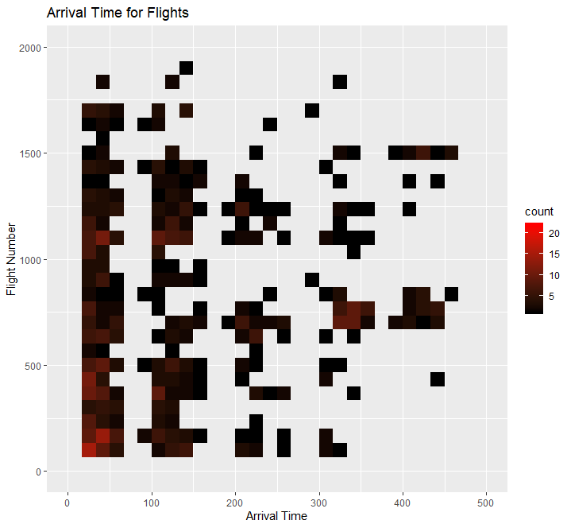
continued…
ggplot(d,aes(arr_time, flight)) + geom_bin2d() + xlim(0,500) + ylim(0,2000) + scale_fill_gradient( low="black”,high = "red") + labs(x="Arrival Time", y="Flight Number", title = "Arrival Time for Flights" )

Slide 19
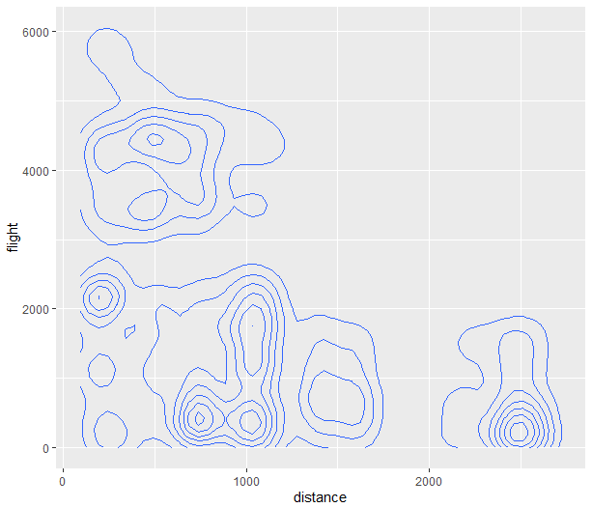
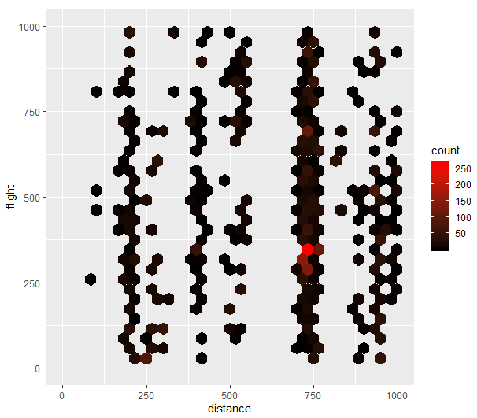
Continued…
geom_density2d() : Computes and draws kernel density estimate. Plots the density on 2d.
h + geom_density2d()
{x, y, alpha, colour, group, linetype, size}
geom_hex() : Plots density in shape of hexagons.
h + geom_hex()
{x, y, alpha,colour, fill, size}

Slide 20
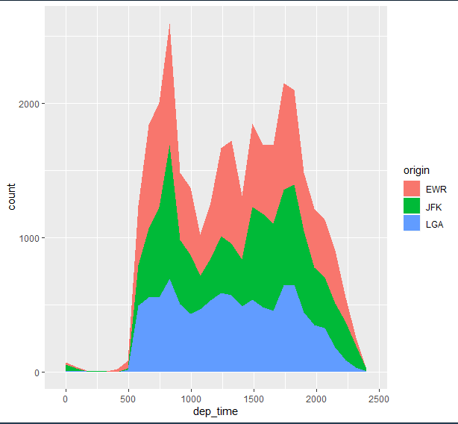
Continuous Functions
geom_area(): Used to create area plot with continuous variable and see how the composition of whole varies over the values of x.
ggplot(data, aes(x=dep_time,fill=origin)) + geom_area(stat='bin')
{x, y, alpha, colour, fill, linetype, size}

Slide 21
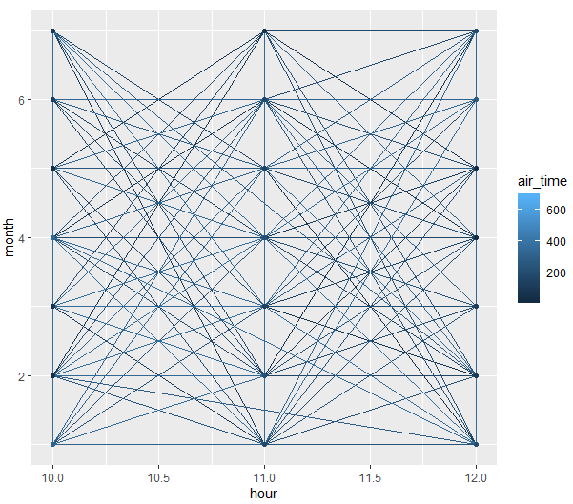
Continued…
geom_line(): Connect observations, ordered by X value.
ggplot(data=d, aes(x=hour, y=month, group=air_time, colour=air_time)) + geom_line()+geom_point()+ xlim(10,12) + ylim(1,7)

Slide 22
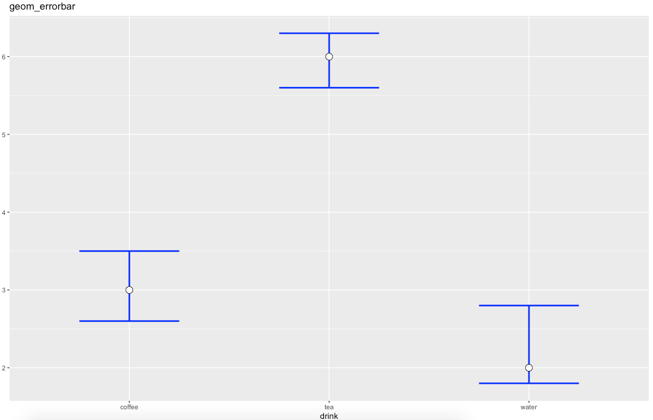
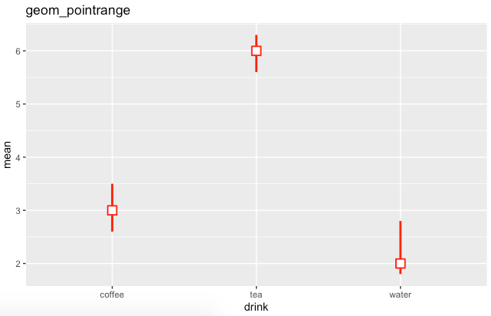
Visualizing error
geom_errorbar(): A geom that draws error bars, defined by an upper and lower value. This is useful e.g., to draw confidence intervals.
geom_crossbar(): A geom that draws point ranges, defined by an upper and lower value for the line, and a value for the point. This is useful e.g., to draw confidence intervals and the mean in one go.

Slide 23
Stats
Stats typically transforms data by summarizing it in some manner.

Slide 24
Some Stat functions and their equivalent Geom functions
stat_bin(): geom_bar()
stat_bin2d():geom_bin2d()
stat_bindot():geom_dotplot()
stat_binhex(): geom_hex()
stat_boxplot():geom_boxplot()
stat_countour():geom_countour()
stat_quantile():geom_quantile()
stat_smooth():geom_smooth()
stat_sum():geom_count()

Slide 25
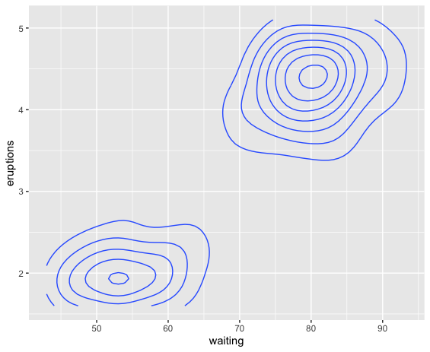
Stat_contour()
ggplot2 can not draw true 3d surfaces and that’s where the function Stat_contour() is used to visualise 3d surfaces in 2d.
Example
v <- ggplot(faithfuld, aes(waiting, eruptions, z = density))
v + stat_contour()

Slide 26
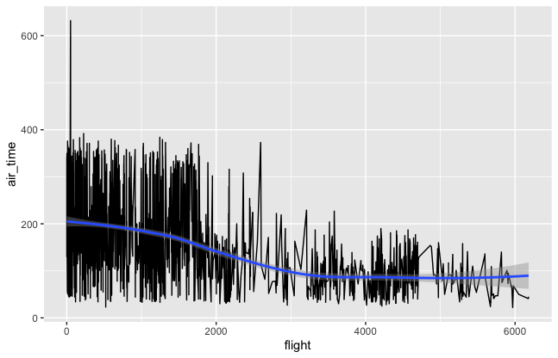
Stat_smooth()
Creates a smooth line using regression lines.
Example:
p<-head(nycflights,n=2000)
ggplot(p,aes(x=flight,y=air_time))+geom_line()+stat_smooth(method="loess")

Slide 27
Stat functions that cannot be created by Geom Functions
Stat_summary
Stat_summary2d

Slide 28
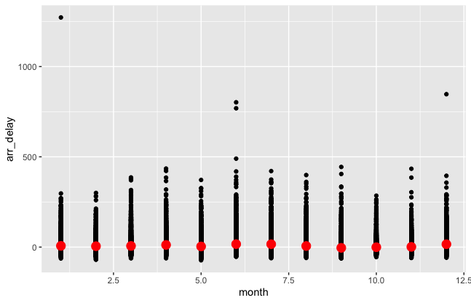
Stat_summary
Summarizes y values at distinct x values
Example
ggplot(nycflights,aes(x=month,y=arr_delay))+geom_point() + stat_summary(geom="point",fun.y="mean",colour="red",size=4)
We can also have below two variations for the above example
fun.ymin = min
fun.ymax= max

Slide 29
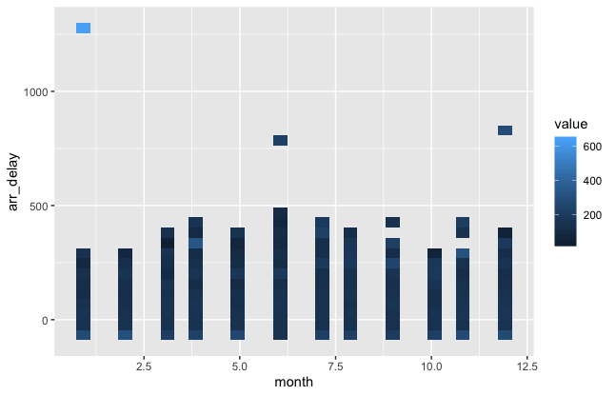
Stat_summary_2d
Stat_summary_2d is a 2d variation of stat_summary()
The data are divided into bins defined by x and y, and then the values of z in each cell is are summarised with fun
Example
ggplot(nycflights,aes(x=month,y=arr_delay,z=air_time))+stat_summary_2d()

Slide 30
scales
Scales control the mapping from data to aesthetics.
They take your data and turn it into something that you can see, like size, color, position or shape.
Scales also provide the tools that let you read the plot: the axes and legends.

Slide 31
TYPES OF Scales
GENERAL PURPOSE SCALE
LOCATION SCALE
scale_*_continuous()
To change x and y axis limits, respectively for continuous variable
scale_*_discrete()
To change x and y axis limits, respectively for discrete variable
scale_*_datetime()
To plot a data on x and y axis respectively that will contain date and time.
scale_*_date()
To plot a data on x and y axis respectively that will contain only date.
scale_*_log10(): Plot x or y on log10 scale
scale_*_sqrt(): Plot x or y on square root scale
scale_*_reverse(): Reverse direction of x or y axis

Slide 32
Color and Fill Scales
scale_fill_brewer(): Uses handpicked “ColorBrewer” colours.
scale_fill_grey() : Maps discrete data to grays, from light to dark.
scale_color_gradient() & scale_fill_gradient(): a two-colour gradient, low-high (light blue-dark blue).
scale_colour_manual(): is useful if you have your own discrete colour palette.

Slide 33
Coordinate Systems
A coordinate system maps the position of objects onto the plane of the plot. Position is often specified by two coordinates(x,y) in ggplot2.
They control how the axes and grid lines are drawn.

Slide 34
Types of coordinate system
There are 2 types of coordinate system
Linear coordinate systems: Preserve the shape of geoms.
coord_cartesian()
coord_flip()
coord_fixed()
Non-linear coordinate systems: Can change the shapes. Eg.a straight line may no longer be straight.
coord_map()
coord_polar()
coord_trans()

Slide 35
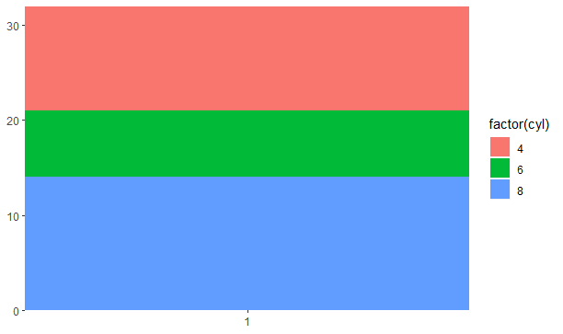
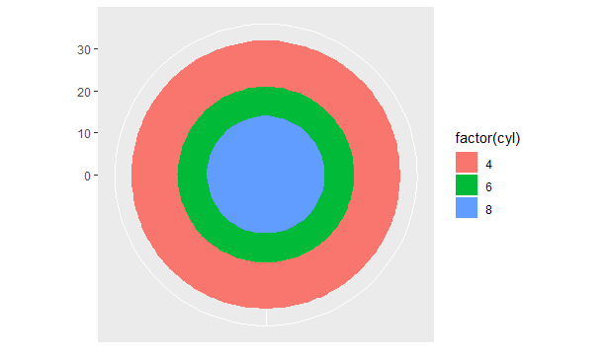
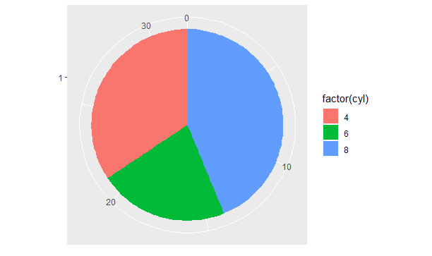
coord_polar
coord_polar - Polar coordinates; the x (or y) scale is mapped to the angle (theta)
Example:
base<- ggplot(mtcars,aes(factor(1),fill=factor(cyl)))+
geom_bar(width=1)+
scale_x_discrete(NULL,expand = c(0,0))+
scale_y_continuous(NULL,expand = c(0,0))
sample<-base
polar_x <-base+coord_polar("x")
polar_y<-base+coord_polar("y")
sample
polar_x
polar_y

Slide 36
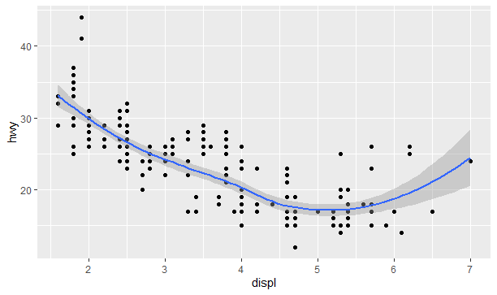
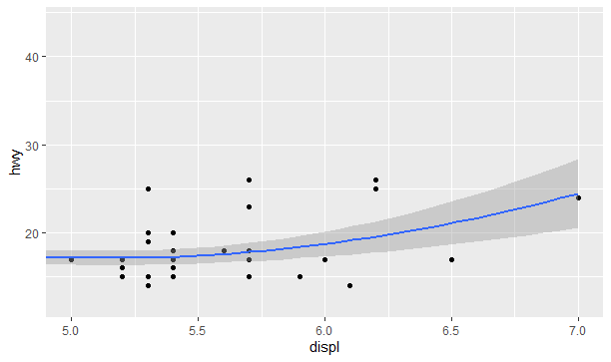
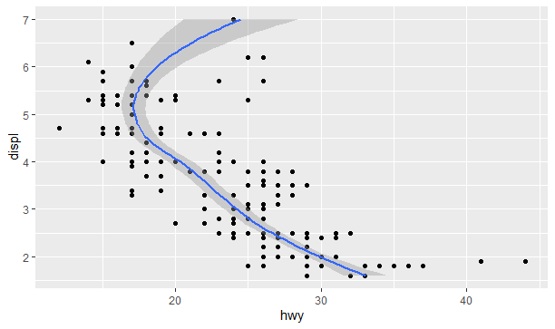
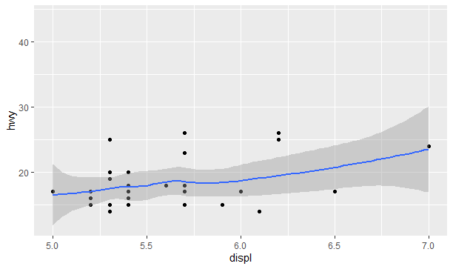
coord_cartesian & coord_flip
coord_cartesian - (default) cartesian coordinate system (x horizontal from left to right, y vertical from bottom to top)
coord_flip - flipped cartesian coordinate system (x vertical from bottom to top, y horizontal from left to right)
Example:
data<- ggplot(mpg,aes(displ,hwy))+
geom_point()+
geom_smooth()
data (see in Fig 1)
data+coord_cartesian(xlim=c(5,7)) (see in Fig 2)
data+coord_flip()(see in Fig 3)
data+scale_x_continuous(limits = c(5,7))
(see in Fig 4)
Fig 1
Fig 2
Fig 3
Fig 4

Slide 37
Labels
Title
Subtitle
Caption
Tag
Labelling X-axis & Y-axis

Slide 38
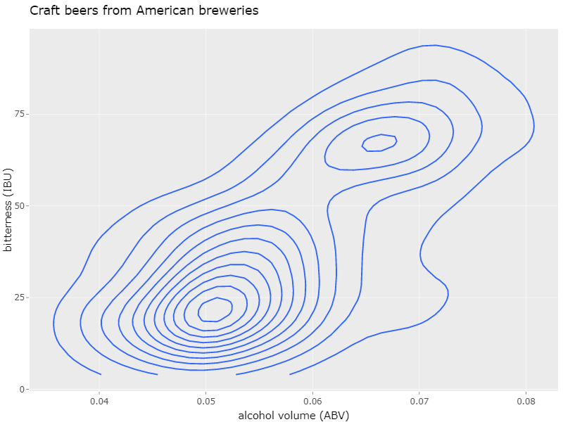
What is a label?
Title
Label is a human readable description of the variable .
Good labels are critical for making your plots accessible to a wider audience.
Y label
X label

Slide 39
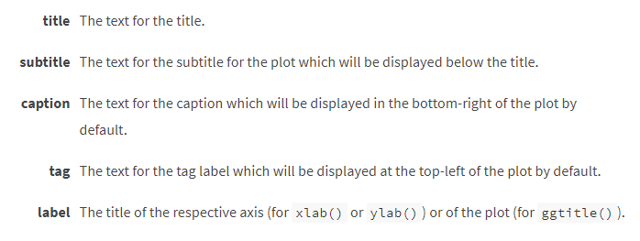
Arguments
A list of new name-value pairs.
The name should be an aesthetic.

Slide 40
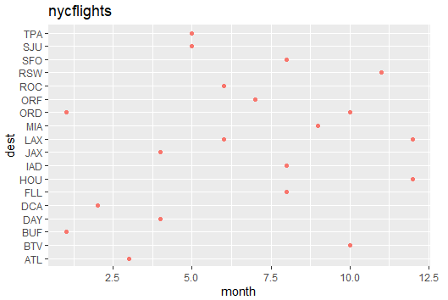
title
The plot title appears at the top-left.
ggplot(a,aes(month,dest))+ geom_point(aes(colour= “carrier”)) + labs(title= “nycflights”)

Slide 41
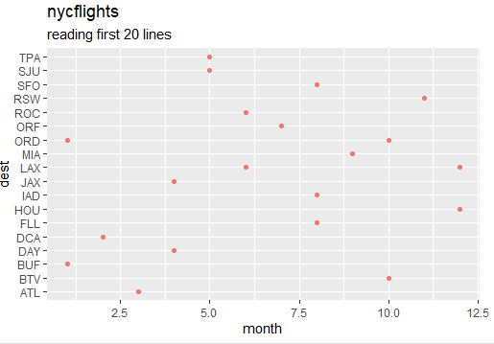
Subtitle
subtitle will display in smaller text underneath the title.
ggplot(a,aes(month,dest))+ geom_point(aes(colour= “carrier”)) + labs(title= “nycflights”, subtitle = “reading first 20 lines”)

Slide 42
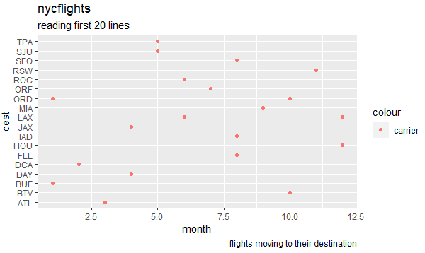
caption
The caption appears in the bottom-right, and is often used for sources, notes or copyright.
b<- ggplot(a,aes(month,dest))+ geom_point(aes(colour= “carrier”)) + labs(title= “nycflights”, subtitle = “reading first 20 lines”)
b+ labs(caption = “flights moving to their destination”)

Slide 43
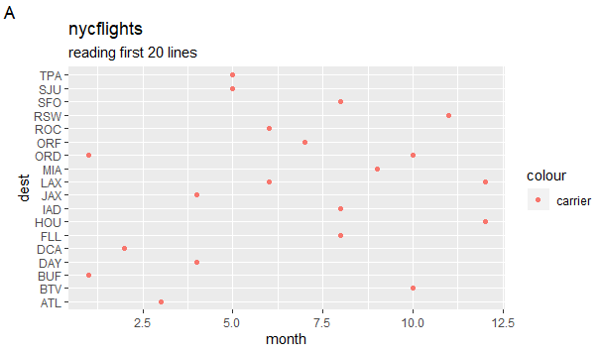
TAG
The plot tag appears at the top-left, and is typically used for labelling a subplot with a letter.
b<- ggplot(a,aes(month,dest))+ geom_point(aes(colour= “carrier”)) + labs(title= “nycflights”, subtitle = “reading first 20 lines”)
b+ labs(title=“nycflights” , tag=“A”)

Slide 44
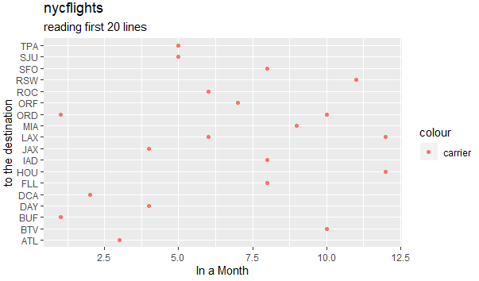
Labelling x-axis and y-axis
b<- ggplot(a,aes(month,dest))+ geom_point(aes(colour= “carrier”)) + labs(title= “nycflights”, subtitle = “reading first 20 lines”)
b+ labs(x=“In a Month”, y= “to the destination”)

Slide 45
Position adjustments
Position adjustments determine how to arrange geoms that would otherwise occupy the same space.

Slide 46
types
Bar
Point
Label

Slide 47
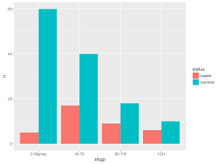

examples
In bar type elements are arranged side by side
In label type, elements are stacked on top of one another.

Slide 48
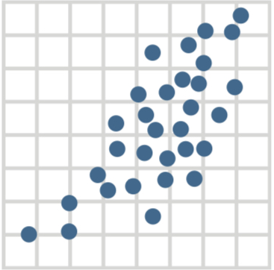
over plotting
To avoid over plotting add random to x and y position to each element

Slide 49
FUNCTIONS FOR THE ABOVE
s <-ggplot(mpg, aes(fl,fill=drv))
s + geom_bar(position=“dodge”)
s + geom_bar(position=“fill”)
s + geom_point(position=“jitter”)
s + geom_label(position=“nudge”)
s + geom _bar(position=“stack”)
s +geom_bar(position=position_dodge(width=1))

Slide 50
VARIATIONS
Each position adjustment can be recast as a function with manual width and height

Slide 51
Facets

Slide 52
What is Facetting ?
Facetting divide a plot into separate subplots based on one or more discrete variables.
When you call ggplot2 , you provide a data source, usually a data frame, then ask ggplot2 to map different variables in our data source to different aesthetics, like position of the x or y-axes or color of our points or bars.
With facets, you gain an additional way to map the variables.

Slide 53
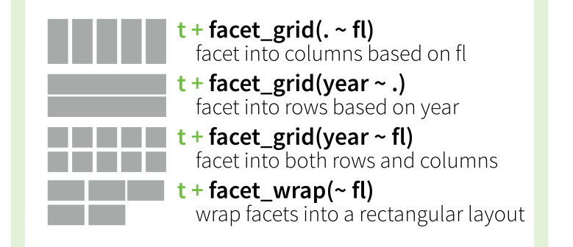
Types :
facet_grid
facet_wrap

Slide 54
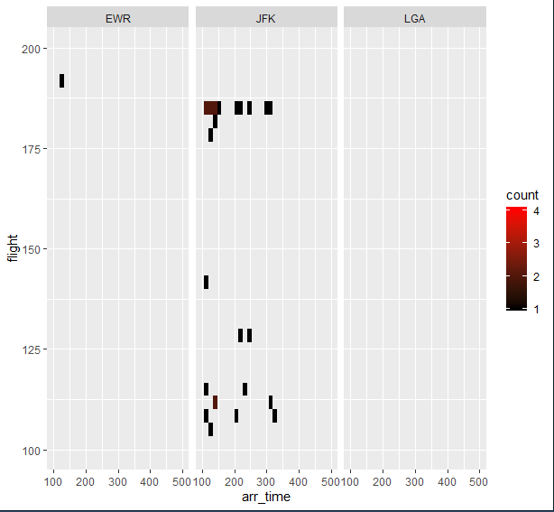
facet_grid() : facet_grid() forms a matrix of panels defined by row and column faceting variables. It is most useful when you have two discrete variables, and all combinations of the variables exist in the data.

Slide 55
facet_wrap() : facet_wrap wraps a 1d sequence of panels into 2d. This is generally a better use of screen space than facet_grid() because most displays are roughly rectangular.

Slide 56
Conclusion
Combine multiple data sets into a single graph with a snap-together, building-block approach.
Easy to make pretty and elaborate graphs.
Carefully chosen default color schemes and layouts.
Only few high-end functions, but with very wide applicability.
Great graphical representations (geoms) and easy transformations.
Flexibility, intuitiveness, and logic of the mapping between the data and its representation.
Powerful layer system that makes it easy to combine different sources of data.

Slide 57

Any Questions??

Slide 58
Thank you

