Slide 1
Vehicle Tracking System Using
Lucas-Kanade algorithm

Slide 2
PROBLEM STATEMENT:
To calculate the speed of a vehicle or an object moving with relative speed with respective to the camera using the images taken by it applying the optical flow technique on the images taken.
The humans eyes cannot perceive the speed of the body in motion directly by looking at it.

Slide 3
INPUTS:
Images taken by the camera back to back or frames extracted from a video.
OUTPUTS:
Speed of the vehicle or the object considered in kmph or mph.

Slide 4
METHODOLOGY:
Speed of the moving object can be calculated from the images taken from it. The most important phase in this is the detection of the repeating object in the subsequent images.
Object tracking is done by Lucas-Kanade Algorithm, which is widely used differential method.

Slide 5
By combining information from several nearby pixels, the Lucas-Kanade Algorithm can often resolve the ambiguities of the optical flow.
The Lucas-Kanade Algorithm is implemented in the using OpenCV, a library of programming functions mainly aimed at real time computer vision.
From the tracked object from the subsequent images the pixel difference is calculated.
This measurement converted into meter. With the known value of the time interval between the subsequent images the velocity is calculated.

Slide 6
The project is divided into following modules:
Data Collection
Lucas-Kanade object tracking
Speed calculation

Slide 7
Step1:
Data Collection:
1.1 Data collection includes the collection of test images.
1.2 The images could be either still photographs taken with specified time gap or could be frames extracted from a video.
1.3 The vehicle can be of any kind, with or without in-built mechanisms for finding out the speed.
1.4 The necessary photos and videos were taken at different speeds.
1.5The speeds at which each photo and video were taken were also noted.

Slide 8
Step 2:
Lucas-Kanade object tracking

Slide 9

The two images from the first module are passed as input here.
2.1: We will mark a common object that is present on both the images(Let A and B be two 2D greyscaled images). Consider an image point p = [px py]T.
2.2: Let ωx, ωy be integers. A small searching window (size of 2*ωx+1 by 2*ωy+1 (in pixels)) is selected within a neighborhood of the point ‘p’ under consideration.
We just have to find the movement which minimizes the error:

Slide 10


2.3:
We begin by obtaining the derivative of the error in comparison with the move:
Then, we apply a Taylor development (order 1) around the move [0, 0] (valid if we consider move is small, and we will admit it):

Slide 11



2.4:
From now, we can briefly stop computations to consider some facts. First, A(x, y) – B(x, y) looks like the picture’s derivative at point (x, y), which we will note dI(x, y).
Then, B’s partial derivatives in x and y look like a gradient. As we can consider the window to be big enough in comparison with the movement vector, windowed picture’s derivative will be the same in image B and in image A.
Therefore, we have the following gradient:
for any (x, y) belonging to the window:
With those notations, we obtain:

Slide 12




2.5:
Finally, a slight transformation gives us:
If we use
and:
we can rewrite the previous equation:

Slide 13
2.6:
As, let us not forget about it, the goal is to cancel out error’s derivative, we get:
G is invertible if gradient of A is defined, i.e if the window is contained into the picture, and if we have a high enough contrast into the window (see last part about good pixels choice).

Slide 14
2.7 : k iterations in order to sharp the result
We can consolidate the result by applying them several times, until, for example, the new found norm of movement is less than a chosen epsilon.
For an iteration index k, if we have a result , we transform B this way:
and then we compute:

Slide 15

We can see now how useful it was to compute gradient of A rather than gradient of B because we won’t have to compute it again through iterations.
We finally get the final move:

Slide 16

2.8 : The Pyramidal form.
We take m pyramidal levels (often 3) and we apply the whole algorithm at each level from Lm to 0.
At each level, we build a new picture at a 2^L less accurate resolution.
We keep a same sized window and just transform coordinates of the tracked pixels in order to remain coherent with new resolution.
To obtain the final move, we just have to sum all rescaled found moves:

Slide 17
Step 3:
Computation of Speed:
3.1 The first step is to find the pixel displacement of the object in the images.
3.2 We had taken many test cases and assumed a factor which estimates the speed of the vehicle.
3.3 This factor multiplied with the pixel distance and then divided by the time, gives the actual speed of the vehicle during that time interval.
3.4 The calculated speed S is the final output.

Slide 18
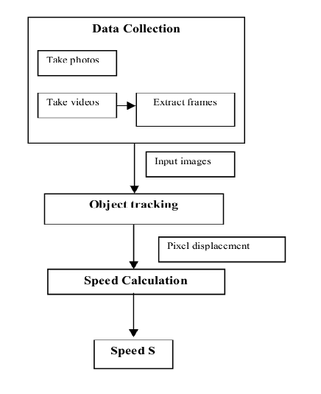
System Architecture:

Slide 19
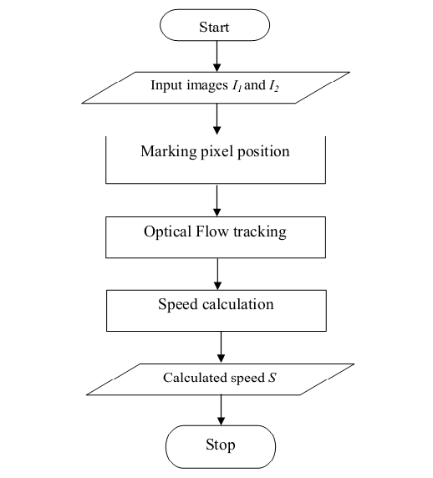
Flowcharts:

Slide 20
Software Specification
Operating system : LINUX
Language : MATLAB
Library : MATLAB library
Hardware specification
• Processor : Intel(R) Core(TM)2 Duo
• Primary Memory : 2GB RAM
• Hard Disk Capacity : 320GB 7200rpm
• Monitor : 14’’ HD WLED
• Digital Camera : Hi res Camera

Slide 21
Applications of the System:
System can be used to find the speed of the vehicle in motion.
Features tracking
Motion detection mechanism.

Slide 22
Scope:
Using another camera placed at different direction, the vehicle is identified so that the vehicle’s journey is tracked by recording its locations in the database at various time intervals and retrieved accordingly.

Slide 23
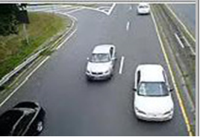

Results:
Fig (a): Frame 1 of Original Video
Fig (b): Frame 2 of Original Video

Slide 24
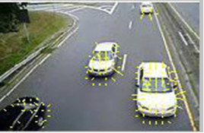
Car 1
Motion Vector of car 1: 67.6389843912.
Speed :
20.6298962393 Km/h
Fig (b): Motion Vector

