Slide 1
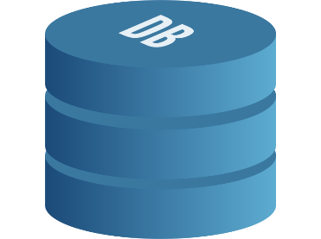
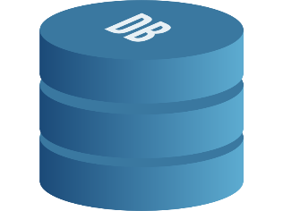
Oracle DB
Linked Server Query
Execute Query
.NET Executable
Execute Query
SQL Server Database A
C# Dataset
C# Dataset
SQL Server
Database B
DAPPER
Compare Dataset and Log Results
Test results DB

