Slide 1



Ryan Applegate

Slide 2

Getting Groovy
with
Notes:
Today I’m going to talk to you about Groovy & Vert.x.

Slide 3
Who am I
Ryan Applegate
Senior Software Engineer @ SmartThings
@rappleg on Twitter and GitHub
Notes:
A little bit about who I am. My name is Ryan Applegate.
I’m a Senior Software Engineer @ SmartThings working on the cloud platform team.
You can also find me on Twitter and GitHub @ rappleg

Slide 4
Vert.x Agenda
Background (Inspired by Node.js)
Why Vert.x?
Benchmarks (How does Vert.x stack up?)
Terminology and examples
Demo 1 – Websockets
How does SmartThings use Vert.x?
Demo 2 – SmartThings Web IDE
What’s new in Vert.x 3
Notes:
Here are the topics we’re going to cover. We’ll start with the background of Vert.x, which was originally inspired by Node and first started out with the name Node.x before it eventually changed it’s name to Vert.x.
Next, we’ll touch on why you’d use Vert.x. There are already so many lightweight frameworks for building microservices, what sets Vert.x apart from the rest of them?
We’ll go over a few benchmarks. As some of you may already know, Vert.x is very fast, but how does it stack up compared to other frameworks?
Before we dig into the demos we’ll go over some terminology in Vert.x and look at a few examples to get you familiar with the syntax.
Then we’ll go through a quick demo using WebSockets on a simple HTTP server
Also, we’ll go through how SmartThings uses Vert.x and demo our Web IDE and how that leverages Vert.x when simulating devices.
Finally, we’ll go through what’s new in Vert.x 3 including framework changes and how you’d go about upgrading from Vert.x 2
Does that sound good to everyone? Also, if this is not what you expected from this talk then feel free to go grab another session, I won’t be offended and want to make sure you feel you’re in the right session.

Slide 5
What is Node?
Server Side Javascript
Event Driven Non-Blocking I/O
Single thread/single event loop
Application registers handlers
Events trigger handlers
Everything runs on the event loop
Notes:
How many of you are familiar with Node? I assume almost everyone.
Since Vert.x was inspired by node we can draw a lot of similarities between the two, so let’s first look at what Node.js is to get a better understanding of where Vert.x is coming from.
Node.js was created by Ryan Dahl starting in 2009
Node.js was influenced by models such as the Ruby’s Mongrel web server and Event Machine along with Python's Twisted model
Follows what is known as the reactor pattern

Slide 6
Reactor Pattern Issues
MUST not block the event loop
Some work is naturally blocking
Intensive data crunching
3rd-party blocking API's (e.g. JDBC, etc...)
Node.js is not good for this type of work

Slide 7
Why Vert.x?
Same event-driven non-blocking IO programming model as Node
Polyglot (Groovy, Ruby, Java, Javascript, Python, Scala, and Clojure)
Mature concurrency framework (JVM)
Hazelcast for Clustering
Interprocess Communication via Event Bus
Built on Netty and NIO2 for Network I/O
Notes:
Vert.x was started by Tim Fox in 2011 while he was employed by Vmware.
Caveat: because built on Netty and NIO2 you’re going to need to be running Java 7 for Vert.x 2 or Java 8 for Vert.x 3.
Vert.x is a toolkit for writing polyglot reactive applications on the JVM.
Unlike the traditional stacks its been designed from day one with microservices in mind, and it's also been designed with scalability in mind so it's almost completely non blocking (OS threads).
This is critical for many modern applications that need to handle a lot of concurrency - e.g. process a lot of messages or events, or handle a lot of connections.
Also, unlike the traditional Java stacks, Vert.x supports other languages than Java - e.g. JS, Ruby and Groovy so we don't force you to always use Java and can use the best language for the job at hand or for the skill-set of your team.
Another important point is that Vert.x is a toolkit, not a container or "framework". That means you can use it within your existing application to give it the Vert.x super powers. For example you can use it within your Spring application, and many users do.

Slide 8
Ideal choice for creating microservices.
Lightweight - Vert.x core is around 650kB in size.
Fast - We’ll take a look at some independent benchmarks
It’s not an application server - There's no monolithic Vert.x instance into which you deploy applications. You just run your apps wherever you want to.
Modular - when you need more bits just add the bits you need and nothing more.
Notes:
Vert.x is an ideal choice for creating microservices. Core is well under a meg in size, it’s very fast as we’ll see in some benchmarks in a minute.

Slide 9
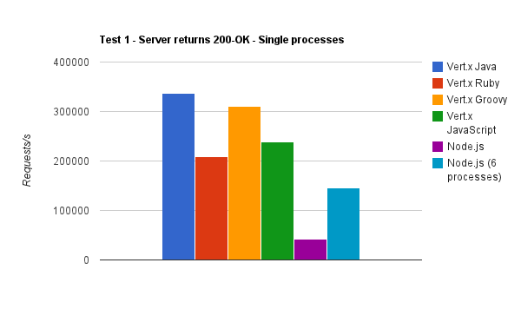
Benchmark #1
Notes:
One of the best things about Vert.x is it is very fast! These are some older benchmarks showing performance of Vert.x vs Node.js, I have links to all of these benchmarks at the end of this talk.
Machine: AMD Phenom II X6 (that’s a six core, not as good as the latest Intels but pretty good), 8GB RAM (although only a fraction was used in the tests), Ubuntu 11.04.
Versions: vert.x-1.0.final, node.js 0.6.6
Test 1: Performance of a trivially simple HTTP server which returns a 200-OK for every request.

Slide 10
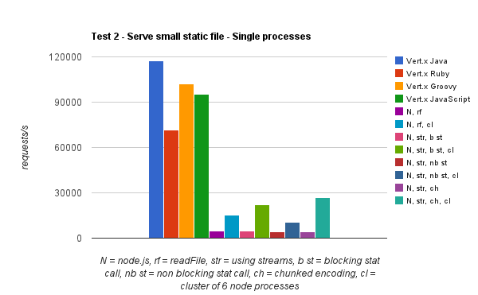
Notes:
Test 2: Slightly less trivial HTTP server which serves a real static file from the file system. The file is 72 bytes in size and just contains simple HTML head and body data.
One of the advantages of Vert.x over Node.js is a single server instance can utilize all the cores on your server without having to manually fork child processes and write load-balancing code to farm out requests to the children.

Slide 11
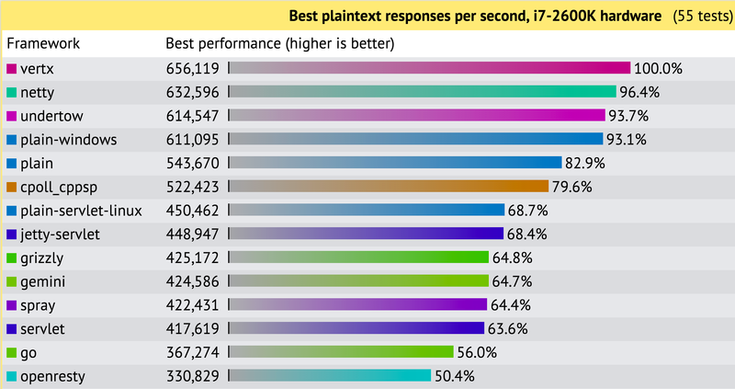
https://www.techempower.com/benchmarks/#section=data-r8&hw=i7&test=plaintext
Notes:
https://www.techempower.com/benchmarks.
These benchmarks are from round 8 and were on Vert.x 2 and about 1 ½ old (12-17-2013) so a little out of date. Currently they are starting to benchmark Vert.x 3, but those results aren’t available yet.
In this test, the framework responds with the simplest of responses: a "Hello, World" message rendered as plain text. The size of the response is kept small so that gigabit Ethernet is not the limiting factor for all implementations. HTTP pipelining is enabled

Slide 12
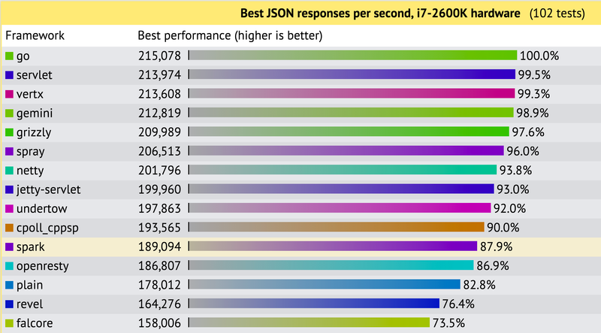
Notes:
Also from round 8 and same version
In this test, each response is a JSON serialization of a freshly-instantiated object that maps the key message to the value Hello, World!
I would love to see Ratpack get into these empower benchmarks, so hopefully that will happen in future rounds.

Slide 13
Notes:
Next we’re going to go through some Vert.x terminology and a few simple examples to get started

Slide 14
Verticle
Verticle
The unit of deployment in vert.x is called a verticle (think of a particle, for vert.x). Verticles can currently be written in Java, JavaScript, Ruby, Python, Groovy, Clojure, and Scala.
A verticle is defined by having a main which is just the script (or class in the case of Java) to run to start the verticle.
Notes:
The fact that each verticle can be polygot is one of the most compelling reasons (along with it’s speed of course) that makes Vert.x a great choice in your tech stack.

Slide 15

Vert.x Instance
Event Loops
vertx run HelloWorld -instances 4
Verticle
Verticle
Verticle
Verticle
Notes:
If you think of verticles as actors you can see why it’s known as an “actor” like concurrency model.
To increase the number of instances and use more cores on your machine just increase the number of instances when running Vert.x
As a good rule of thumb if you’re going for raw performance and don’t know where to start you’ll probably want to start by setting your number of instances to the number of cores on the box you’re running on.

Slide 16
Running Vert.x Server
Server.groovy
vertx.createHttpServer().requestHandler { req ->
def file = req.uri == "/" ? "index.html" : req.uri
req.response.sendFile "webroot/$file"
}.listen(8080)
Start the server
vertx run Server.groovy
Utilize more cores, up your instances...
vertx run Server.groovy -instances 32

Slide 17
Concurrency
Verticle instance ALWAYS executes on assigned thread/event loop.
Verticles can have isolated classloaders and therefore not share global state.
Write all your code as single threaded.
No more synchronized and volatile!
Notes:
I’m sure some of you may remember the Brian Goetz book “Concurrency in Practice” with the white trains on the front. I remember when writing Java I use to lose sleep thinking about which methods I didn’t add synchronized and what horrible race conditions we’d find in prod. As Venkat would say this is known as the synchronize and suffer pattern.
It’s nice that the verticles are isolated, but how do they talk to another?

Slide 18
Verticle
Verticle
Verticle
Verticle
Event Bus

Slide 19
Event Bus Addressing
Address simply a String
Dot-style namespacing recommended
"messages.inbound.foo"

Slide 20
Handler Registration
messages.inbound.foo
Handler 1
Handler 2
Handler 3

Slide 21
Handler Registration
def eb = vertx.eventBus()
eb.registerHandler("test.address") { message ->
println "I received a message ${message.body}"
}
Notes:
This is an example of a handler registration you might have inside of a verticle. This vertx.eventBus() is referencing the vertx instance you would have available to your polyglot Verticle by just extending the base Verticle class. We can dig more into that code a little later.

Slide 22
Pub/Sub
Deliver single message to all handlers registered at an address
messages.inbound.foo
Handler 1
Sender
Handler 2
Handler 3

Slide 23
Pub/Sub
Deliver single message to all handlers registered at an address
eb.publish("test.address", ”hello world")
Notes:
This eb is the vertx.eventBus() reference we got on the previous example. From there we just need to call publish to deliver the message to all handlers registerd at that address.

Slide 24
P2P
Deliver message to only one handler registered at an address
messages.inbound.foo
Handler 1
Sender
Handler 2
Handler 3

Slide 25
P2P
Deliver message to only one handler registered at an address
eb.send("test.address", ”hello world")

Slide 26
P2P Messaging Options
Send (Fire and Forget)
Request/Reply Model
Implement replyHandler for messages

Slide 27
Sender
eb.send("test.address”, ”Some msg") { message ->
println "I received a reply ${message.body}"
}
Receiver
eb.registerHandler("test.address") { message ->
println "I received a message ${message.body}”
// Do some work here
message.reply("test.address”)
}
Notes:
If we want to just fire and forget then we wouldn’t implement a reply handler in the top section for eb.send. However, if we want to handle the reply and do something based on it then we’d add the closure that takes in a message.

Slide 28
Vert.x in the Browser
Clustered along with Vert.x instances using HazelCast (In-memory data grid)
SockJS - Older browsers/Corp Proxy
Talk to event bus through SockJS Bridge
WebSockets - HTML 5 feature that allows a full duplex between HTTP servers

Slide 29
WebSockets on the Server
def server = vertx.createHttpServer()
server.websocketHandler{ ws ->
println "A websocket has connected!”
}.listen(8080, "localhost")

Slide 30
Demo – WebSockets in the Browser
BroChat – Connect and join the gr8conf room to send messages back and forth
Simple chat server example to start up HTTP Server on 8080 and allow messages to be sent back and forth using the event bus and websockets
Notes:
Connect url on 8080?

Slide 31
Vert.x Shared State
Shared Data Object (vertx.sharedData())
ConcurrentMap or Set
Elements MUST be immutable values
Currently only available within a Vertx instance, not across the cluster

Slide 32
Allowed Values
Strings
Boxed Primitives
byte[]
org.vertx.java.core.buffer.Buffer
org.vertx.java.core.shareddata.Shareable

Slide 33
Shared Map
Verticle 1
def map = vertx.sharedData.getMap('demo.mymap')
map["some-key"] = 123
Verticle 2
def map = vertx.sharedData.getMap('demo.mymap')
// Retrieve value 123 from the map
def value = map."some-key"

Slide 34
Shared Set
Verticle 1
def set = vertx.sharedData.getSet('demo.myset')
set << "some-value"
Verticle 2
def set = vertx.sharedData.getSet('demo.myset')
// Set will now contain some-value
set.contains("some-value")

Slide 35
BG Pool
BG Pool
Verticle
Verticle
Verticle
Verticle
Worker Verticle
Worker Verticle
Event Bus
Notes:
Can utilize Worker Verticles with their own background pool to execute long running tasks off the event loop
Known as Multi-Reactor

Slide 36
Worker Verticle Example
public class FibWorker extends Verticle {
@Override
public void start() {
def eb = vertx.eventBus()
eb.registerHandler("fib.request") { message ->
def result = fib(message.body.intValue())
def resultMessage = { nbr: message.body,
result: result }
eb.send("fib.response", resultMessage)
}
}
def fib(n) { n < 2 ? 1 : fib(n-1) + fib(n-2) }
}

Slide 37
Verticle (Running on Event Loop)
public class WorkerExample extends Verticle {
@Override
public void start() {
def eb = vertx.eventBus()
eb.registerHandler("fib.response") { msg ->
println "Fib:${msg.body.nbr}=${msg.body.result}"
}
container.deployWorkerVerticle("worker.FibWorker")
{ msg ->
eb.send("fib.request", 20)
}
}
}

Slide 38
More stuff with Vert.x Core APIs
TCP/SSL servers and clients
HTTP/HTTPS servers and clients
WebSockets servers and clients
Accessing the distributed event bus
Periodic and one-off timers
Buffers
Flow control
Accessing files on the file system
Shared map and sets
Logging
Accessing configuration
Writing SockJS servers
Deploying and undeploying verticles

Slide 39
Notes:
Ok, so all of these APIs look pretty cool and I now you kinda get the idea of Vert.x, but how does SmartThings use it?
First of all how many of you have heard of SmartThings?

Slide 40

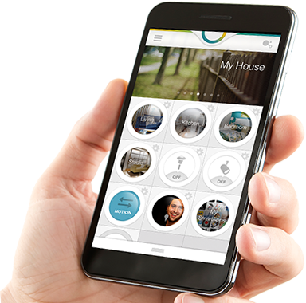
SmartThings is
Your home in the palm of your hand
Notes:
For customers SmartThings is your home in the palm of your hand
With a focus on Home Automation, Safety/Security, Energy Savings

Slide 41
SmartThings is the
Open platform for the Internet of Things
Notes:
For developers we want SmartThings to be THE open platform for the Internet of Things
We want to connect the everyday things in your life
In the 1st wave of the web, Google brought the Knowledge Graph online
In the 2nd wave of the web, Facebook and Twitter brought the Social Graph online
…
Now, We are bringing your Physical Graph online

Slide 42

Notes:
Since are bringing your Physical Graph online we think everything you have connected should be programmable.

Slide 43

Why now?
Notes:
To do this …
We sell a hub and some devices to help you get started

Slide 44

Notes:
But we actually want to connect to everything
Dropcam, Withings, Philips Hue, Belkin Wemo, Sonos
There are Hundreds of supported devices, some of them integrated by 3rd-party developers
It doesn’t matter how they’re connected: through our hub, through another cloud, or via IFTTT
Including Zigbee, Zwave, LAN-connected, Cloud-connected, BLE
In fact … if you don’t find something to do what you want to do, how you want it to work:

Slide 45
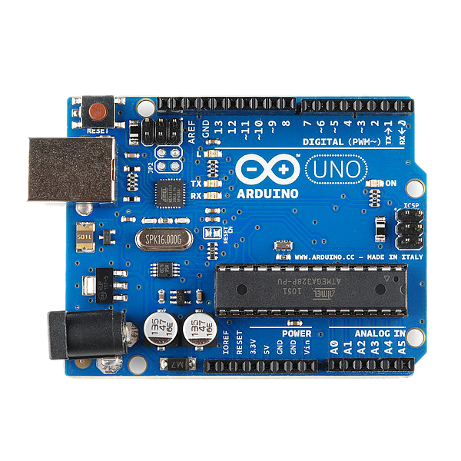
Notes:
If you don’t like what you find
With Arduino, you can create your own devices

Slide 46

http://www.businessweek.com/articles/2013-02-14/smartthings-aims-to-deliver-the-internet-connected-home
Notes:
Because – again – we think the everyday things in your life should be programmable
So you have all of these devices in your home, but how do they talk to each other and how do we make them programmable?

Slide 47
How does SmartThings use Vert.x?
Hubs/Clients need to maintain
always open socket
amqp bus mode to push/pull events
to/from Rabbit MQ
Event Bus to get messages to the
right socket
Notes:
At SmartThings we’ve been using Vert.x for about 3 years now, starting with around version 1.2.3.final. We use it for one of the most critical pieces of our platform and it’s continued to scale as we do, as more hubs/devices come online we’ve been able to easy scale out as needed. We have 3 primary Vert.x applications at SmartThings. These are the application layers help you connect the Web IDE (which I’m going to demo in a minute), Clients (like this mobile phone I have in my pocket), and Devices (like this open/close I have in my hand).
We also have used Vert.x in our load testing applications to simulate hubs and push messages into Vert.x to simulate device traffic. This is actually not a use case we originally even thought of for Vert.x, but it’s actually worked out quite well.

Slide 48
SmartThings Vert.x Throughput
> 1k events/second ~ 100 million events/day from hubs to Vert.x in our production environment
In our load testing environment we’ve easily achieved 5x our production numbers and still plenty of room to go. That’s almost ½ billion events/day!
Running 8 Vert.x instances in prod
Primary reason is stability, not throughput
Mirrored on ios, android, and windows clients

Slide 49
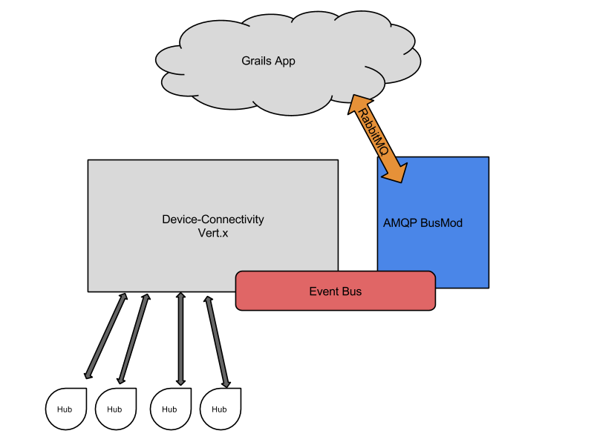

Slide 50
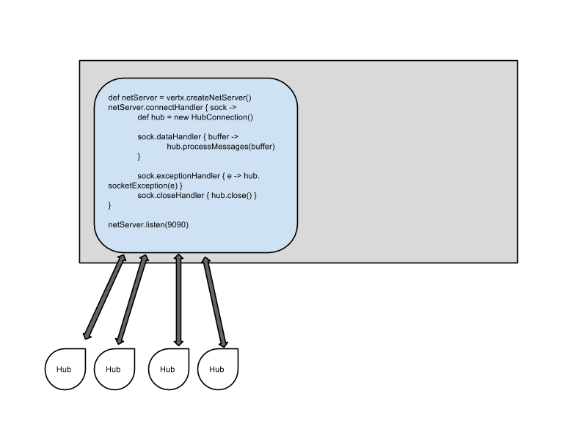

Slide 51
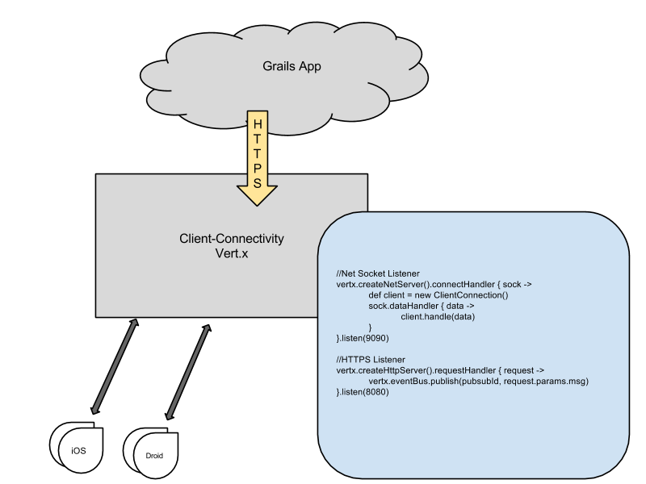

Slide 52
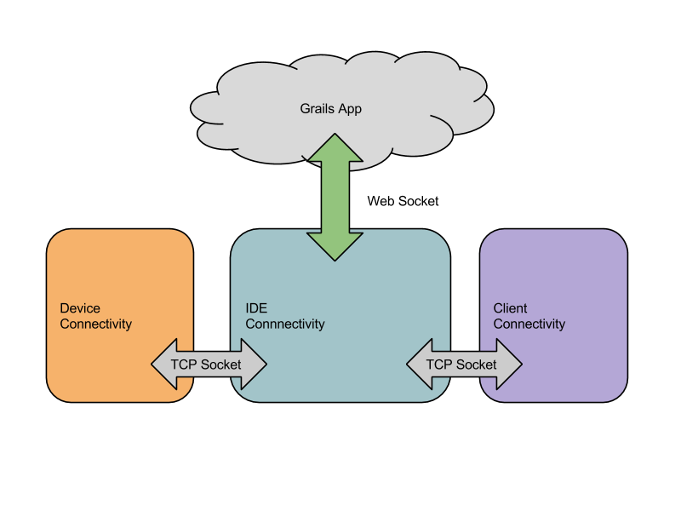

Slide 53
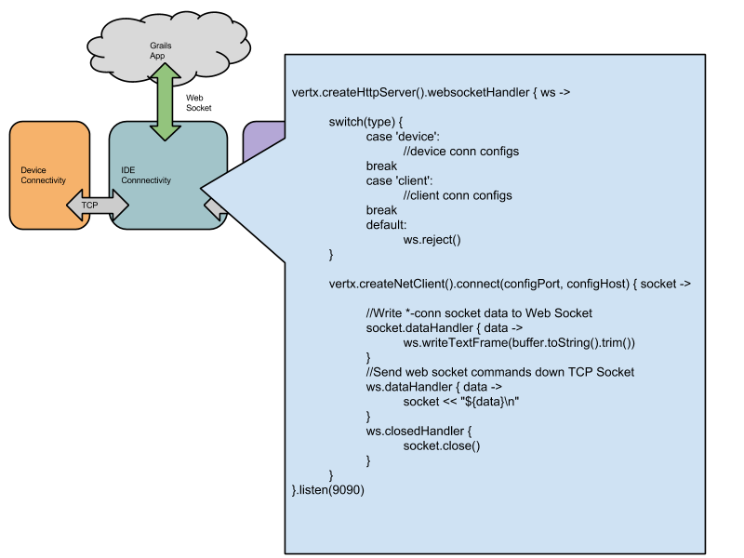

Slide 54
Demo – WebSockets in the IDE
Log into SmartThings IDE and show simulator
Show how ide, device, and client conns work together to send device messages back and forth using the event bus and websockets to update the simulator

Slide 55
What’s new in Vert.x 3
Truly embeddable, pluggable library (no longer framework)
Simple flat model (no extra classloaders)
Build in RxJava support (Rx-ified versions of all Vert.x APIs)
Vert.x-Web - this is a toolkit for writing modern web applications with Vert.x
Experimenting with synchronous style code without the need for callback hell of programming against asynchronous APIs
Notes:
In Vert.x 3, the module infrastructure used by Vert.x 2 was effectively abandoned, and the model for loading classes by default changed so that each verticle (the unit of code in Vert.x) is loaded by the current classloader, in effect leading to a single flat classpath within the application. This makes a Vert.x deployment essentially like any other JVM application.
Now since Vert.x components are packaged as standard jars and you can handle them like any other dependency from Maven or Bintray. The flat classloader model has made things easier to run and debug in IDEs - just create a main and you’re ready to go. All of these have contributed to giving Vert.x 3 a much easier and simpler developer experience.

Slide 56
Vert.x 3 - Continued
Vertx 3 is even more targeted at the reactive microservice space
Support for pluggable messaging
Support for more than one cluster manager
Async support for MySQL, Redis, PostgreSQL, MongoDB, etc…
Out of the box metrics support with DropWizard metrics
Notes:
Vert.x is arguably the Original Reactive, Microservice Toolkit for the JVM, but with Vert.x 3 it’s even more targeted at the reactive space with the addtion of Rx built in API support
Vert.x has an out of the box metrics implementation that uses DropWizard metrics and another one in the works that uses Hawkular.

Slide 57
Vert.x 3 - Core
Vert.x core contains fairly low level functionality including support for HTTP, TCP, file system access, and various other features. You can use this directly in your own applications, and it's used by many of the other components of Vert.x
https://github.com/vert-x3/vertx-examples/tree/master/core-examples
Notes:
Now in Vert.x 3 it’s been split out into 2 major components. The first is core.

Slide 58
Vert.x 3 – Core Examples
Embed Vert.x core in any Java class and run it that way
Vert.x Net servers and clients (TCP/SSL)
HTTP/HTTPS servers
Websockets
Pub/Sub
Notes:
A few examples of when you might want to use core, all of which have examples on GitHub that we can dig into code if you want.

Slide 59
Vert.x 3 - Web
Vert.x-Web is a toolkit for writing sophisticated modern web applications and HTTP microservices.
https://github.com/vert-x3/vertx-examples/tree/master/web-examples
Notes:
The second is Vert.x-Web.

Slide 60
Vert.x 3 – Web Examples
HTTP/REST microservices
Static sites with templating
Sessions
Auth
Cookies
HTML Forms
Notes:
A few examples of when you might want to use Vert.x web, these all have examples on GitHub as well if we want to dig in deeper into any of these.

Slide 61
Upgrading from Vert.x 2 – Dependency Changes
Remove vert.x-platform from pom
Change all imports for Vertx from org.vertx to io.vertx
If using a language other than Java, change the dependency to vertx-lang-<<language>>
Remove any modules references that are using Vert.x 2.x
Use Vertx-unit and remove old teststools dependency
Notes:
First thing you’re going to want to do when upgrading to Vert.x 3 from Vert.x 2 is address all breaking dependency changes.

Slide 62
Upgrading from Vert.x 2 – Build Changes
Remove all vertx maven plugin code to generate modules and create fat jars instead
If you were running your application with runMod or something like that then you need to create a fat jar, changing the build file as in
Notes:
Next, to deal with build changes you’re going to want to remove all vertx maven plugin code to generate modules, instead create fat jars, which requires adding the Shade maven plugin to put all jar files into a big fat jar. The vertx-examples project has simplest-maven which has the stuff to create the fat jar. simplest-gradle is the gradle equivalent.

Slide 63
Upgrading from Vert.x 2 – Code Changes
Verticle is now an interface and not a class to extend, so using Groovy as an example you now extend GroovyVerticle. In Java extendAbstractVerticle instead.
JsonObject.toMap() changed to JsonObject.getMap()
There isn’t a container variable in Verticles anymore for deploying verticles and also a config file. You need to usevertx.getOrCreateContext().config() to get to it
Notes:
Depending on the size of your app there could be a lot of coding changes needed as well.

Slide 64
Resources
http://vertx.io/
http://vertx.io/core_manual_groovy.html
http://vertxproject.wordpress.com/2012/05/09/vert-x-vs-node-js-simple-http-benchmarks/
http://techempower.com/benchmarks/

Slide 65
Questions?
Notes:
So that’s all slides I have, if you’re looking for a toolkit for writing polyglot reactive applications on the JVM I’d recommend you give Vert.x a try. You can download Vert.x 3 @ vertx.io which was just recently released.
Are there any questions or anymore code examples you’d like to look at it?
If not thanks for coming to my talk, and now we can all go grab our set for Groovy puzzlers.

Slide 66
Ryan Applegate

