Slide 1
Lecture 2 — Energy generation
PHY199-RAP · Energy in the 21st Century
Dr. Salvatore Rappoccio

Slide 2
Forces and energy

Slide 3
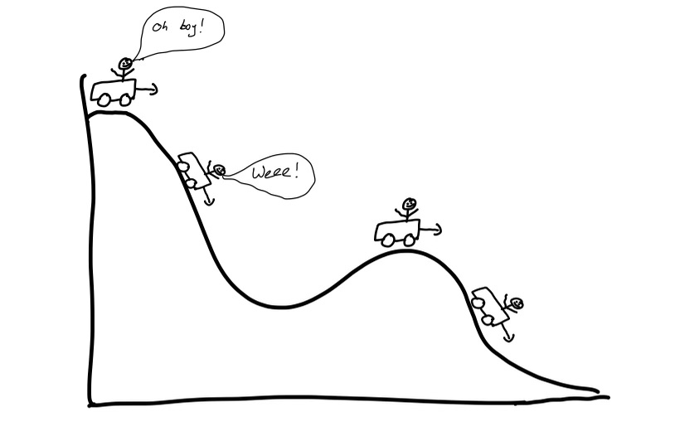
Energy
From Lecture 1
Potential energy
Two types of energy:
  Kinetic : something in motion
    Moving cars, people, electrons, planets, quarks, etc
  Potential : something that can be stored to convert into motion later
    Electric potential energy, gravitational potential energy
This class is about energy generation, i.e. converting potential energy from something into kinetic energy of something else (primarily machinery, electronics, or vehicles)
Converted to kinetic energy
I wish I could blame AI, but I’m just bad at drawing

Slide 4
The Four Forces
From Lecture 1
Gravity
Electromagnetism
Strong nuclear interaction
Weak nuclear interaction
Of these four forces, there's one we don't really understand."
"Is it the weak force or the strong--"
"It's gravity."
All energy comes from one of these four sources. We’ll investigate them all.
https://xkcd.com/1489/

Slide 5

Force
Forces are what act upon bodies to change their acceleration (or shape, or pressure of fluids). In 1 dimension:
  (Caveat: Force and acceleration are VECTORS. We won’t go into it though)
Velocity is how your position changes per unit time (20 miles per hour, 6 meters per second)
Acceleration is how your velocity changes per unit time (9.8 meters per second per second, or 9.8 m/s²)
mass (kg)
Force:
mass * distance / time² (1 Newton = 1 kg m/s²)
Acceleration:
distance / time² (m/s²)
$$F=ma$$

Slide 6

Work
Applying a FORCE over a DISTANCE means you did WORK
Don’t panic this is going to get easier in a minute, bear with me.
Force:
mass * distance / time² (1 Newton = 1 kg m/s²)
Work:
mass * distance² / time² (1 Joule = 1 kg m²/s²)
$$W=F⋅d$$
distance (m)
Not responsible for this, just for enrichment

Slide 7
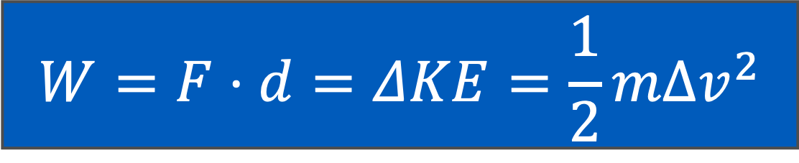
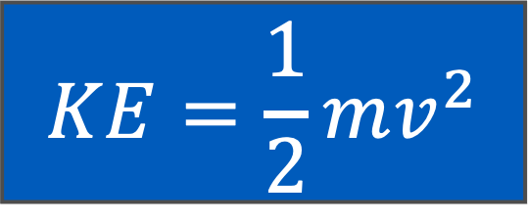
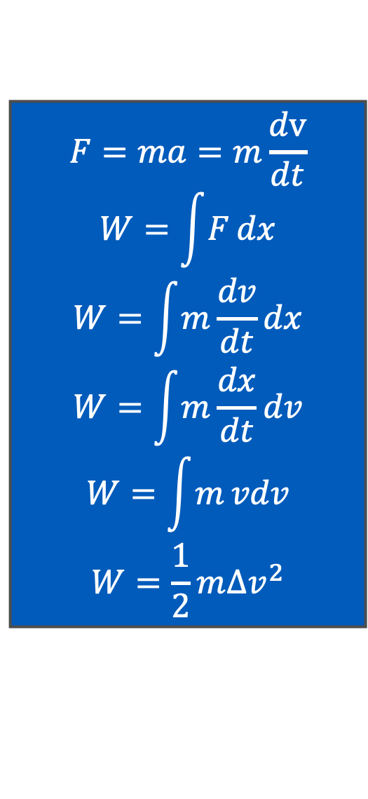
Work and Kinetic Energy
For those who love calculus like me:
$$F=ma=m\frac{dv}{dt}$$
$$W=\int{F}dx$$
$$W=\int{m}\frac{dv}{dt}dx$$
$$W=\int{m}\frac{dx}{dt}dv$$
$$W=\int{m}vdv$$
$$W=\frac{1}{2}m{Δv}^{2}$$
Work is the thing that changes KINETIC energy
So we see:
$$W=F⋅d=ΔKE=\frac{1}{2}mΔv^{2}$$
mass (kg)
$$KE=\frac{1}{2}mv^{2}$$
Velocity: distance/time (m/s)
Energy:
1 Joule = 1 kg m²/s²
Not responsible for this, just for enrichment

Slide 8


Kinetic and Potential Energy
High potential energy,
Low kinetic energy
If you can put energy INTO something, sometimes it can be retrieved later (“conservative forces”)
  Like gravity: What comes up, must come down
For a conservative force, the total energy (kinetic plus potential) remains the same!
Still equal to the force times the distance
  For gravity near the earth’s surface:
Low potential energy,
High kinetic energy
$Energy =ΔKE+ΔPE$ = constant
$$PE=mg⋅h$$
Not responsible for this, just for enrichment

Slide 9
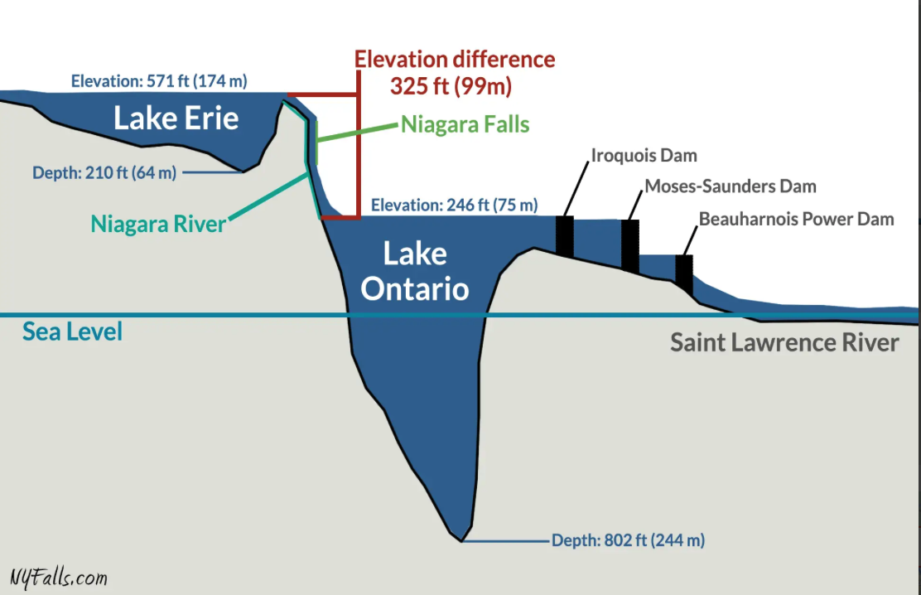
Using Energy
Example: water running in a river or down a huge waterfall
  Niagara Falls!
You ARE responsible to understand that Niagara Falls (and all hydroelectric power) is powered ultimately by GRAVITY
https://nyfalls.com/niagara-falls/faq-6/

Slide 10
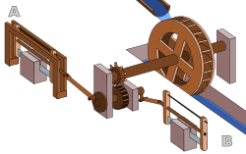
Using Energy
Water turns a wheel
Running rivers have been used for centuries to convert the gravitational energy of the earth to mechanical energy
Water mills!
Crank does something useful
(mill grain)
Wheel turns a
crank
https://en.wikipedia.org/wiki/Water_wheel#/media/File:Römische_Sägemühle.svg

Slide 11
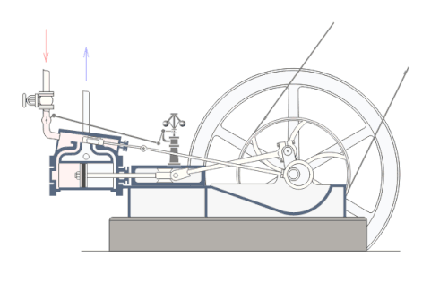
Kinetic and Potential
The industrial revolution replaced moving water (from gravity) to burning coal (thermal energy from chemical energy) and using STEAM instead of water
Critically: This is portable!
https://en.wikipedia.org/wiki/Steam_engine#/media/File:Steam_engine_in_action.gif

Slide 12
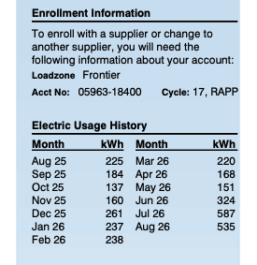
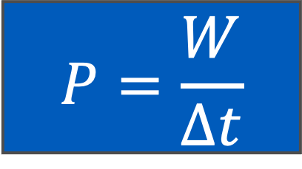
Power
You ARE responsible to understand that power is the energy expended per unit time
Power is defined as the amount of energy expended per unit time
We often go the other way around and say that Energy is the Power times the time (like kilowatt-hours, which is what goes on your electricity bill)
Energy:
1 Joule = 1 kg m²/s²
$$P=\frac{W}{Δt}$$
My electric bill history
Power:
1 Watt = 1 kg m²/s³
time (s)
Energy:
1 kilowatt-hour = 1000 Watts (J/s) * 3600 seconds = 3,600,000 Joules

Slide 13

Power
If the force being used to generate the work is constant, we remember
$$P=\frac{W}{Δt}=\frac{F⋅Δd}{Δt}=F⋅v$$
Not responsible for this, just for enrichment

Slide 14
Electricity

Slide 15
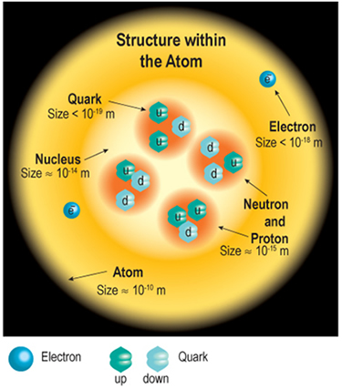
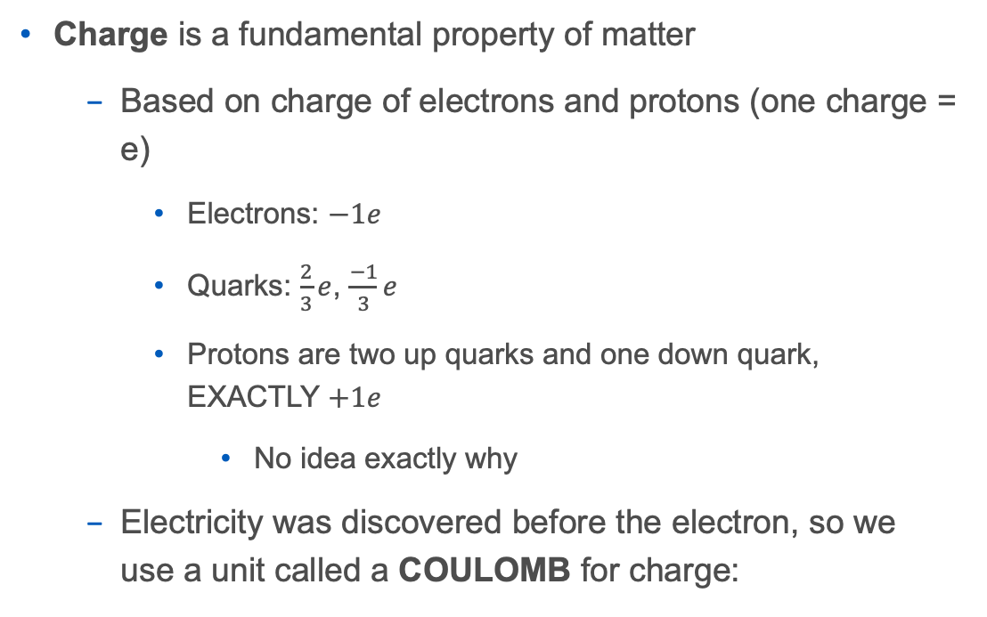
Electricity
Charge is a fundamental property of matter
  Based on charge of electrons and protons (one charge = e)
    Electrons: $−1e$
    Quarks: $\frac{2}{3}e$, $\frac{−1}{3}e$
    Protons are two up quarks and one down quark, EXACTLY $+1e$
      No idea exactly why
  Electricity was discovered before the electron, so we use a unit called a COULOMB for charge:
Not responsible for this, just for enrichment
1 Coulomb (C) = 6.24 x 10¹⁸ e
Notes:
Keep the water analogy honest but don’t oversell it (it breaks for AC/reactance later). P=VI is the one equation they should leave with. A US wall outlet is ~120 V; a phone charger pulls ~0.15 A → ~18 W. Source: Britannica (electric current, voltage); HyperPhysics (Georgia State) for the water analogy done carefully.

Slide 16
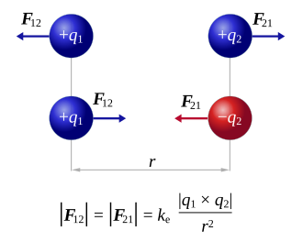


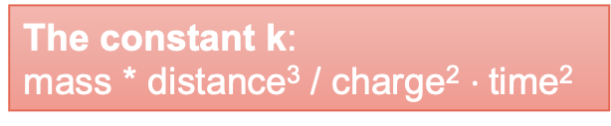
Electricity
Charge:
Coulombs (C)
Electricity exerts a FORCE on charged things with magnitude:
The constant $k$ depends on the units you use.
For SI units:
$$F=\frac{kq_{1}q_{2}}{r^{2}}$$
Force:
mass * distance / time² (1 Newton = 1 kg m/s²)
distance (m)
ew
that’s confusing
https://en.wikipedia.org/wiki/Coulomb%27s_law
The constant k:
mass * distance³ / charge² $⋅$time²
Not responsible for this, just for enrichment

Slide 17
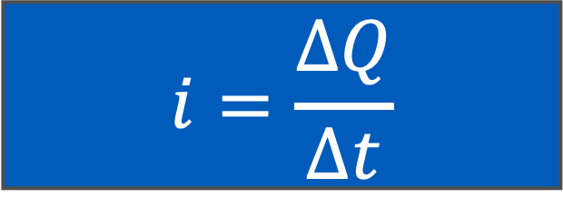
Electricity
You ARE responsible to understand that current is the number of charges per unit time
Practically speaking, for most things we don’t actually care about the individual charge, we care about how much charge is passing through (the current)
$$i=\frac{ΔQ}{Δt}$$
Charge:
Coulombs
Current:
Ampere = Coulombs / second
time:
seconds

Slide 18
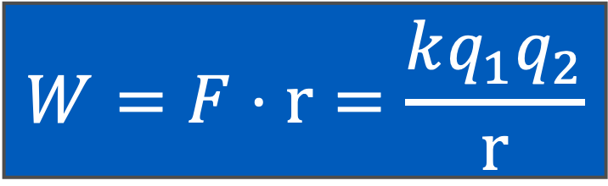

Electricity
What about energy and work?
$$F=\frac{kq_{1}q_{2}}{r^{2}}$$
$$W=F⋅r=\frac{kq_{1}q_{2}}{r}$$
Work is the product of the amount of force over the distance
Not responsible for this, just for enrichment

Slide 19
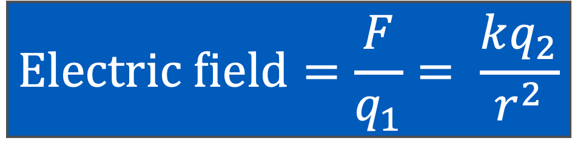
Electricity
This is hard… let’s simplify.
Develop the concept of an electric FIELD by dividing out one charge
  The “test charge”
Then we have the FIELD from the other charge
$$Electric field=\frac{F}{q_{1}}= \frac{kq_{2}}{r^{2}}$$
https://en.wikipedia.org/wiki/Coulomb%27s_law
Electric field:
Newtons / Coulomb
Not responsible for this, just for enrichment

Slide 20
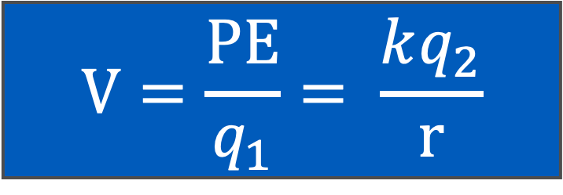
Electricity
We can also develop the electric POTENTIAL from the electric ENERGY (or work) in the same way
$$V=\frac{PE}{q_{1}}= \frac{kq_{2}}{r}$$
Electric potential:
Joules / Coulomb or VOLTS
https://en.wikipedia.org/wiki/Coulomb%27s_law
“Wait! VOLTS! I know that one!
240 Volts come out of a wall socket!”
Not responsible for this, just for enrichment

Slide 21
Electricity
Positive charge
Negative charge
Teeny tiny bit of vector addition
The components of Coulomb’s law parallel to the plates CANCEL, the components perpendicular to the plates ADD, so you get a constant electric field
Why is this important?
  If you hook up a battery, this supplies a direct current electric field between the plates
Not responsible for this, just for enrichment

Slide 22
Electricity
Draw their vector field lines
Teeny tiny bit of vector addition
The components of Coulomb’s law parallel to the plates CANCEL, the components perpendicular to the plates ADD, so you get a constant electric field
Why is this important?
  If you hook up a battery, this supplies a direct current electric field between the plates
Not responsible for this, just for enrichment

Slide 23
Electricity
Perpendicular components cancel
Teeny tiny bit of vector addition
The components of Coulomb’s law parallel to the plates CANCEL, the components perpendicular to the plates ADD, so you get a constant electric field
Why is this important?
  If you hook up a battery, this supplies a direct current electric field between the plates
Parallel components cancel
Not responsible for this, just for enrichment

Slide 24
Electricity
Draw only the part in the middle where it doesn’t cancel
Teeny tiny bit of vector addition
The components of Coulomb’s law parallel to the plates CANCEL, the components perpendicular to the plates ADD, so you get a constant electric field
Why is this important?
  If you hook up a battery, this supplies a direct current electric field between the plates
Not responsible for this, just for enrichment

Slide 25
Electricity
Add more together
Teeny tiny bit of vector addition
The components of Coulomb’s law parallel to the plates CANCEL, the components perpendicular to the plates ADD, so you get a constant electric field
Why is this important?
  If you hook up a battery, this supplies a direct current electric field between the plates
Not responsible for this, just for enrichment

Slide 26
Electricity
Add more together
Teeny tiny bit of vector addition
The components of Coulomb’s law parallel to the plates CANCEL, the components perpendicular to the plates ADD, so you get a constant electric field
Why is this important?
  If you hook up a battery, this supplies a direct current electric field between the plates
Not responsible for this, just for enrichment

Slide 27
Electricity
Now just draw a line to represent the charges, and you get a PARALLEL PLATE CAPACITOR
Teeny tiny bit of vector addition
The components of Coulomb’s law parallel to the plates CANCEL, the components perpendicular to the plates ADD, so you get a constant electric field
Why is this important?
  If you hook up a battery, this supplies a direct current electric field between the plates
Not responsible for this, just for enrichment

Slide 28
Electricity
Then you can attach a WIRE between them, and electrons will be repelled from the negative side and attracted to the positive side
+
-

Slide 29
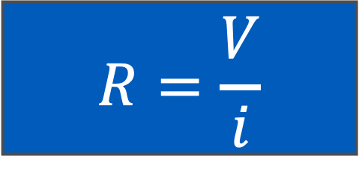
Electricity
You ARE responsible to understand that resistance is voltage divided by current
Unfortunately, friction exists
The electrons flowing through the wires bump into other electrons in the metal, so you get RESISTANCE
Just like all resistance, it generates heat.
+
-
$$R=\frac{V}{i}$$
Electric potential:
Joules / Coulomb or VOLTS
Resistance:
Ohms = volts per amp
Current:
Ampere = Coulombs / second

Slide 30
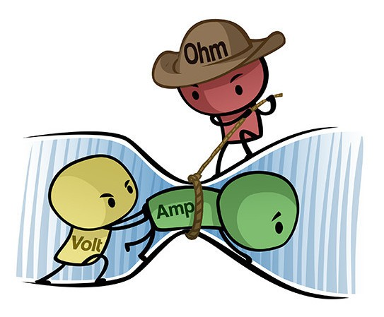
Electricity
Now we have:
  Current (amps) : charge per unit time
  Voltage (volts) : pushes current
  Resistance (ohms): restricts current
https://www.build-electronic-circuits.com/ohms-law/

Slide 31
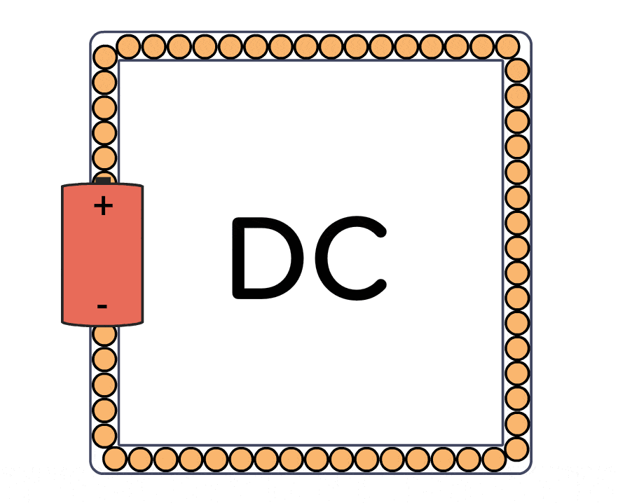
Electricity
We now have enough knowledge to understand DIRECT CURRENT (DC)
DC is supplied by batteries and solar panels
You can then combine elements (wires, light bulbs, batteries) to make a circuit
https://www.build-electronic-circuits.com/difference-ac-vs-dc/

Slide 32
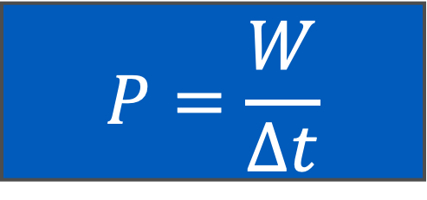

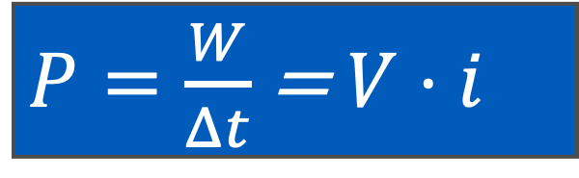
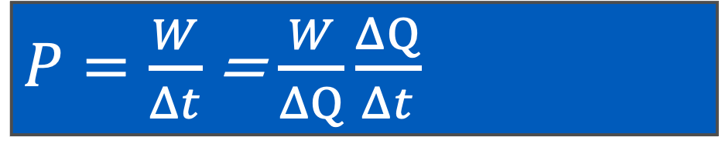
Energy and Power
$$P=\frac{W}{Δt}$$
Remember that power is energy over time
But now do a trick… multiply and divide by $ΔQ:$
$P=\frac{W}{Δt}$ = $\frac{W}{ΔQ}\frac{ΔQ}{Δt}$
Electric potential:
Joules / Coulomb or VOLTS
Electric current:
Coulombs / second or AMPERES
$P=\frac{W}{Δt}$ = $V⋅i$
You ARE responsible to understand that power in a circuit is the voltage times the current

Slide 33

Energy and Power
You ARE responsible to understand these three concepts
We’re now able to quantify resistive losses in a circuit
$$V = iR$$
$$P = iV$$
$$P=i^{2}R$$
Critically:
Power dissipated by a circuit is proportional to current times voltage, or current SQUARED times resistance
This sets up the War of the Currents

Slide 34
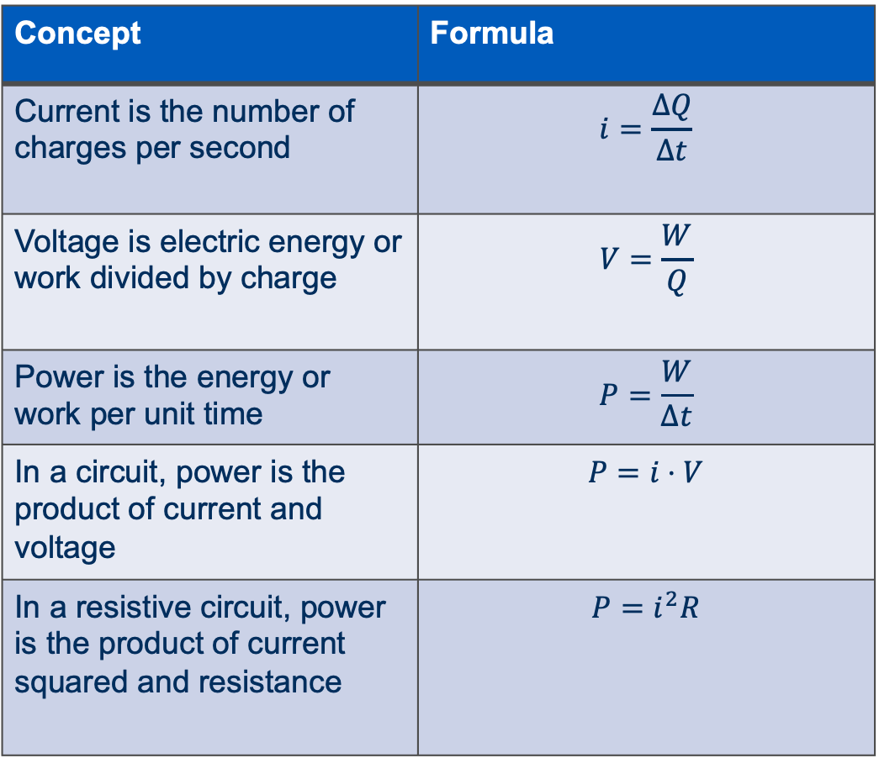
To remember
Concept | Formula
Current is the number of charges per second | $$i=\frac{ΔQ}{Δt}$$
Voltage is electric energy or work divided by charge | $$V=\frac{W}{Q}$$
Power is the energy or work per unit time | $$P=\frac{W}{Δt}$$
In a circuit, power is the product of current and voltage | $$P=i⋅V$$
In a resistive circuit, power is the product of current squared and resistance | $$P=i^{2}R$$
Current is the number of charges per second
Voltage is the electric energy (or work) divided by the charge
Power is the product of current and voltage
Power dissipated in a resistor is current squared times resistance

