Slide 1
Lecture 2 — Energy generation
PHY199-RAP · Energy in the 21st Century
Dr. Salvatore Rappoccio

Slide 2
Magnetism

Slide 3
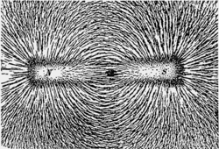
Magnets
Magnets have been known to humans for centuries
Similar to electricity, there are two poles (North and South)
Distinctly, however, they ALWAYS come in pairs
  You can have a single positive charge or a single negative charge, but there is no such thing (that we know of) of a magnetic “monopole”
https://en.wikipedia.org/wiki/Magnet

Slide 4
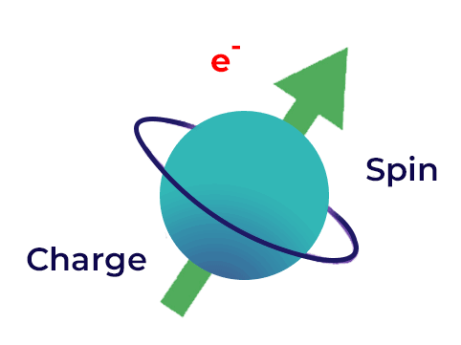
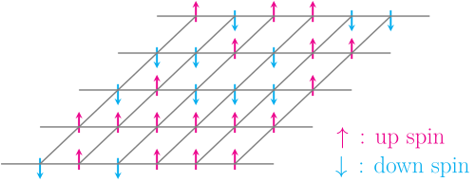
Magnets
This is a lie, it is not actually spinning, it just ACTS like it’s spinning… sort of
The way permanent magnets work is ultimately quantum mechanical
Electrons and protons have a quantum property that acts like a “spin”
However, it isn’t actually spinning!
  As far as we know, electrons are pointlike (it has a radius less than 10⁻¹⁸ m), so can’t spin
Spins want to be aligned if they can, so the spins at the microscopic level add together to make a macroscopic spin
https://www.geeksforgeeks.org/physics/spintronics/
https://en.wikipedia.org/wiki/Ising_model

Slide 5
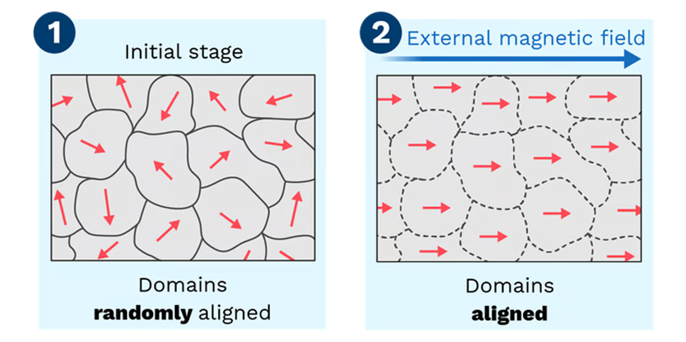
Magnets
Macroscopically, certain metals (like iron) can have DOMAINS of spin
If you put them into another magnetic field, they will align and retain their magnetization
https://sdmmagnets.com/orientation-directions/

Slide 6
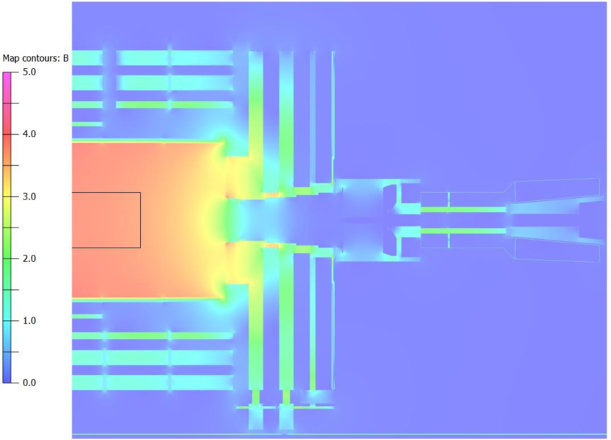
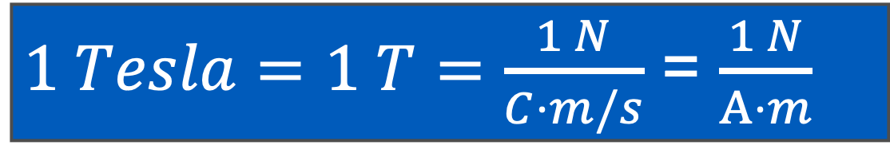
Magnets
You ARE responsible to understand Teslas as a unit of magnetic field
Strength of magnets is measured in Teslas:
1 Tesla is a HUGE magnetic field. The experiment I work on (Compact Muon Solenoid) has a 3.8 Tesla magnetic field, and it is the largest flux magnet on earth.
$1 Tesla=1 T=\frac{1 N}{C⋅m/s}$ = $\frac{1 N}{A⋅m}$

Slide 7
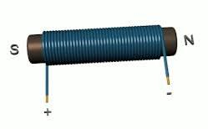
Magnets from Electricity
If you have a current, the current INDUCES a magnetic field
Wrap a wire around an iron core and BOOM. Magnet.
https://en.wikipedia.org/wiki/Electromagnet

Slide 8
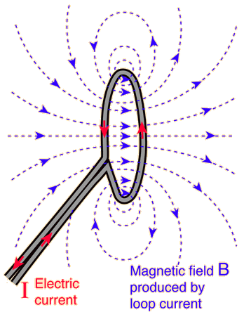


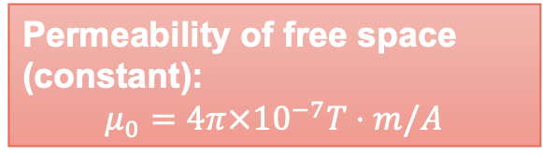
Magnetic Fields
Magnets have a magnetic field just like charges have an electric field
Circular loop carrying current $i:$
Current:
Ampere = Coulombs / second
$$B=\frac{μ_{0}i}{2R}$$
Magnetic field:
1 Tesla =1 Newton / Amp-meter
Permeability of free space (constant):
$$μ_{0}=4π×{10}^{−7}T⋅m/A$$
Radius of loop:
meters

Slide 9
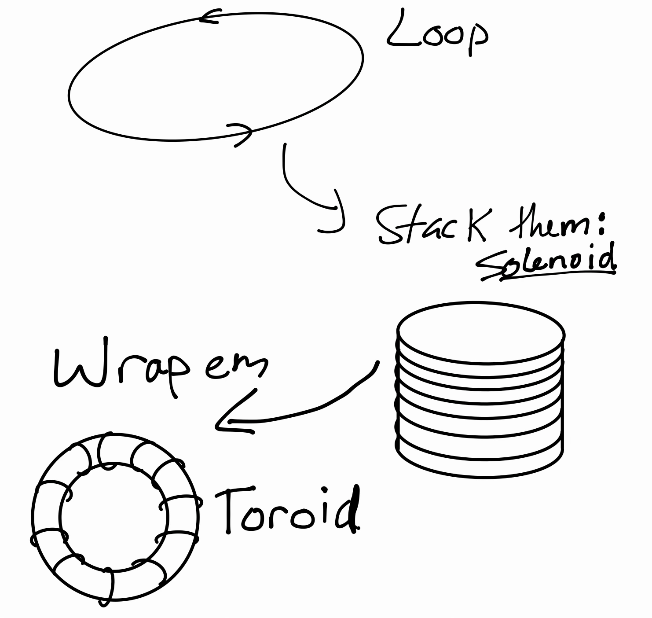
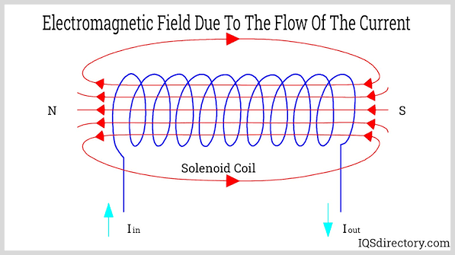
Magnetic Fields
When you stack loops together, the magnetic fields add to form a solenoid:
https://www.iqsdirectory.com/articles/electric-coil/solenoid-coils.html

Slide 10

Magnetic Fields
We won’t derive the magnetic field of a solenoid (Ampere’s law, PHY108)
Just quote the result:
$$B=\frac{μ_{0}iN}{L}$$
Number of turns
Magnetic field:
1 Tesla =1 Newton / Amp-meter
Length of solenoid
You ARE responsible to understand the magnetic field of a solenoid is proportional to the current and the number of turns per unit length
Permeability of free space (constant):
$$μ_{0}=4π×{10}^{−7}T⋅m/A$$

Slide 11
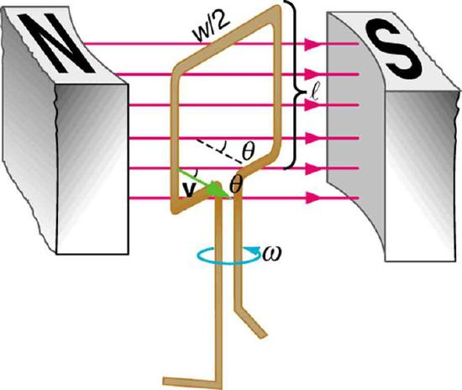

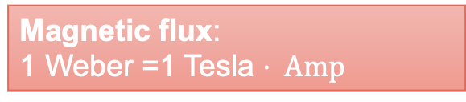
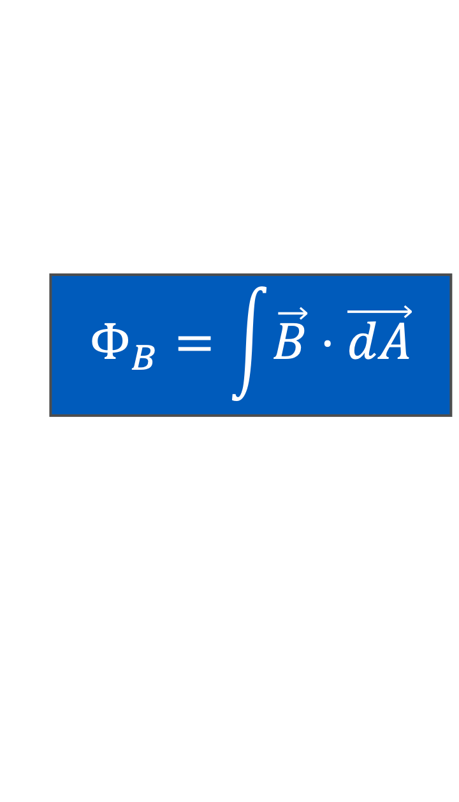
Magnetic Flux
For those who love calculus like me:
The flux is the integral of the dot product of the magnetic field and the plane of the area.
An important concept we’re going to use is the idea of a magnetic flux
For simple cases (constant magnetic field passing directly through an area) it is the product of the magnetic field times the area:
$$Φ_{B}=\int{\vec{B}}⋅\vec{dA}$$
Magnetic flux:
1 Weber =1 Tesla $⋅ Amp$
$$Φ_{B}=B⋅A$$
Magnetic field:
1 Tesla =1 Newton / Amp-meter
You ARE responsible to understand the flux of a magnetic field is the product of the magnetic field and the area
Area: m²

Slide 12
Electricity and magnetism : now together!

Slide 13
Magnetic Induction
The modern electrical grid is built upon the law of induction.
A current can be created (“induced”) by a changing magnetic flux
Arguably the most influential scientific statement in human history.
This allows us to generate electric power.
You absolutely need to understand this. Every human should.

Slide 14
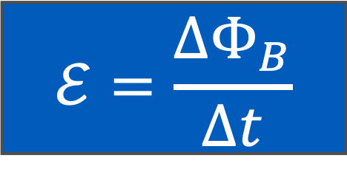
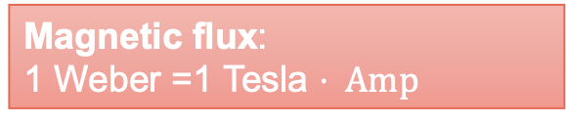
Magnetic Induction
Mathematically:
  Electromotive force (voltage) is generated by changing magnetic field
Electromotive force (Voltage):
1 Volt
Magnetic flux:
1 Weber =1 Tesla $⋅ Amp$
$$ℰ=\frac{ΔΦ_{B}}{Δt}$$
Time:
seconds
You ARE responsible to understand a voltage is induced from a changing magnetic flux

Slide 15
Tophat quiz

Slide 16
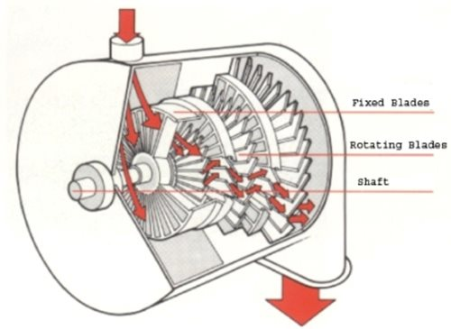
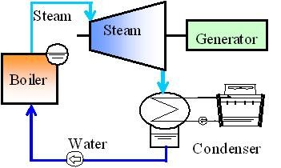
Turbines and Motors
Turbine:
  Fixed blades and rotating blades are inside a casing.
  The rotating blades are attached to a shaft, which is then connected to a wire that rotates inside a magnetic field.
  Steam passes through, turning the rotating blades and the shaft, generating electricity
https://www.turbinesinfo.com/steam-turbines/

Slide 17
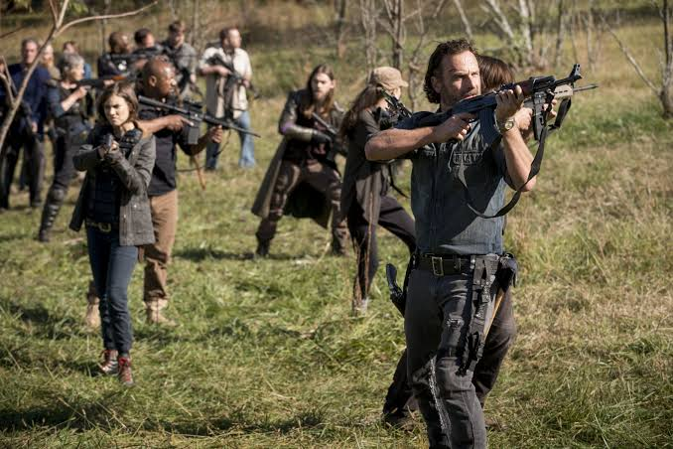
REMEMBER THAT!
I do not understand how easy it is to generate electricity with the law of induction
It could save your life in the zombie apocalypse
Shut up, Rick
Me neither
What’s induction?
What’s a law?
https://www.rollingstone.com/tv-movies/tv-movie-news/the-walking-dead-what-the-hell-happened-to-this-show-627893/

Slide 18
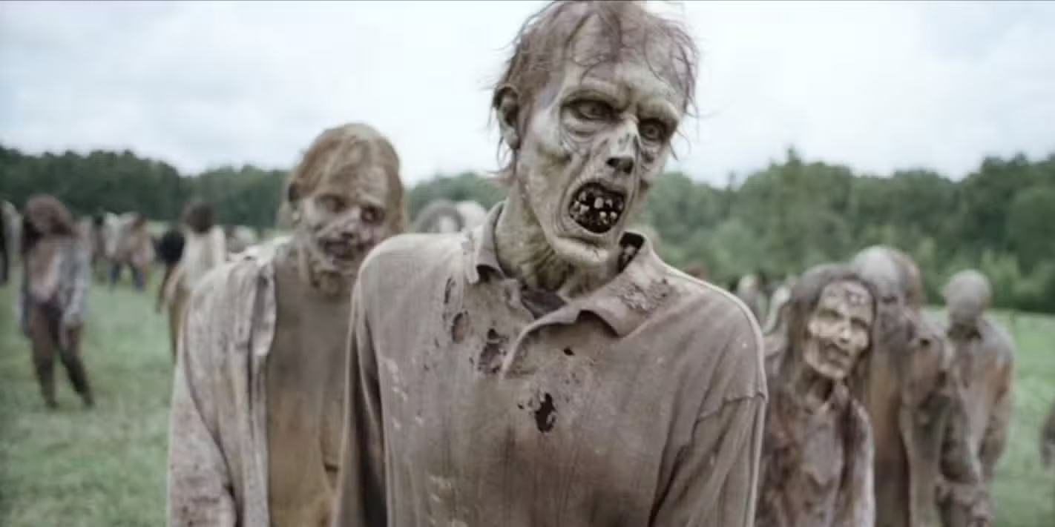
My side rant about zombie shows
Normally zombies kind of sit around for a long time without eating anything
Where do they get the energy to move?
  Like, really, they shouldn’t be able to violate the law of conservation of energy, so????
I haven’t eaten in weeks but somehow I can still walk and run and take down a full grown-ass human with my super strength
https://screenrant.com/every-walking-dead-zombie-type-explained-roamer-lurker-variant/

Slide 19
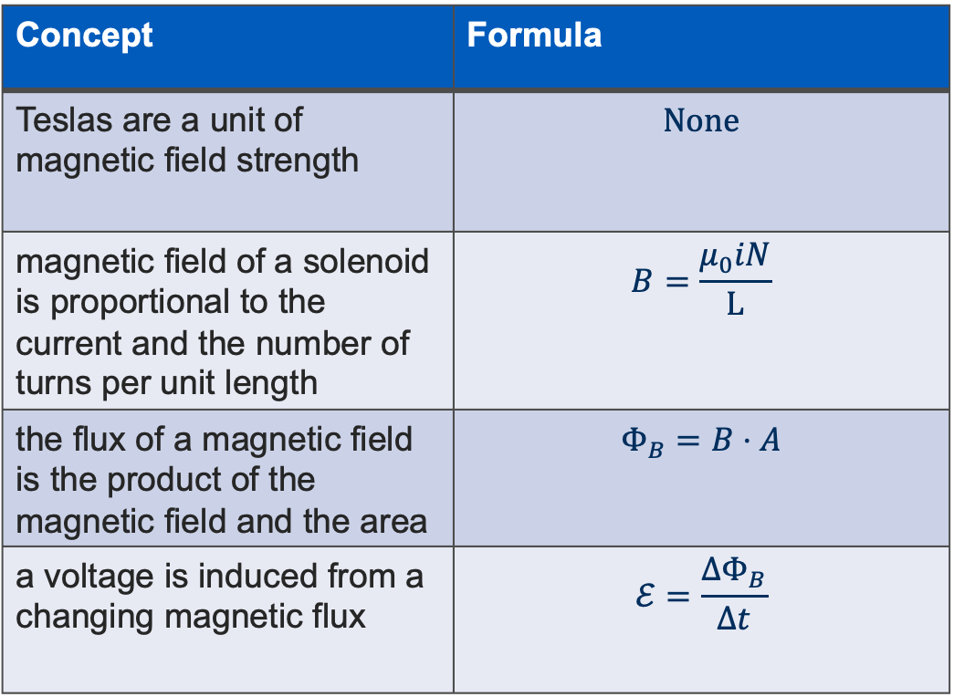
To remember
Concept | Formula
Teslas are a unit of magnetic field strength | $$None$$
magnetic field of a solenoid is proportional to the current and the number of turns per unit length | $$B=\frac{μ_{0}iN}{L}$$
the flux of a magnetic field is the product of the magnetic field and the area | $$Φ_{B}=B⋅A$$
a voltage is induced from a changing magnetic flux | $$ℰ=\frac{ΔΦ_{B}}{Δt}$$

Slide 20
Links & References
Magnets — https://en.wikipedia.org/wiki/Magnet
Spintronics — https://www.geeksforgeeks.org/physics/spintronics/
Ising model — https://en.wikipedia.org/wiki/Ising_model
Magnet orientation — https://sdmmagnets.com/orientation-directions/
Electromagnets — https://en.wikipedia.org/wiki/Electromagnet
Solenoid coils — https://www.iqsdirectory.com/articles/electric-coil/solenoid-coils.html
Magnetic flux — https://en.wikipedia.org/wiki/Magnetic_flux
Faraday's law — https://en.wikipedia.org/wiki/Faraday's_law_of_induction
Turbines — https://www.turbinesinfo.com/steam-turbines/
Walking Dead review — https://www.rollingstone.com/tv-movies/tv-movie-news/the-walking-dead-what-the-hell-happened-to-this-show-627893/
Zombie types — https://screenrant.com/every-walking-dead-zombie-type-explained-roamer-lurker-variant/

