Slide 1
Lecture 2 — Skill of the week: note-taking
PHY199-RAP · Energy in the 21st Century
Dr. Salvatore Rappoccio

Slide 2
The skills to succeed in college
This is a UB Seminar so we teach “how to college”
  This week: taking notes
Use your brain! Process, don’t transcribe
Writing things down helps them be cemented in your brain
  Some science behind this:
  Mueller & Oppenheimer, 2014
  Weak replication in Urry et al., 2021
  The real lesson: notes are for thinking, not stenography. If you’re just copying, you’ve turned your brain off
Notes:
Callback to Lecture 1’s “process, don’t transcribe” slide, now the formal skill of the week (course schedule Wk 2 lists “Skill: note-taking”; Wk 3 quiz is on it). Model the course’s sourcing ethic again: cite the original AND the replication, don’t oversell. Sources: Mueller & Oppenheimer (2014, Psychological Science); Urry et al. (2021, Psychological Science) — registered direct replication + mini meta-analysis.

Slide 3
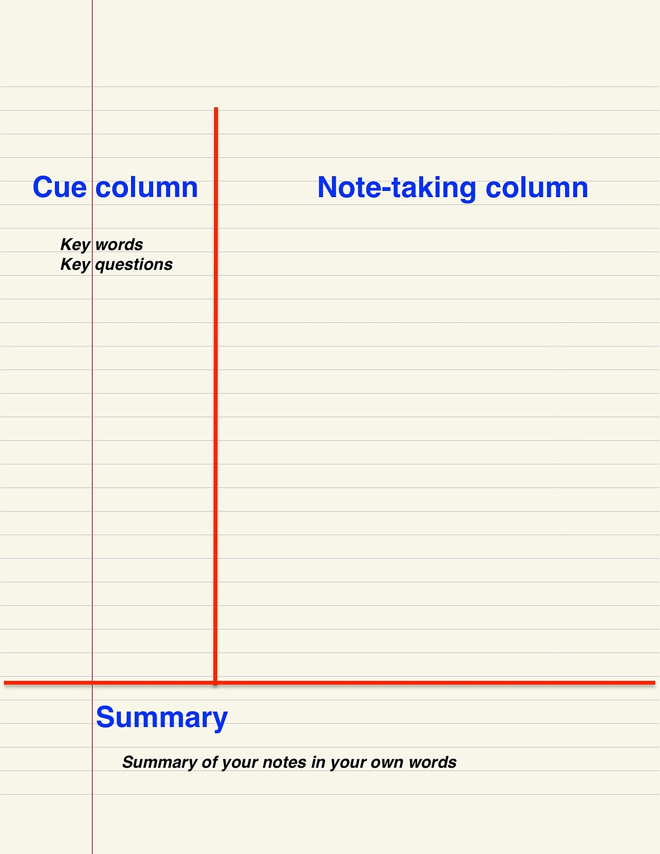
The Cornell method
1950s, Cornell: Walter Pauk designed a page layout that forces processing
  “How to Study in College”
Split the page: narrow left column (cues/questions), wide right column (notes in class), strip along the bottom (a 2-line summary you write after)
Can cover the right side, and your left-column questions become a self-quiz
It bakes in the two things that actually work (next slide): retrieval and spacing
Notes:
Pauk formalized this at Cornell (his book How to Study in College, 1962, is the primary source). Keep it concrete — maybe show my own handwritten page. The point isn’t the exact layout, it’s that the layout forces you to (a) write questions and (b) summarize. Source: Pauk & Owens, How to Study in College; Cornell Learning Strategies Center.

Slide 4
What the evidence says actually works
Two techniques that are demonstrated to work: practice and spacing
  Be consistent, let your prefrontal cortex be engaged!
  When you’re panicking, you don’t think, reflexes take over
  Consistent regular practice cements things in your rational mind
Rereading and highlighting feel productive but doesn’t engage your mind
In this class:
  Take notes you can be quizzed from, then actually quiz yourself
  We’re mostly focused on vocab, history, a few concepts of science/engineering
In other classes:
  Keep practicing example problems
Practice makes permanent!
Notes:
Dunlosky et al. (2013, Psychological Science in the Public Interest) reviewed 10 techniques; practice testing + distributed practice came out on top, highlighting/rereading at the bottom. Tie explicitly to our grading structure (quizzes = retrieval practice). Accessible version: “Strengthening the Student Toolbox,” American Educator (2013).

Slide 5
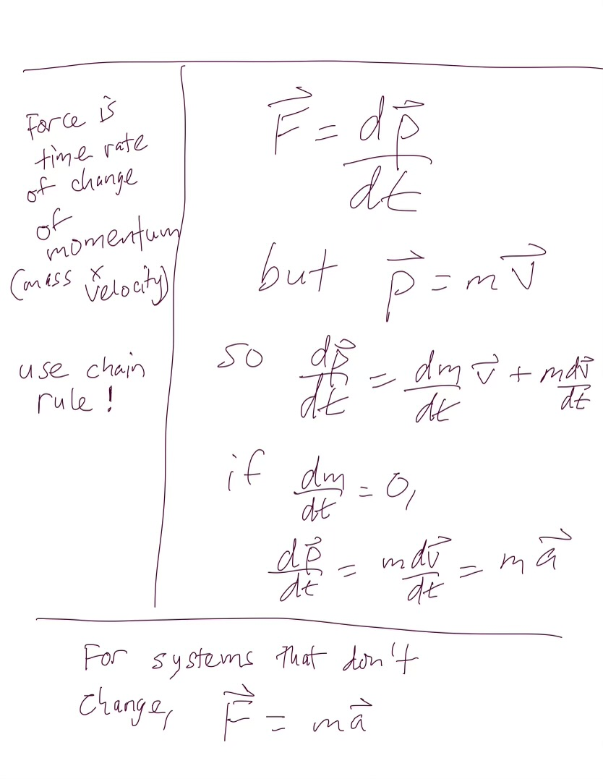
Derivations: Special Case
In many classes, you’ll perhaps be asked to follow along with derivations of mathematical formalisms (math, physics, chemistry, engineering)
Can adapt the Cornell method to use the left column as a “narration” area so you can understand what’s going on later

Slide 6
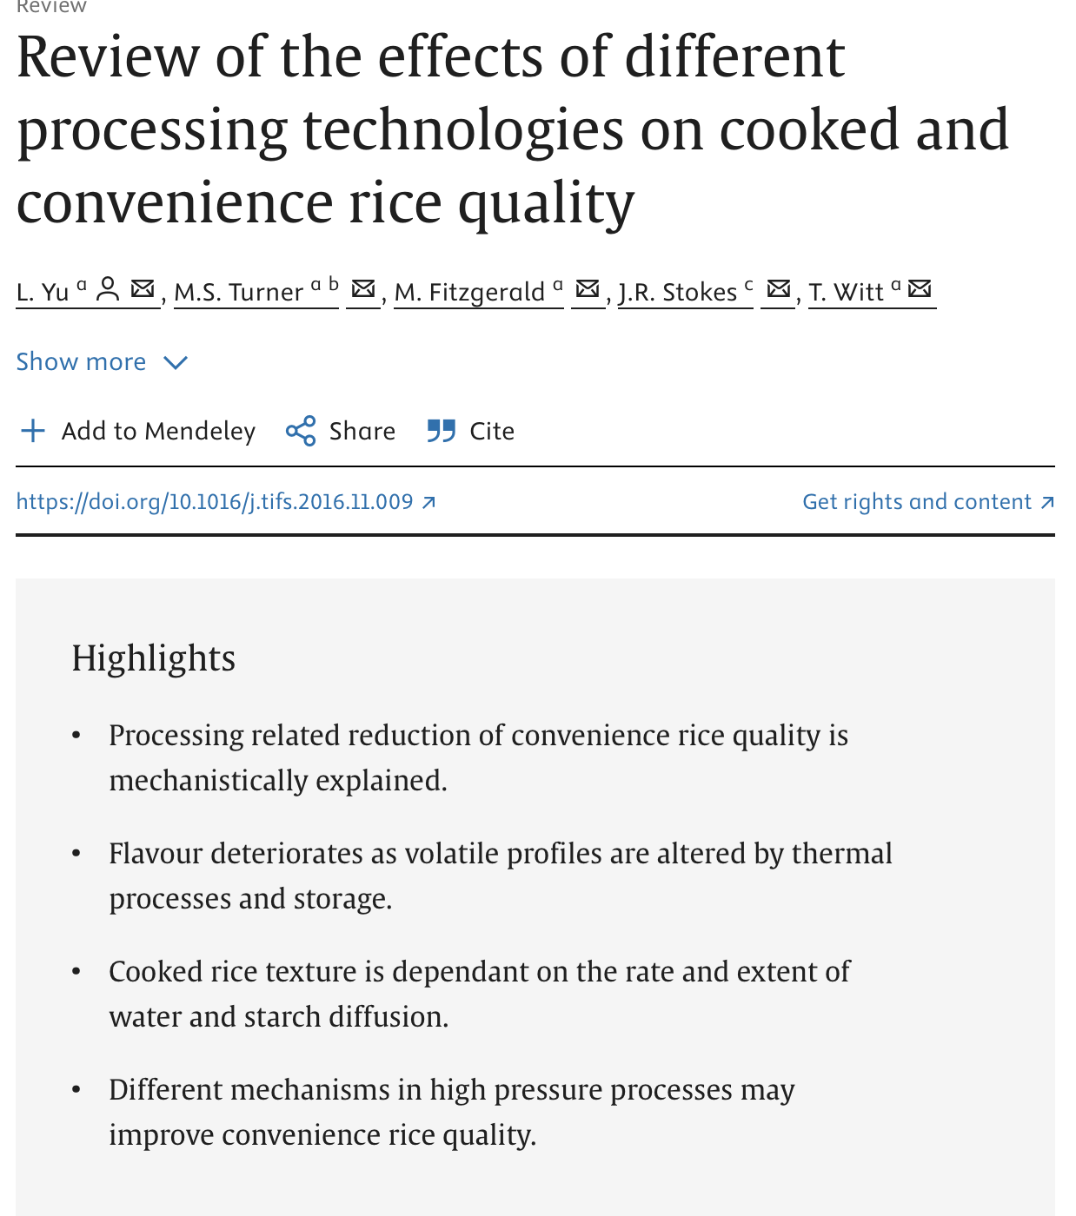
Example: Should you wash your rice?
We’ll do the Cornell method together
Fill the right column first, but don’t just transcribe
The left column and the summary come during a pause or after class
Let’s watch this together:
  @pbsterra short on washing rice
  The Conversation from Evangeline Mantzioris, Program Director of Nutrition and Food Sciences University of South Australia
    Yu et al.: Review of the effects of different processing technologies on cooked and convenience rice quality
    Dessi et al.: Plastics contamination of store-bought rice
Notes:
Deliberately a non-physics, everyday topic so the method is the star, not the content. Bonus: it has a satisfying “the folk wisdom is wrong” turn, which is exactly what good notes should capture — a claim AND its correction. Narrate what I’d write as if it were a real mini-lecture. Rice-fact sources are in the notes on the following slides.

Slide 7
Quiz for this week: Note-taking
Write you name (legibly) and UBIT login (legibly) at the top of your notes page
  If I can’t read it, I can’t grade it
You’ll hand in your notes on washing rice for your quiz today

Slide 8
Example: Should you wash your rice?
Hints:
  Use abbreviations
  Draw arrows between concepts
  If something confuses you, ask! Then jot down a note on the side column.
  At the end, summarize, and if you want to really get it, ask if your summary is the right understanding

Slide 9
Example: Should you wash your rice?
Raw notes:
Washing rice controversial on interwebs
Affect stickiness? Studies say no.
TYPE of rice matters, washing doesn’t
Health:
  remove 20% of microplastics, also arsenic
  but washes away copper, iron, zinc (nutrients!)
Doesn’t remove bacteria
Notes:
Model the shorthand out loud: arrows for “leads to / because,” “ppl” for people, dropping vowels. The point is that I’m writing the logic, not the sentences. Facts: The Conversation, “Do you need to wash rice before cooking? Here’s the science” (academic-authored), summarizing a study that found washing did not change stickiness/hardness.

Slide 10
Example: Should you wash your rice?
Cue Column:
Raw notes:
Washing rice controversial on interwebs
Affect stickiness? Studies say no.
TYPE of rice matters, washing doesn’t
Health:
  remove 20% of microplastics, also arsenic
  but washes away copper, iron, zinc (nutrients!)
Doesn’t remove bacteria
Does washing affect stickiness?
Pros of washing rice
Cons of washing rice
Misconceptions about washing
Notes:
Model the shorthand out loud: arrows for “leads to / because,” “ppl” for people, dropping vowels. The point is that I’m writing the logic, not the sentences. Facts: The Conversation, “Do you need to wash rice before cooking? Here’s the science” (academic-authored), summarizing a study that found washing did not change stickiness/hardness.

Slide 11
Example: Should you wash your rice?
Cue Column:
Raw notes:
Washing rice controversial on interwebs
Affect stickiness? Studies say no.
TYPE of rice matters, washing doesn’t
Health:
  remove 20% of microplastics, also arsenic
  but washes away copper, iron, zinc (nutrients!)
Doesn’t remove bacteria
Does washing affect stickiness?
Pros of washing rice
Cons of washing rice
Misconceptions about washing
Summary:
Washing doesn’t affect stickiness. Contaminants removed but also nutrients.
Notes:
Model the shorthand out loud: arrows for “leads to / because,” “ppl” for people, dropping vowels. The point is that I’m writing the logic, not the sentences. Facts: The Conversation, “Do you need to wash rice before cooking? Here’s the science” (academic-authored), summarizing a study that found washing did not change stickiness/hardness.

Slide 12
Note-taking — sources
Mueller & Oppenheimer (2014), Psychological Science · Urry et al. (2021) — replication
Dunlosky et al. (2013), Psych. Science in the Public Interest · accessible version, American Educator
Cornell method: Pauk & Owens, How to Study in College; Cornell Learning Strategies Center
Worked example (washing rice): The Conversation — “Do you need to wash rice? Here’s the science” · arsenic/nutrient tradeoff: “Cooking rice in excess water reduces both arsenic and enriched vitamins…” (2016); Menon et al. 2020, Sci. Total Environ.

