Slide 1
Lecture 2 — Energy generation
PHY199-RAP · Energy in the 21st Century
Dr. Salvatore Rappoccio

Slide 2
Magnetism

Slide 3

Magnetism
$$Power = voltage x current$$

Slide 4
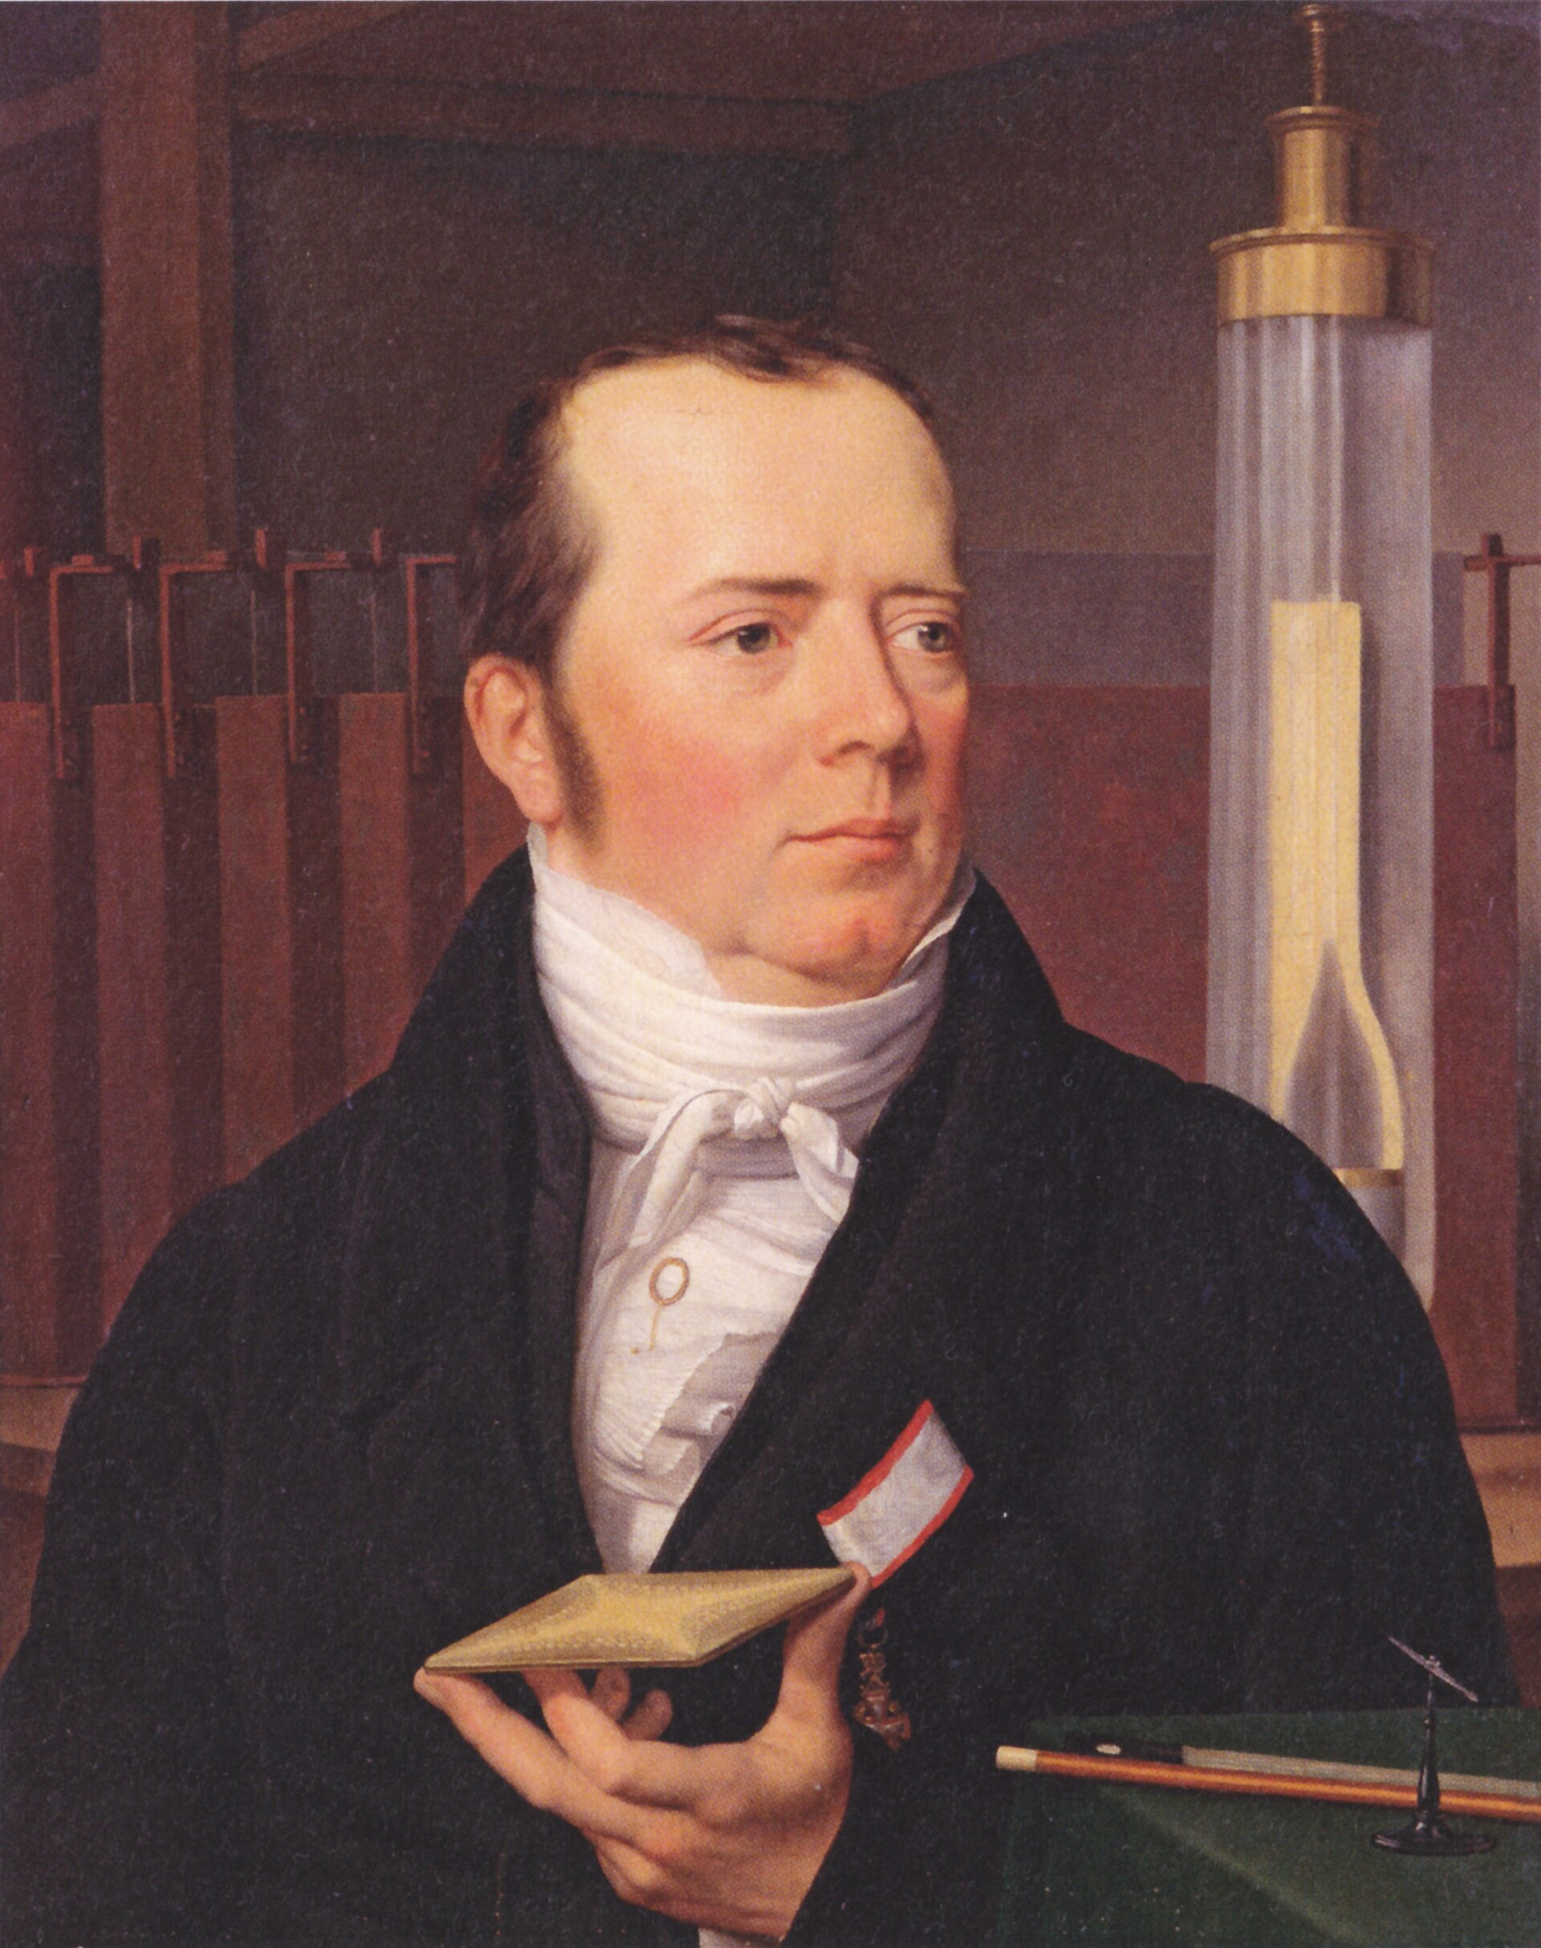
1820: Ørsted’s compass twitches
Hans Christian Ørsted is lecturing when he notices a compass needle deflect next to a wire carrying current
Bombshell: electricity and magnetism are the same thing, wearing two hats
A current makes a magnetic field. Hold that thought — the reverse is where the power comes from
Hans Christian Ørsted (1777–1851). Portrait by C. W. Eckersberg, public domain.
Notes:
Ørsted, Copenhagen, spring 1820 — the founding moment of electromagnetism. Ampère then quantified the force within months. This is the “electricity → magnetism” direction; Faraday (next slide) closes the loop the other way, and that loop is every generator. Source: Britannica (Hans Christian Ørsted; Ampère); Royal Society historical accounts.

Slide 5
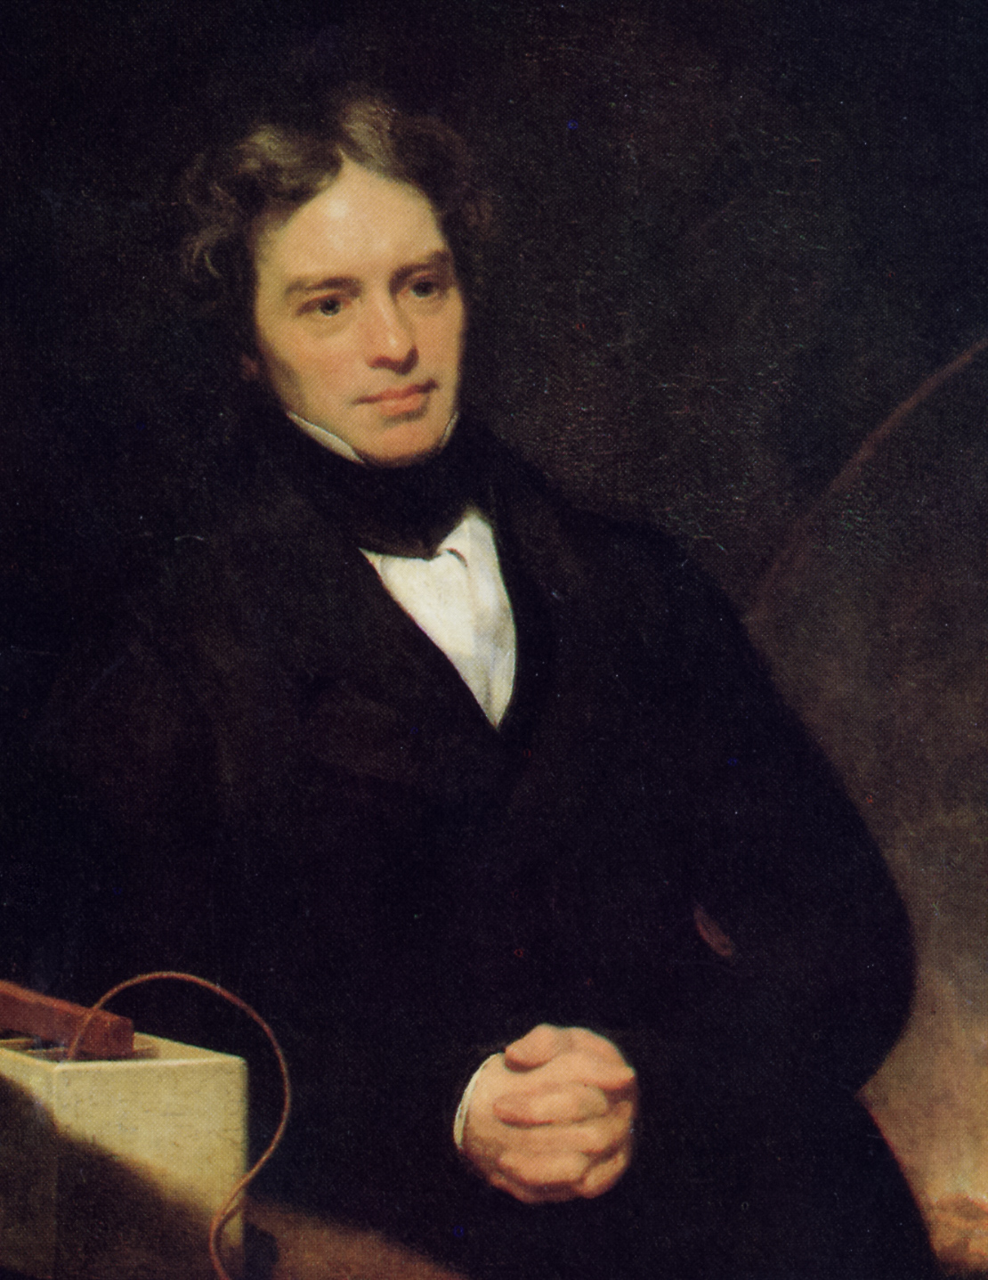
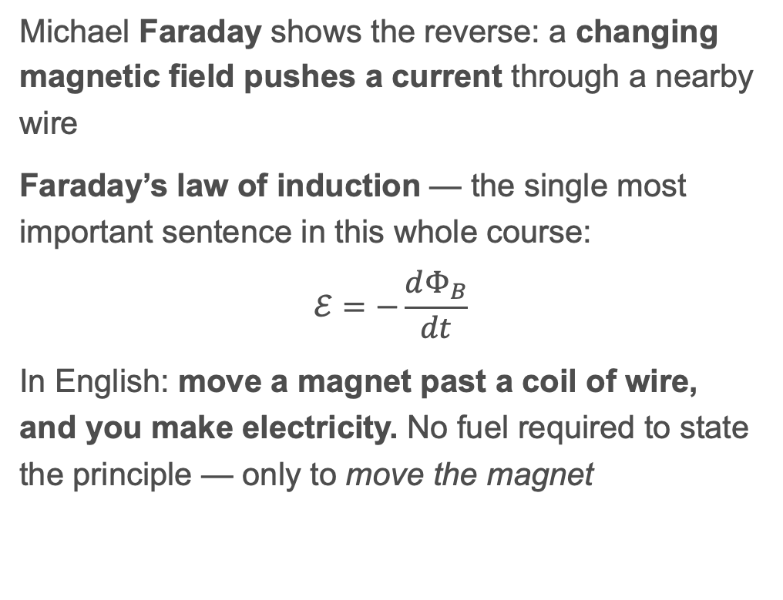
1831: Faraday runs it backwards
Michael Faraday shows the reverse: a changing magnetic field pushes a current through a nearby wire
Faraday’s law of induction — the single most important sentence in this whole course:
$$ℰ=−\frac{dΦ_{B}}{dt}$$
In English: move a magnet past a coil of wire, and you make electricity. No fuel required to state the principle — only to move the magnet
Michael Faraday (1791–1867). Portrait by Thomas Phillips, 1842, public domain.
Notes:
\Phi_B = magnetic flux (field × area through the loop); the EMF is minus its rate of change (Lenz’s law = the minus sign, nature pushing back). Don’t derive it — land the sentence: changing magnetic flux → voltage. Primary source: Faraday, “Experimental Researches in Electricity” (1832, Phil. Trans. R. Soc.); Royal Society commentary (Phil. Trans. A 373:20140208, 2015) is a clean modern anchor.

Slide 6
Every power plant is the same machine
Coal, gas, nuclear, hydro, geothermal, wind — all do one thing: spin a magnet inside coils of wire (a turbine + generator)
The only difference is what spins the turbine: steam, falling water, or wind
Solar photovoltaic is the lone exception — it makes current directly, no moving parts (we met this in Lecture 1)
Callback: Niagara’s Adams Plant (1895) — the first big AC power — was this exact machine, driven by falling water
SUGGESTED GRAPHIC: cartoon cross-section of a generator — turbine blades on a shaft, rotating magnet, stationary copper coils, current out. (Diagram, allowed to draw.) Alt: “Schematic of a turbine-driven generator: blades spin a shaft holding a magnet inside copper coils, inducing an electric current.”
Notes:
This is the payoff of the two previous slides and the unifying idea of the physics half: “boil water → spin magnet” is ~80% of the world’s electricity. Ties back to Lecture 1’s Adams Plant / Current Wars slides. The PV exception forward-refs to solar in later weeks. Source: DOE energy.gov (how generators/turbines work) — corroborate with Britannica (electric generator) per source-integrity rule.

Slide 7
1865: Maxwell writes the whole thing down
James Clerk Maxwell unifies electricity, magnetism, and light into four equations
His shocker: light is an electromagnetic wave — radio, microwaves, X-rays, and visible light are the same phenomenon at different frequencies
Why you care: this is the physics behind the grid (AC at 60 Hz), wireless charging, and every screen you own
Notes:
Don’t show the four equations as math to first-years; show them as “the grammar of E&M.” Maxwell (1865, “A Dynamical Theory of the Electromagnetic Field,” Phil. Trans. R. Soc.) predicted EM waves travel at c; Hertz confirmed radio waves in 1887. Forward-ref: 60 Hz grid frequency comes up in the grid section. Source: Maxwell (1865); Britannica.

Slide 8
Electricity & magnetism — sources
Foundations: Britannica — Electromagnetism; HyperPhysics (Georgia State) — E&M
Ørsted/Ampère (1820): Britannica — Hans Christian Ørsted
Faraday (1831–32): Royal Society commentary on Faraday’s Experimental Researches; Britannica — Faraday’s law
Maxwell (1865): Britannica — Maxwell’s equations
Generators: DOE energy.gov (corroborate w/ Britannica per source rule)

Slide 9
Nuclear: fission and fusion

Slide 10
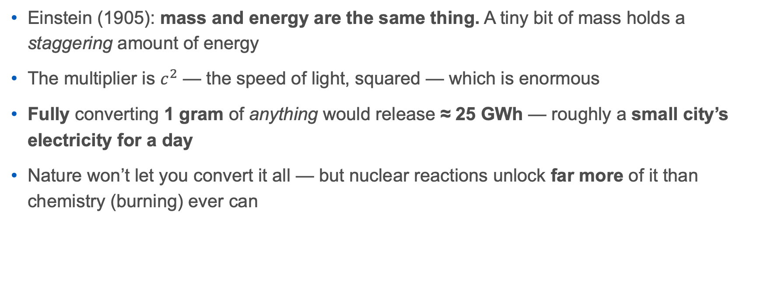
$E=mc^{2}$: mass is frozen energy
Einstein (1905): mass and energy are the same thing. A tiny bit of mass holds a staggering amount of energy
The multiplier is $c^{2}$ — the speed of light, squared — which is enormous
Fully converting 1 gram of anything would release ≈ 25 GWh — roughly a small city’s electricity for a day
Nature won’t let you convert it all — but nuclear reactions unlock far more of it than chemistry (burning) ever can
Notes:
Worked (re-checked this session): E = m c² = (0.001 kg)(2.998×10⁸ m/s)² ≈ 8.99×10¹³ J = 8.99×10¹³ / 3.6×10⁶ ≈ 2.50×10⁷ kWh = 25 GWh. For scale, ~25,000 MWh ≈ what ~2,300 US homes use in a year (US avg ~10,800 kWh/home/yr, EIA — corroborate). Chemistry releases ~a billionth of this per atom; nuclear releases ~a millionth of the rest-mass. That gap is the whole story of nuclear energy. Source: Einstein (1905, Annalen der Physik).

Slide 11
Why iron sits at the bottom of the valley
Every nucleus has a binding energy — how tightly its protons and neutrons are glued
Plot it and you get a valley with iron-56 at the bottom (most tightly bound, most stable)
Two ways downhill = two ways to release energy:
  Fission: split a heavy nucleus (uranium) → move toward iron → energy out
  Fusion: join light nuclei (hydrogen) → move toward iron → energy out
Everything from here is just: roll downhill toward iron
Nuclear binding energy per nucleon vs. mass number — iron-56 sits at the peak; fusion (light nuclei) and fission (heavy nuclei) both release energy by moving toward it. Fastfission, public domain.
Notes:
The binding-energy curve is the single best physics slide of the lecture — fission and fusion are the same idea (roll toward iron-56) from opposite ends. Peak is actually Ni-62 / Fe-56 depending how you measure; “iron” is the right first-year answer. Source: Krane, Introductory Nuclear Physics; IAEA nuclear data. Commons file candidate: “Binding energy curve - common isotopes.svg” (PD).

Slide 12
Fission: splitting the heavy stuff
1938: Hahn, Strassmann, Lise Meitner and Frisch discover nuclear fission — a uranium nucleus split by a neutron
Each split throws out more neutrons → they split more nuclei → a chain reaction
Controlled slowly in a reactor (steam → turbine → the same machine as before). Uncontrolled, it’s a bomb — the dark side we cover in Weeks 5–6
Meitner did the theory and was snubbed by the Nobel — a name worth knowing
A fission chain reaction: a neutron splits a nucleus into fragments plus more neutrons, which split more. Diagram by MikeRun, CC BY-SA 4.0.
Notes:
Meitner & Frisch (1939, Nature) named and explained fission; Hahn got the 1944 Chemistry Nobel alone — a well-documented snub worth flagging (ties to the course’s justice thread). Forward-ref to Weeks 5–6 (Hiroshima, Church Rock, the human cost). Keep the reactor-vs-bomb distinction crisp: same physics, wildly different rate. Source: Meitner & Frisch (1939); Rhodes, The Making of the Atomic Bomb (secondary but rigorous).

Slide 14

Fusion: the Sun’s furnace
Fusion joins light nuclei (hydrogen → helium) and powers every star, including the Sun
It’s the cleanest energy imaginable: fuel from water, no long-lived waste, no meltdown, no CO₂
The deuterium in 1 liter of water holds fusion energy comparable to ~300 liters of gasoline
One catch: it needs ~100 million °C. The Sun cheats with crushing gravity; we don’t have that
The Sun in ultraviolet light — the churning surface of our nearest fusion reactor. NASA/SDO (AIA), public domain.
Notes:
Motif hook (optional, continues L1’s Game of Thrones thread): “the Sun is the only dragon that actually works.” Deuterium-in-water figure (re-checked this session): ~1 D per 6,420 H; 1 L water ≈ 111 mol H → ~1.0×10²² D atoms. Pure water has no tritium, so the realistic route is catalyzed D–D fusion at ~7.2 MeV per deuteron consumed → ~1.2×10¹⁰ J ≈ 3,300 kWh ≈ the energy in ~350 liters of gasoline (gasoline ~34 MJ/L). That’s the origin of the classic “deuterium in 1 L of water ≈ 300 L of gasoline” line. Order-of-magnitude only. Source: ITER Organization (fusion basics); Britannica (nuclear fusion).

Slide 15
2022–2039: fusion’s real, slow timeline
Dec 2022, Livermore (NIF): for the first time, a fusion shot released more energy than the lasers delivered to the fuel — scientific “ignition,” peer-reviewed and independently repeated
ITER (France, a 35-nation project) is the big test reactor — but it just slipped a decade: first plasma now ~2034, full deuterium–tritium burn ~2039, at billions over budget
Honest verdict: fusion is real physics and still decades from your wall socket. Don’t let anyone sell you “five years away”
Notes:
NIF ignition: Abu-Shawareb et al. (2024, Phys. Rev. Lett. 132, 065102) — peer-reviewed; target gain >1 (2.05 MJ out vs 2.05 MJ laser to target), later shots exceeded it. Careful framing: that’s energy to the fuel, not wall-plug breakeven — the lasers drew ~300 MJ. ITER revised baseline (announced 2024): first plasma 2034, D-T operation 2039, ~€5B over prior estimate — cite Physics World / ITER Organization. Gen Z explainer: Kurzgesagt “Fusion Power Explained” (verify link at build). Sources on the sources slide.

Slide 16
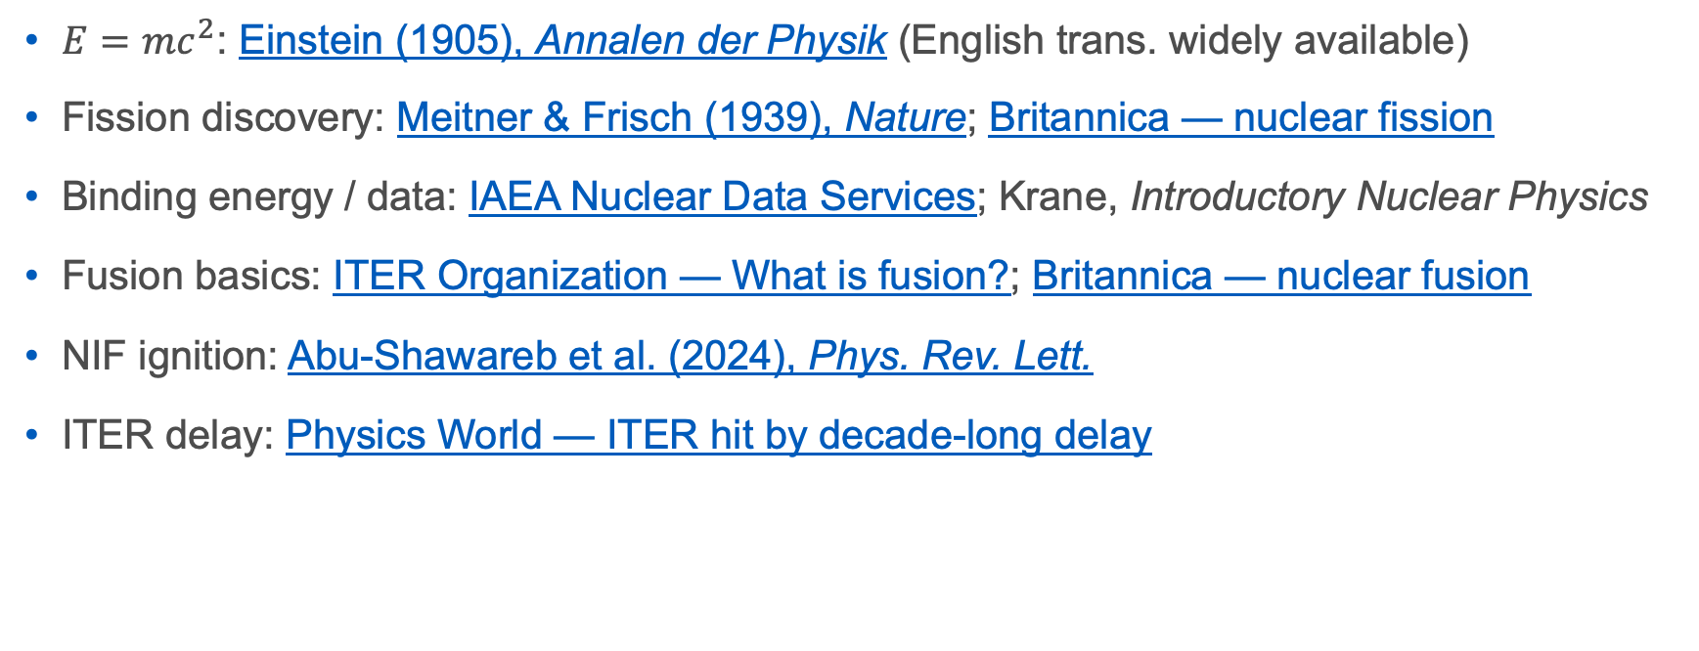
Nuclear — sources
$E=mc^{2}$: Einstein (1905), Annalen der Physik (English trans. widely available)
Fission discovery: Meitner & Frisch (1939), Nature; Britannica — nuclear fission
Binding energy / data: IAEA Nuclear Data Services; Krane, Introductory Nuclear Physics
Fusion basics: ITER Organization — What is fusion?; Britannica — nuclear fusion
NIF ignition: Abu-Shawareb et al. (2024), Phys. Rev. Lett.
ITER delay: Physics World — ITER hit by decade-long delay

Slide 17
What does it cost? Levelized Cost of Electricity

Slide 18
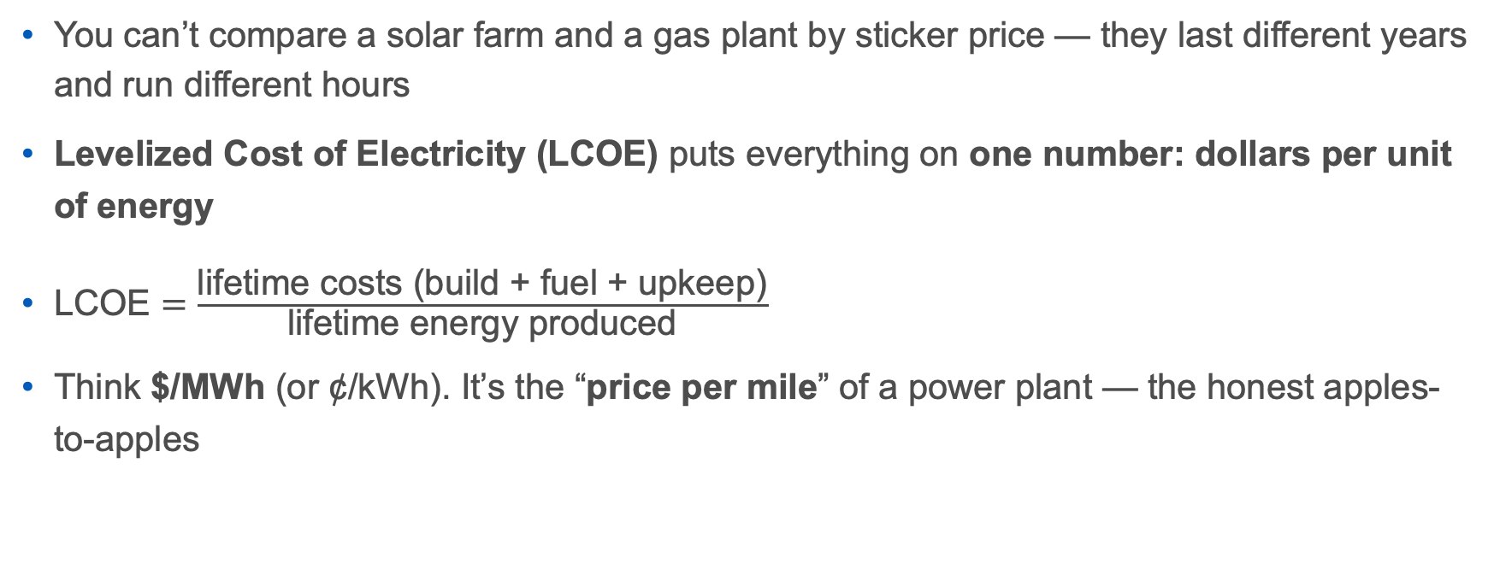
LCOE: the only fair way to compare
You can’t compare a solar farm and a gas plant by sticker price — they last different years and run different hours
Levelized Cost of Electricity (LCOE) puts everything on one number: dollars per unit of energy
$\text{LCOE}=\frac{\text{lifetime costs (build + fuel + upkeep)}}{\text{lifetime energy produced}}$
Think $/MWh (or ¢/kWh). It’s the “price per mile” of a power plant — the honest apples-to-apples
Notes:
Keep the formula intuitive: total money in over the plant’s life, divided by total energy out. Real LCOE also discounts future cash flows (time value of money) — mention it exists, don’t compute it. Units: 1 MWh = 1,000 kWh; $50/MWh = 5¢/kWh (about what you pay retail is higher because of the grid — next section). Source: NREL (LCOE explainer); Lazard method.

Slide 19
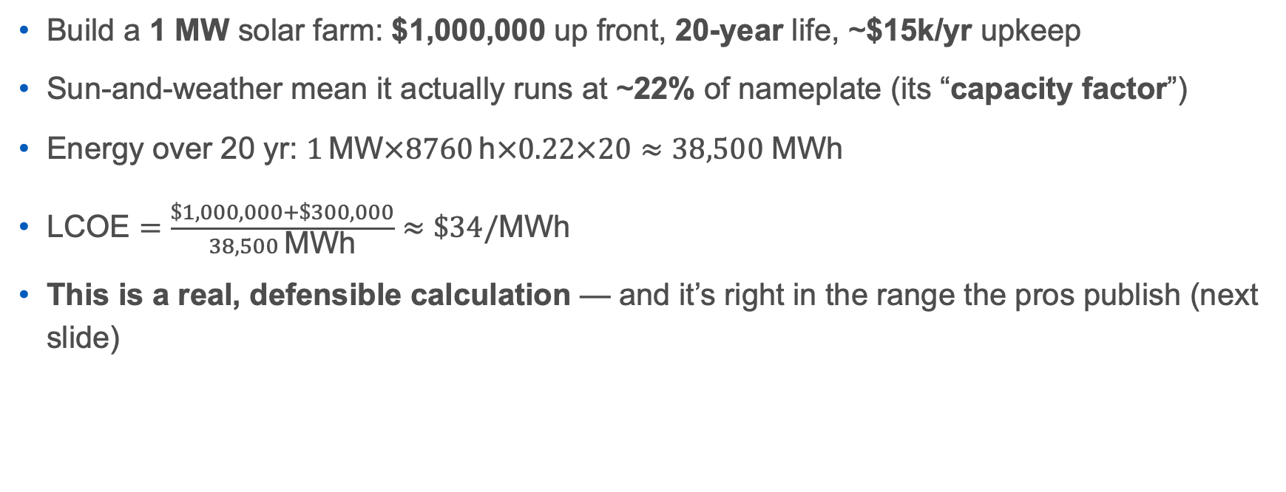
Worked example: one megawatt of solar
Build a 1 MW solar farm: $1,000,000 up front, 20-year life, ~$15k/yr upkeep
Sun-and-weather mean it actually runs at ~22% of nameplate (its “capacity factor”)
Energy over 20 yr: $1 \text{MW}×8760 \text{h}×0.22×20≈38,500 \text{MWh}$
$\text{LCOE}=\frac{\$1,000,000+\$300,000}{38,500 \text{MWh}}≈\$34/\text{MWh}$
This is a real, defensible calculation — and it’s right in the range the pros publish (next slide)
Notes:
Re-checked this session: annual MWh = 1×8760×0.22 = 1,927; ×20 = 38,544 MWh; O&M 15k×20 = $300k; (1,000,000+300,000)/38,544 ≈ $33.7/MWh. Numbers are illustrative but realistic (capital ~$1/W is a reasonable 2025 utility-solar figure). This is the kind of “simple calculation” the course promises — walk it slowly, it’s very defensible in Q&A. Capacity factor is the honest asterisk on every renewable. Source: NREL ATB (method); Lazard 2025.

Slide 20
Lazard 2025: what’s actually cheapest (unsubsidized)
Source | LCOE ($/MWh) | Notes
Onshore wind | 37 – 86 | cheapest new build
Utility solar | 38 – 217 | also cheapest at the low end
Combined-cycle gas | 48 – 109 | the fossil workhorse
Coal | 71 – 173 | dirty and not cheap
Battery storage (2-hr) | 81 – 174 | the intermittency patch
Nuclear | 141 – 220 | safe, low-carbon, expensive to build
Gas peaker | 149 – 251 | only for demand spikes

Slide 21
New wind and solar are the cheapest electricity humans have ever built — even before subsidies
Source: Lazard, LCOE+ (June 2025), unsubsidized ranges.
Notes:
Lazard 2025 unsubsidized (converted from their $/kWh): onshore wind $37–86, utility solar $38–217, CC gas $48–109, coal $71–173, standalone 2-hr battery $81–174, nuclear $141–220, gas peaker $149–251. Note Lazard flags wind rose YoY (onshore +55%) and solar fell ~4%. Lazard’s own caveat (important, next slide): excludes subsidies, carbon price, and grid/ firming costs. Source: Lazard LCOE+ June 2025 (corroborated by pv-magazine, RTO Insider).

Slide 22
What LCOE quietly leaves out
Intermittency: the sun sets and the wind drops. A cheap solar MWh at noon isn’t a cheap MWh at 9 pm — you need storage or backup (that’s the battery row)
Grid/firming costs: Lazard’s own numbers exclude the wires and balancing needed to make power dependable
Externalities: LCOE ignores the death cost and carbon cost we met in Lecture 1 — coal’s cheap $/MWh doesn’t include the people it kills
Takeaway: LCOE is the best starting number and a terrible ending one. Cheapest on the spreadsheet ≠ cheapest in full
Notes:
This slide is the moral hinge that connects the physics half to the course’s justice throughline. Callback to L1’s “deaths per TWh” (Our World in Data / Markandya & Wilkinson 2007, Lancet) and the climate cost (IPCC AR6). Firming/intermittency forward-refs to the grid section. The honest scientist’s move: love the metric, know its blind spots.

Slide 23
LCOE — sources
Method: NREL — Levelized Cost of Energy; NREL Annual Technology Baseline
2025 figures: Lazard — LCOE+ (June 2025); Lazard 2025 press release
Independent write-ups: pv magazine — solar/wind still cheapest; RTO Insider
Externalities (callback): Our World in Data — deaths per TWh; IPCC AR6 Synthesis

Slide 24
The grid: getting it to your wall

Slide 25
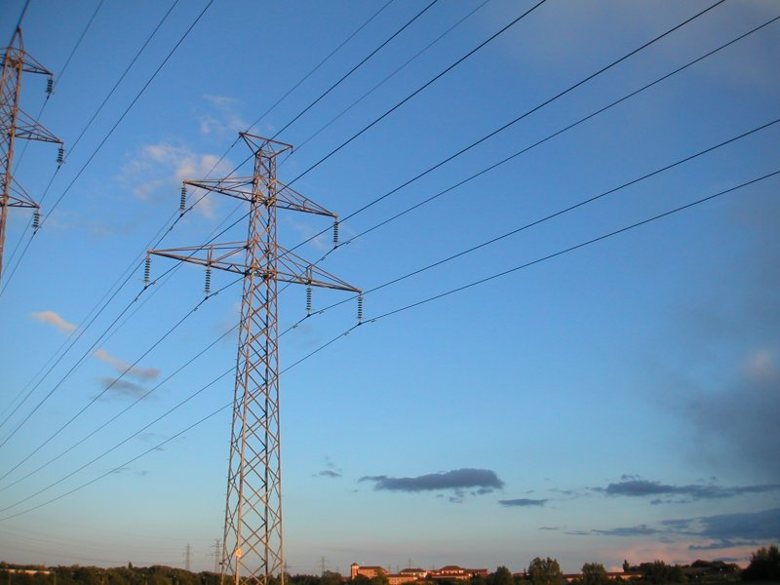
From the plant to your phone charger
Electricity is made in a few big places and used in millions of small ones. The grid is the machinery in between
Three stages: generation (the plant) → transmission (the tall steel towers, very high voltage) → distribution (the wooden poles on your street, stepped back down)
It is arguably the largest machine ever built — a continent wired into one synchronized system
High-voltage transmission towers — the grid moves power at high voltage to cut resistive losses. Photo by Nixdorf, CC BY-SA 3.0.
Notes:
Generation → transmission → distribution is the mental model to leave them with. The North American grid is genuinely one of the largest engineered systems in existence. Source: Britannica (electric power system); IEEE overview. Keep the “largest machine” line — it’s accurate and it lands.

Slide 26
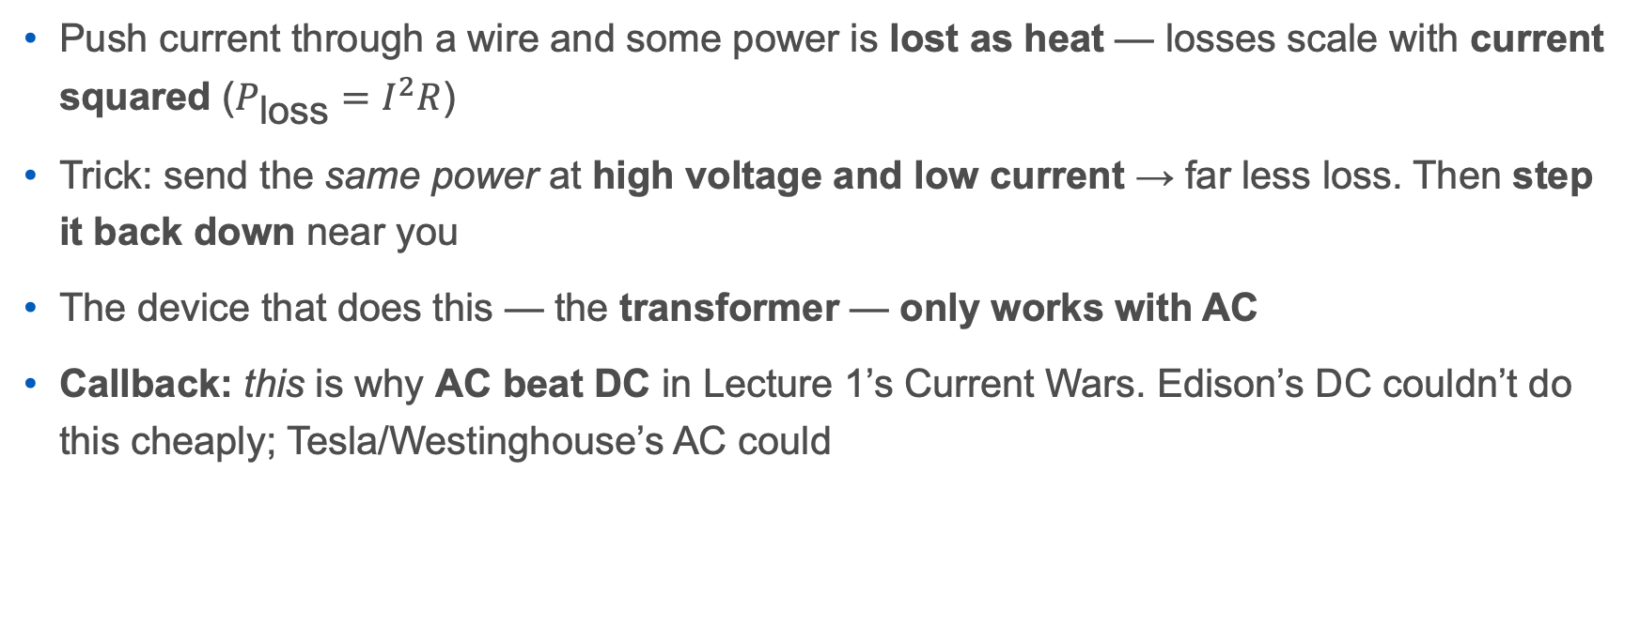
Why the towers run at insane voltage
Push current through a wire and some power is lost as heat — losses scale with current squared ($P_{\text{loss}}=I^{2}R$)
Trick: send the same power at high voltage and low current → far less loss. Then step it back down near you
The device that does this — the transformer — only works with AC
Callback: this is why AC beat DC in Lecture 1’s Current Wars. Edison’s DC couldn’t do this cheaply; Tesla/Westinghouse’s AC could
Notes:
P_{loss}=I^2R is the whole reason for high-voltage transmission and the deep reason AC won (transformers need changing flux — Faraday again — so they need AC). This is a beautiful callback that ties the E&M section, the Current Wars (L1), and the grid together. US transmission runs 100–765 kV; homes get 120/240 V. Source: HyperPhysics; Britannica (transformer); US-Canada Task Force report background.

Slide 27
The grid is a tightrope walk — every second
You can’t store much electricity in the grid — supply must match demand instant to instant
The proof is the frequency: North America runs at 60 Hz, and it must stay there. Too much demand → it sags; too much supply → it climbs
Grid operators (here, the NYISO) rebalance second by second, all day, forever
Lose the balance and the system protects itself by shutting down — which is how a small fault becomes a blackout
Notes:
60 Hz is the US/Canada standard (50 Hz most of the rest of the world). Frequency is the real-time tell of supply-vs-demand — generators literally spin at a rate that sets it. NYISO runs New York’s grid (good local hook). This sets up the 2003 blackout perfectly. Source: NYISO (how the grid works); NERC frequency standards; Britannica.

Slide 28
Aug 14, 2003: the day the Northeast went dark
It started small: an Ohio utility’s software failed and some overgrown trees touched power lines near Cleveland
With operators flying blind, the imbalance cascaded across the grid in minutes
~50 million people across eight US states and Ontario lost power — including right here in Buffalo and Western New York
One overgrown tree + one software bug → a subcontinent dark. That’s how tightly coupled the grid is
SUGGESTED GRAPHIC (optional, manifest): the DMSP/NOAA before-and-after satellite night image of the Northeast blackout (federal/PD — corroborate). Alt: “Satellite night images of the northeastern United States before and during the August 2003 blackout, showing the region gone dark.” (If license is unclear, the script will flag it — fine to omit.)
Notes:
Primary source: U.S.–Canada Power System Outage Task Force, Final Report (2004) — this is federal, so per the source-integrity rule pair it with an independent account (Scientific American 5-years-later; Wikipedia as finding aid → its cited sources). Trigger: FirstEnergy (Ohio) — a software race condition in the alarm system + unmanaged vegetation contact → cascade. Buffalo/WNY were squarely in the blackout zone (good local hook). Deaths estimated ~90+ (indirect). Keep the “coupled system” lesson.

Slide 29
Keeping the lights on (and the hard part ahead)
The grid is always juggling: baseload (steady — nuclear, some gas), peakers (fast spikes), and increasingly wind, solar, and batteries
Renewables are the cheapest energy (LCOE) but variable — so the 21st-century grid problem is timing and storage, not generation cost
Batteries, long-distance transmission, and demand shifting are how we square cheap-but-intermittent with a grid that must balance every second
Relevant later (Week 7): all those AI data centers are enormous new demand landing on this same tightrope
Notes:
Synthesizes the whole lecture: physics (how we generate) + LCOE (what it costs) + grid (delivering it reliably). The honest frontier is storage/timing, not raw cost. Forward-ref to Week 7 (AI/data-center demand) and Week 8 (future energy needs). Source: IEA (grids and storage); NYISO. End on the real 21st-century challenge.

Slide 30
The grid — sources
Grid basics: Britannica — electric power system; HyperPhysics — transformers & transmission
Operations / frequency: NYISO — how the grid works; NERC frequency standards
2003 blackout: U.S.–Canada Power System Outage Task Force Final Report (federal — corroborate); Scientific American — five years later
Storage/future grid: IEA — Electricity Grids and Secure Energy Transitions

Slide 31
How this deck was built

Slide 32
AI-use disclosure (per our own policy)
Model / company: Claude (Anthropic)
What it drew from: the primary sources on every Sources slide — I verified each one and did the physics/finance myself
Where: Anthropic compute runs on major U.S. cloud regions (exact region confirmed at build)
Compute / tokens: ≈ 0.9 million tokens (estimate) to research, calculate, and draft this quarry
Energy / water (order-of-magnitude): ≈ 0.15–0.4 kWh and ≈ 0.05–0.8 L — a range on purpose; providers report differently
The human (me) checked every number and source. That’s the standard I’ll hold you to in your final project.
Notes:
This is the same capstone move as Lecture 1 — model the disclosure the syllabus requires. Swap in the exact token count from this session’s usage log if you want a firm number. Method/uncertainty same as L1: ~0.15–0.45 Wh per 1,000 tokens; water ~0.3–1.8 mL/Wh. The point is the honesty and the range, not false precision. Sources: Google 2025 environmental disclosures; Li et al. “Making AI Less Thirsty”; IEA “Energy and AI.”

Slide 33
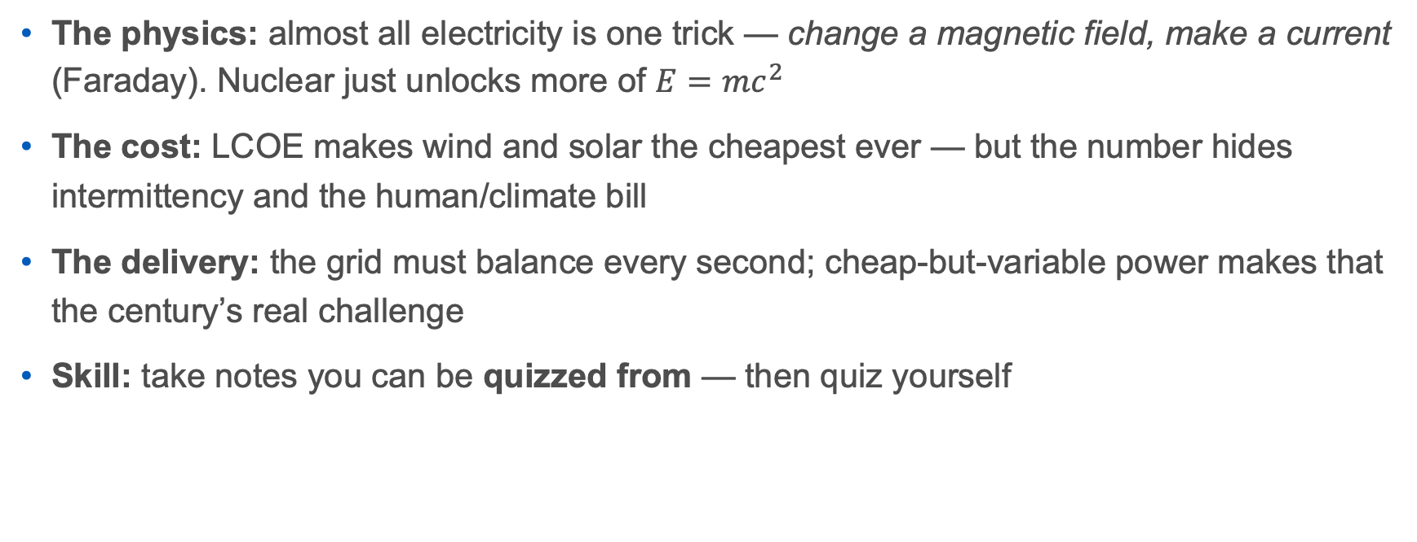
Takeaway: one machine, one ledger, one tightrope
The physics: almost all electricity is one trick — change a magnetic field, make a current (Faraday). Nuclear just unlocks more of $E=mc^{2}$
The cost: LCOE makes wind and solar the cheapest ever — but the number hides intermittency and the human/climate bill
The delivery: the grid must balance every second; cheap-but-variable power makes that the century’s real challenge
Skill: take notes you can be quizzed from — then quiz yourself
Notes:
Warm, tight close. This is the “one thing to remember” slide — the through-line from generation (physics) to cost (LCOE) to delivery (grid), with the skill of the week folded in. Then take questions.

Slide 34
Watch this week (optional)

Slide 35
Physics on your feed: fields & Maxwell
3Blue1Brown — “Divergence and curl: the language of Maxwell’s equations.” The best visual intuition for the E&M we did today (Grant Sanderson; vetted)
Elle Cordova — her “Fundamental Forces of Physics” bits personify electromagnetism as a character. Funny, and it sticks (vetted)
learnwithsherlock — short, clean physics explainers, incl. electromagnetism (vetted; IG/TikTok)
Notes:
Confirmed this session (RE-VERIFY exact links at build): 3Blue1Brown “Divergence and curl” = youtube.com/watch?v=rB83DpBJQsE (also 3blue1brown.com/lessons/divergence-and-curl); his neural-network series is the one to save for the Week-7 AI lecture. Elle Cordova = @ellecordova (youtube.com/@ElleCordova; also IG/TikTok) — “Fundamental Forces” reels; pick the electromagnetism one and confirm the exact reel URL. learnwithsherlock = instagram.com/learnwithsherlock + tiktok.com/@learnwithsherlock. All three are on the project’s trusted list.

Slide 36
The atom: fission, fusion, and CERN
Dr. Clara Nellist — @particleclara — real CERN particle physicist doing first-year-friendly explainers. She’s a friend of mine — lean in (vetted; IG/TikTok/YouTube)
CERN (official, vetted) — the source for “what a lab actually does.” Reminder: I work on CMS, one of the big LHC experiments — ask me anything
Brian Cox — “Can We Make a Star on Earth?” (BBC) on fusion and how stars burn. A trusted traditional communicator (vetted) — I’ve worked with him
Kurzgesagt — “Fusion Power Explained: Future or Failure” (secondary) — great animation; pairs with our “real, but decades away” verdict
Notes:
Authenticity hooks (project style note): particleclara (Clara Nellist) is a personal friend — “a friend of mine makes these”; and I’m a CMS experimentalist, so CERN/CMS content I can speak to firsthand. Confirmed: particleclara = instagram.com/particleclara, tiktok.com/@particleclara, youtube.com/@ParticleClara. CERN official = home.cern (@CERN across platforms). Brian Cox fusion: BBC Horizon “Can We Make a Star on Earth?” (2009) + “Wonders of the Universe” stellar-fusion segments — pick a clip and verify. Kurzgesagt fusion = youtube.com/watch?v=mZsaaturR6E (same video referenced in Lecture 1; NOT on the vetted list — established and reliable, mark as secondary).

Slide 37
The grid: how electricity actually travels
Veritasium — “The Big Misconception About Electricity” (secondary) — energy rides in the fields around the wires, not “through” them. A mind-bending pairing with our transmission/grid slides
Follow-up (same channel, secondary): “How Electricity Actually Works” answers the pushback on the first video
Honest gap: our vetted list is a physics/AI/math roster — it doesn’t yet cover LCOE / energy economics or note-taking. If you find a good creator for those, add them to the trusted list
Notes:
Veritasium “The Big Misconception About Electricity” = youtube.com/watch?v=bHIhgxav9LY (2021); the follow-up “How Electricity Actually Works” answers critics — both are strong on the Poynting- vector idea that ties directly to our high-voltage/transmission slide. Veritasium is NOT on the vetted list (mark secondary), but Lecture 1 already leaned on it, so it’s consistent. Real gaps to flag for the trusted-creator list as it grows: LCOE/energy-economics and study-skills/note-taking — no vetted creator covers these yet. Candidate energy-explainer channels exist but need your vetting before they go on the list. Per course policy, cite any creator’s underlying primary sources if this material makes it into a graded deliverable. (The next section broadens the net to fill these gaps.)

Slide 38
Cast a wider net: creators to vet

Slide 39
Energy economics & LCOE (filling the gap)
Engineering with Rosie — engineer Rosemary Barnes; her video “Does LCOE give us the right numbers?” is a near-perfect match for today’s cost section
Our World in Data — the data source behind our LCOE/deaths-per-TWh figures; charts you can actually cite
Volts — David Roberts — deep energy-economics & policy (podcast/newsletter; more advanced)
Just Have a Think & Undecided w/ Matt Ferrell — energy-transition explainers with sources
Ziroth — clean energy-data visualizations
None vetted yet — candidates for the trusted list. They point where the cost and climate data point; vet each for rigor and primary sourcing, and watch for hype (over-optimistic timelines), not for “balance.”
Notes:
Confirmed this session (RE-VERIFY links at build): Engineering with Rosie (Rosemary Barnes, wind/ composites engineer) — LCOE video = youtube.com/watch?v=i-891blV02c; channel youtube.com/@EngineeringwithRosie. Our World in Data = ourworldindata.org/energy + youtube.com/@ourworldindata3652 — this is the actual data behind our Lazard-adjacent figures and the L1 deaths-per-TWh chart; strongest for “cite the data.” Volts = volts.wtf (David Roberts) — excellent on electricity-market economics but adult/advanced and opinionated (clean-energy advocate — flag POV). Just Have a Think = Dave Borlace, youtube.com/@JustHaveaThink (rigorous, cites sources). Undecided = Matt Ferrell, youtube.com/@UndecidedTechnology (tech + payback- period economics). Ziroth = Ryan Hughes, youtube.com/c/ZirothTech (data viz). ON “BALANCE”: this set leans pro- renewable because that’s where the LCOE numbers and the climate science actually land — that’s the evidence, not a bias to offset, and there’s no reason to manufacture fossil-fuel equal time on a settled empirical question. The real scrutiny is per-creator rigor: do their claims trace to primary data, and are they overselling (hyped timelines, tech that isn’t deployed yet)? All NON-VETTED — your review needed on that basis.

Slide 40
Grids, reactors & how things really work
Practical Engineering — Grady Hillhouse — the gold standard on the grid: transmission, transformers, balancing, blackouts
Illinois EnergyProf — Prof. David Ruzic — an actual nuclear/plasma professor on fission & fusion; energetic and rigorous
Real Engineering — well-produced deep dives (e.g., “The Problem with Nuclear Fusion”)
Steve Mould — hands-on electromagnetism/induction demos you can almost feel
Notes:
Practical Engineering (Grady Hillhouse, licensed PE) = practical.engineering + youtube.com/@PracticalEngineering; “How Does the Power Grid Work?” is the single best grid explainer and maps straight onto our grid slides — strong candidate to formally vet/add. Illinois EnergyProf (Prof. David Ruzic, UIUC Nuclear/Plasma/Radiological Eng) = youtube.com/@illinoisenergyprof6878 — credentialed, great on reactors and fusion plasma. Real Engineering = youtube.com/@RealEngineering (Brian McManus) — polished, generally reliable; verify specifics. Steve Mould = youtube.com/@SteveMould — physics demos incl. induction/eddy currents, pairs with the E&M section. All NON-VETTED; Practical Engineering + Illinois EnergyProf are the two I’d prioritize for review.

Slide 41
Study skills: note-taking
Justin Sung — former doctor turned learning-science coach; evidence-based note-taking (mapping over transcribing) that lines up with today’s skill
Benjamin Keep — learning-science explainers on retrieval, spacing, and note strategies
Ties directly to our Cornell-method / “process, don’t transcribe” slides — good optional follow-up for the Week-3 note-taking quiz
Non-vetted — review before recommending; both cite the cognitive-science literature.
Notes:
Justin Sung = youtube.com/@JustinSung (learning-science coach; leans into his iCanStudy course — flag the soft sales angle, but the content aligns with Dunlosky/retrieval-practice evidence). Benjamin Keep = youtube.com/@BenjaminKeep (PhD; learning science, careful with evidence). Both fill the note-taking gap the prior slide flagged. NON-VETTED. Reminder: our vetted list had no study-skills creators — if you like either, that’s a natural addition. As always, the real check on any of this is whether students can defend it in Q&A.

