Slide 1
Lecture 3 —
Coal country and the Battle of blair mountain
PHY199-RAP · Energy in the 21st Century
Dr. Salvatore Rappoccio

Slide 2
Content Warnings
Genocide and colonialism against Native American populations
Abuse and death of enslaved people and escaped enslaved people
White supremacy organizations
Child labor
Exploitation and suppression of workers

Slide 3
The Resources

Slide 4

How to Make Steel
Iron + coal = steel
https://thatvideogameblog.com/blast-furnace-recipe/

Slide 5
How to Make Steel

Slide 6
How to Make Steel

Slide 7
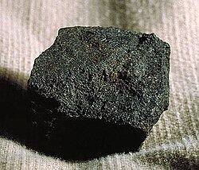
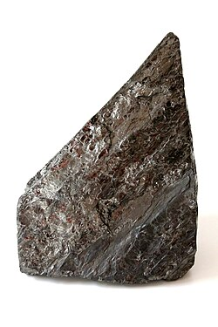
Coal
Bituminous :
  Very abundant
  Used for production of steel and also for power generation
  Burns with lots of outgassing and pollution
Anthracite :
  Very rare (<1% of coal)
  Used for power generation and high-grade metallurgy
  Mostly coming from area surrounding Lehigh Valley in PA

Slide 8
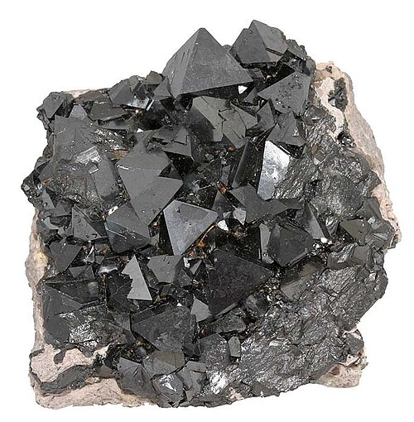

Iron Ore
Magnetite
Magnetite
Hematite
Mostly came from Minnesota
Almost all used to make steel
Hematite

Slide 9
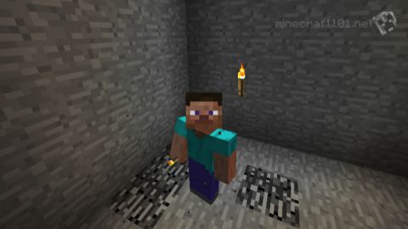
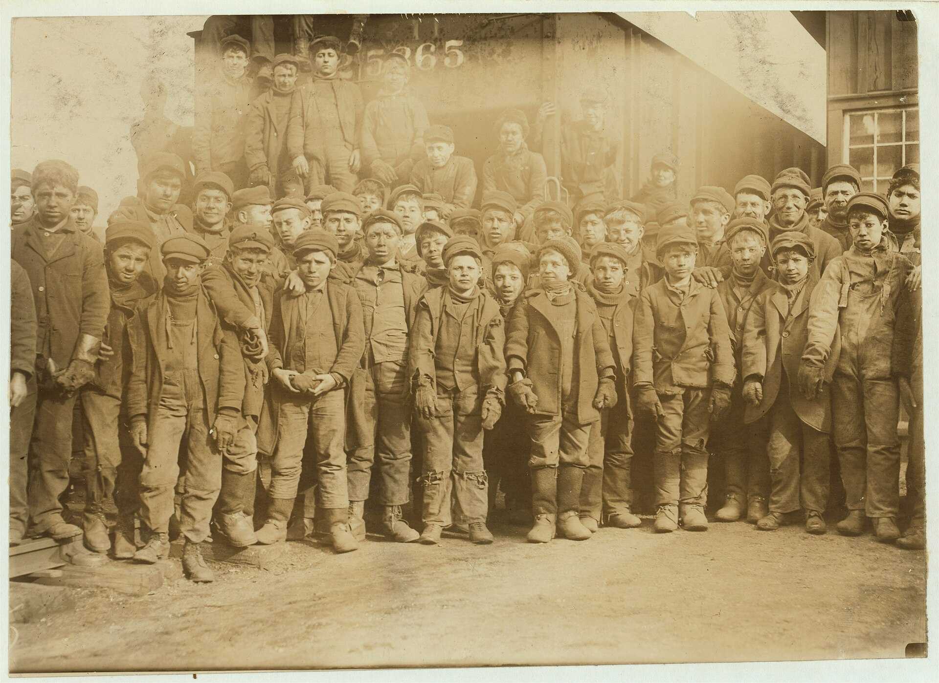
Mining Coal and Iron
Mining in Minecraft
Mining IRL
Fun
Has zombies
Can fight Ender Dragon
Breaker boys and men, Pennsylvania Coal Co. Photo Lewis Hine. PD (LoC).
Not fun
Has coal lung
Can fight your… boss?

Slide 10
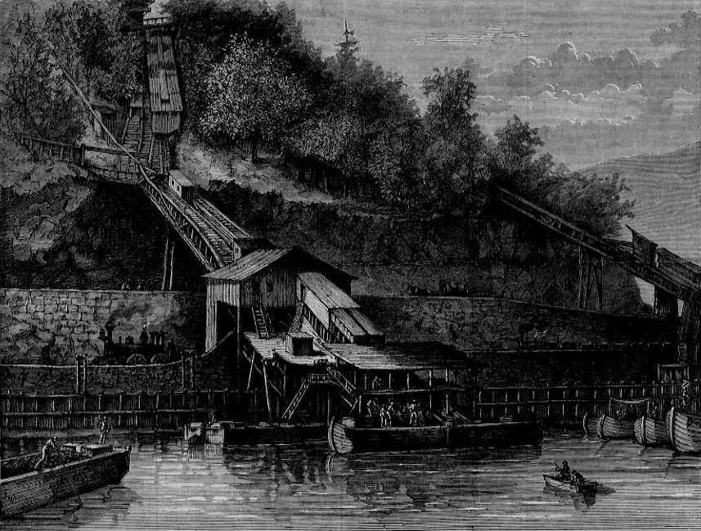
Anthracite Coal
Pennsylvania's Coal Region — Carbon, Lackawanna, Luzerne, Northumberland, Schuylkill counties — holds the largest known anthracite deposits in the world: roughly 7 billion short tons.
The Lehigh Valley in the Appalachian range is where that coal got out:
  Lehigh Canal, opened 1827 — coal to Philadelphia and New York
  Lehigh Valley Railroad (Asa Packer) — coal to everywhere else
  Bethlehem Steel, founded 1899 — the nation's #2 steelmaker, built on that coal
Breaker boys and men, Pennsylvania Coal Co. Photo Lewis Hine. PD (LoC).
Chutes loading coal boats on the Lehigh Canal (opened 1827). PD.
Notes:
Geology as destiny. Anthracite is ~300-million-year-old Carboniferous swamp buried deeper and squeezed harder than bituminous - more heat and pressure, more carbon, fewer volatiles.
Note the ordering: canal FIRST (1827), then rail, then steel. Energy infrastructure precedes and determines industry location. Still true - it is why data centers are going up next to Susquehanna and next to hydro.

Slide 11
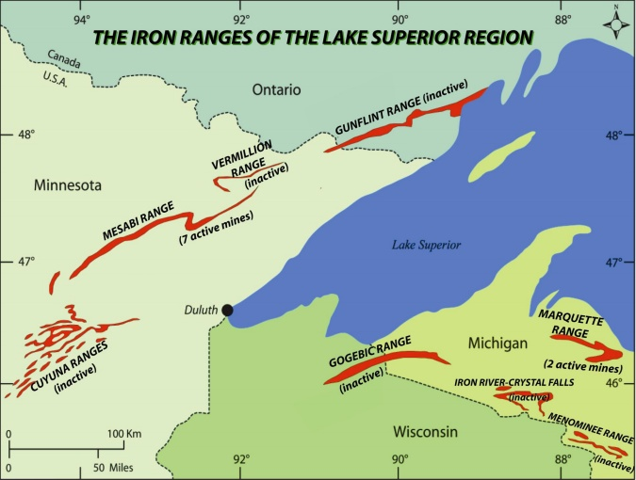
Iron Ore
Primarily from the Mesabi Range in northeastern Minnesota
  Ojibwe in N.E. Minnesota knew of the iron ore in the region, and told blacksmith N.A. Posey in 1863 and surveyor George Stunz
  Immigrants from Europe (German, Irish, Swedes, Italians) moved into the region near Duluth in the late 19th Century
Mining companies opened in the late 19th century, examples:
  Soudan Mine
  Mountain Iron Mine
Carnegie, Morgan, Charles Schwab, Elbert Gary and others eventually merged all of the disparate steel operations into one megacorporation, US Steel, which held a virtual monopoly on steel production in the US

Slide 12
The people, Their unions, and the company town

Slide 13
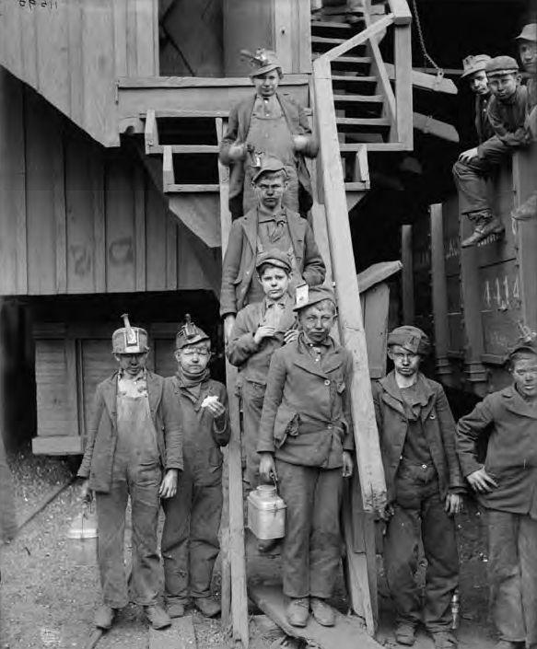
Who dug it, and where the wealth went
The Coal Region's workforce was imported in waves: English, Welsh, Irish, German first, then Polish, Slovak, Ukrainian, Hungarian, Italian, Russian, Lithuanian and Jewish immigrants, as well as extensive migration of Black Americans escaping the Jim Crow South in the Great Migration
The coal did not stay. It went to the Steel Belt — Pittsburgh, Cleveland, Detroit, Chicago, and Buffalo — where Appalachian coking coal met Minnesota iron ore over Great Lakes shipping.
“Breaker boys” in a Kingston, Pennsylvania, anthracite coal mine in 1900. Predominantly immigrants, these boys often worked fourteen- to sixteen-hour days separating slate from the coal after it was taken out of the mine shafts. (Library of Congress)
Notes:
[BUFFALO] The local hook, and a sharp one: a steel company relocated several hundred miles, in part, to get away from a union. Lackawanna NY is named after Lackawanna PA - the company brought the name with it. ~2,000 workers moved; ~6,000 employed by 1903. Bethlehem Steel bought it in 1922.
Lackawanna Iron & Steel also started its own company town in 1901 - it 'lacked most services' and 'the housing stood empty for many years'. Buffalo has its own small company-town story; Section 4 picks it up.

Slide 14
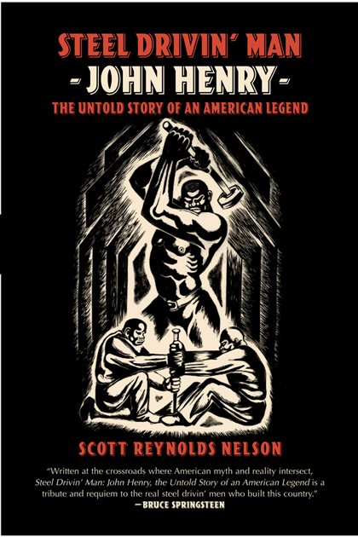
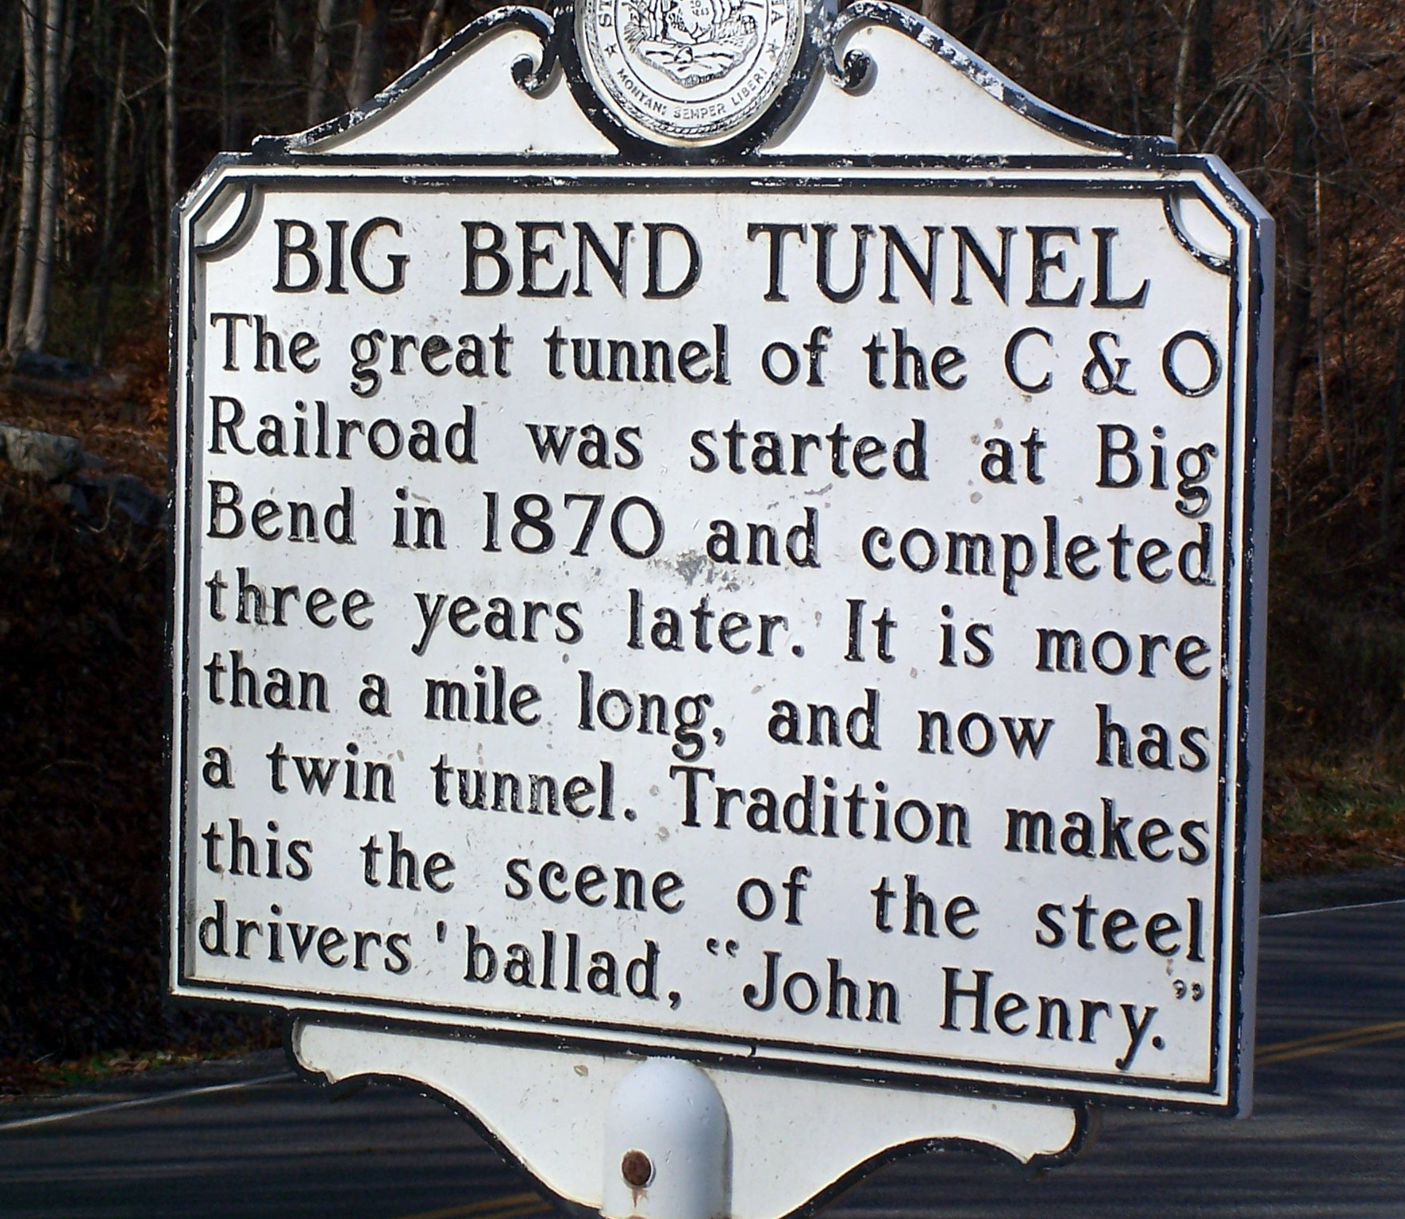
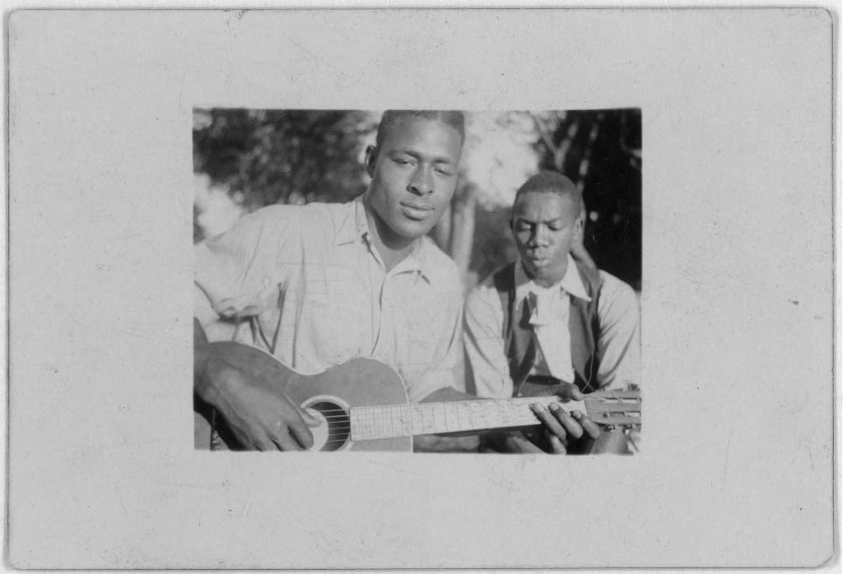
John Henry
John Henry is a Black American folk hero. According to legend, he raced a steam drill through a mountain at Big Bend Tunnel, won, and died with the hammer in his hand.
Historian Scott Reynolds Nelson traced him to prison records — a 19-year-old named John William Henry, in the Virginia Penitentiary, sent to tunnel work on the Chesapeake & Ohio Railway in the 1870s.
  Convict laborer, and he probably died of silicosis from rock dust — not a burst heart.
  John Henry stands for hundreds who died anonymously.
  Convict leasing put thousands of Black men, arrested on minor or invented charges, into mines and tunnels across America,
    For-profit prisons and leasing prisoners is a practice that still exists today
The Ballad of John Henry became a very popular folk song, Sung by many including Gabriel Brown and Rochelle French, as well as 21st century artists like Joe Bonamassa (From Rochester)
Gabriel Brown and Rochelle French, Eatonville, Florida
Notes:
[WEEK 7 SETUP] The strongest bridge in the deck to the AI material. The American folk archetype of technological unemployment is a Black convict laborer who wins the contest and dies anyway. When we talk about automation in Week 7, that is the image to return to: the question is never only 'can the machine do it' but 'what happens to the person, and did anyone owe them anything.'
Flag the honest uncertainty: Nelson's identification is a strong argument, not a proven fact. Others favour Big Bend Tunnel in WV - and the C&O's chief engineer denied steam drills were even used there. Good research-skills moment.
Lead Belly (Huddie Ledbetter, 1888/89-1949) recorded John Henry and much else. 'Discovered' by John and Alan Lomax at Angola prison in 1933; the Lomaxes initially presented him to white audiences in prison stripes as a curiosity. Even the preservation of Black music ran through a system that treated the musician as property of a narrative. He shaped Dylan, the Weavers, Nirvana, and by George Harrison's account, the Beatles.

Slide 15
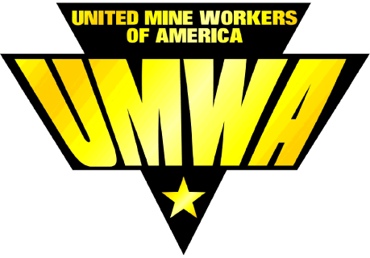
Unions
The brutal mining conditions, awful health outcomes, and exploitation of workers and the community led to the formation of the United Mine Workers of America in 1890
Modeled after the American Federation of Labor (AFL), but then broke with AFL to set up its own federation, the Congress of Industrial Organizations, later all incorporated into the AFL-CIO
https://umwa.org

Slide 16
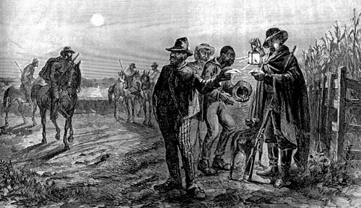
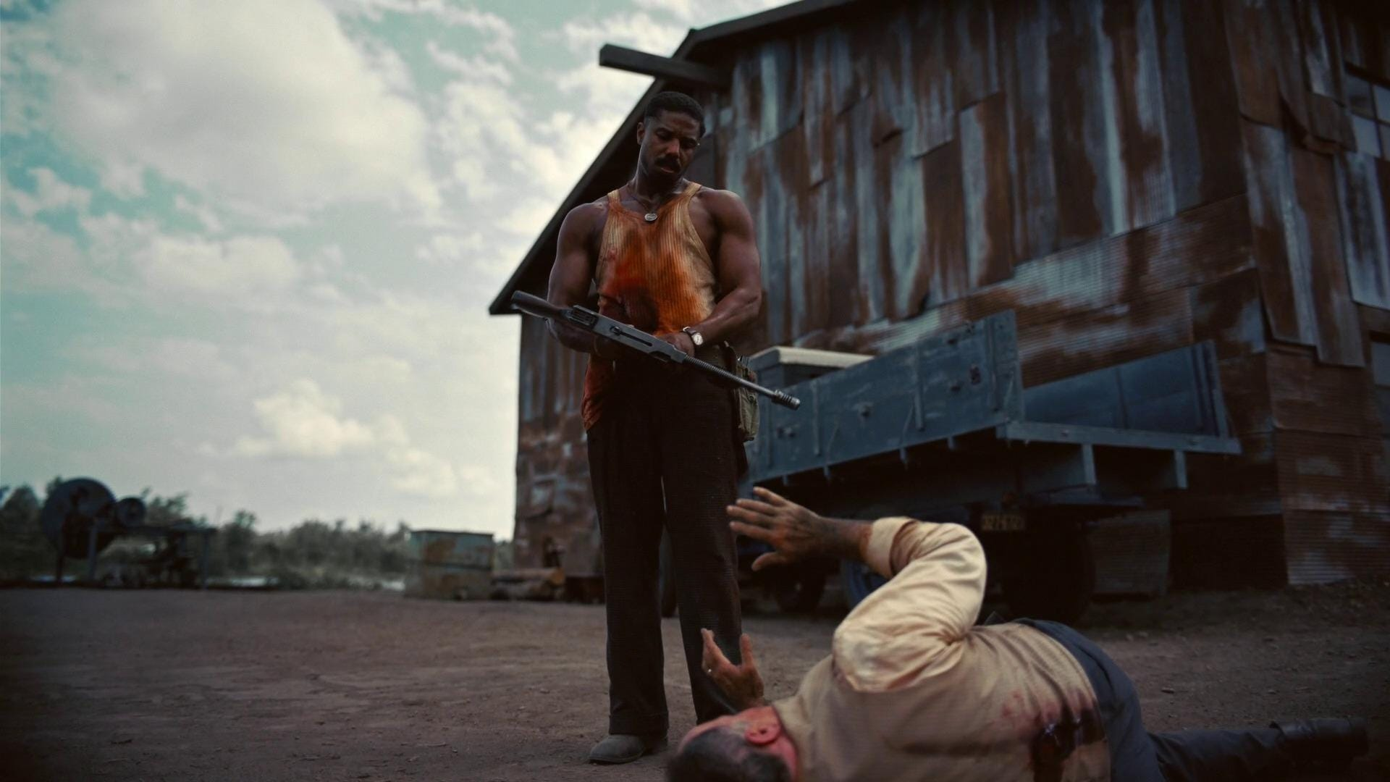
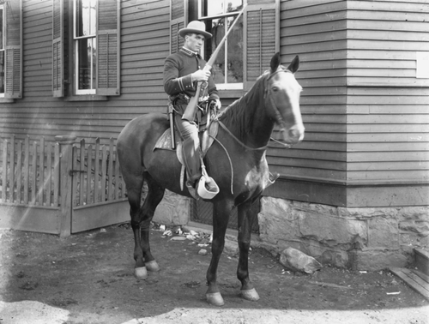
Slave Catchers and Private Detective Agencies
Before the Civil War, slave catching was a regular occupation in the US, especially the South
  Recruited militia from places like The Citadel and the Virginia Military Institute
  Became a paramilitary operation
  After the Civil War, led / linked to the formation of the Ku Klux Klan
  These were still implicitly and explicitly enforced by Southern police officers
  Addressed in popular culture, such as Sinners (2025) where Smoke and Stack confront KKK members who come to kill them after selling them the juke joint
Companies needed a private military force, hired existing agencies to infiltrate and break up unions
  Baldwin-Felts
  Pinkertons
This led to a ready-made force of paramilitary thugs who were deputized and enabled by the Federal and local governments to brutally suppress the workforce, Black people escaping the Jim Crow south, and immigrants from everywhere
Depiction of Mississippi slave patrol
Michael B. Jordan as Smoke, killing a member of the KKK in the 2025 film “Sinners”
A Baldwin Felts agent at Glen Jean, Fayette County, 1902.

Slide 17
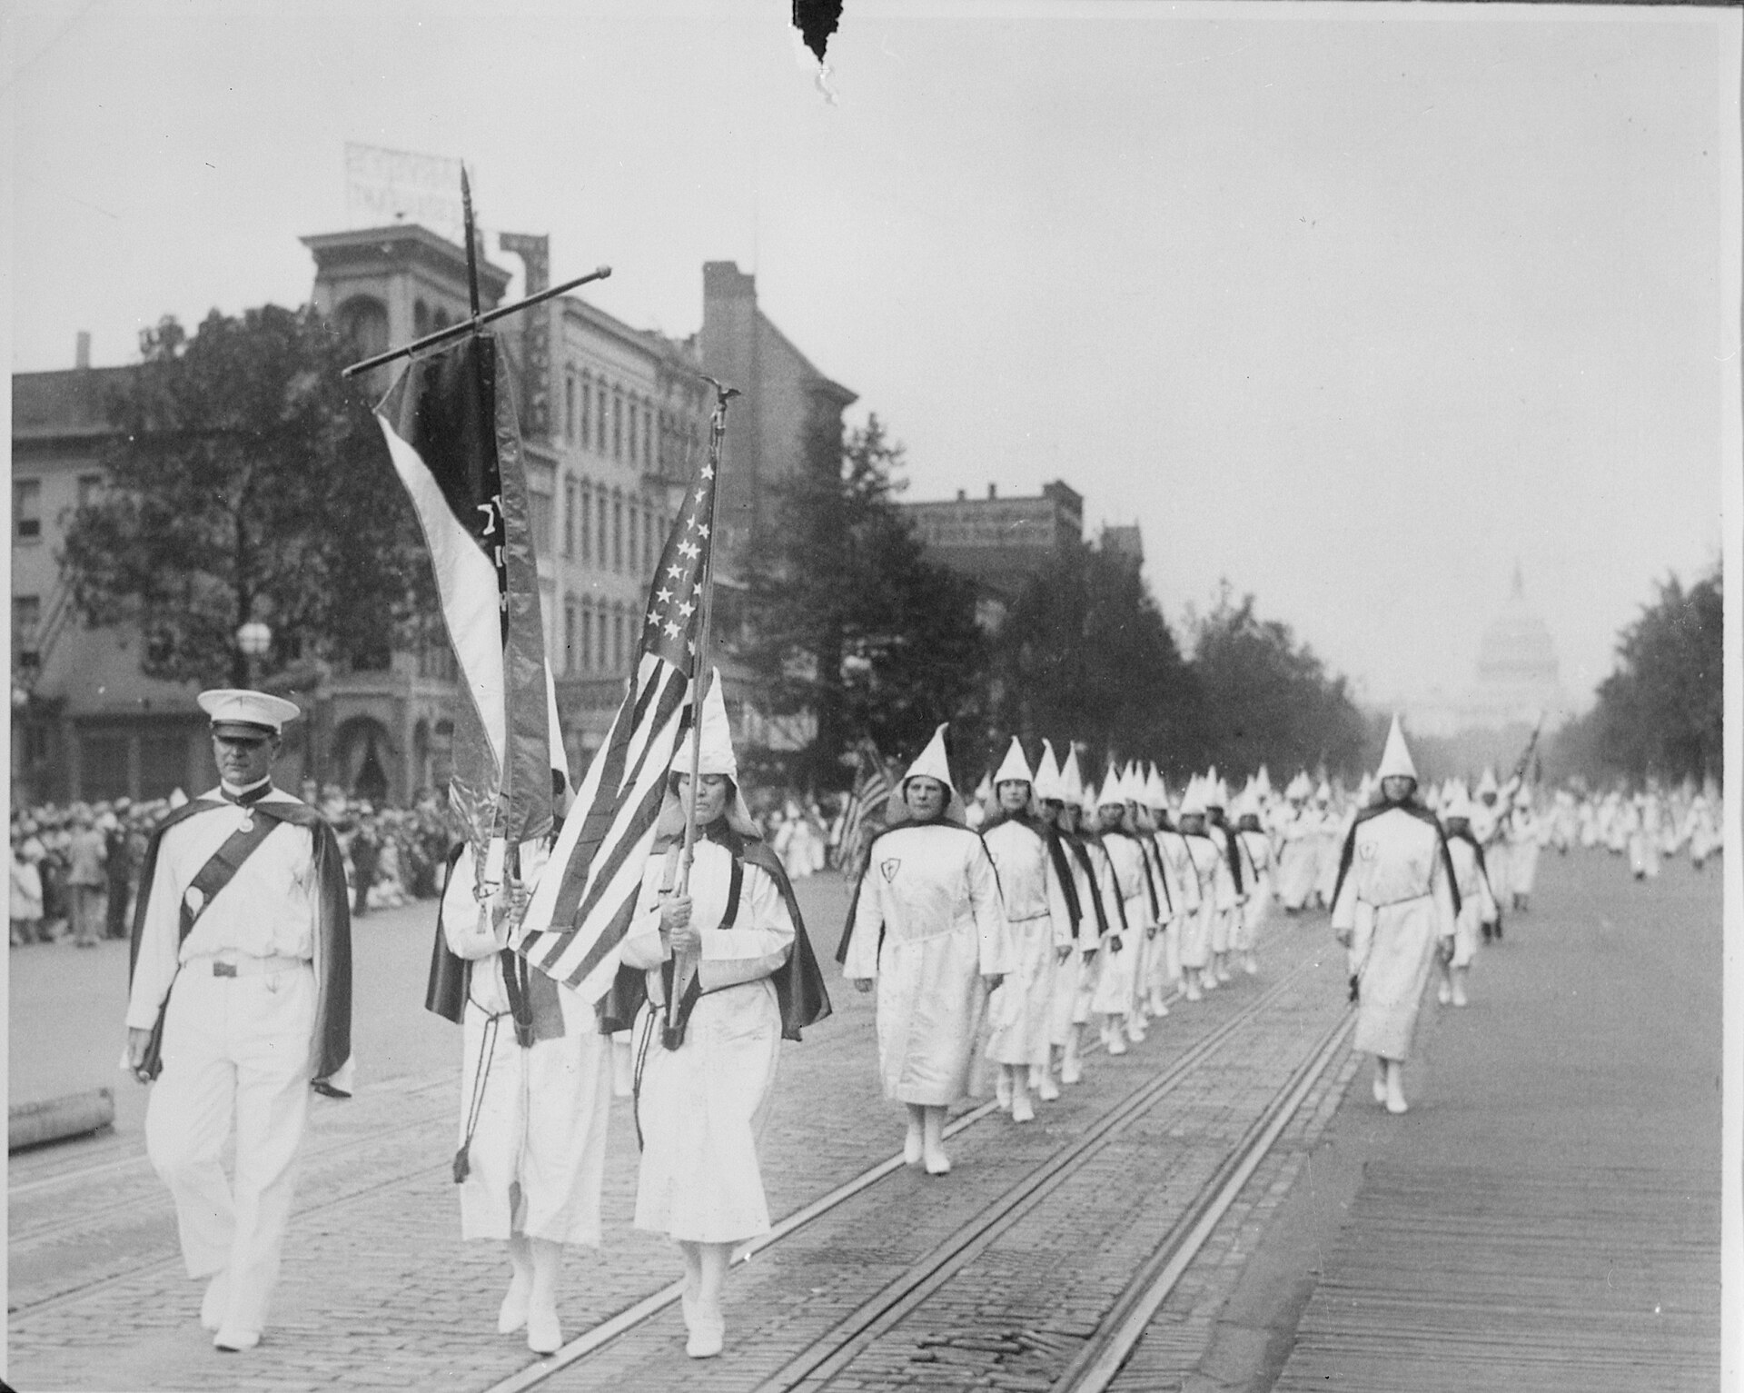
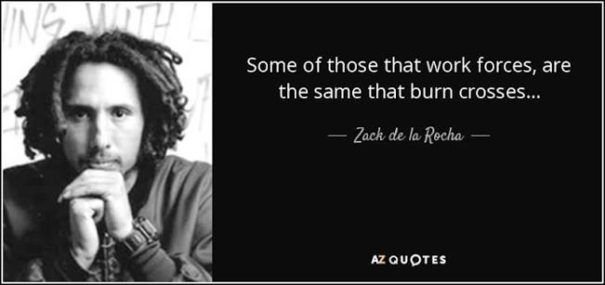
The Revival of the Ku Klux Klan
In the same years, the second Ku Klux Klan was the fastest-growing membership organization in America.
  Refounded 24 December 1915 at Stone Mountain, GA, inspired by the film The Birth of a Nation
  Peak membership by 1924: an estimated 3-8 million
  Not just the South. Detroit had ~40,000 members. In Indiana, ~18% of eligible men joined
  Targets: Black Americans, Catholics, the Jewish diaspora, and Southern and Eastern European immigrants
During that period, many law enforcement members were also part of the KKK
  Inspired the lyrics of the popular song “Killing in the Name Of” by Rage Against the Machine
Klan parade, Pennsylvania Avenue, Washington DC, 1928. PD (NARA).
Notes:
The closing moral argument, so land it carefully.
The historiography is genuinely mixed and you should say so: the second Klan sometimes SUPPORTED striking white Protestant workers while opposing interracial unions. It was not simply a company weapon. But its function in the coalfields was the same either way - a workforce divided by race and religion cannot strike, and every operator knew it. Division was the cheapest possible security expense.
Chuck Keeney's line, repeated here: 'they all understood that if they did not work together they couldn't be effective.'
Then the honest ending: it did not save them. They lost anyway in 1921. Solidarity was necessary and insufficient - the same verdict as 'the oligarchy won'. What finally changed things was law, in 1933. Which is a statement about POLITICS, and politics is the title of this lecture.
[MOTIF] Hunger Games close: the mockingjay wasn't a weapon, it was a signal that other people were also refusing. The red bandana did the same job.

Slide 18
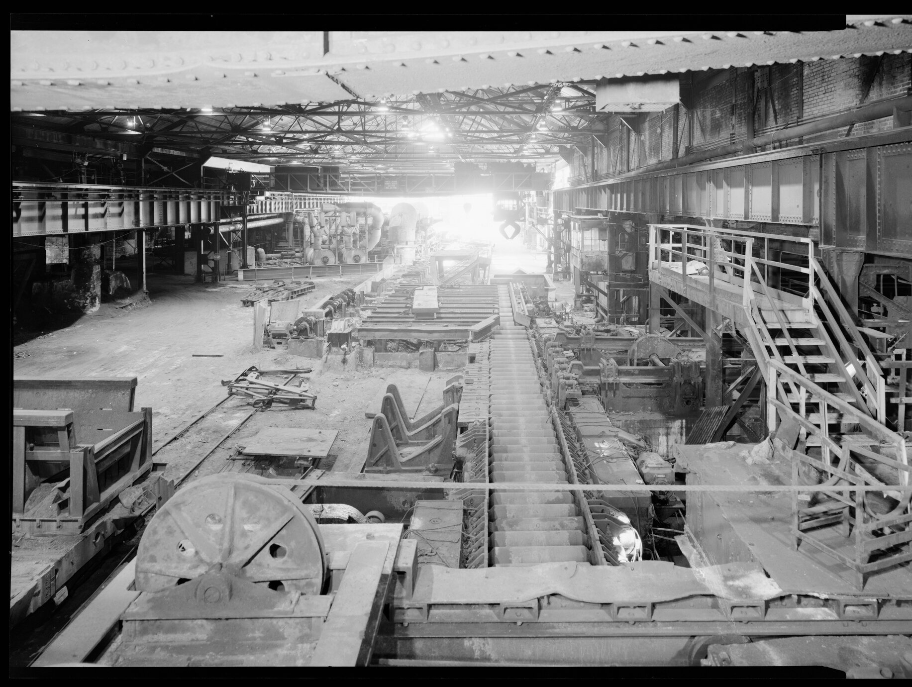
Lackawanna Steel
The Seneca nation sold part of the Buffalo Creek Reservation in 1842
  Part of this became the town of Seneca
  1899-1902 Lackawanna Steel moved from Scranton, in the Coal Region, to the Lake Erie shore south of Buffalo and renamed part of Seneca and we got West Seneca and Lackawanna in the end
  Consolidated into US Steel in 1907
Stated reasons included shipping costs — and the fact that the United Mine Workers of America had organized Scranton in 1897 and struck successfully in 1900 and 1902.
Acquired by Bethlehem Steel in 1922
By the 1940s that plant employed over 20,000 people, and closed in 1982 after massive layoffs
The company had considerable friction with the neighboring communities due to public health problems including cholera, typhoid, and flu, and incorporated Lackawanna, NY in 1909
Inside the Lackawanna plant, Buffalo. PD (HAER, LoC).

Slide 19
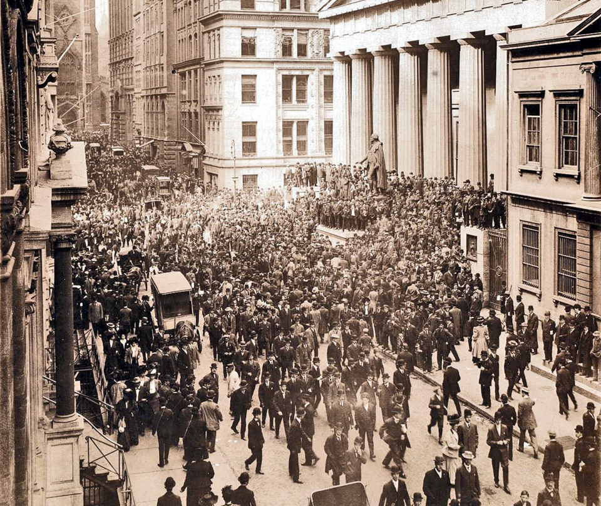
Panic of 1907
The “Knickerbocker Crisis” of 1907 was a three-week-long financial crisis that caused a recession and the NYSE fell 50%
Triggered by an attempt to corner the market of the United Copper Company (not steel, but also had its own mining issues and exploitation)
JP Morgan stabilized the financial system and the action was approved by US President Theodore Roosevelt
Wall Street during the bank panic in October 1907. Federal Hall National Memorial, with its statue of George Washington, is seen on the right.

Slide 20
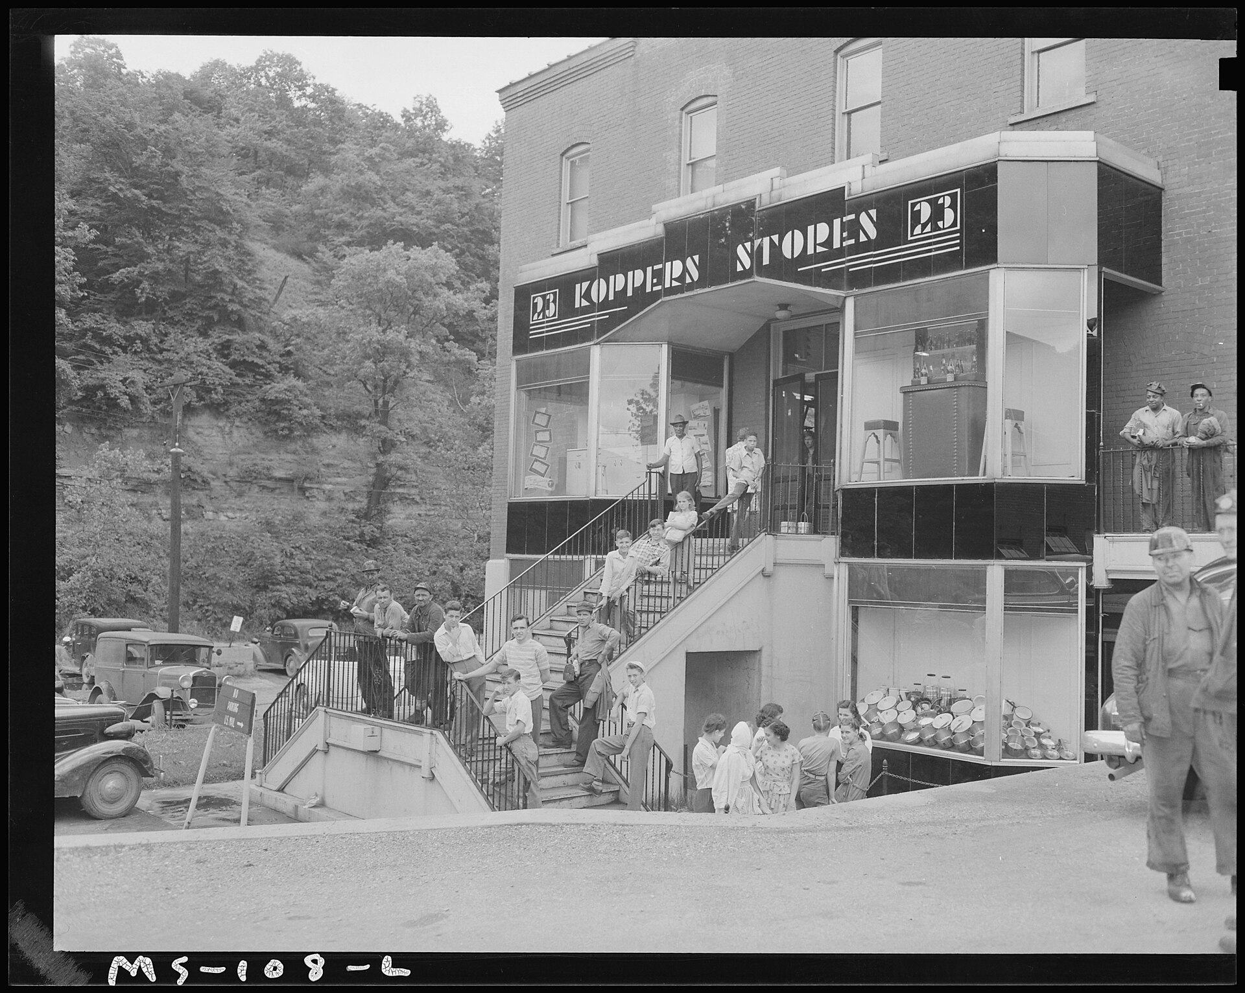
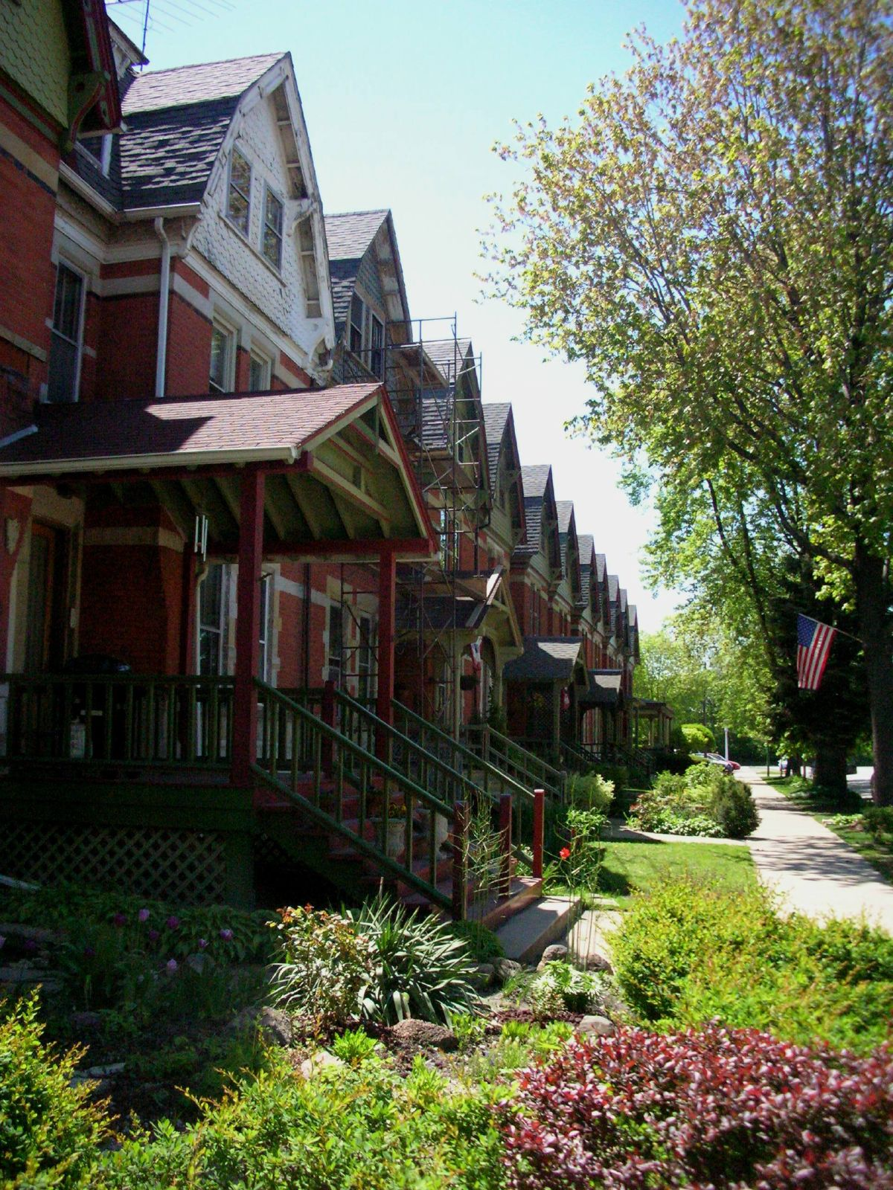
The Company Store
A company town is a settlement where one company owns the housing, the store, the school, the church, and the job.
At their peak: more than 2,500 company towns in the US, housing about 3% of the population. A 1916 Bureau of Labor Statistics survey found 34.4% of the surveyed workforce living in company housing.
The company called this paternalism and considered it a moral duty. A federal commission investigating the Pullman strike of 1894 called it something else:
  "The aesthetic features are admired by visitors, but have little money value to employees, especially when they lack bread."
Its verdict on Pullman's paternalism: "Un-American." Illinois sued, and in 1898 the state Supreme Court forced Pullman to sell the town.
The company store, Federal No. 1 Mine, Grant Town, WV. PD (NARA).
Pullman company housing, Chicago, today. Photo Richie Diesterheft, CC BY 2.0.
Notes:
Pullman built his town outside Chicago in the 1880s for 6,000 employees and 6,000 dependents. After the Panic of 1893 he cut wages but did NOT cut rents or store prices - because those were separate business lines. That is the logic of the company town exposed in one decision: your wage is a cost to be minimized, your rent is revenue to be maximized, and you are the same person.
Note the dates: 1898, Illinois breaks up Pullman. 1921, Blair Mountain. The legal precedent existed and did not reach West Virginia for another generation.

Slide 21
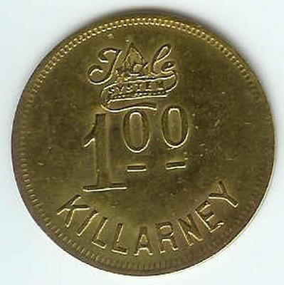
Scrip: private money
Miners were often paid in scrip — basically 19th century crypto. Metal or paper tokens issued by the coal company.
  Worth full face value only at the company store
  Companies refused to redeem it for cash
  Independent traders bought it at a discount of 25% and up; nearby stores took it at 10-30% off
  So taking your pay somewhere else meant taking a pay cut of up to a quarter
West Virginia banned scrip-as-wages in 1891 and made it non-transferable in 1925. It survived until the coal industry itself collapsed in the 1950s.
"I owe my soul to the company store" is not a metaphor. It is a description of a currency system.
Coal scrip, Killarney, West Virginia. PD.
Notes:
WORKED NUMBER - our simple calculation for the day:
Earn $5.00/day in scrip. Nearest independent store takes it at 25% off.
Real wage if you shop anywhere but the company store: $3.75/day.
= a 25% pay cut for the crime of shopping around.
Over a 300-day working year: $1,500 nominal, $1,125 real. $375/yr taken.
In 1921 dollars, $375 is roughly three months of a miner's earnings.
(Or the company store simply charges more. Either way the money comes back.)
Economists do debate how coercive scrip was in practice - see Price Fishback, 'Did Coal Miners Owe Their Souls to the Company Store?', Journal of Economic History. Honest framing: the discount is documented; the argument is about how much choice miners actually had. In isolated single-road hollows, not much.
The operators' defense was that scrip 'educated miners to sound credit practices'. A 1925 investigation concluded it did the opposite.

Slide 22
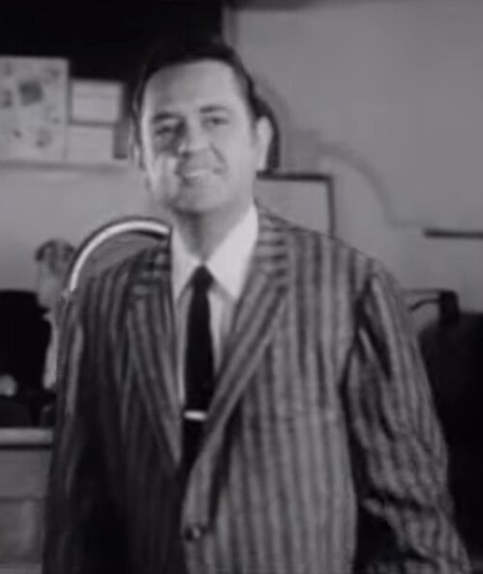
Sixteen Tons
Song written by Merle Travis about the life of a coal miner in Rosewood, Kentucky
  Travis grew up in Rosewood, and sung often about the exploitation of workers in the 19th and 20th centuries
“Saint Peter don’t call me, cuz I can’t go… I owe my soul to the Company store”

Slide 23
The Shooting War

Slide 24
Conflicts Arise
The conditions in the 19th and 20th century were rife for exploitation:
  After expelling the Native American nations in the regions, there was a ready-made workforce of Black Americans and immigrants
    Poor, desperate, and often unhoused
    They took what they had to in order to live
  Rapidly expanding industry with little to no oversight from the US government, and often direct and indirect support from them
Classic case of the “haves” versus the “have nots”

Slide 25
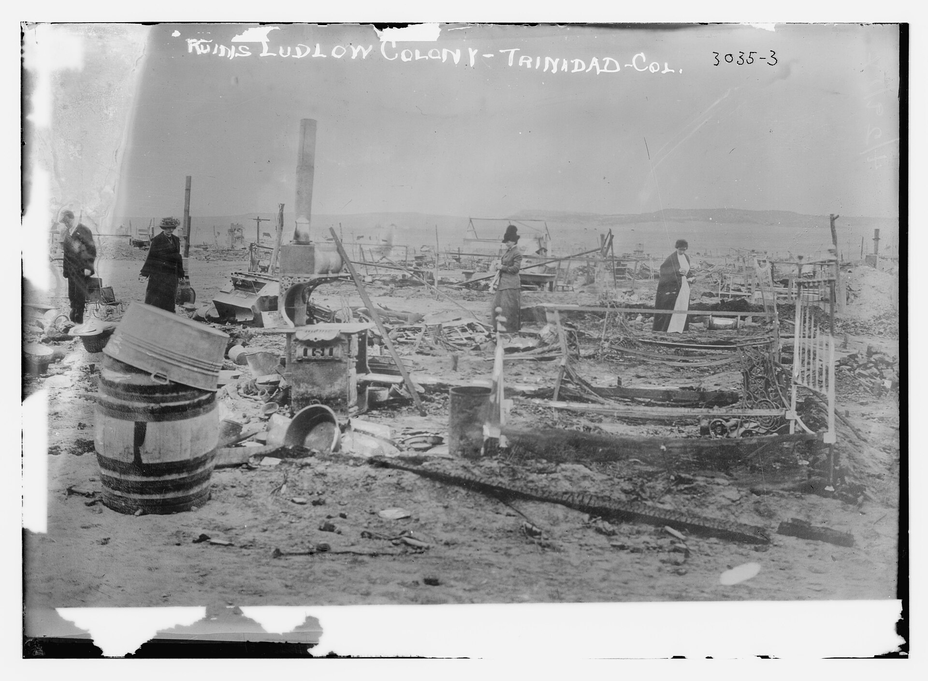
1890-1930: the Coal Wars
Year | Event | What happened
1894 | Cripple Creek strike (CO) | Miners vs. hired deputies
1902 | Anthracite strike (PA) | 150,000+ out for 163 days
1912-13 | Paint Creek-Cabin Creek (WV) | Mine guards, an armored train, martial law
1914 | Ludlow Massacre (CO) | ~19-25 dead, including 12 children
1920 | Matewan Massacre (WV) | 10 dead in a 15-second gunfight
1921 | Battle of Blair Mountain (WV) | ~10,000 armed miners
1931-39 | Harlan County War (KY) | "Bloody Harlan"
Ruins of the Ludlow tent colony, Colorado, April 1914. PD (LoC).
Notes:
We call them 'labor disputes'. They were armed conflicts with a body count. The private army in most of them is the same one: the Baldwin-Felts Detective Agency.
Read the Ludlow line slowly. 20 April 1914: Colorado National Guard and Baldwin-Felts guards attacked a tent colony of evicted strikers the day after Orthodox Easter. Four women and eleven children hid in a pit under a tent; the tent was set on fire above them. Two women and all eleven children suffocated. The mine was Colorado Fuel & Iron - controlled by JOHN D. ROCKEFELLER JR. Twenty-two guardsmen were court-martialed. All acquitted.
That is the same Rockefeller from the table two sections ago. These are not separate stories.

Slide 26
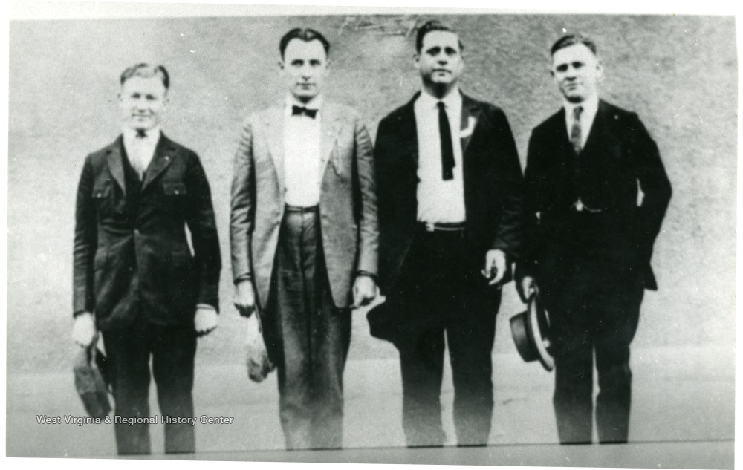
1890-1930 : The Coal Wars
Not fought over wages, primarily. The right to have a union at all.
To get there, miners had to get past:
  Yellow-dog contracts — sign away your right to join a union as a condition of employment
  Mine guards — private security agents, paid by the operators, deputized by the county
  Eviction — you live in the company's house, so a strike makes you homeless the same week
  Scrip — you are paid in the company's private money, worth face value only at the company store
A miner in 1921: after loading car after car of coal, you still "couldn't come out to the company store and get enough food to feed your family."
Union leaders during the armed march, southern West Virginia, 1921. PD.
Notes:
Sets up Section 4. The key idea: the company was simultaneously your employer, your landlord, your grocer, your bank, your police force, and in many counties your judge. There is no part of your life that striking does not put at risk. That is the design.
Ask the class: 'what would it take for you to go on strike under those conditions?' Then tell them 10,000 people did.

Slide 27
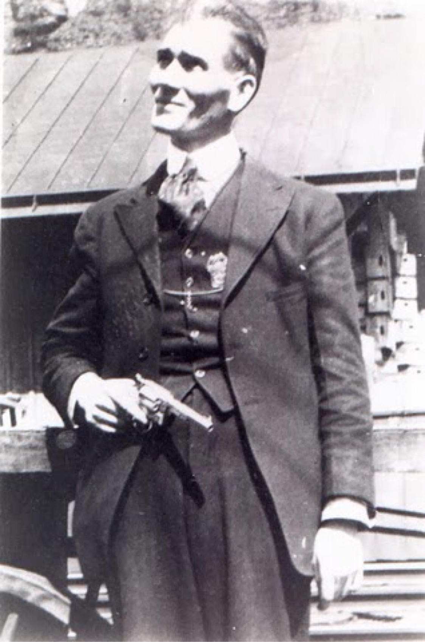
19 May 1920 → 1 Aug 1921: the fuse
Matewan, WV, 19 May 1920. Baldwin-Felts agents come to evict miners' families. Police chief Sid Hatfield and Mayor Cabell Testerman confront them. Fifteen seconds of shooting: ten dead, including the mayor and Albert Felts.
Hatfield becomes a folk hero. Tried for murder in January 1921 — and acquitted.
1 August 1921. Hatfield walks up the courthouse steps in Welch, unarmed, with his wife on his arm. Baldwin-Felts agents shoot him and his friend Ed Chambers dead on the steps.
Nobody is ever convicted.
Two weeks later, ten thousand miners pick up rifles.
Sid Hatfield, chief of police of Matewan. PD.
Notes:
The emotional pivot of the deck. Slow down. The detail that does the work: on the courthouse steps, in front of his wife, unarmed, and nobody was charged. Miners concluded, correctly, that the law was not available to them.
Mother Jones was 83 and urged them to stand down, fearing a massacre. Frank Keeney and Fred Mooney led the rally on 7 Aug; both later fled to Ohio.
[MOTIF] Hunger Games: this is the whipping in the square. The system demonstrates its rules do not apply to itself - that is what starts a rebellion, not the poverty they had already endured for thirty years.
John Sayles' film MATEWAN (1987) dramatizes the massacre - Chris Cooper, James Earl Jones. Worth a two-minute clip.

Slide 28
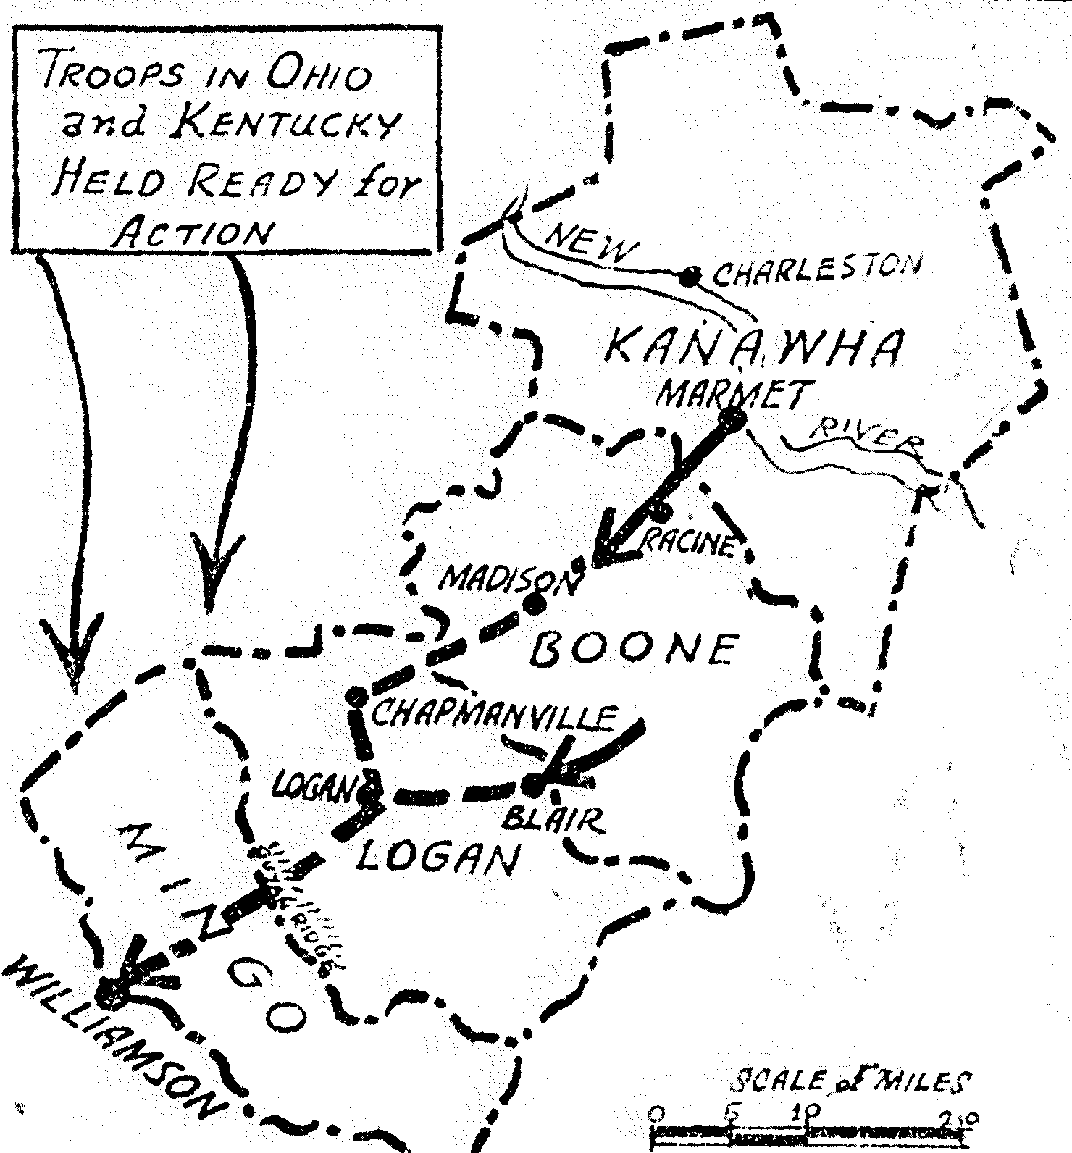
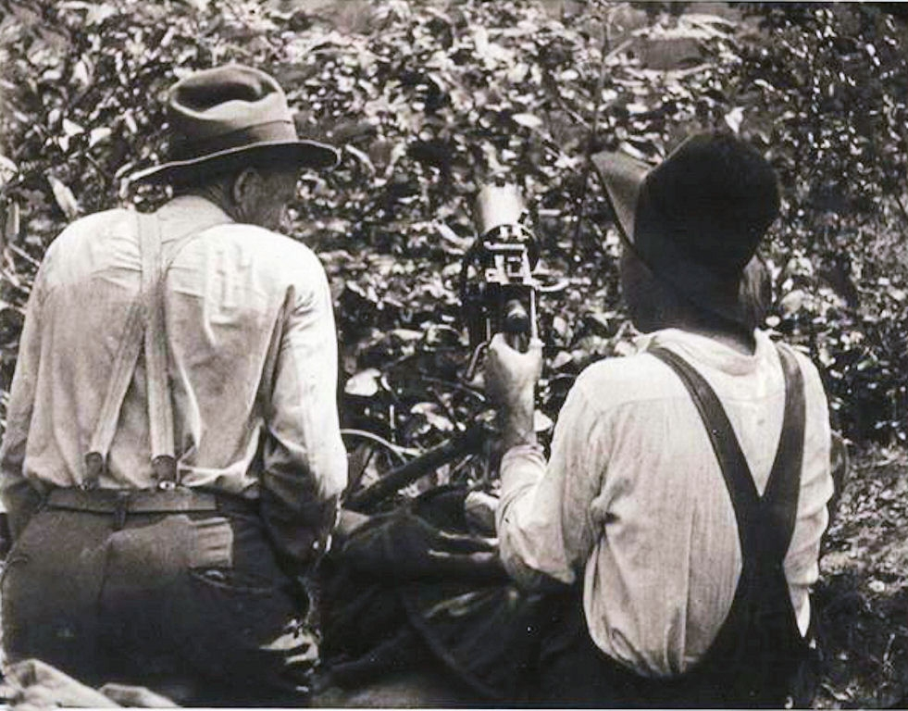
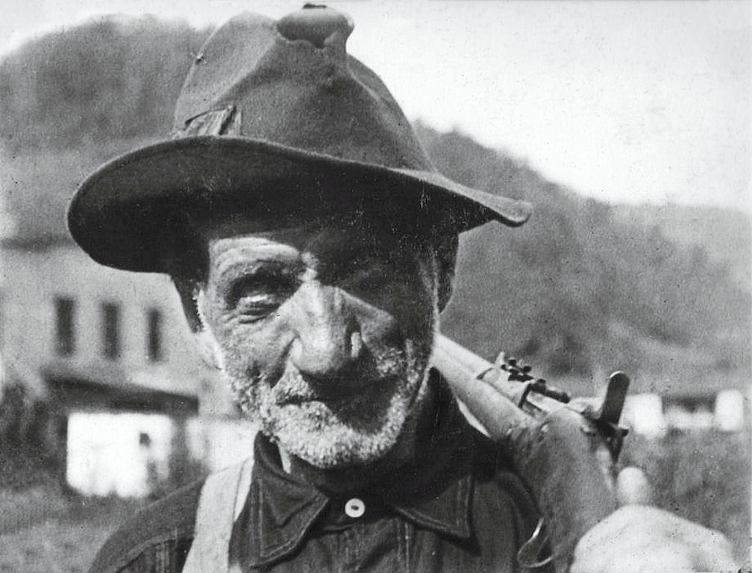
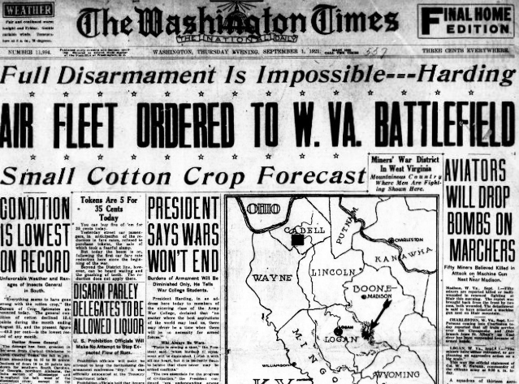
25 Aug - 2 Sep 1921: Blair Mountain
~10,000 miners marched on Logan County. Against them: ~3,000 "Logan Defenders" under Sheriff Don Chafin, paid by the Logan County Coal Operators Association, plus state police.
Five days of fighting along a mountain ridge. Roughly one million rounds fired. Machine guns on both sides.
Private planes, hired by Chafin, dropped homemade bombs on American citizens. Army bombers flew surveillance under Gen. Billy Mitchell.
It ended on 2 September when federal troops arrived — because the miners would not shoot at US soldiers. Many had been US soldiers three years earlier.
Casualty figures are contested: Wikipedia gives 50-100 miners killed; the WV Mine Wars Museum documents ~16 confirmed.
A machine-gun nest at Blair Mountain. PD.
The miners' march on Logan County. PD.
A miner of the armed march. PD.
The Washington Times, 1921. PD.
Notes:
[RESEARCH SKILL TIE-IN] Use the casualty disagreement deliberately - the best teaching moment in the deck. Ask: why would the number be unknown? Who would have had to count? Who had an interest in it being small, or large? What would count as a primary source? (Coroner's records, incomplete for Logan County; UMW Journal reporting, partisan; the 985 indictments, a hard number precisely because the state generated them.)
The miners wore RED BANDANAS around their necks to identify each other. Their opponents wore white armbands and called them 'rednecks' - one credible origin of the word, per the WV Mine Wars Museum. Flag it as ONE account, not settled etymology.
The army was BLACK, WHITE AND IMMIGRANT TOGETHER - 'a darn solid mass of different colors and tribes blended together' (Fred Ball, UMW Journal). Matewan in 1921 was one of very few US towns where Black and white children attended school together. Chuck Keeney: Black and white miners held cafeteria workers at gunpoint until everyone was served in the same room. In 1921. In the South. Hold that for the Klan slide.

Slide 29
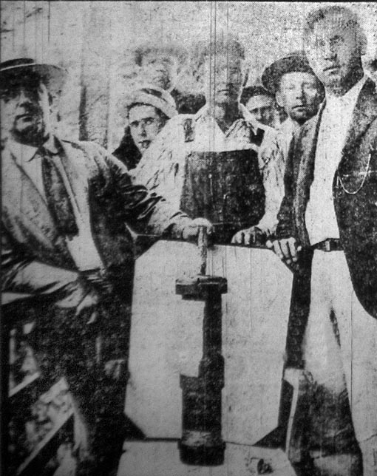
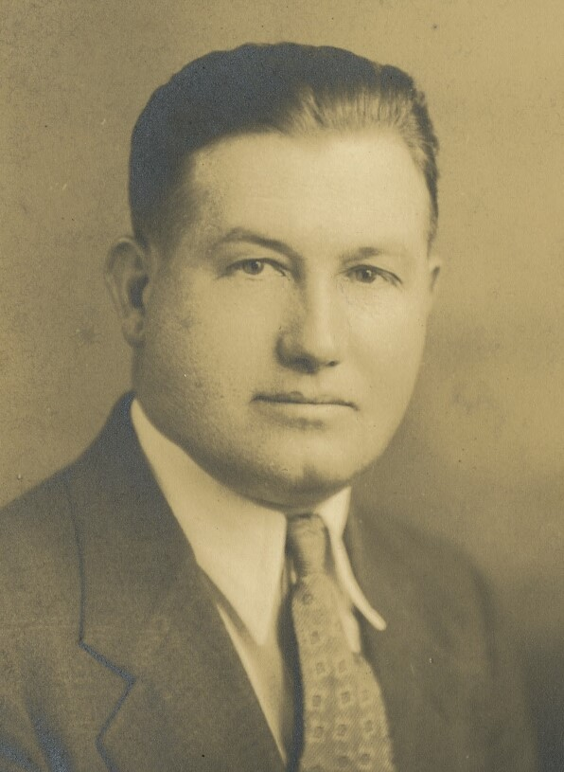
Big Coal Won the War
Let us be completely clear about the outcome.
  985 miners indicted — murder, conspiracy, and treason against the State of West Virginia
  UMWA membership in the region collapsed from 50,000+ to about 10,000
  80% of mines reopened with replacement workers and yellow-dog contracts
  Union organizing in southern West Virginia was dead until 1933
  Nobody was ever punished for killing Sid Hatfield. Nobody was punished for Ludlow either.
The operators kept the coal, kept the towns, kept the money, and kept the courts.
The people who committed the atrocities got richer. That is the actual ending.
Miners display a bomb dropped on them from the air. PD.
Bill Blizzard - tried for treason, acquitted. PD.
Notes:
Resist the urge to redeem this slide. Students expect a triumphant labor story and this is not one. The honest version: organized workers lost badly for twelve years, and what eventually changed it was federal law (NIRA, 1933) plus the Depression - not courage alone. Courage was necessary and not sufficient.
Bill Blizzard was acquitted of treason. His defense exhibit was an unexploded bomb dropped on the miners from an aircraft, recovered from the battlefield.
Then pivot: if losing a shooting war didn't change it, what did? -> the political movement.

Slide 30
Popular culture at the time

Slide 31
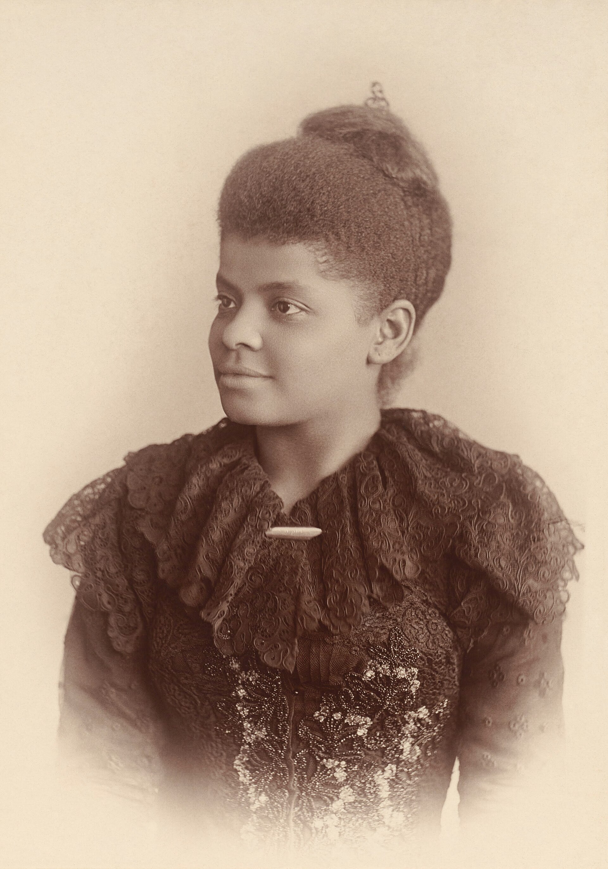
The Muckrakers
The same decades produced journalists who made the abuses impossible to ignore — muckrakers, a name Roosevelt gave them as an insult on 14 April 1906, borrowed from Pilgrim's Progress.
  Ida B. Wells — Southern Horrors (1892), The Red Record (1895) → documented lynching
  Ida Tarbell — The History of the Standard Oil Company (1902-08) → fed the 1911 breakup
  Upton Sinclair — The Jungle (1906) → Pure Food and Drug Act; Meat Inspection Act
  Jacob Riis — How the Other Half Lives (1890) → tenement reform
  Lincoln Steffens — The Shame of the Cities (1904) → municipal corruption prosecutions
  Ray Stannard Baker — "The Right to Work" (1903) → wrote specifically on coal mining
Ida B. Wells (1862-1931). PD.
Notes:
Sinclair's own verdict on The Jungle is the line worth quoting: he aimed at the public's heart and hit its stomach. He wrote a book about WORKERS being destroyed and America responded by regulating MEAT. That is a lesson about whose suffering registers.
Ida B. Wells belongs on this list and is usually left off it. She was doing the hardest and most dangerous investigative journalism of the era - her Memphis newspaper office was destroyed by a mob and she was driven out of the South under threat of death. She counted and documented lynchings when no institution would.

Slide 32
Songs as primary sources
When you own the press, the courts and the police, the thing workers still have is a song.
  "Which Side Are You On?" — Florence Reece, Harlan County KY, 1931. Written on a kitchen calendar the night Sheriff J.H. Blair's men ransacked her house hunting her husband. Set to a Baptist hymn tune. Later picked up by the Freedom Singers in the civil rights movement.
  "Sixteen Tons" — Merle Travis, 1946. The company-store line came from a letter by his brother John. Tennessee Ernie Ford's 1955 cover sold a million copies in under four weeks.
  "Ludlow Massacre" — Woody Guthrie. A verse-by-verse account of the tent colony and the pit.
  "John Henry" — the steel-driving man who beats the steam drill and dies of it.
Notes:
The point for a physics class: these songs are EVIDENCE. When the official record is written by the people who own the mine, the folk record is a primary source about conditions, and historians treat it as one.
Play 30 seconds of 'Which Side Are You On?' - preferably the Almanac Singers 1941 version, or Florence Reece's own late recording, which is better because she is old and furious and unaccompanied.
Ask the class what the 2026 equivalent is. It's a real question, not a rhetorical one.

Slide 33
Where this leaves us

Slide 34

2025: Starbase, Texas
On 3 May 2025, the residents of Boca Chica, Texas voted to incorporate as a city called Starbase.
  Mayor: Bobby Peden, a SpaceX vice-president. He ran unopposed. So did both commissioners, both with SpaceX ties
  SpaceX owns large tracts; ~7,133 more acres slated for annexation
https://en.wikipedia.org/wiki/Starbase,_Texas
Modern Company Town
Notes:
The company-town checklist, 1921 vs 2025: one employer (yes), company-owned housing (yes), company-selected local government (yes), company control over public access and movement (yes, as of HB 5246). What is missing is scrip - and note the crypto wing of this movement is explicitly interested in that.
Rep. Trey Martinez Fischer on the beach bill: 'The question is who gets to make the call...? I submit to you it's not the people in the company town.'
Opposition is led by the CARRIZO/COMECRUDO TRIBE OF TEXAS, the South Texas Environmental Justice Network, and Save RGV. Note who is objecting: an Indigenous nation whose ancestral land this is. That is the Susquehannock slide again, 262 years later. Say it out loud.
Be fair: Boca Chica Village residents were bought out in 2019 at a reported 3x fair market value, and some took it willingly. Blair Mountain this is not. The argument is about STRUCTURE, not about whether SpaceX has shot anyone.

Slide 35
The bill always comes due
Energy is never just physics. Every joule we consume has a supply chain, and every supply chain runs through somebody's home.
The costs land on whoever has the least power to refuse. Native Americans, immigrant miners, Black people escaping the Jim Crow south and convict laborers.
Losing is a normal outcome. The miners were right, brave, organized, and defeated by the full backing of the US, State and Local governments as well as privatized paramilitary forces sanctioned by the government.
The structures come back. The company town is being rebuilt right now, in Texas, with better branding.
Notes:
Explicit handoff to Lecture 4. The emotional arc of today is deliberately unresolved; next week we make it quantitative, which is both the physicist's move and a genuine relief after this material.
Participation question to close on, if time: 'Blair Mountain is a National Register site that coal subsidiaries of Arch Coal and Massey Energy held mountaintop-removal permits over. It was listed in 2008, removed in 2009 on a clerical technicality, litigated, and restored on 27 June 2018. Who decides what gets remembered?'

Slide 36
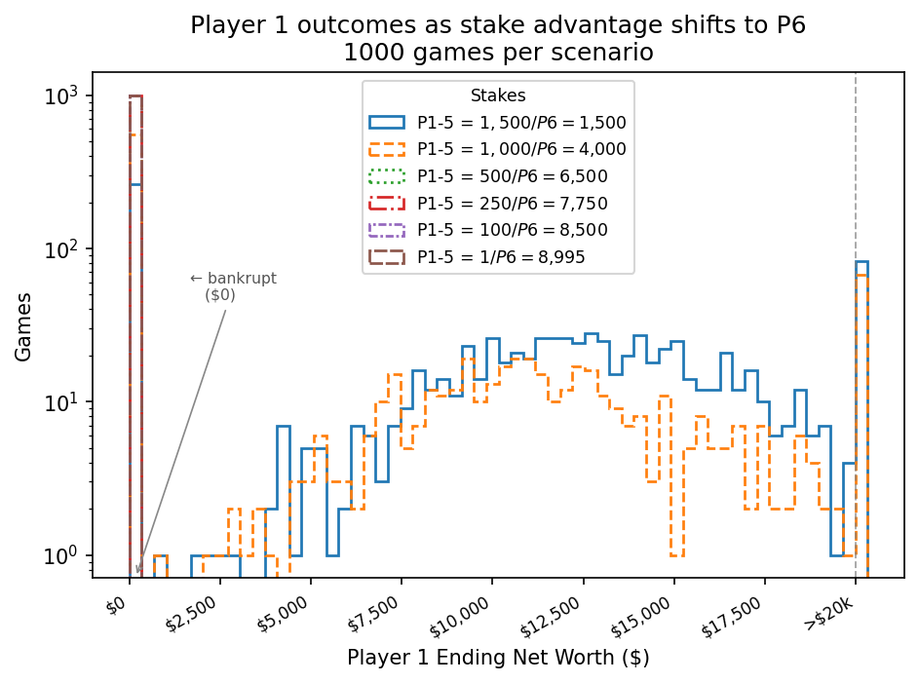
Data Analysis
Impossible to win Monopoly beyond a wealth inequality gap of 4x

Slide 37
Sources
Wikipedia entry points (finding aids — trace to the primary sources they cite): Battle of Blair Mountain · Coal Wars · Company town · Coal Region · Susquehannock · Ludlow Massacre · Coal strike of 1902 · Muckraker · Starbase, Texas · Second Industrial Revolution · History of rail transport in the United States · Cornelius Vanderbilt · John D. Rockefeller · J. P. Morgan · Pujo Committee · Lehigh Valley · Theodore Roosevelt · Pan-American Exposition · Rough Riders · California Forever · Ku Klux Klan
Institutional / scholarly: West Virginia Mine Wars Museum · e-WV: The West Virginia Encyclopedia (scrip) · Smithsonian Magazine, "What Made the Battle of Blair Mountain the Largest Labor Uprising in American History" · Price V. Fishback, Journal of Economic History · Scott Reynolds Nelson, Steel Drivin' Man (2006) · Lon Savage, Thunder in the Mountains (1990)
Contemporary reporting: Texas Tribune (Starbase incorporation; HB 5246) · Scientific American (Starbase opposition) · New Republic ("Freedom Cities")
Watch / read: Matewan (dir. John Sayles, 1987) · Denise Giardina, Storming Heaven (1987)
Notes:
Per course policy: Wikipedia is a finding aid here, not the citation of record. Before this goes in front of students as coursework, the .gov items (NPS, coalheritage.wv.gov) should each be paired with an independent source - the Mine Wars Museum and the Smithsonian piece already cover most of it.
AI-USE DISCLOSURE (per course policy):
Model: Claude (Anthropic), claude-opus-5, session of 15-Sep-2026.
Task: source gathering, summarization and drafting. All factual claims traced to the sources listed; no text generated without a source.
Source material: English Wikipedia articles listed above; WV Mine Wars Museum; e-WV; Smithsonian Magazine; Texas Tribune; Scientific American; New Republic.
Data centers: Anthropic runs on AWS and Google Cloud, primarily US regions (us-east / us-west); exact facility not disclosed by the vendor.
Compute estimate: to be filled in from this session's token count.
Human authorship: outline, framing, argument and final assembly by S. Rappoccio.

