Slide 1
Lecture 4 — energy generation
PHY199-RAP · Energy in the 21st Century
Dr. Salvatore Rappoccio

Slide 2
Grid efficacy

Slide 3
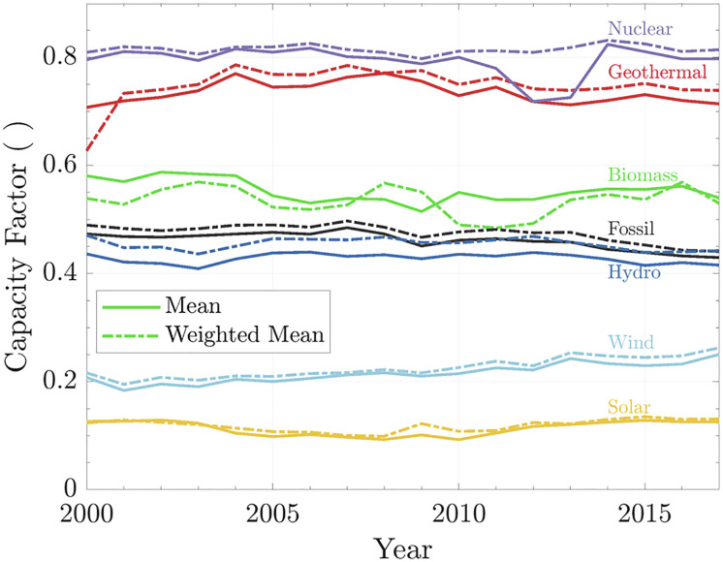
Capacity Factor
Capacity factors for electrical power generation from renewable and nonrenewable sources
Defined as the “ratio of actual electrical energy output over a given period of time to the theoretical maximum electrical energy output over that period”
What limits capacity factor?
  Availability of fuel or source
  Cooling
  Efficiency (maintenance, outages)
World capacity factor. The solid line is for the capacity factor, and the dashed line shows weighted capacity factor for the respective year.

Slide 4
Capacity Factor
Capacity factors for electrical power generation from renewable and nonrenewable sources
What limits capacity factor?
  Nuclear:
    Refueling and maintenance
  Geothermal:
    Reservoir / resource degradation over time, maintenance
  Biomass:
    Fuel supply
World capacity factor. The solid line is for the capacity factor, and the dashed line shows weighted capacity factor for the respective year.

Slide 5
Levelized Cost of Electricity (LCOE)

Slide 6
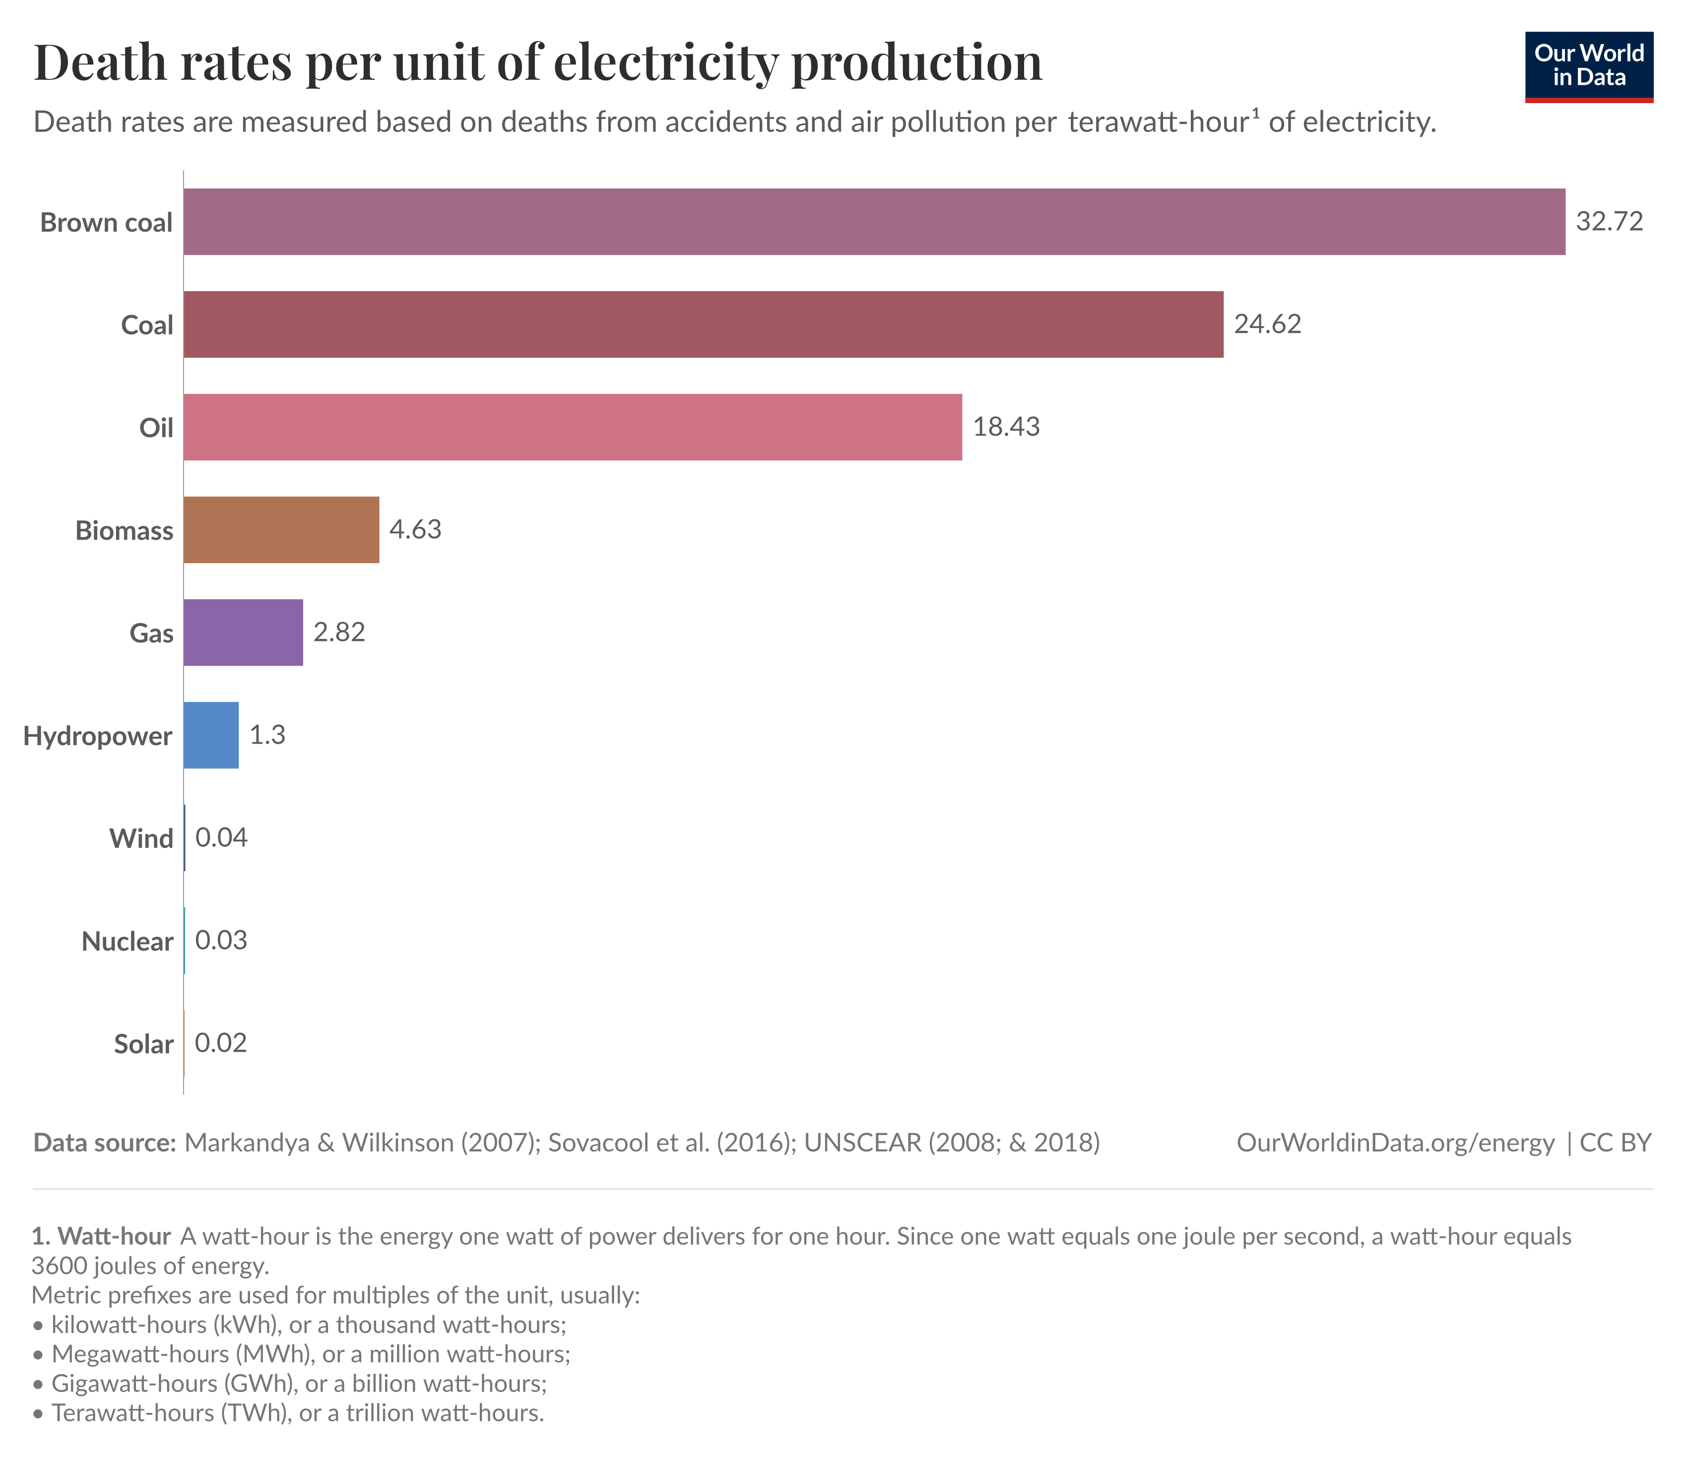
Which energy actually kills people?
Measured as deaths per unit of energy, coal and oil are by far the deadliest, mostly from air pollution
Nuclear, wind, solar, and hydro are among the safest
This surprises almost everyone! Follow the data, not the vibe
Source: Our World in Data, from Markandya & Wilkinson (2007, The Lancet) and Sovacool et al. (2016)
Notes:
Sources: Our World in Data — death rates per TWh; originals: Markandya & Wilkinson (2007, The Lancet); Sovacool et al. (2016). The peer-reviewed studies are the anchor.

