Slide 1
Lecture 4 — energy generation
PHY199-RAP · Energy in the 21st Century
Dr. Salvatore Rappoccio

Slide 2
How to manage your time effectively
Use a calendar and mark urgent items
Develop a consistent work schedule
Prioritize your tasks by urgency
Keep records of your progress to “save state” while context switching
Be sure to rest and maintain work/life balance

Slide 3
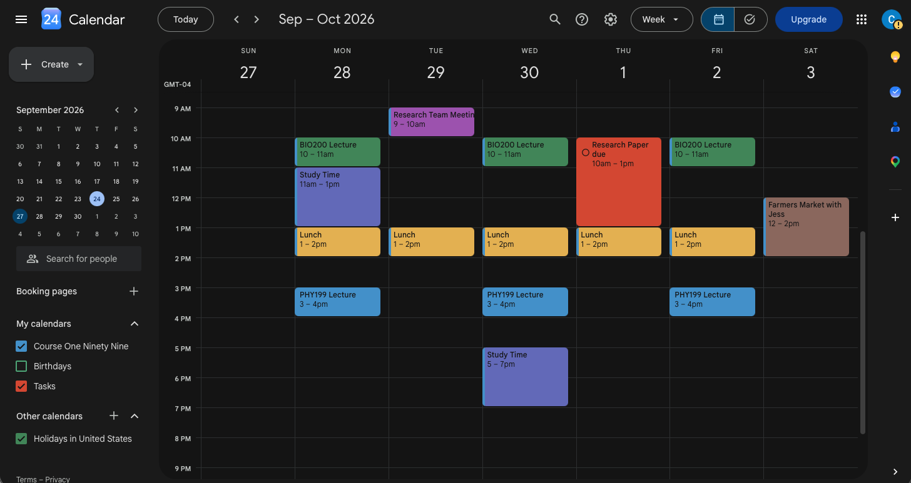
Use a calendar and mark urgent items

Slide 4

Be sure to rest and maintain work/life balance
Outside of your scheduled work and practice time, GO HAVE FUN
Touch grass
Talk to humans
Do video games
Pet a cat
Play soccer
Sleep in
Have a nice breakfast with friends
Dance
Be joyous
https://www.tixr.com/groups/venu

Slide 5
Develop a consistent work schedule
Practice practice practice!
I tell this to all of my graduate students too
Work specific hours. It doesn’t have to be M-F 9am-5pm, but block out times and stick to them
  Block them off in your calendar
  You will not run out of tasks, but in the odd event that you do, PRACTICE
    Homework problems
    Dance routines, Music performances, etc
    Case studies
    Whatever your discipline requires, do it often

Slide 6
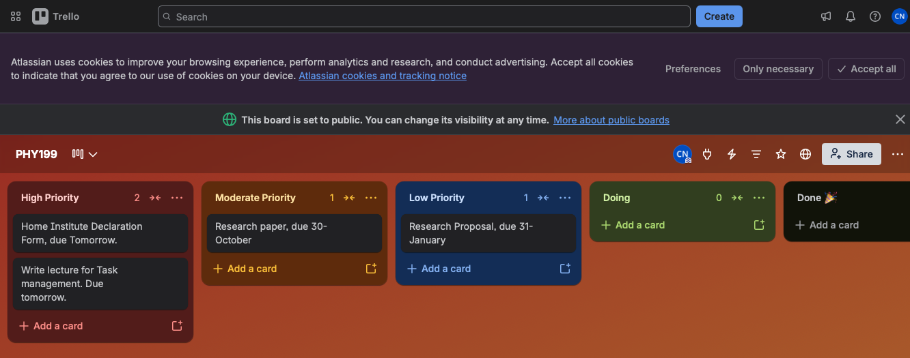
Prioritize your tasks by urgency
Options can include :
  Keep a daily to-do list
  Use your email directly (make a “tasks” folder, email tasks to yourself)
  Apps like Obsidian
  Websites like Trello

Slide 7
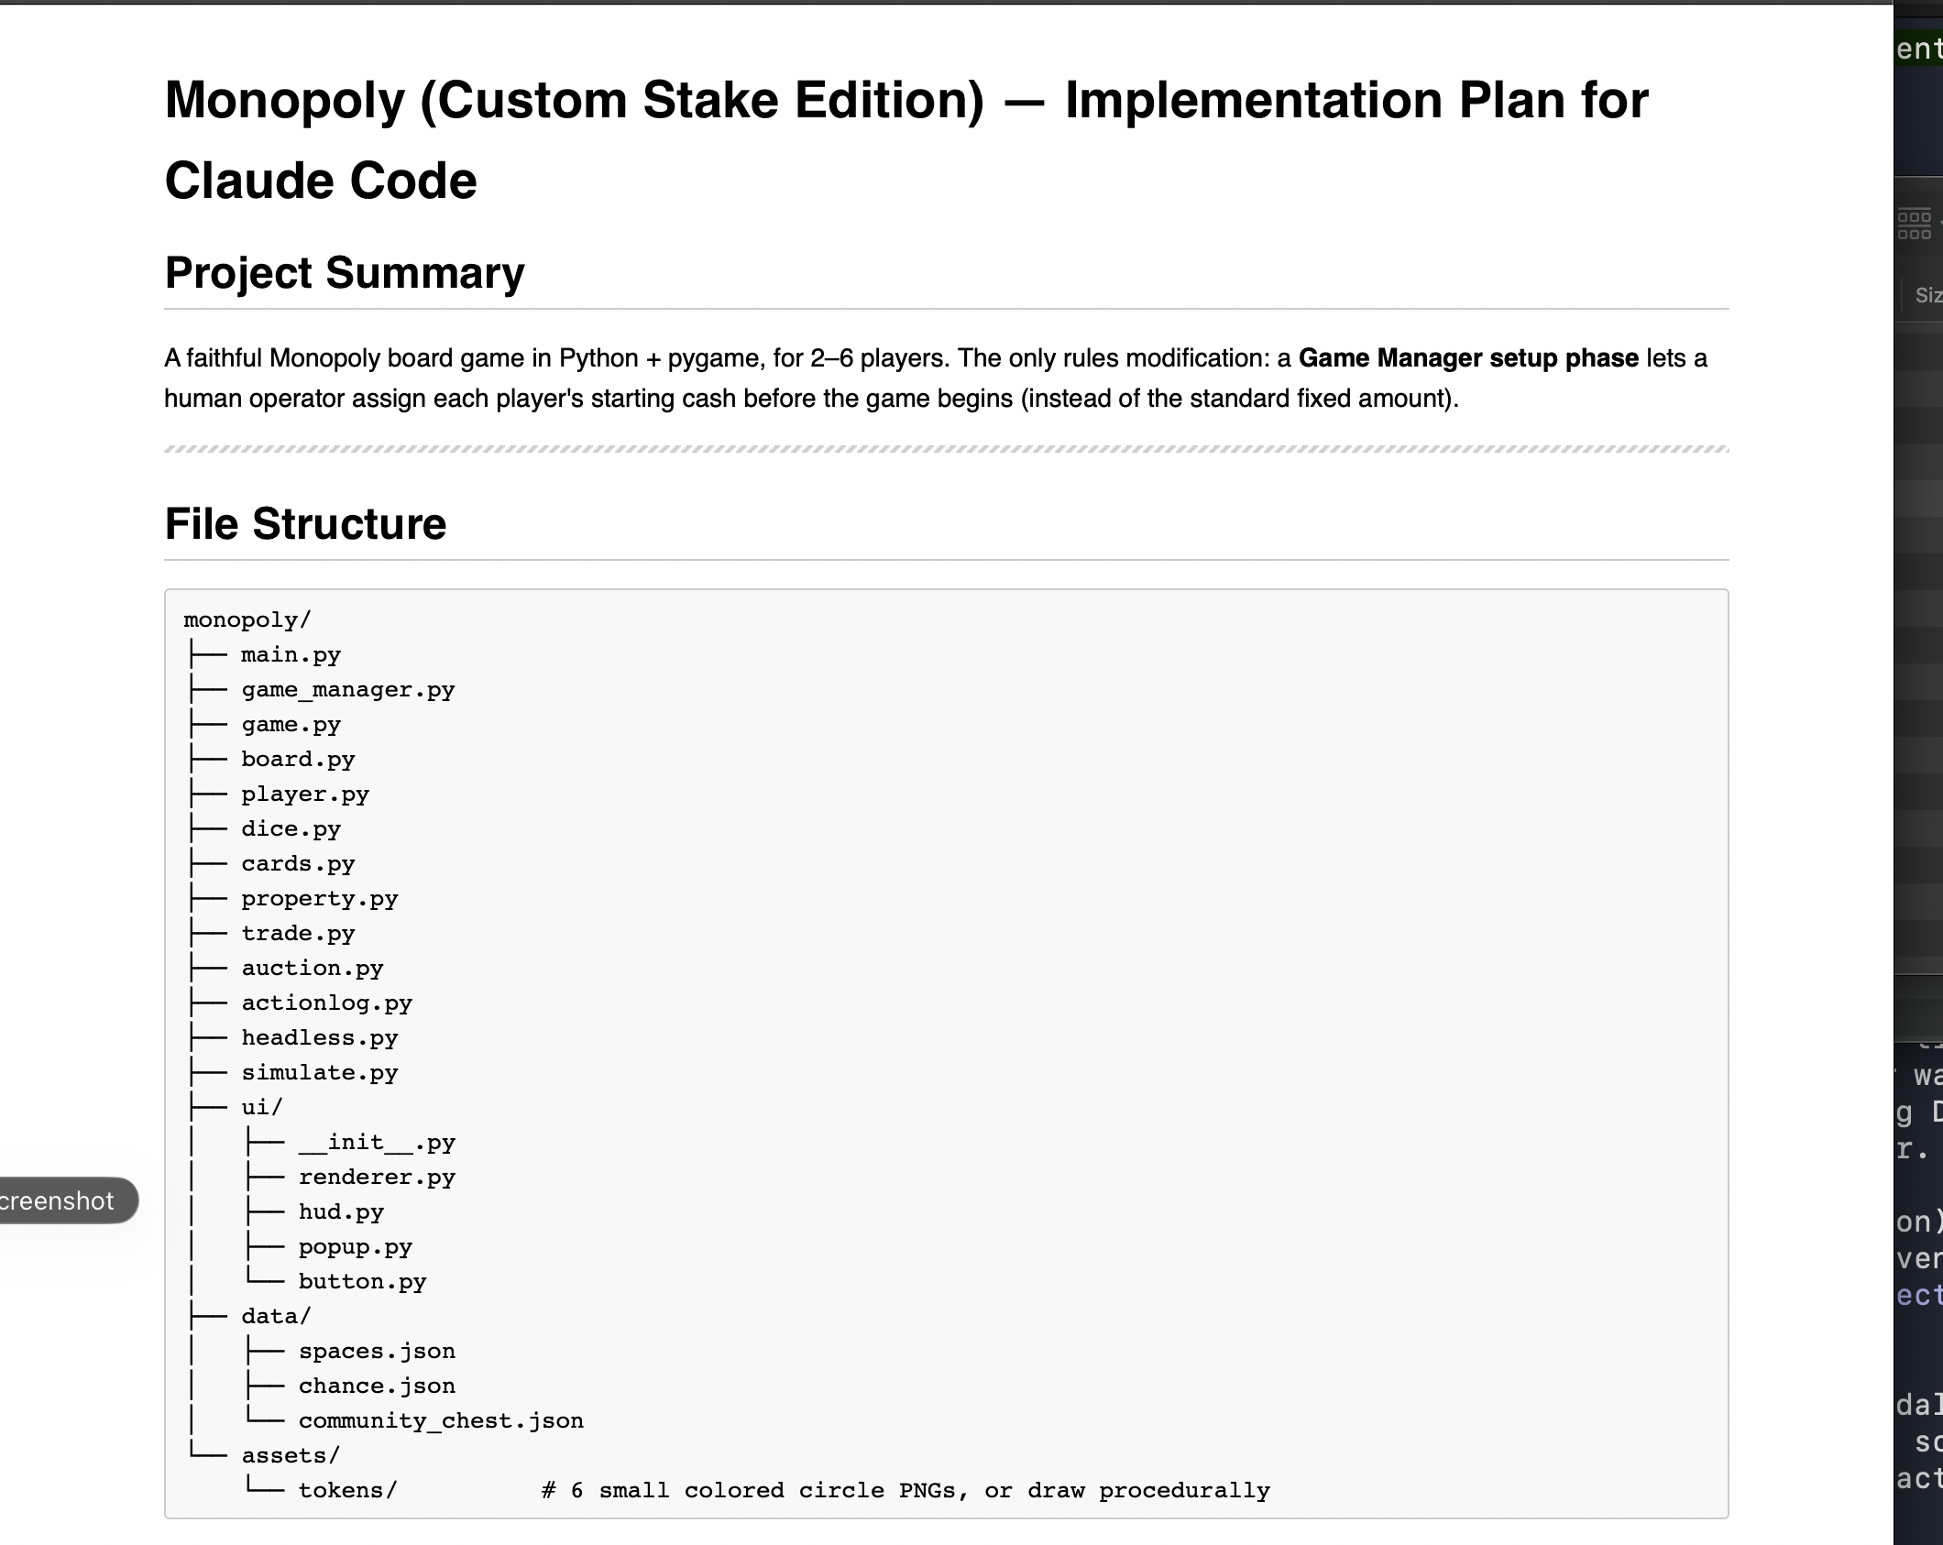

Keep records of your progress to “save state” while context switching
Keeping a log of what you do is very useful (or even required) in a lot of fields
  Programming
  AI workflows! ABSOLUTELY CRITICAL
  Research
  Clinical work (required often by law)
  Law
  But hell, why not keep a log of what you need to do to finish your book that you’ve been writing for, oh I don’t know, 15 YEARS GEORGE!
This allows you to migrate between tasks that need to be done and assist in time management
Software options : Text editors (google docs, word, obsidian, other markdown editors), project management tools, log books
George R R Martin, author of Game of Thrones

Slide 8
This is also how to use AI effectively!
It requires careful planning of workflows
Your calendar is a workflow! Your to-do list is a workflow!
Doing these tasks is increasingly important as AI begins to take over more and more of the workforce.

