Slide 1
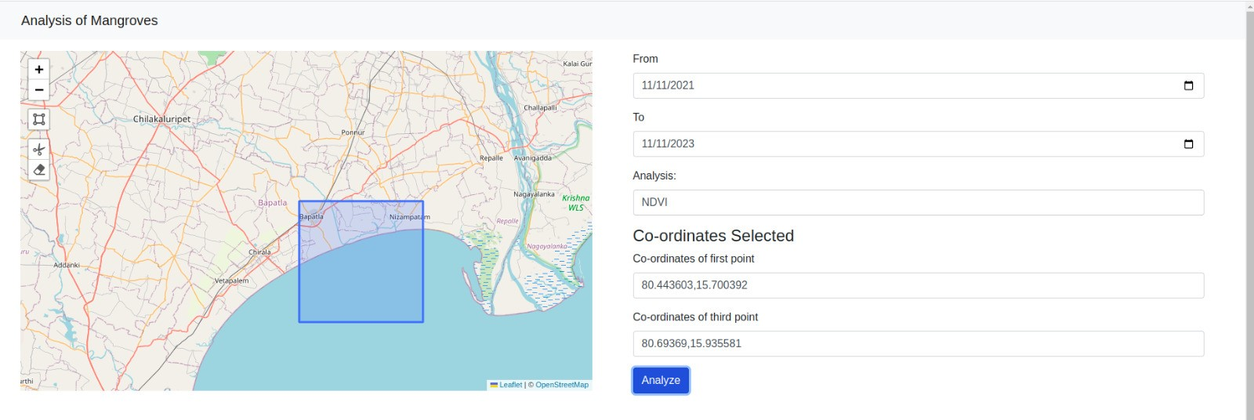
Problem Statement
Develop a datacube using satellite images to gain a better understanding of status of the ecosystems.
This datacube can provide valuable information for conservation of mangroves.

Slide 2
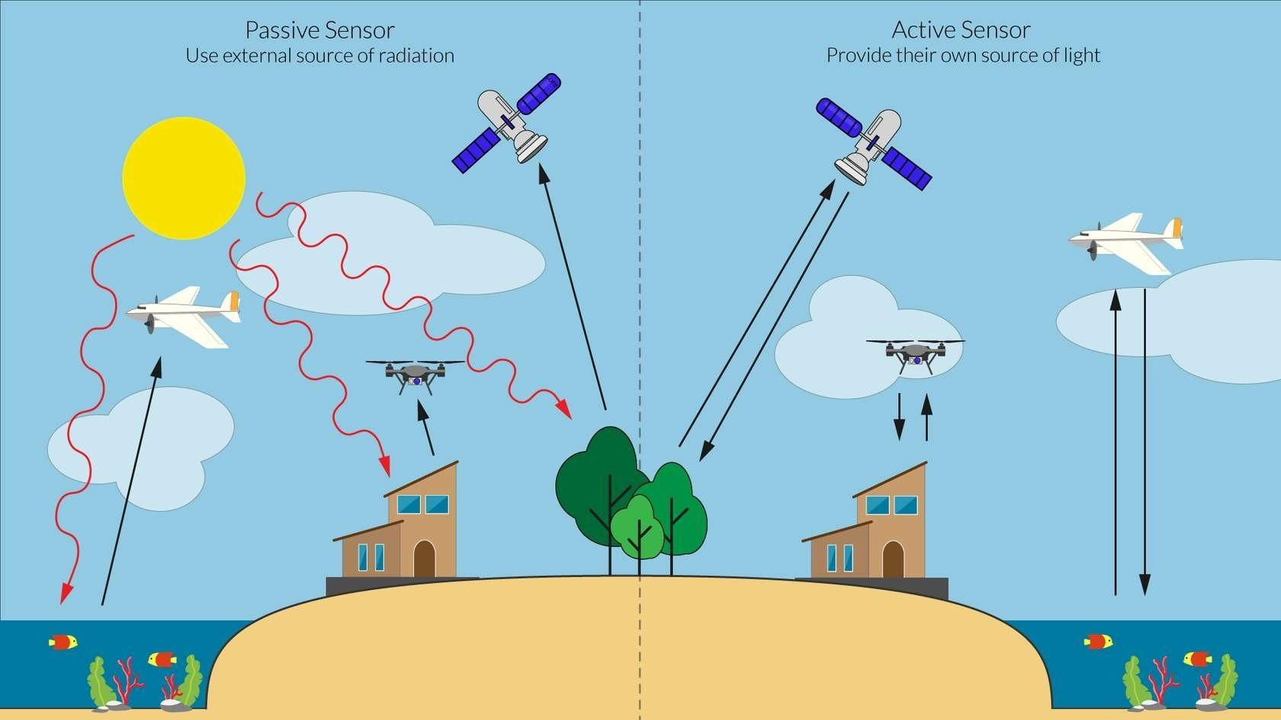
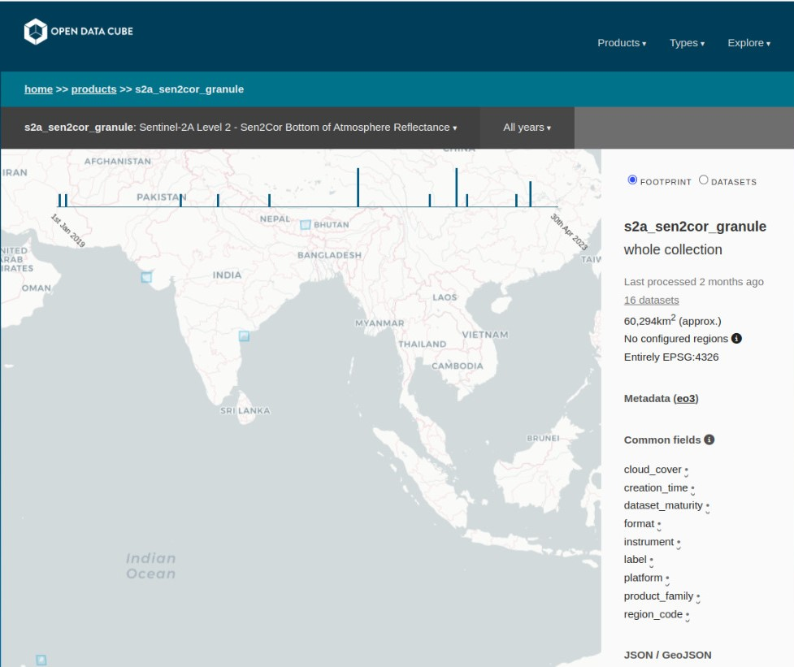
Remote sensing
Datacube API

Slide 3
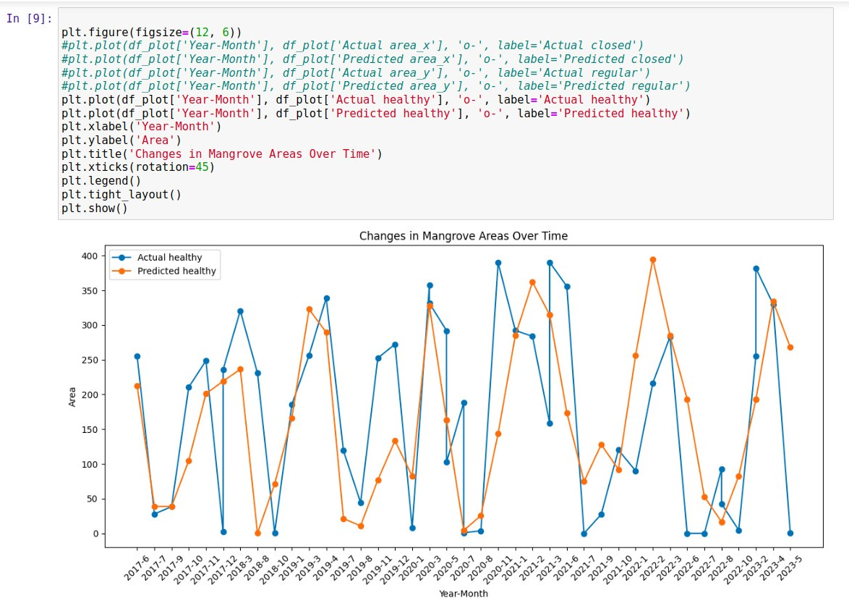
Machine learning
Machine learning algorithms are used to gain deeper insights about the mangrove ecosystems.
Random forest algorithm is used.
Combination of decision trees.

Slide 4
