Slide 1

Genetic Algorithm
N-Queens Problem Implementation
소프트웨어학과 2015125005 강정석

Slide 2
INDEX
02
제목을 적어주세요
소제목을 적어주세요
01
03
04
제목을 적어주세요
제목을 적어주세요
제목을 적어주세요
소제목을 적어주세요
소제목을 적어주세요
소제목을 적어주세요

Slide 3

01
What is the N-Queens Problem?
Problem Definitions
N (must be 4 in this case) queens are placed on the board.
No two queens are on the same row, column, or diagonal.
Image from: The N-queens Problem (Google Optimization Tools, https://developers.google.com/optimization/cp/queens)

Slide 4
02
How to apply Genetic Algorithm
Definitions
The Basic Elements of Genetic Algorithm
1) Chromosome (set queen to 1 and no queen to 0)
0 0 1 0
2) Population (each consists of N chromosomes)
1 0 0 0
3) Pool (with 100 populations)
0 0 0 1
4) Operations (e.g. Selection, Crossover, Mutation, etc.)
0 1 0 0
Image from: The N-queens Problem (Google Optimization Tools, https://developers.google.com/optimization/cp/queens)

Slide 5
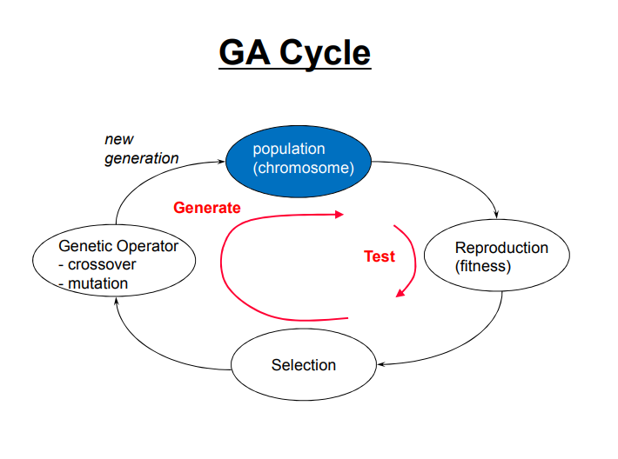
03
Process
with Java Implementation

Slide 6
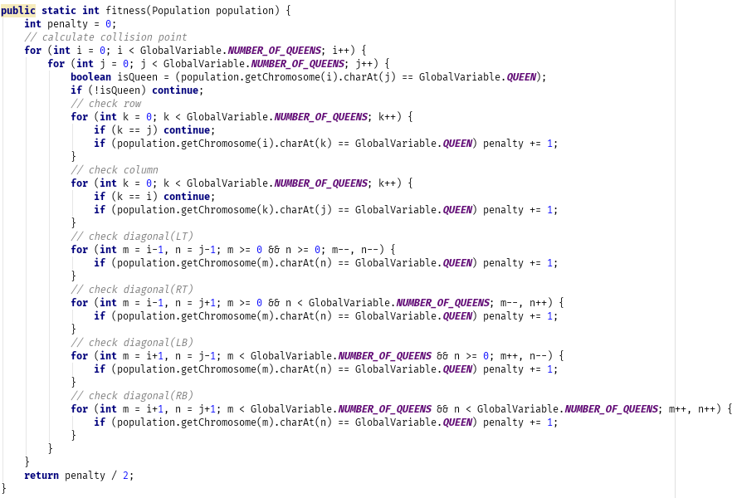
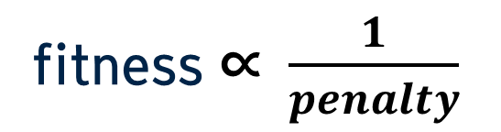
03
Process
Fitness
fitness ∝ $\frac{1}{penalty}$
Notes:
∝: proportionality sign

Slide 7
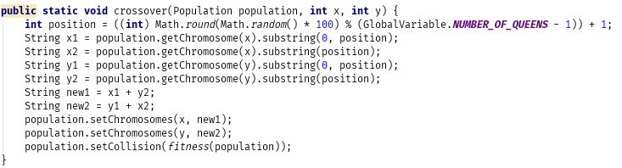
03
Process
Crossover
Chromosome #1
01010000
New Chromosome #1
01011111
Crossover
Chromosome #2
10101111
New Chromosome #2
10100000
position (random)

Slide 8
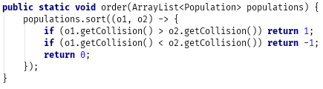
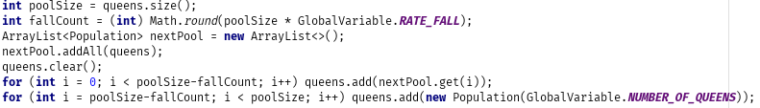
03
Process
Selection
Order populations by fitness
Select the fittest populations and drop the others

Slide 9
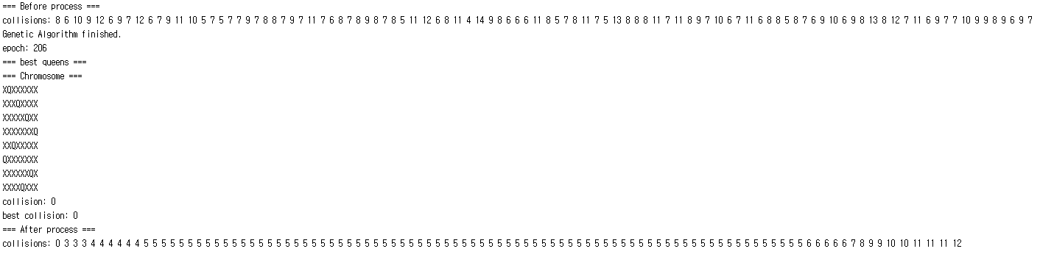
04
Run
Whole process
epoch: 206
https://github.com/rapsealk/GeneticAlgorithm.git

Slide 10
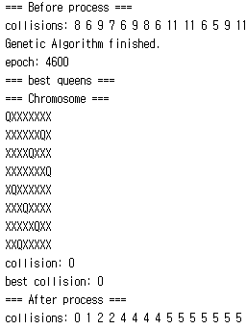
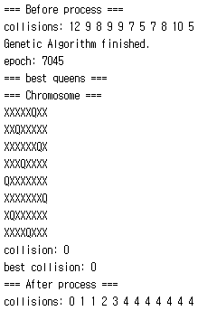
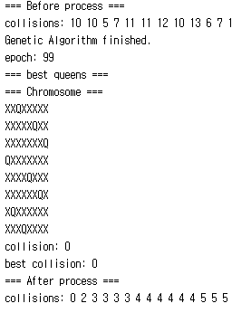
05
Result
way to get better performance
epoch: 206
epoch: 4600
epoch: 7045
epoch: 99
* Performance depends on the initial pool state.
https://github.com/rapsealk/GeneticAlgorithm.git

Slide 11
감사합니다

