Slide 1

Genetic Algorithm
N-Queens Problem Implementation
소프트웨어학과 2015125005 강정석

Slide 2

01
What is the N-Queens Problem?
Problem Definitions
N (must be 4 in this case) queens are placed on the board.
No two queens are on the same row, column, or diagonal.
Image from: The N-queens Problem (Google Optimization Tools, https://developers.google.com/optimization/cp/queens)

Slide 3
02
How to apply Genetic Algorithm
Definitions
The Basic Elements of Genetic Algorithm
1) Chromosome (set queen to 1 and no queen to 0)
0 0 1 0
2
2) Population (each consists of N chromosomes)
1 0 0 0
0
3) Pool (with 100 populations)
0 0 0 1
3
4) Operations (e.g. Selection, Crossover, Mutation, etc.)
0 1 0 0
1
Image from: The N-queens Problem (Google Optimization Tools, https://developers.google.com/optimization/cp/queens)

Slide 4
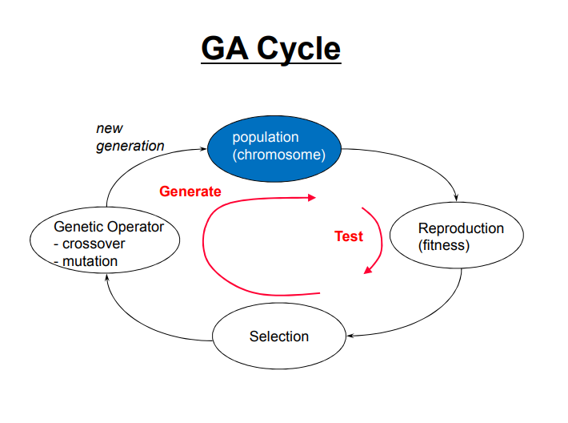
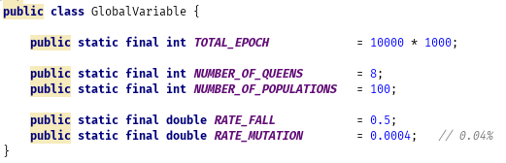
03
Process
with Java Implementation

Slide 5
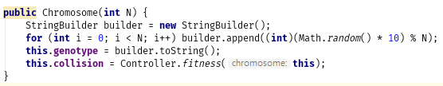
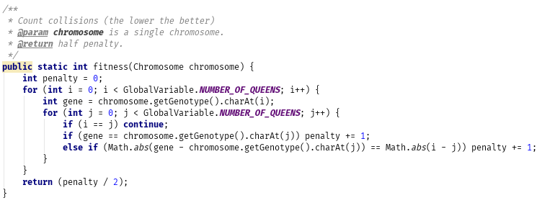
03
Process
Population and fitness
Pool
14602223
13000167
61030753
13002223

Slide 6
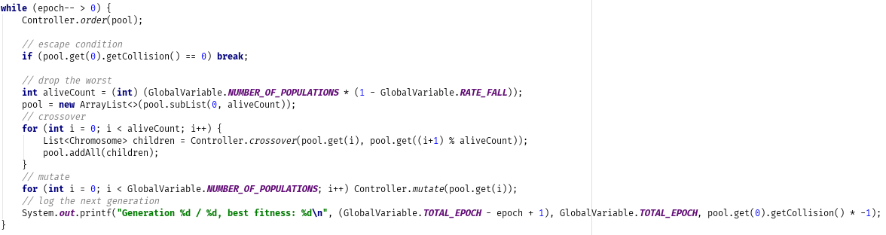
03
Process
Loop

Slide 7
03
Process
Drop, crossover and mutate
Pool
14602223
13050167
13000167
50% drop (selection)
14600167
13002223
61030753
13002223
14602223
14600167
crossover
mutate
0.04%
13000167
13050167
13000167
13002223

Slide 8
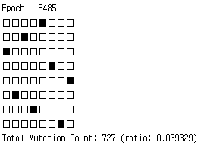
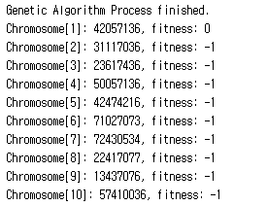
04
Run
Whole process
epoch: 18485
https://github.com/rapsealk/GeneticAlgorithm.git

Slide 9
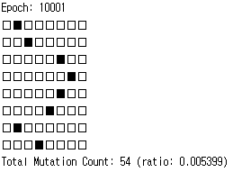
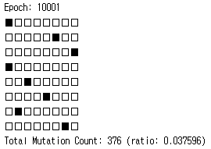
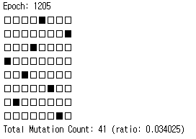
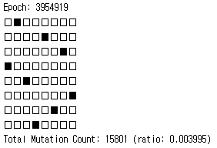
05
Result
way to get better performance
epoch: 10,000 / 10,000
Population: 10
epoch: 10,000 / 10,000
Population: 100
epoch: 1205 / 10,000,000
Population: 100
epoch: 3,954,919 / 10,000,000
Population: 10
https://github.com/rapsealk/GeneticAlgorithm.git

